Slide 1
Online_store_tata
File created on: 8/25/2022 6:16:08 AM

Slide 2
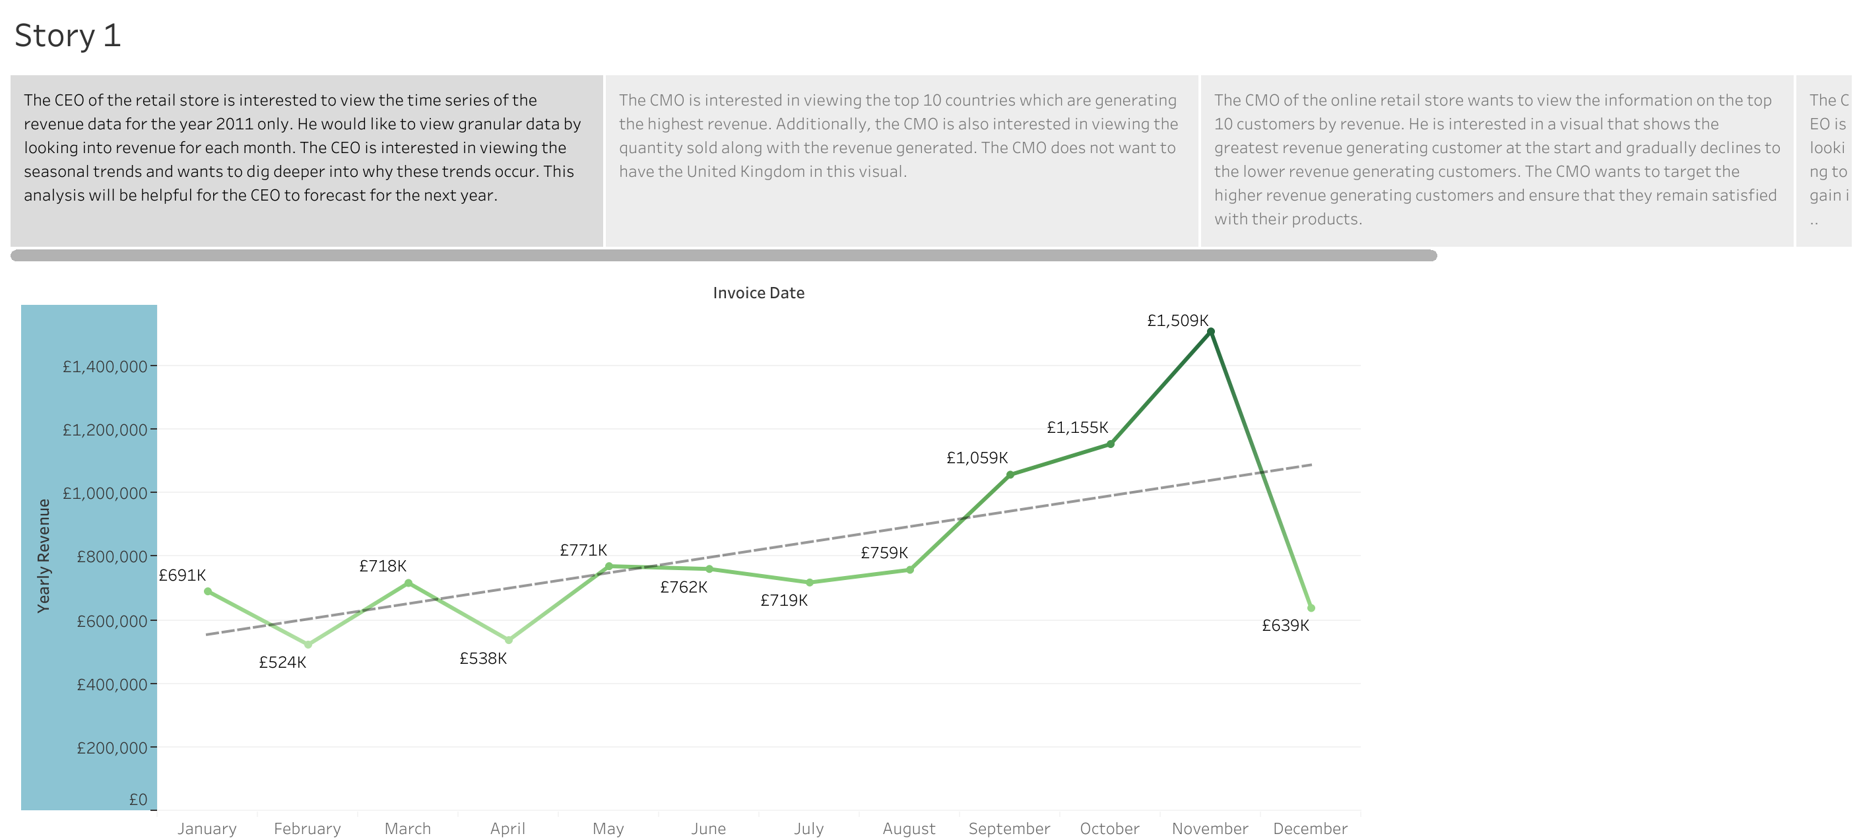

Slide 3
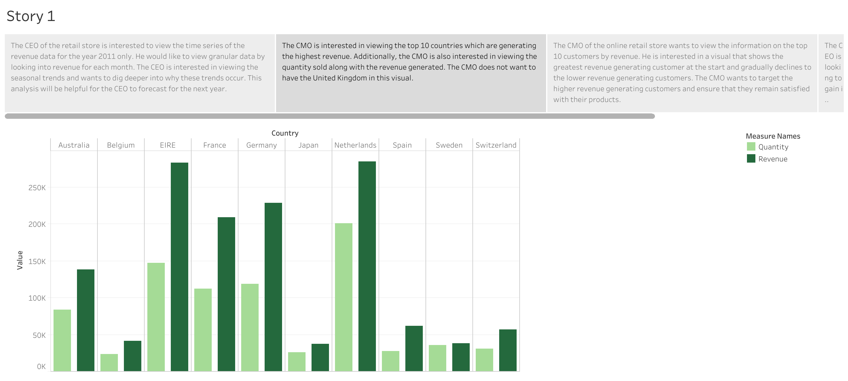

Slide 4
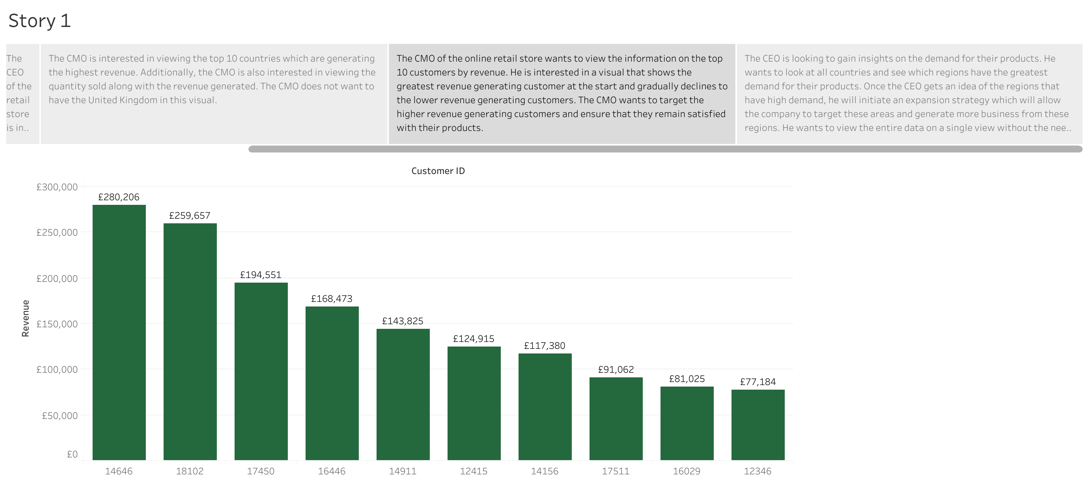

Slide 5
