Slide 1

SHARNBASVA UNIVERSITY
Faculty Of Computer Application
Department of BCA (CO-EDUCATION)
2021-2022
A
Seminar
on
Online Men Shopping
Presented by :
Name : Praveen.Vishwakarma
USN: SG19BCA094
Under the Guidance of
Prof. K G Patil Sir (MCA)

Slide 2
Online men shopping
Here is where our presentation begins

Slide 3
Table of Contents
ABSTRACT
INTRODUCTION
OBJECTIVES
EXISTING SYSTEM AND ITS DISADVANTAGES
PROPOSED SYSTEM AND ITS ADVANTAGES
SYSTEM DESIGN
HARDWARE AND SOTWARE REQUIREMENTS
CONCLUSION
BIBILOGRAPHY

Slide 4
Abstract
The Online Shopping is a web based application intended for online retailers. The main objective of this application is to make it interactive and its ease of use. It would make searching, viewing and selection of a product easier. It contains a sophisticated search engine for user's to search for products specific to their needs. The user can then view the complete specification of each product. They can also view the product reviews and also write their own reviews. The application also provides a drag and drop feature so that a user can add a product to the shopping cart by dragging the item in to the shopping cart.

Slide 5
Introduction
An online Shopping website is an information technology method in which trader, /distributor/marketers can sell products/services and the customer can purchase on that website electronically by using internet on the mobile and computer.It means an e-commerce website is an online shop.
The system would be easy to use and hence make the shopping experience pleasant for the users. The goal of this application is
To develop an easy to use web based interface where users can search for products, view a complete description of the products and order the products.
A search engine that provides an easy and convenient way to search for products specific to their needs. The search engine would list a set of products based on the search term and the user can further filter the list based on various parameters.
Drag and Drop feature which would allow the users to add a product to or remove a product from the shopping cart by dragging the product in to the shopping cart or out of the shopping cart.
A user can view the complete specification of the product along with various images and also view the customer reviews of the product. They can also write their own reviews.

Slide 6
OBJECTIVES
The objective of the project is to make an application in android platform to purchase items in an existing shop. In order to build such an application complete web support need to be provided. A complete and efficient web application which can provide the online shopping experience is the basic objective of the project. The web application can be implemented in the form of an android application with web view.

Slide 7
EXISTING SYSTEM AND ITS DISADVANTAGES
The present scenario for shopping is to visit the shops and market manually and then from the available product list one needs to choose the item he or she wants and then pay for the same item mainly in cash mode is done, as not every society is well educated and aware to use net banking or card modes or wallets . This system is not much user-friendly as one needs to go to the market physically and then select items only from the available list. So mostly it is difficult to get the product as per our desire. Description About the products is less available and are mostly verbal only. For this type of shopping, one needs to have an ample amount of free time.

Slide 8
DISADVANTAGES
Time consuming.
Risk taking in a non-controlled environment.
Possible conflict with user.
Incomplete project can be a major issue.
Group conflicts.

Slide 9
PROPOSED SYSTEM AND ITS ADVANTAGES
In the proposed system customer need not go to the shop for buying the products. He can order the product he wish to buy through the application in his Smartphone. The shop owner will be admin of the system. Shop owner can appoint moderators who will help owner in managing the customers and product orders. The system also recommends a home delivery system for the purchased products. . People in large number are doing online shopping today, and it is not only because it is convenient as one can shop from home, but also because there is an ample number of varieties available, with a high competition of prices, and also it is easy to navigate for searching regarding any particular item. For sellers, their product has access to the World-Wide market, which also increases the number of customers and enhances customer relationships.

Slide 10
ADVANTAGES
Working with an actual end-user.
Improves communications skills: interviewing, problem solving, conflict resolution, and oral and written communication.
Projects have “real” meaning, not artificially invented.
Promotes industry/university relationships.
Potential employee source.

Slide 11
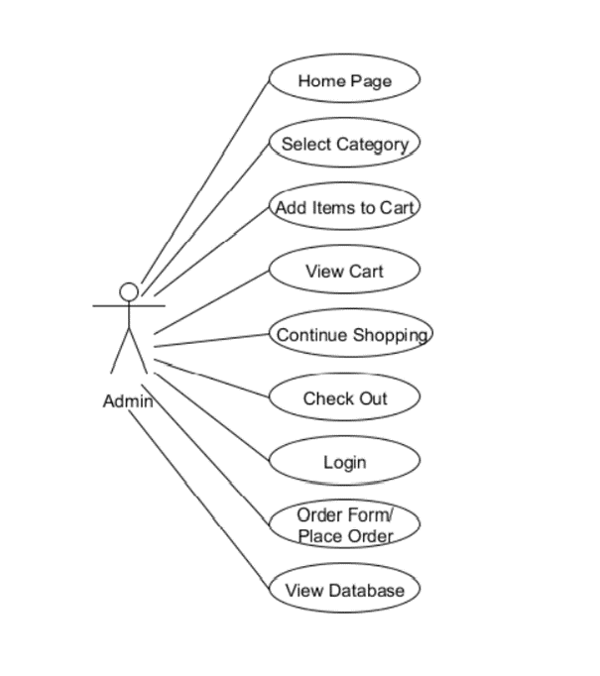
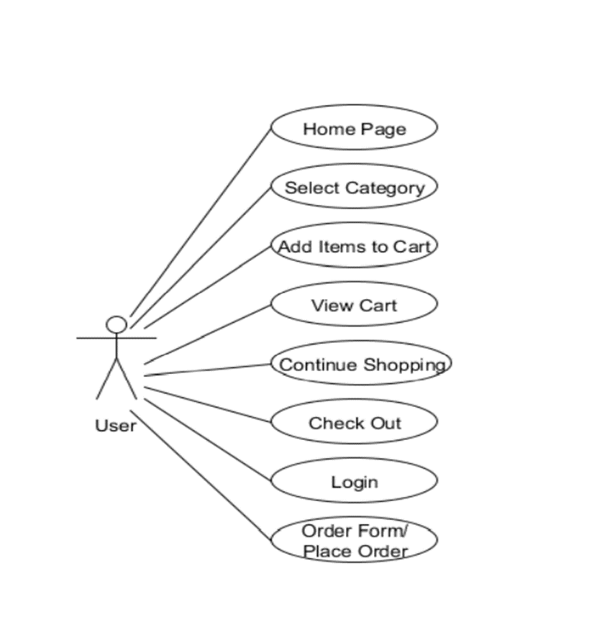
SYSTEM DESIGN
USE CASE DIAGRAM
Fig: Use-Case Diagram: Admin
Fig: Use-Case Diagram: User

Slide 12
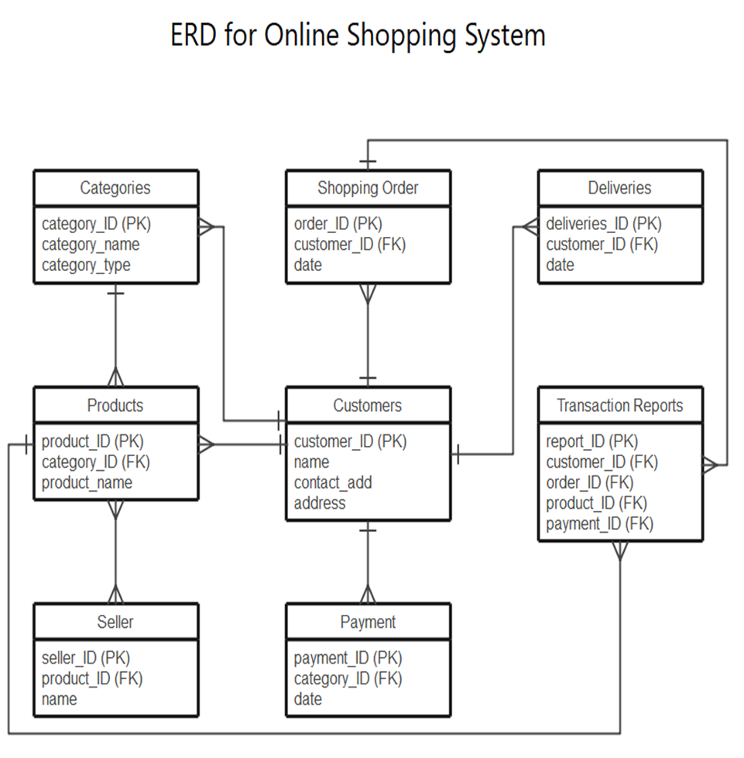
SYSTEM DESIGN
ER-DIAGRAM
Fig: ER DIAGRAM

Slide 13
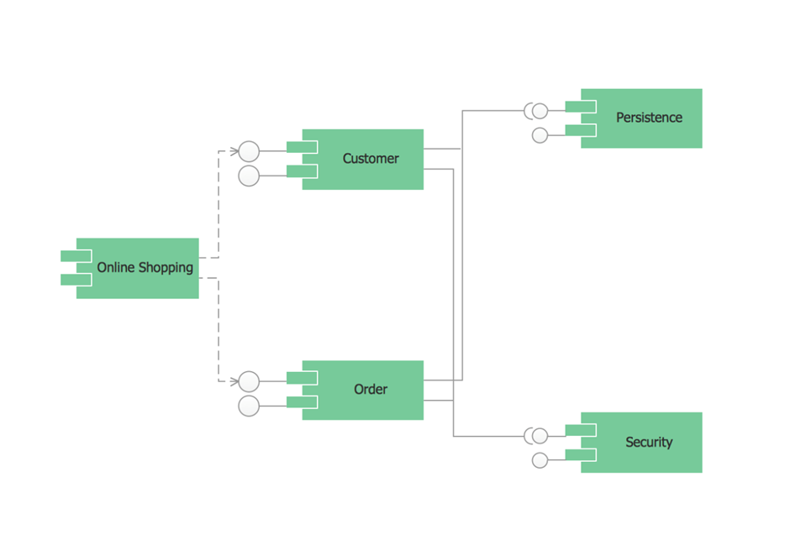
SYSTEM DESIGN
CLASS DIAGRAM
Fig: CLASS DIAGRAM

Slide 14
HARDWARE AND SOTWARE REQUIREMENTS
HARDWARE SPECIFICATION
SOFTWARE SPECIFICATION
Any operating system (Windows, Linux, MAC, etc..).
Ram Must be at least 512 mb.
The System Should Has Internet Connection.
Modem, Dongel, Wifi can be used for internet connection.
Google Chrome/Firefox is recomended for this project for better performance and a good interaction with the end user.
XAMPP Server, WAMP Server, etc(any one)
Browsers and other Internet clients access to the web applications.
The operating system should support HTTPS (Hyper Text Transfer Protocol Secured) protocols.
The operating system should support IP (Internet Protocol).

Slide 15
CONCLUSION
The project entitled Online shopping Website was completed successfully. The system has been developed with much attention and free of errors and at the same time, it is effectual and less time consuming.
The purpose of this project was to develop a web Site for purchasing items from a shop.
This project helped us in gaining appreciated information and practical knowledge on numerous subjects like designing web pages using Php ,Html & CSS, usage of responsive templates and controlling of database using MySQL.
A number of features can be added to this scheme in future like providing moderator more control over products so that each moderator can conserve their own products.

Slide 16
BIBILOGRAPHY
https://www.tutorialspoint.com/php/index.htm
https://youtu.be/1SnPKhCdlsU
Introduction · Bootstrap v4.5 (getbootstrap.com)
Learn JavaScript Tutorial - javatpoint
CSS Tutorial (w3schools.com)`

Slide 17
Thank You !

