Slide 1




RETAIL ANALYSIS
Multi-tool analytics pipeline across Excel, SQL, Python, and Power BI.
Phase 1 · Excel
Phase 2 · SQL
Phase 3 · Python
Phase 4 · Power BI
PRAVEEN T
Vinsup Skill Academy | Final Project Presentation

Slide 2
About This Project
A four-phase pipeline — each tool hands clean work to the next
PHASE 1
PHASE 2
PHASE 3
PHASE 4
Excel
SQL
Python
Power BI
Data cleaning, validation, and pivot analysis across 9 linked sheets.
Relational schema design, multi-table joins, aggregations, and business logic.
EDA, visualization, and RFM-based customer segmentation.
4-page interactive dashboard with KPIs, slicers, and store mapping.
Retail Analysis | About

Slide 3
OVERVIEW
Executive Summary
Raw transactions to executive insight
Problem Statement
Core Use Cases
In a competitive retail market, businesses need to track sales performance, understand customer behavior, and identify growth opportunities. This project aims to build an end-to-end analytics solution that enables insights generation from raw transactional data using a multi-tool approach.
Store & staff revenue
RFM customer segmentation
Inventory stock alerts (<10 units)
Executive dashboarding
Domain Scope
Retail Bicycle Chain operating across NY, CA, and TX.
Retail Analysis | Overview

Slide 4
DATASET
Dataset at a Glance
Nine linked tables, verified across the pipeline
1,445
1,615
4,722
321
3 / 10
Customers
Orders
Order Items
Products
Stores / Staff
Customers by State
Also in the schema
NY
1019
9 Brands
7 Categories
939 Stock records
CA
284
TX
142
Retail Analysis | Dataset

Slide 5
PHASE 1 · EXCEL
Data Cleaning & Preparation
Turning raw exports into a validated dataset
✓
Header standardization
Sales by Category
✓
Deduplication
₹8.58M
✓
Missing values handled
Total revenue
✓
Date & numeric types fixed
Mountain Bikes lead
✓
Derived total_price formula
₹3.03M
Retail Analysis | Phase 1

Slide 6
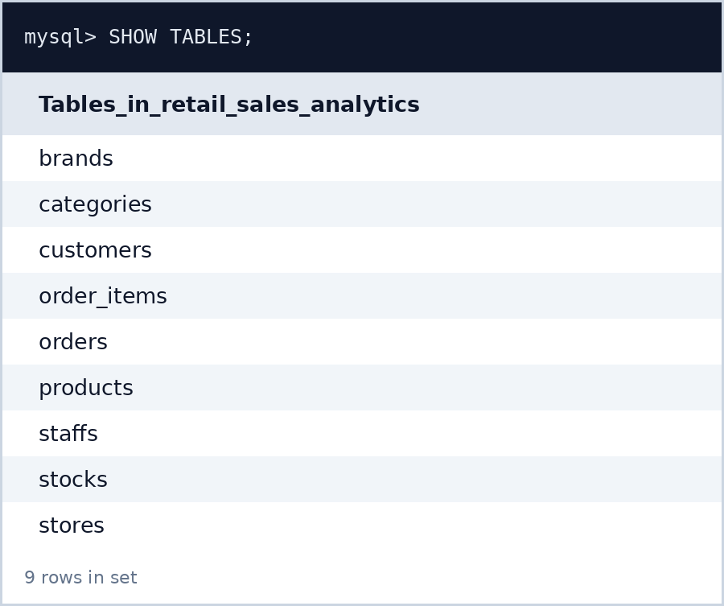
PHASE 2 · SQL
Database Design & Setup
Initializing the schema and importing 9 linked tables
customers
orders
order_items
products
stocks
stores
staffs
brands
categories
Cleaned CSVs imported as relational tables, linked via primary and foreign keys.
Retail Analysis | Phase 2

Slide 7
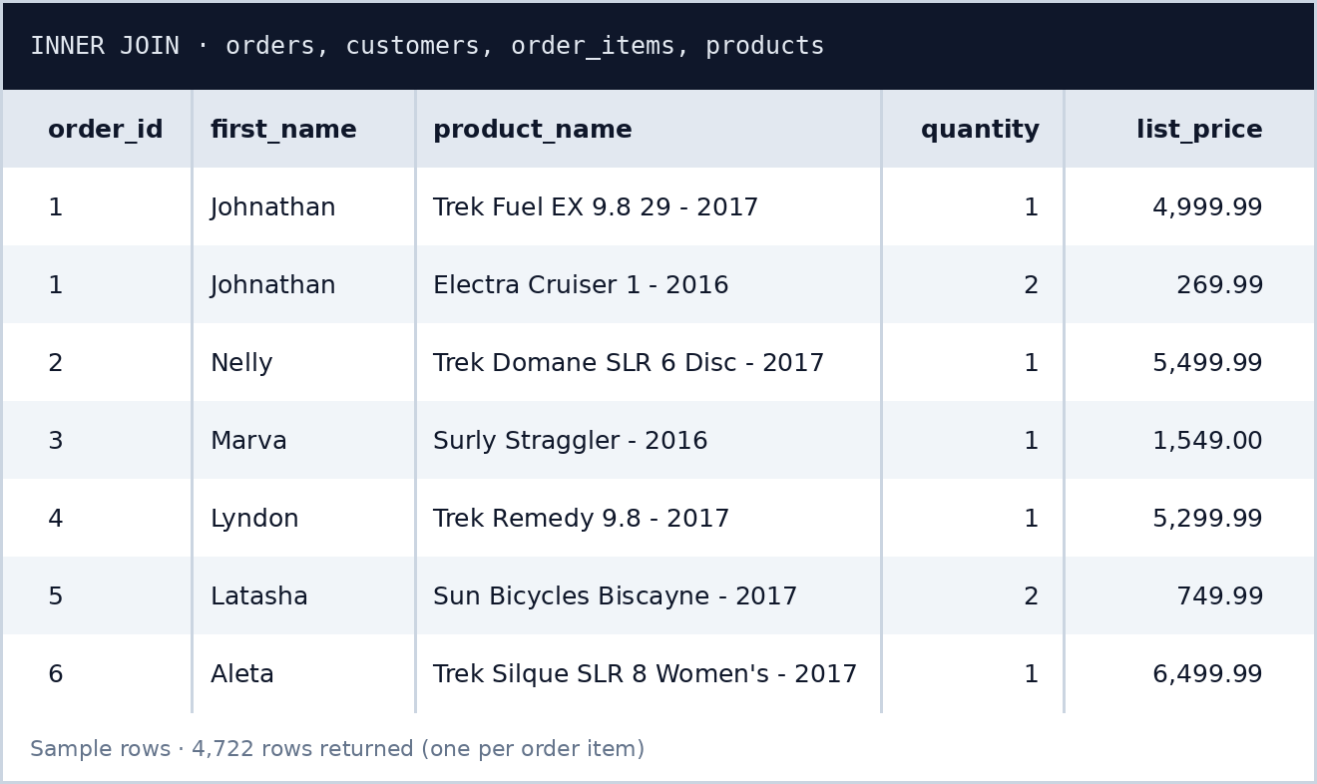
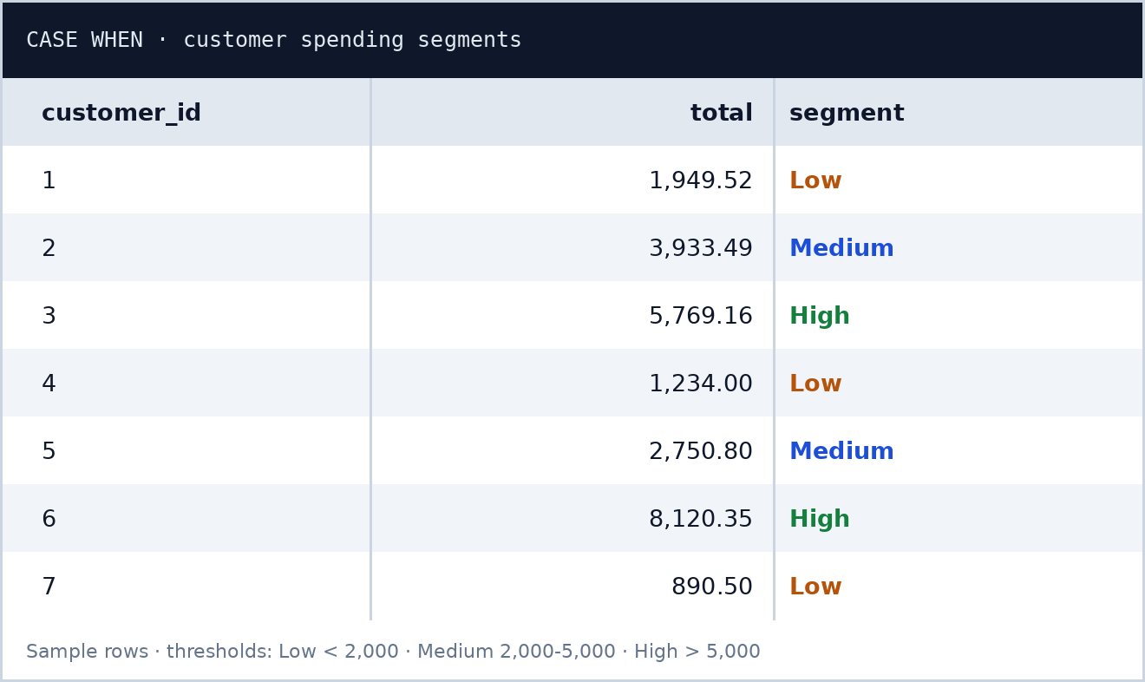
PHASE 2 · SQL
Querying for Business Insight
Joins, aggregation, and conditional segmentation
Multi-table INNER JOIN
Spending Segments (CASE WHEN)
Sample rows shown — Low · Medium · High segments from the spending thresholds.
Retail Analysis | Phase 2

Slide 8
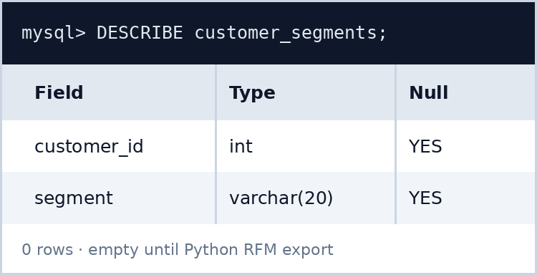
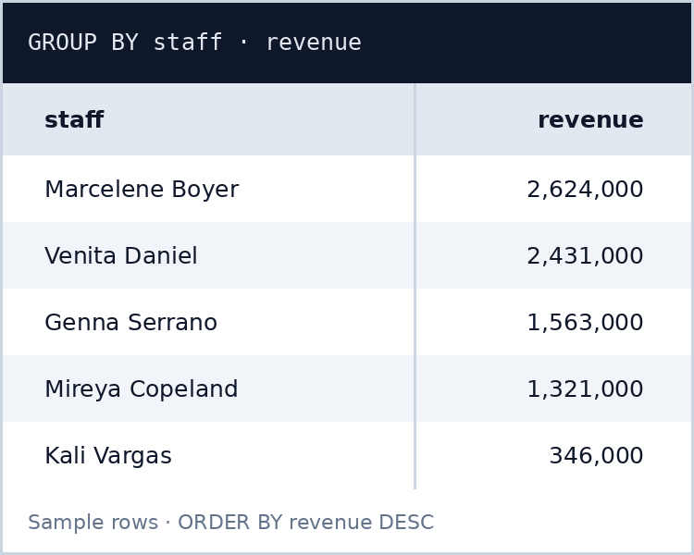
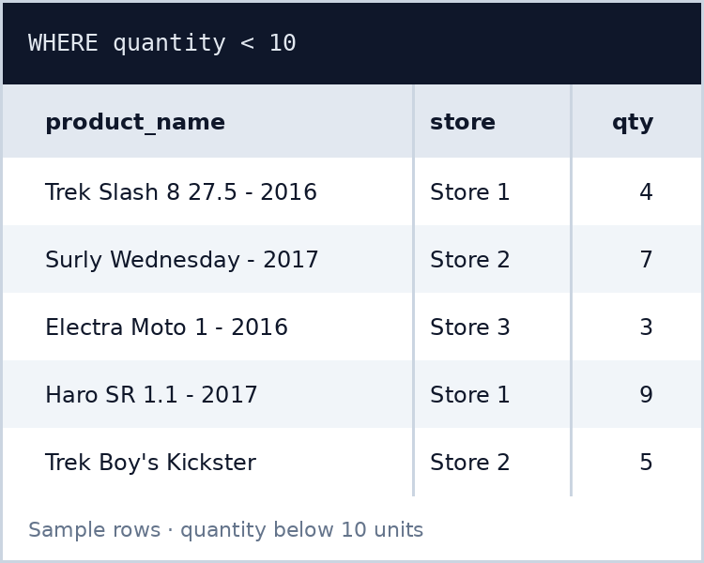
PHASE 2 · SQL
Operational Queries & ML Handoff
Staff performance, stock alerts, and the Python export table
Staff Revenue
Low Stock Alerts
customer_segments
Aggregates revenue per staff member by joining orders, order_items, and staffs — GROUP BY staff, ordered by total.
Flags products where stock quantity is below 10 units so stores can reorder before they run out.
Empty table created in Phase 2; Python writes the RFM results into it.
Retail Analysis | Phase 2

Slide 9
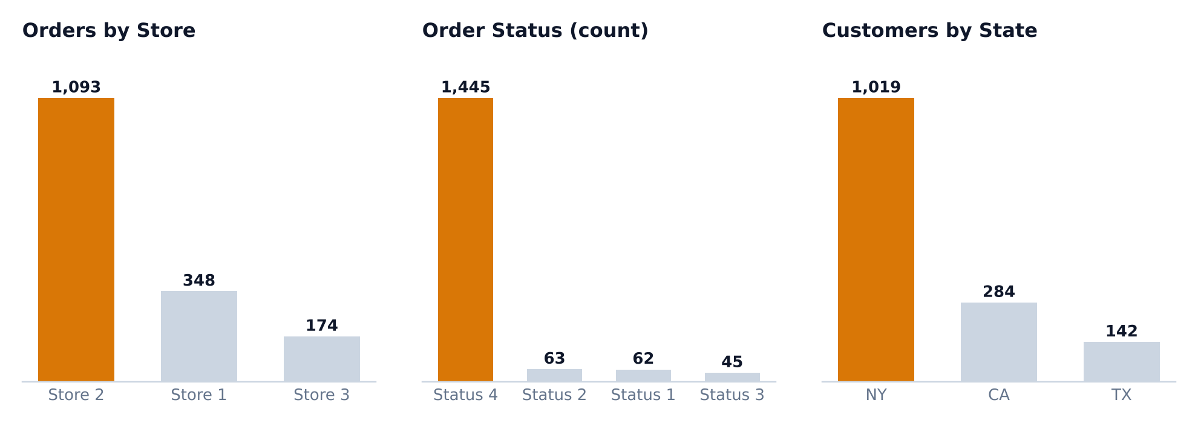
PHASE 3 · PYTHON
Ingestion & Exploratory Data Analysis
SQLAlchemy + Pandas on all 9 tables
Retail Analysis | Phase 3

Slide 10
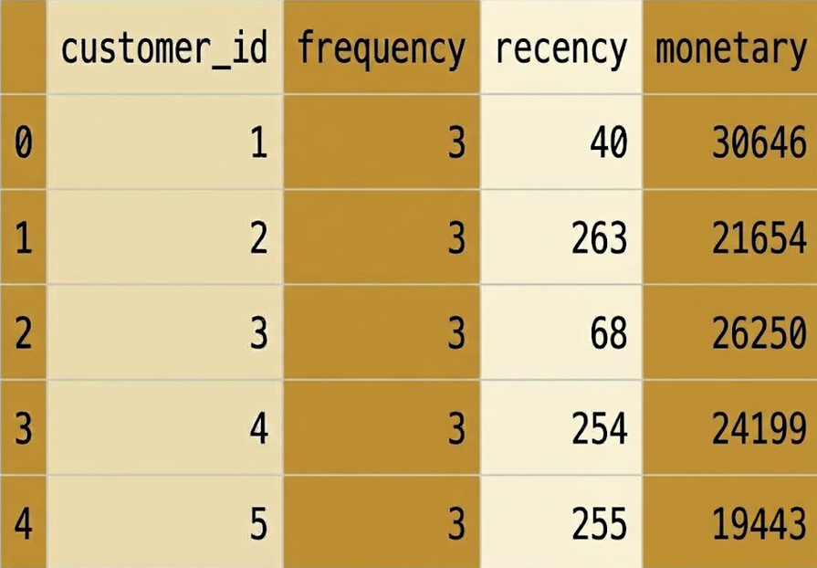
PHASE 3 · PYTHON
RFM Analysis & Segmentation
Recency, Frequency, Monetary — scored per customer
Recency
Days since last order
Frequency
Distinct orders placed
Monetary
Total spend per customer
Retail Analysis | Phase 3

Slide 11
PHASE 4 · POWER BI
Dashboard Overview
One consolidated view of the whole business
₹ 8.58M
1,615
1,445
₹ 5.31K
Total Revenue
Total Orders
Active Customers
AOV
Monthly Sales Trend
Customer RFM Donut
Store Map & Staff Revenue
Sales trend by month, with the 2018 peak.
Customer segments at a glance.
Store locations mapped, with revenue by staff.
Retail Analysis | Phase 4

Slide 12
PHASE 4 · POWER BI
Sales Analysis & Drill-Down
Page 4 of the dashboard
Page 4 Visuals
Why four Pages?
Retail Sales Analytics: Gives an overall view of the business using KPIs, store revenue, product quantity, and sales by location.
Sales Overview: Shows total revenue, customers, orders, average order value, top brands: /products, and monthly sales.
Customer Segmentation: Shows different customer segments, their revenue, customer count, and performance by city and brand.
Staff Performance: Shows each staff member’s profit and revenue, along with store-wise sales and product quantities.
Category columns
Top 5 models
Monthly trend lines
Slicers
Bookmark navigators
Retail Analysis | Phase 4

Slide 13
Key Insights
Strategic findings from the pipeline
1
Mountain Bikes Lead Revenue
₹3.03M — roughly double other categories.
2
Store 2 Volume Dominance
68% of all orders.
3
New York Customer Concentration
70% of the customer base.
Retail Analysis | Insights

Slide 14
Suggestions
Recommended actions based on the findings
1
Grow Beyond Mountain Bikes
Bundle accessories and promote the other categories.
2
Balance Store Performance
Lift Stores 1 & 3; keep Store 2 well stocked.
3
Expand Reach in CA & TX
Run targeted campaigns to win new customers there.
4
Act on Low-Stock Alerts
Auto-reorder products that fall below 10 units.
5
Reward High-Value Customers
Use RFM segments for loyalty perks and win-back offers.
Retail Analysis | Suggestions

Slide 15
End-to-End Analytics Pipeline Successfully Executed
Excel
SQL
Python
Power BI
Clean, validated CSVs
Relational DB & segments table
EDA & RFM segments
Interactive 2-page dashboard
Thank You!
Questions & Discussion Welcome
PRAVEEN T | Vinsup Skill Academy

