Slide 1
Additional ML Models

Slide 2
Agenda
K- Nearest neighbours
Decision Tree and Random forest
Boosting Techniques
Support Vector machines
Naive bayes
k-Fold Cross Validation and Grid Search

Slide 3
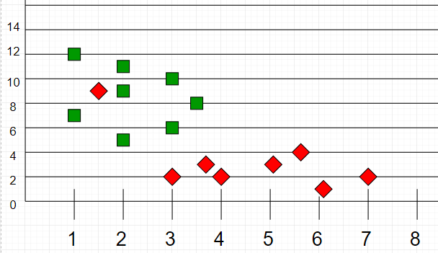
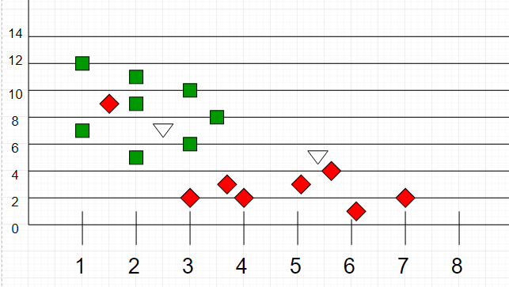
KNearest Neighbour

Slide 4
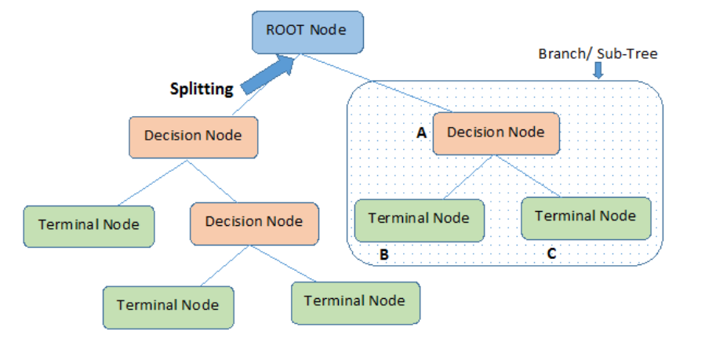
Decision Tree

Slide 5
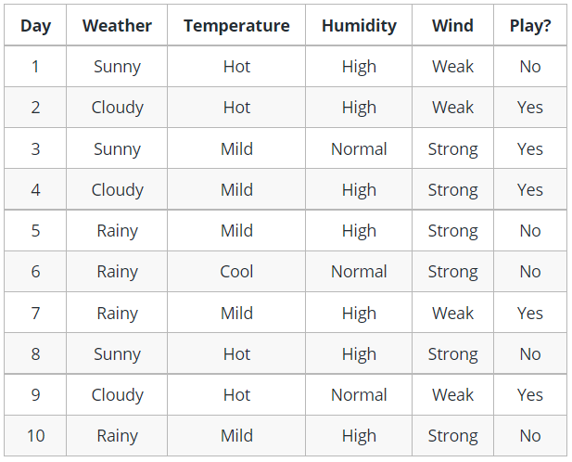
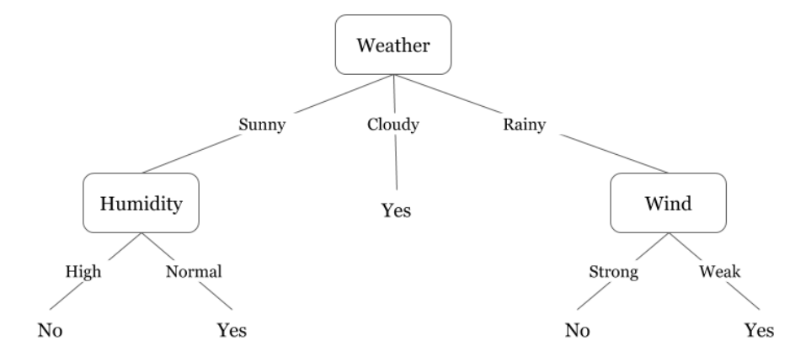

Slide 6
Information Gain
Gini Index

Slide 7
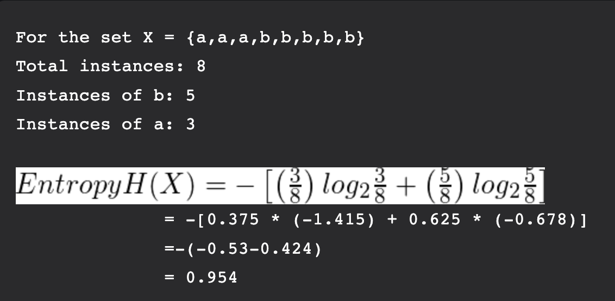
Information Gain

Slide 8
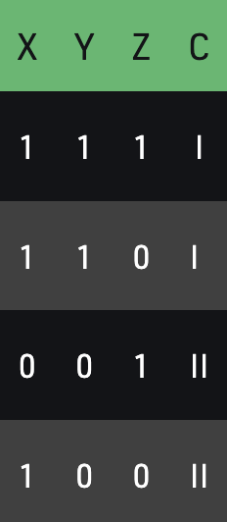
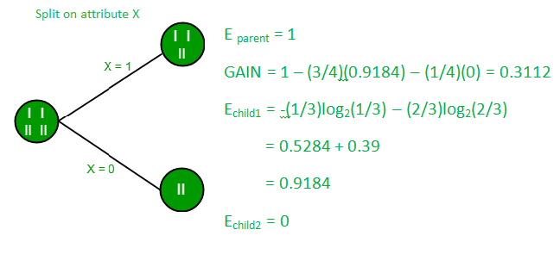
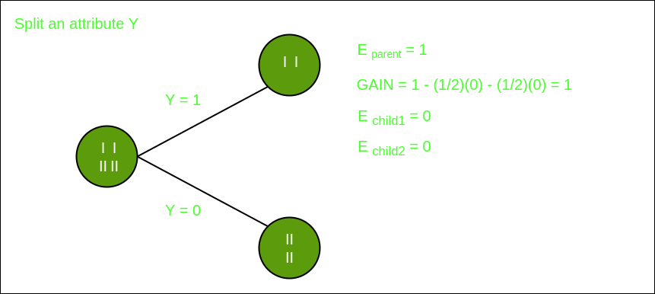


Slide 9
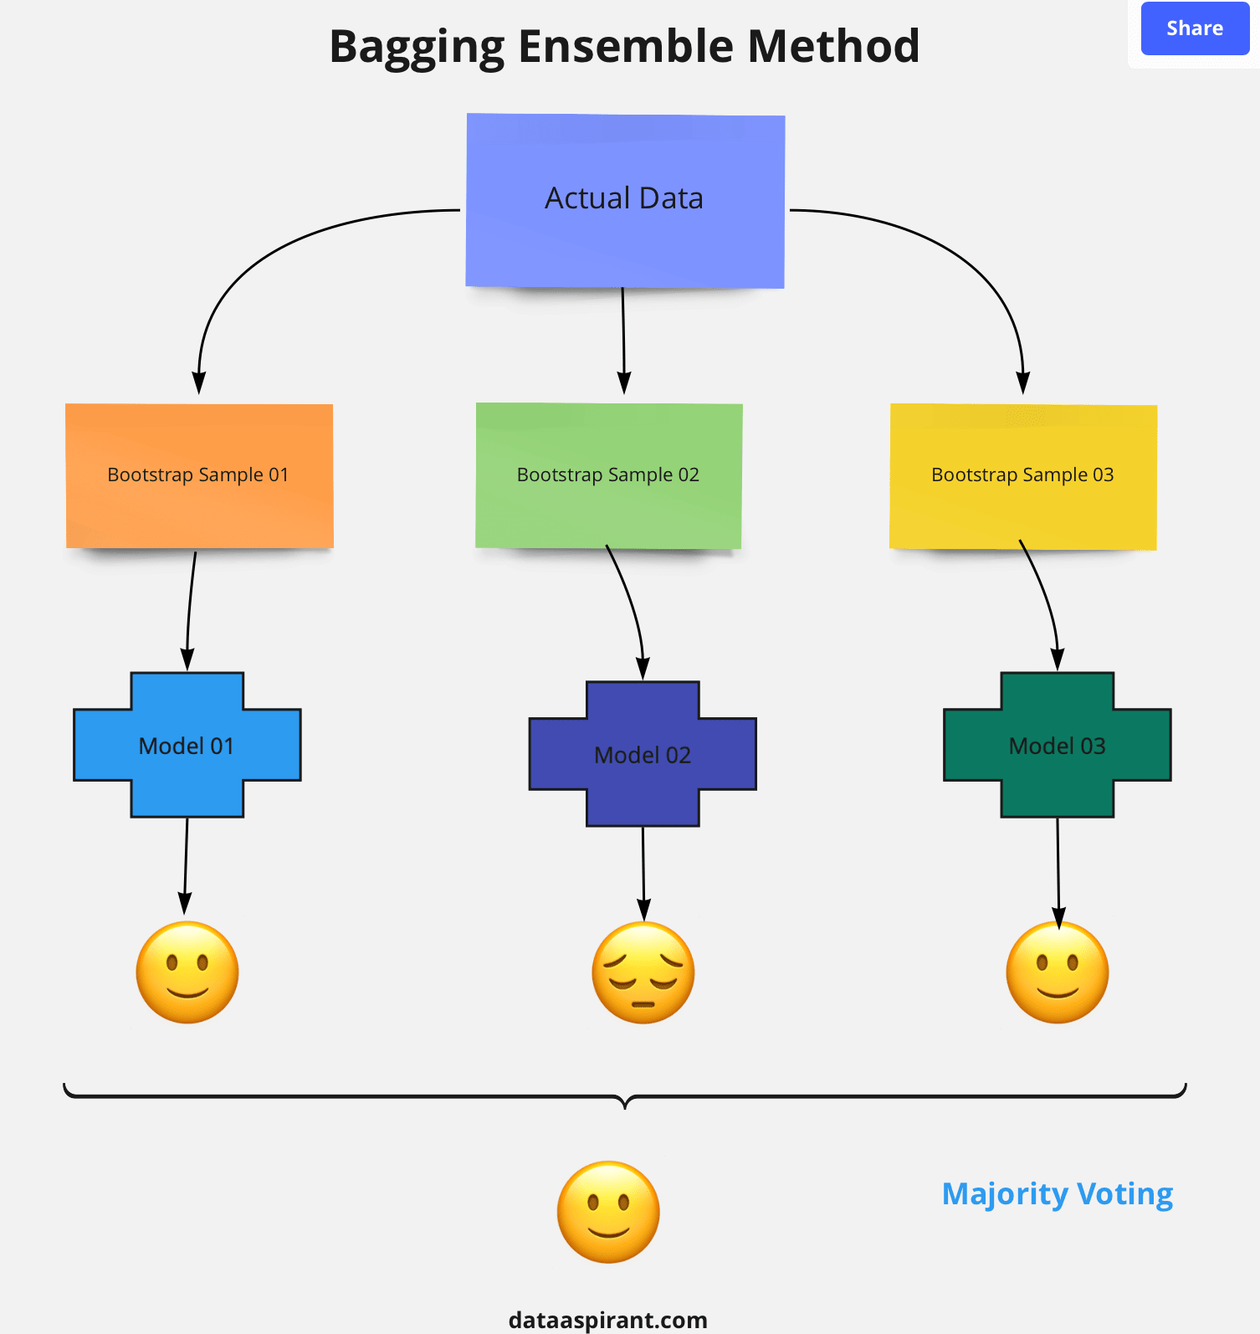
RandomForest

Slide 10
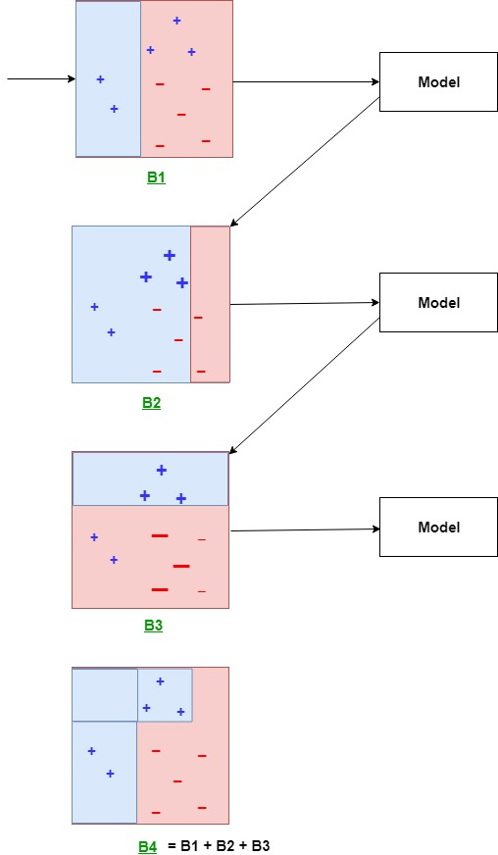
Boosting Technique

Slide 11
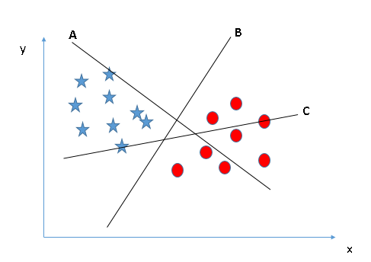
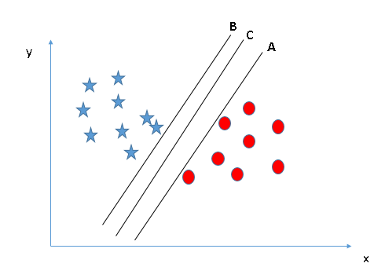
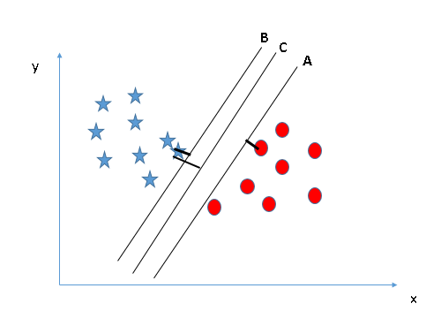
SVM

Slide 12
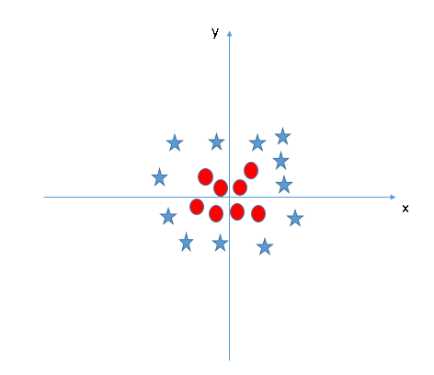
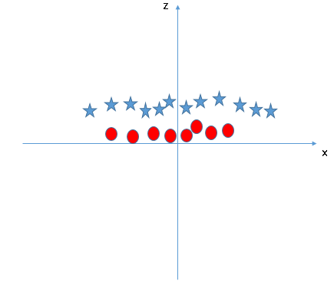
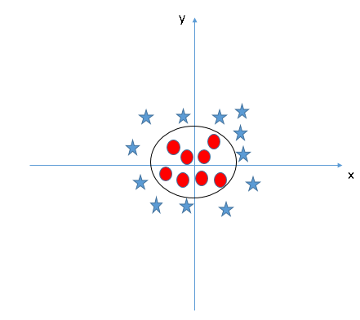
SVM

Slide 13
SVM Kernel
Polynomial Kernel
Gaussian Kernel
Radial Basis Function (RBF)
Laplace RBF Kernel
Sigmoid Kernel
Anove RBF Kernel

Slide 14



Naïve Bayes

Slide 15
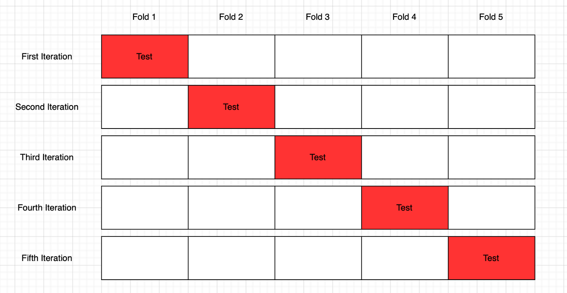
KFold

Slide 16
Grid Search
param_grid={ 'C': [1.1, 5.4, 170, 1001],
    'epsilon': [0.0003, 0.007, 0.0109, 0.019, 0.14, 0.05, 8, 0.2, 3, 2, 7],
    'gamma': [0.7001, 0.008, 0.001, 3.1, 1, 1.3, 5] }

Slide 17
Reference
KNN : https://www.geeksforgeeks.org/k-nearest-neighbours/
DT : https://www.geeksforgeeks.org/decision-tree-introduction-example/
DT : https://www.analyticsvidhya.com/blog/2021/08/decision-tree-algorithm/
RandomForest : https://www.analyticsvidhya.com/blog/2021/06/understanding-random-forest/
SVM: https://www.analyticsvidhya.com/blog/2017/09/understaing-support-vector-machine-example-code/
Kfold: https://towardsdatascience.com/cross-validation-and-grid-search-efa64b127c1b

