Slide 1
Clustering

Slide 2
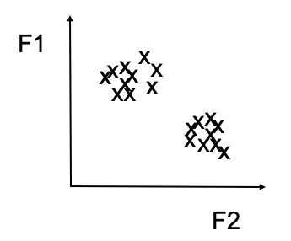
Goal of Custering
Given a set of data points, each described by a set of attributes, find clusters such that:
  Inter-cluster similarity is
    maximized
  Intra-cluster similarity is
    minimized

Slide 3
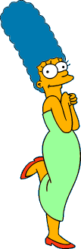




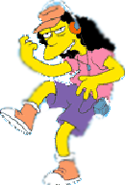
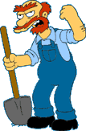

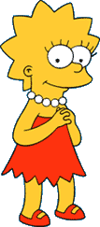
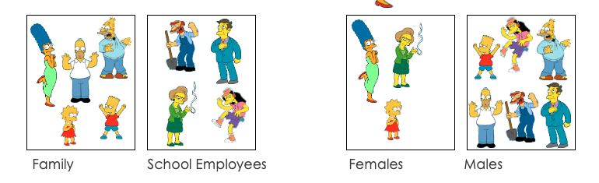
What is a natural grouping of these objects?

Slide 4
What is clustering?
Is an unsupervised machine learning method
Real life example for clustering?
Applications
  Recommendation engine
  Market and Customer segmentation
  Search Results
Notes:
https://www.analyticssteps.com/blogs/5-clustering-methods-and-applications

Slide 5
Why cluster?
Labelling is expensive
Gain insights into structure of data
Find prototypes in the data

Slide 6

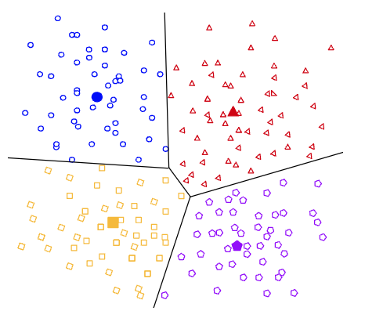
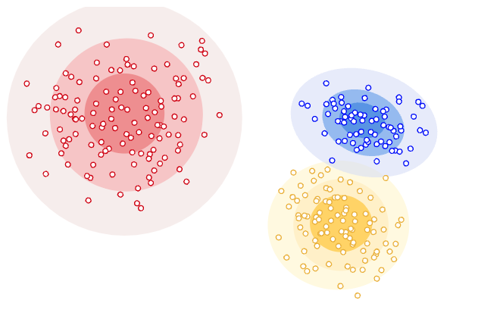
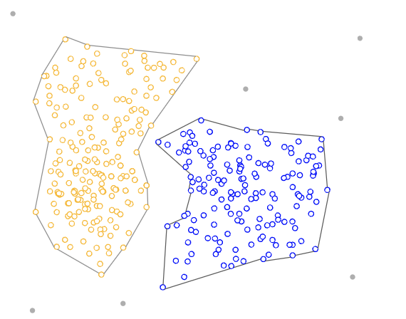
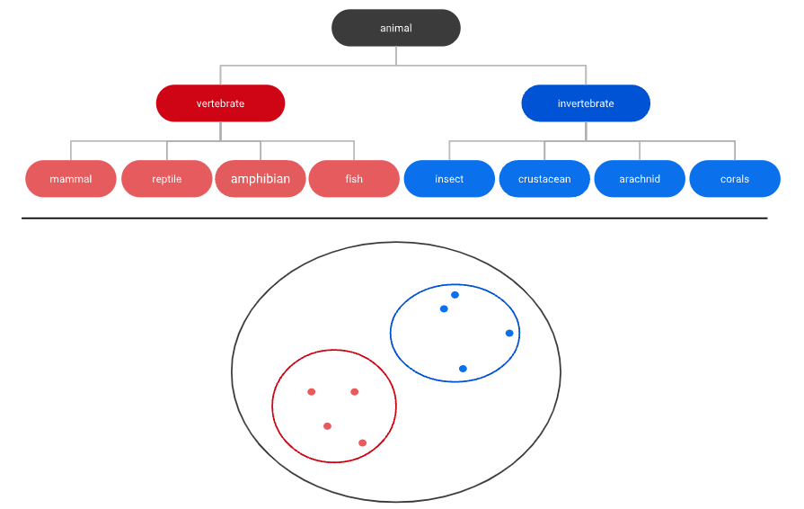
Types of clustering models
Centroid based
Distribution based
Density based
Hierarchical clustering
Notes:
https://developers.google.com/machine-learning/clustering/clustering-algorithms

Slide 7
K – Means Clustering
the most popular clustering algorithm, given that it is very easy to understand and apply to a wide range of data science and machine learning problems
Algorithm:
  1. Decide on a value for k.
  2. Initialize the k cluster centers (randomly, if necessary).
  3. Decide the class memberships of the N objects by assigning them to the nearest cluster center.
  4. Re-estimate the k cluster centers, by assuming the memberships found above are correct.
  5. If none of the N objects changed membership in the last iteration, exit. Otherwise goto 3.

Slide 8
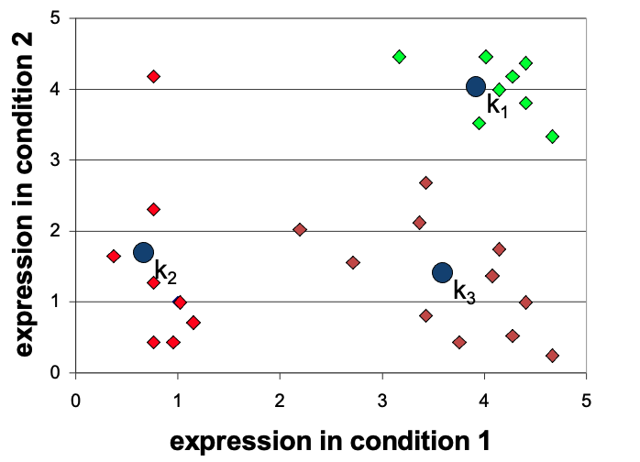
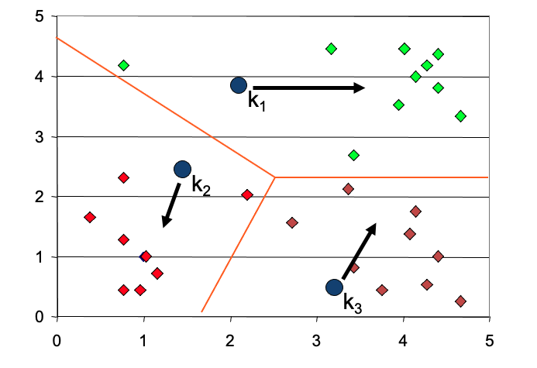
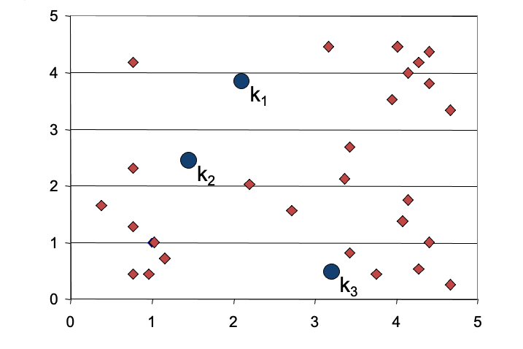
K-means Algorithm

Slide 9
Hierarchical clustering
Types:
  Agglomerative Clustering is a bottom-up strategy in which each data point is originally a cluster of its own, and as one travels up the hierarchy, more pairs of clusters are combined. In it, two nearest clusters are taken and joined to form one single cluster.
  The divisive clustering algorithm is a top-down clustering strategy in which all points in the dataset are initially assigned to one cluster and then divided iteratively as one progresses down the hierarchy. It partitions data points that are clustered together into one cluster based on the slightest difference. This process continues till the desired number of clusters is obtained.

Slide 10
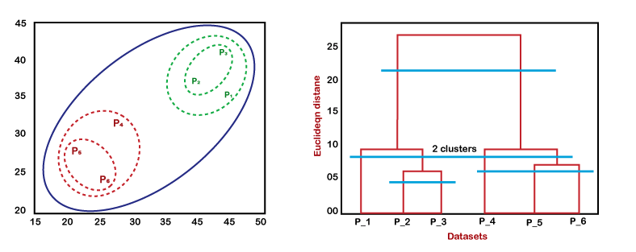
Dendrogram
A dendrogram is a visual representation of the hierarchical connection between items. It's most often produced as a result of hierarchical clustering.
A dendrogram's main purpose is to figure out the best approach to assign items to clusters according to similarities and dissimilarities and our desired problem.
In the dendrogram plot, the Y-axis shows the Euclidean distances between the data points, and the x-axis shows all the data points of the given dataset.

Slide 11
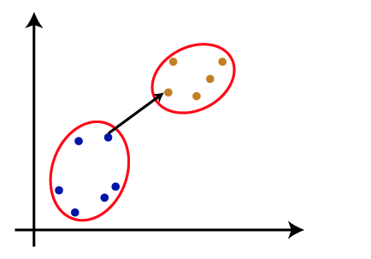
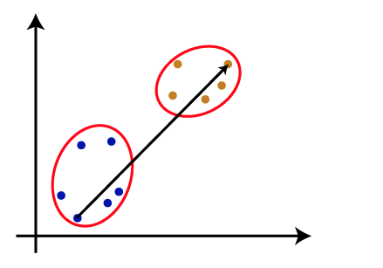
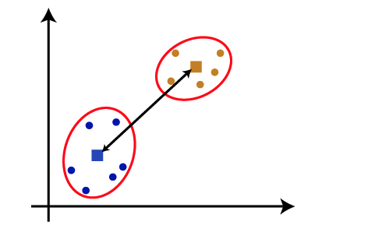
Measure for the distance between two clusters
1.Single Linkage (Min). 2.Complete (Max) 3.Centroid

Slide 12
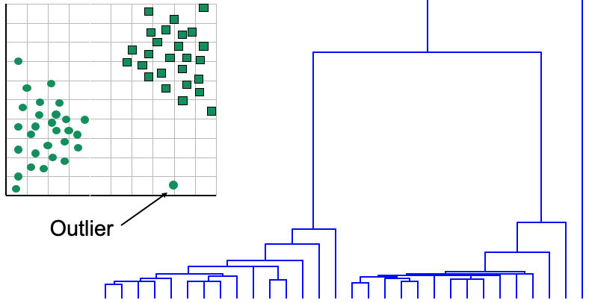
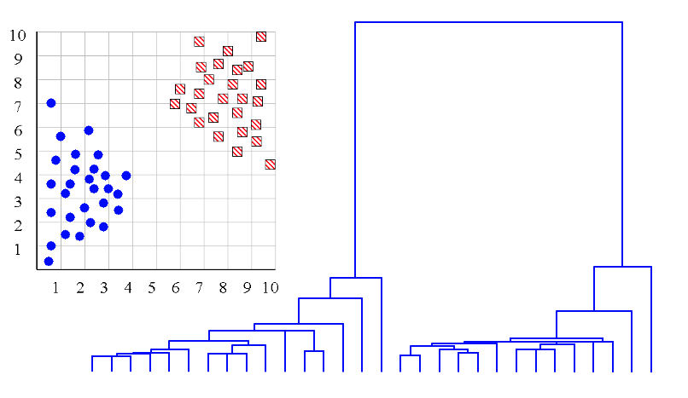
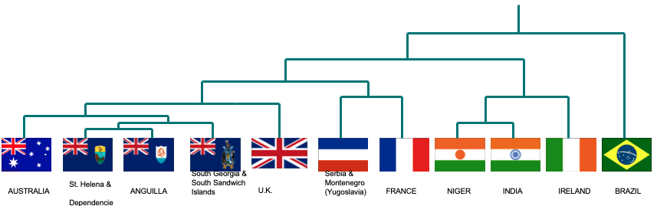
One potential use of a dendrogram: detecting outliers
Determine correct number of clusters
Detecting outliers
showpatterns

