Slide 1
LINEAR REGRESSION

Slide 2
In Machine Learning,
What is regression?
Regression is a technique for investigating the relationship between independent variables or features and a dependent variable or outcome
Linear Regression is a supervised machine learning algorithm.
It tries to find out the best linear relationship that describes the data you have.
It assumes that there exists a linear relationship between a dependent variable and independent variable(s).
The value of the dependent variable of a linear regression model is a continuous value i.e. real numbers.
e.g. scores of a student, diamond prices, etc.

Slide 3
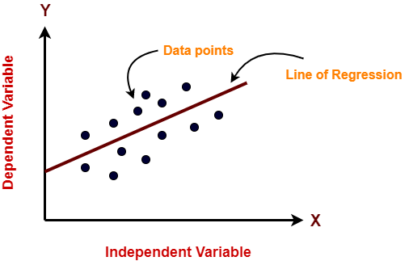
Linear regression model represents the linear relationship between a dependent variable and independent variable(s) via a sloped straight line.
The sloped straight line representing the linear relationship that fits the given data best is called as a regression line.
It is also called as best fit line.

Slide 4
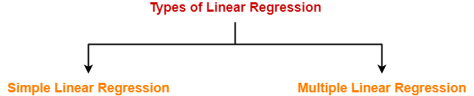
Types of Linear Regression-
Based on the number of independent variables, there are two types of linear regression-
Simple Linear Regression
Multiple Linear Regression

Slide 5
1. Simple Linear Regression-
In simple linear regression, the dependent variable depends only on a single independent variable.
For simple linear regression, the form of the model is
Y = β₀ + β₁X
Here,
Y is a dependent variable.
X is an independent variable.
β₀ and β₁ are the regression coefficients.
β₀ is the intercept or the bias that fixes the offset to a line.
β₁ is the slope or weight that specifies the factor by which X has an impact on Y.

Slide 6
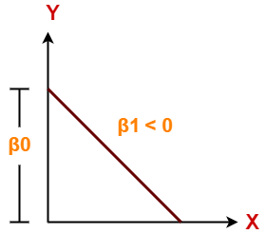
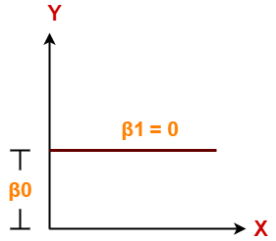
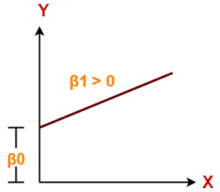
There are following 3 cases possible-
Case-01: β₁ < 0
It indicates that variable X has negative impact on Y.
If X increases, Y will decrease and vice-versa.
Case-02: β₁ = 0
It indicates that variable X has no impact on Y.
If X changes, there will be no change in Y
Case-03: β₁ > 0
It indicates that variable X has positive impact on Y.
If X increases, Y will increase and vice-versa.

Slide 7

How the linear regression finds out which is the best fit line?
The goal of the linear regression algorithm is to get the best values for B₀ and B₁ to find the best fit line. The best fit line is a line that has the least error which means the error between predicted values and actual values should be minimum
Random Error(Residuals)
In regression, the difference between the observed value of the dependent variable(y_{i}) and the predicted value(predicted) is called the residuals.
ε_{i} = y_{predicted} – y_{i}
where y_{predicted} = B₀ + B₁ X_{i}
What is the best fit line?
In simple terms, the best fit line is a line that fits the given scatter plot in the best way. Mathematically, the best fit line is obtained by minimizing the Residual Sum of Squares(RSS)
Cost Function for Linear Regression
The cost function helps to find out the optimal values for B₀ and B₁, which provides the best fit line for the data points.
In Linear Regression, generally Mean Squared Error (MSE) cost function is used, which is the average of squared error that occurred between the y_{predicted} and y_{i}.
We calculate MSE using simple linear equation y=mx+b:

Slide 8
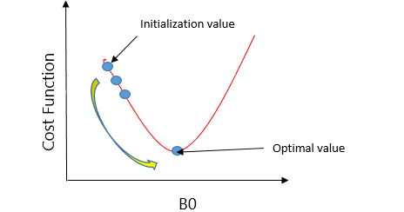
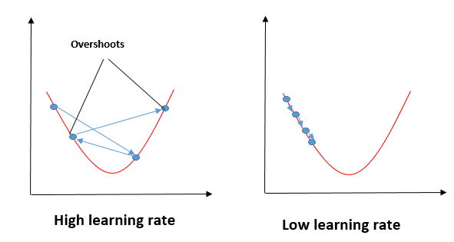
Using the MSE function, we’ll update the values of B₀ and B₁ such that the MSE value settles at the minima. These parameters can be determined using the gradient descent method such that the value for the cost function is minimum
Gradient Descent for Linear Regression
Gradient Descent is one of the optimization algorithms that optimize the cost function(objective function) to reach the optimal minimal solution..
A regression model optimizes the gradient descent algorithm to update the coefficients of the line by reducing the cost function by randomly selecting coefficient values and then iteratively updating the values to reach the minimum cost function.
In the gradient descent algorithm, the number of steps you’re taking can be considered as the learning rate, and this decides how fast the algorithm converges to the minima.

Slide 9
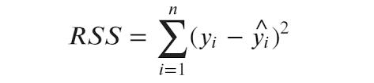
Evaluation Metrics for Linear Regression
The strength of any linear regression model can be assessed using various evaluation metrics. The most used metrics are,
Coefficient of Determination or R-Squared (R2)
Root Mean Squared Error (RSME) and Residual Standard Error (RSE)
1. Coefficient of Determination or R-Squared (R2)
R-Squared is a number that explains the amount of variation that is explained/captured by the developed model. It always ranges between 0 & 1 . Overall, the higher the value of R-squared, the better the model fits the data.
Mathematically it can be represented as,
R² = 1 – ( RSS/TSS )
  Residual sum of Squares (RSS) is defined as the sum of squares of the residual for each data point in the plot/data. It is the measure of the difference between the expected and the actual observed output.
  Total Sum of Squares (TSS) is defined as the sum of errors of the data points from the mean of the response variable. Mathematically TSS is,
z

Slide 10
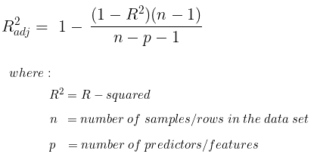

2.Adjusted R squared
Adjusted R2 is a corrected goodness-of-fit (model accuracy) measure for linear models..
R2 tends to optimistically estimate the fit of the linear regression. It always increases as the number of effects are included in the model. Adjusted R2 attempts to correct for this overestimation. Adjusted R2 might decrease if a specific effect does not improve the model.
3. Root Mean Squared Error
The Root Mean Squared Error is the square root of the variance of the residuals. It specifies the absolute fit of the model to the data i.e. how close the observed data points are to the predicted values. Mathematically it can be represented as,

Slide 11
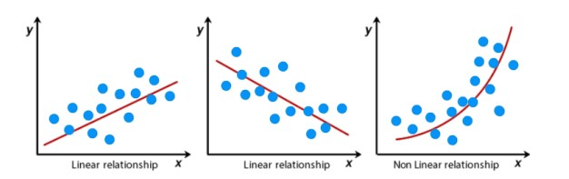
Assumptions of Linear Regression
Regression is a parametric approach, which means that it makes assumptions about the data for the purpose of analysis.
1. Linearity of residuals: There needs to be a linear relationship between the dependent variable and independent variable(s)
2. Independence of residuals: The error terms should not be dependent on one another (like in time-series data wherein the next value is dependent on the previous one). There should be no correlation between the residual terms. The absence of this phenomenon is known as Autocorrelation.
There should not be any visible patterns in the error terms.
3. Normal distribution of residuals: The mean of residuals should follow a normal distribution with a mean equal to zero or close to zero
4. The equal variance of residuals: The error terms must have constant variance. This phenomenon is known as Homoscedasticity.

Slide 12
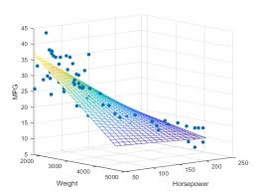
2. Multiple Linear Regression-
In multiple linear regression, the dependent variable depends on more than one independent variables.
For multiple linear regression, the form of the model is
Y = β₀ + β₁X₁ + β₂X₂ + β₃X₃ + …… + β_{n}X_{n}
Here,
Y is a dependent variable.
X₁, X₂, …., X_{n} are independent variables.
β₀, β₁,…, β_{n} are the regression coefficients.
β_{j} (1<=j<=n) is the slope or weight that specifies the factor by which X_{j} has an impact on Y.

Slide 13
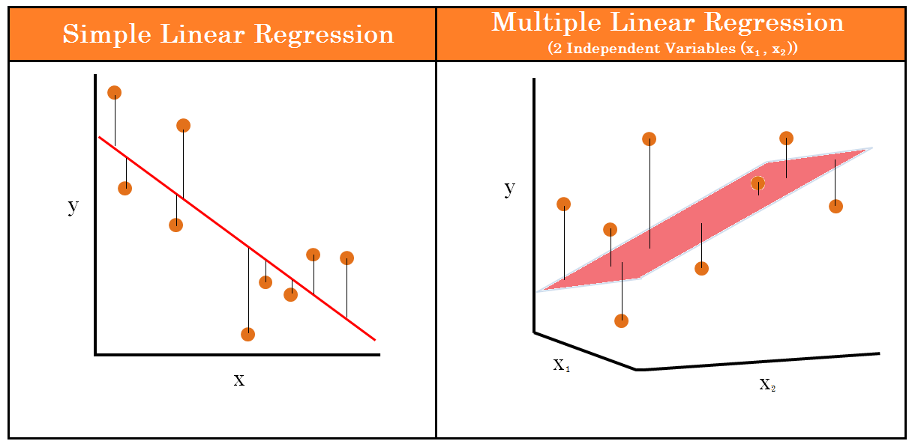
The simple linear regression model can be represented graphically as a best-fit line between the data points,
while the multiple linear regression model can be represented as a plane (in 2-dimensions) or a hyperplane (in higher dimensions).

Slide 14
Considerations of Multiple Linear Regression
All the four assumptions made for Simple Linear Regression still hold true for Multiple Linear Regression
along with a few new additional assumptions
1.Multicollinearity: It is the phenomenon where a model with several independent variables, may have some variables interrelated
2.Overfitting: When more and more variables are added to a model, the model may become far too complex and usually ends up memorizing all the data points in the training set. This phenomenon is known as the overfitting of a model. This usually leads to high training accuracy and very low test accuracy.
3.Feature Selection: With more variables present, selecting the optimal set of predictors from the pool of given features (many of which might be redundant) becomes an important task for building a relevant and better model.

Slide 15
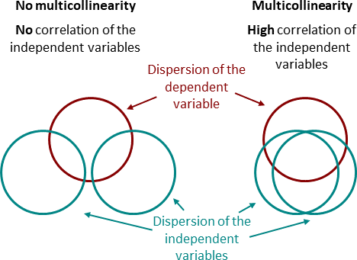

Multicollinearity
In statistics, multicollinearity is a phenomenon in which one predictor variable in a multiple regression model can be linearly predicted from the others. Multicollinearity can be detected using the following methods.
Pairwise Correlations: Checking the pairwise correlations between different pairs of independent variables can throw useful insights in detecting multicollinearity.
Variance Inflation Factor (VIF): . VIF basically explains the relationship of one independent variable with all the other independent variables. VIF is given by,

Slide 16
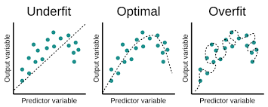
Overfitting
When a model learns each and every pattern and noise in the data to such extent that it affects the performance of the model on the unseen future dataset, it is referred to as overfitting. This usually leads to high training accuracy and very low test accuracy.
There are several ways to prevent overfitting, which are stated below:
If the training data is too small to train add more relevant and clean data.
If the training data is too large, do some feature selection and remove unnecessary features.
Regularization
Underfitting
When the model fails to learn from the training dataset and is also not able to generalize the test dataset, is referred to as underfitting. This type of problem can be very easily detected by the performance metrics. When a model has high bias and low variance it ends up not generalizing the data and causing underfitting. It is unable to find the hidden underlying patterns from the data. This usually leads to low training accuracy and very low test accuracy.
The ways to prevent underfitting are stated below,
Increase the model complexity
Increase the number of features in the training data
Remove noise from the data.
.

Slide 17
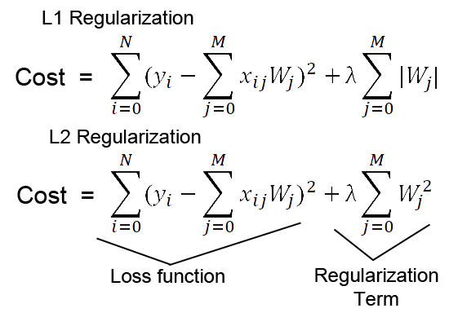
Regularization
Regularization is commonly used in multiple regression settings to lower the complexity of the model.
Regularization can be thought of as a feature selection method, whereby features with lower contributions to the goodness of fit are removed and/or diminished in their effects, while the important features are emphasized.
There are two major regularization techniques that are frequently used in linear regression settings:
Lasso L1 Regression - uses a penalty term to remove predictor variables, which have low contributions to overall model performance
Ridge L2 Regression - uses a penalty term to lower the influence of predictor variables (but does not remove features)
Elastic-Net Regression - combines Lasso Regression with Ridge Regression to give you the best of both worlds
Notes:
The complexity relates to the number of coefficients or weights (or features) that a model uses for its predictions.

