Slide 1
Introduction to Machine Learning

Slide 2
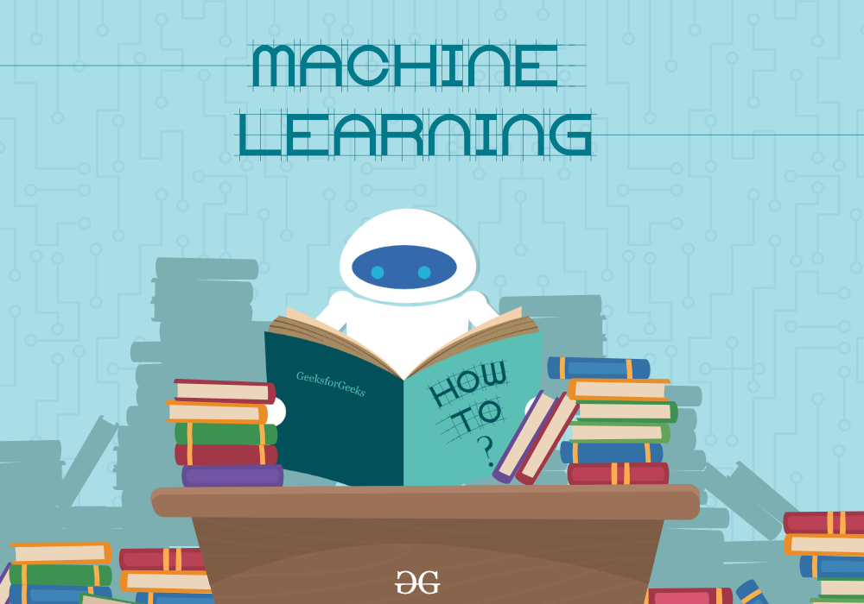
What is Machine Learning?
Machine Learning explores the study and construction of algorithms that can learn from and make predictions on data.
Such algorithms operate by building a model from example inputs in order to make data driven predictions rather than following strictly static program instructions

Slide 3
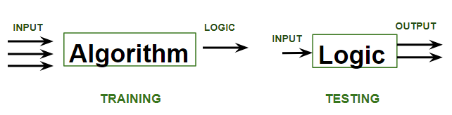
A machine is said to be learning from past Experiences(data feed-in) with respect to some class of tasks if its Performance in a given Task improves with the Experience.
While training the model, data is usually split in the ratio of 80:20 i.e. 80% as training data and the rest as testing data.
Once the model is ready then it is good to be tested. At the time of testing, the input is fed from the remaining 20% of data

Slide 4
Eg 1 - Will customer buy an Antivirus this year?

Slide 5
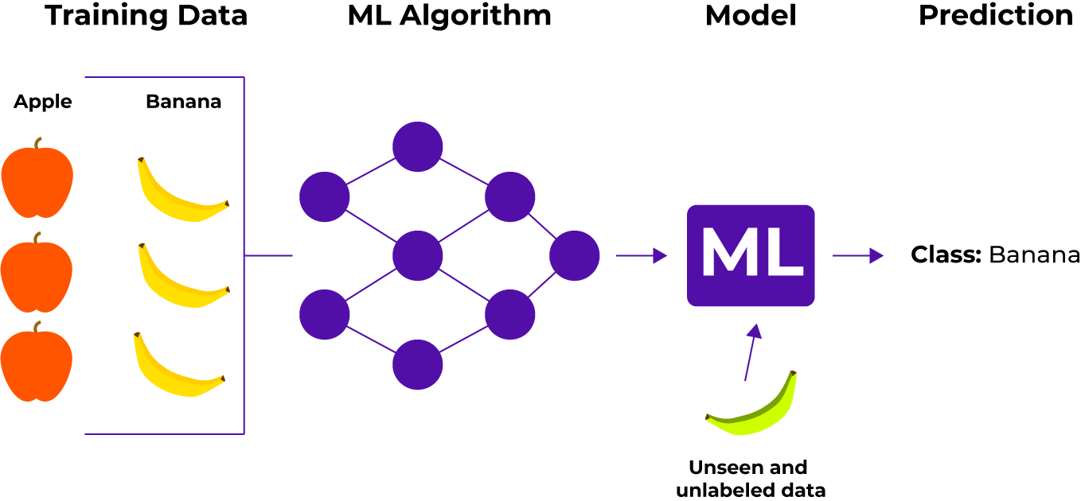
Eg : 2

Slide 6
TYPES OF MACHINE LEARNING
SUPERVISED
LEARNING
SUPERVISED
LEARNING

Slide 7
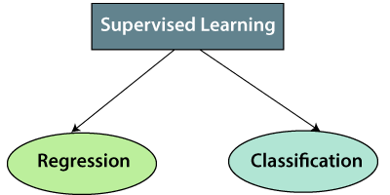
Supervised Learning
Supervised learning is when the model is getting trained on a labelled dataset.
A labelled dataset is one that has both input and output parameters.

Slide 8
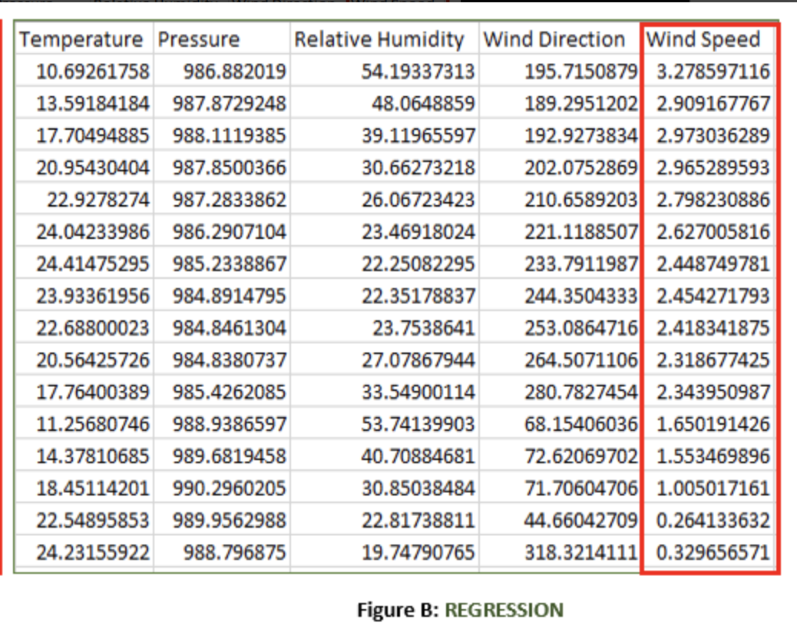
Regression
It is a Supervised Learning task where output is having continuous value.
Figure B: It is a Meteorological dataset that serves the purpose of predicting wind speed based on different parameters.
Input: Dew Point, Temperature, Pressure, Relative Humidity, Wind Direction.
Output: Wind Speed

Slide 9
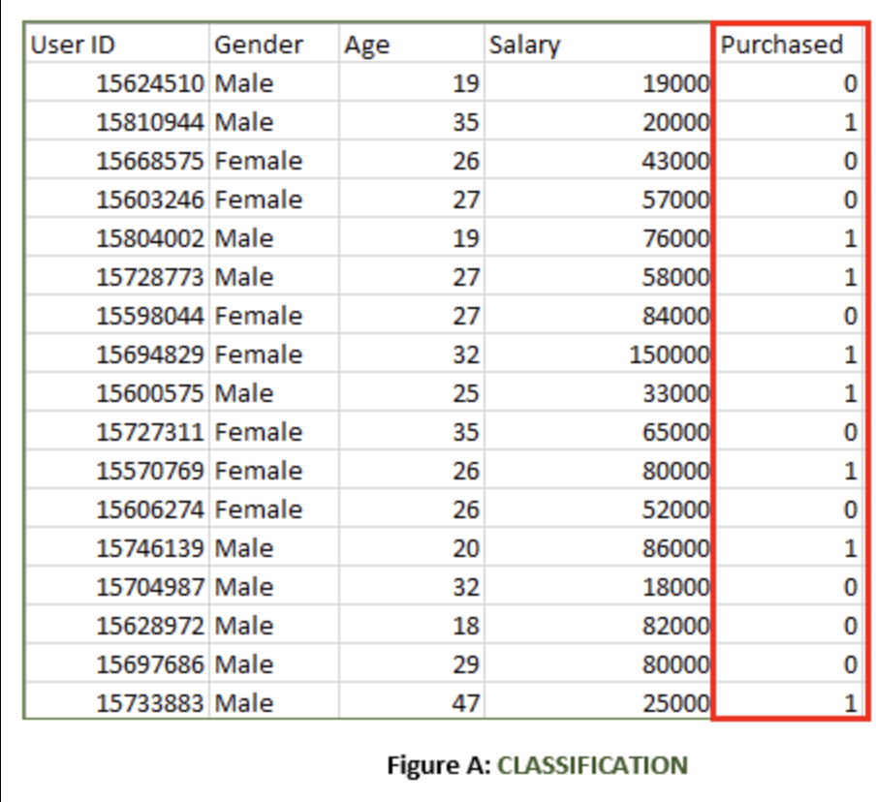
Classification
It is a Supervised Learning task where output is having defined labels(discrete value).
Figure A: It is a dataset of a shopping store that is useful in predicting whether a customer will purchase a particular product under consideration or not based on his/ her gender, age, and salary.
Input: Gender, Age, Salary
Output: Purchased i.e. 0 or 1; 1 means yes the customer will purchase and 0 means that the customer won’t purchase it.

Slide 10
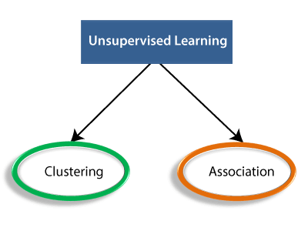
Unsupervised Learning
Unsupervised learning is the training of a machine using information that is neither classified nor labelled and allowing the algorithm to act on that information without guidance
The task of the machine is to group unsorted information according to similarities, patterns, and differences without any prior training of data.

Slide 11
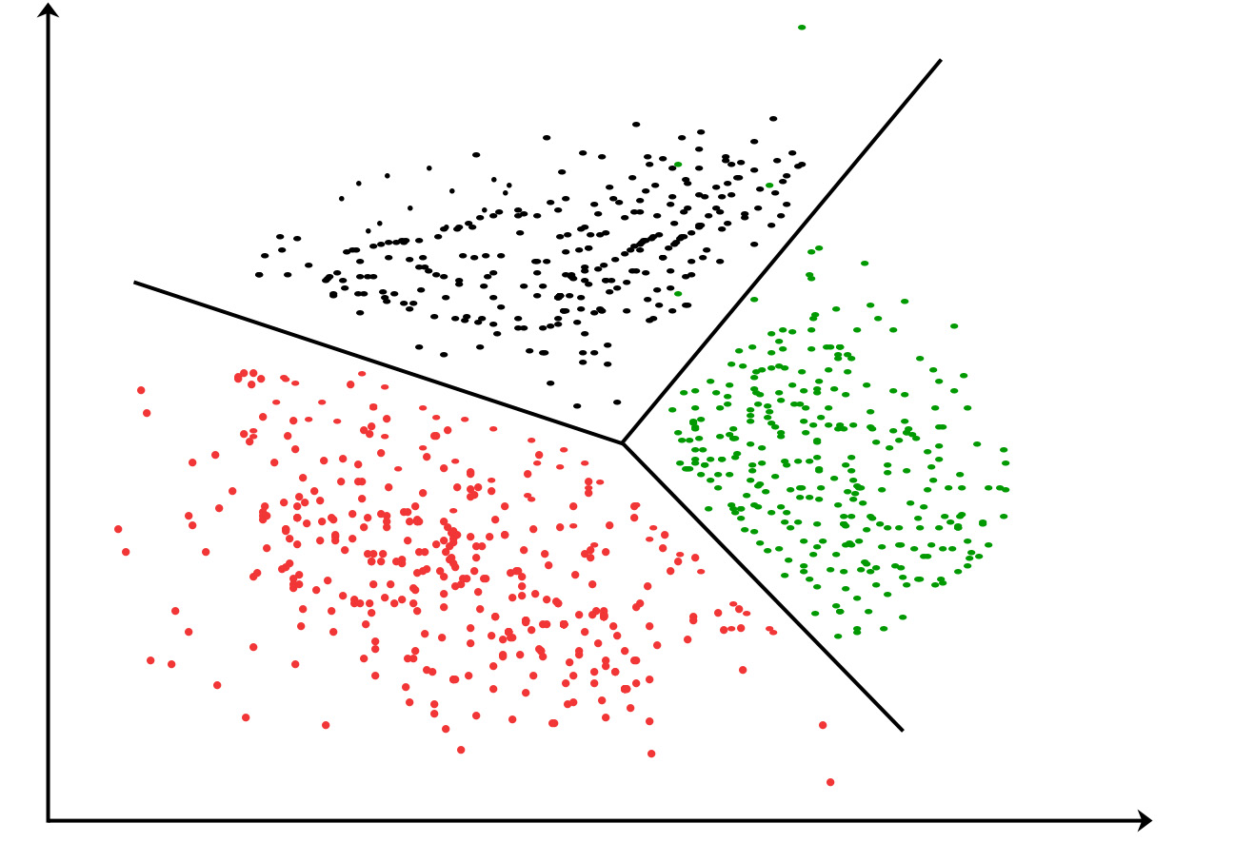
Clustering
A clustering problem is where you want to discover the inherent groupings in the data, such as grouping customers by purchasing behavior.
Applications of Clustering in different fields
Marketing: It can be used to characterize & discover customer segments for marketing purposes.
Biology: It can be used for classification among different species of plants and animals.
Libraries: It is used in clustering different books on the basis of topics and information.
Insurance: It is used to acknowledge the customers, their policies and identifying the frauds.

Slide 12
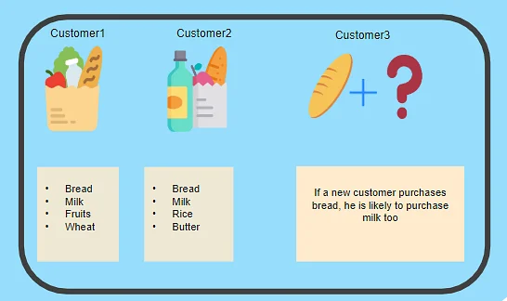
Association
An association rule learning problem is where you want to discover rules that describe large portions of your data, such as people that buy X also tend to buy Y.
A typical example is a Market Based Analysis.
It allows retailers to identify relationships between the items that people buy together frequently.

