Slide 1
Statistics for Machine Learning

Slide 2

Basic concepts in statistics for Machine learning
What Is Statistics?
Statistics is a branch of mathematics that deals with collecting, analysing, interpreting, and visualizing data.
Use of Statistics in Machine Learning
Asking questions about the data
Cleaning and preprocessing the data
Model evaluation
Model prediction
With this basic understanding, it’s time to dive deep into learning all the crucial concepts related to statistics for machine learning.

Slide 3
Random Variable
A random variable is a set of all the possible values from a random experiment
Population:
In statistics, the population comprises all observations (data points) about the subject under study.
An example of a population is studying the voters in an election.
In the 2019 Lok Sabha elections, nearly 900 million voters were eligible to vote in 543 constituencies.
Sample:
In statistics, a sample is a subset of the population. It is a small portion of the total observed population.
An example of a sample is analysing the first-time voters for an opinion poll.
Parameter:
When we perform some arithmetic operation (statistical calculation) on the population then this value is known as the parameter
Statistic:
When we perform some arithmetic operation (statistical calculation) on the sample then this value is known as the statistic.
Sampling Error:
sampling error is the difference between a population parameter and a sample statistic.

Slide 4
Why do I need a sample?
  Inaccessibility: The data is not easily accessible (the data cannot be collected easily).
  Computational Limitation: The data is in very large quantity, and it is not efficient for us to work directly on it.
How are samples created / Ways of creating a sample?
  Random Sampling: collecting the values from the population without any further condition or bias.
  Stratified Sampling: 100 randomly: Collecting the values from the population while considering underlying conditions that are present in the population.
  Cluster Sampling: Collecting the values from the population by grouping the geographical area and then from each of this divided area we are collecting random/stratified samples. (Exit Polls, TRP Evaluation)
  Convenience Sampling: We don’t go after the subject and simply provide them with a platform where to provide their response(data).

Slide 5
Numerical / Quantitative Data
I. Discrete Numerical variables
II. Continuous Numeric variable
Categorical / Qualitative Data
I. Ordinal Variables
II. Nominal Variables
Data : A data is a collection of responses or observations from a sample or entire population

Slide 6
TYPES OF STATISTICS
Descriptive statistics and inferential statistics are the two major areas of statistics.
I) Descriptive statistics
Descriptive statistics is understanding, analyzing, summarizing the data in form of numbers and graphs. We analyze the data using different plots and charts on different kinds of data(numerical and categorical) like bar plot, pie chart, scatter plot, Histogram, etc. All the kind of interpretation, visualizing is part of descriptive statistics.
II) Inferential statistics
We are extracting some sample of data from population data, and from that sample of data, we are inferencing something(driving conclusion) for population data. It means we perform some tests on sample data and make a conclusion specific to that population.

Slide 7
Descriptive statistics
  Descriptive statistics summarize and organize characteristics of a data set. It is a way of measuring your data so that it can be easily described.
Measures of descriptive statistics
    Measure of FREQUENCY
    Measure of CENTRAL TENDENCY
    Measure of DISPERSION / VARIABILITY
    Measure of SHAPE
Research example :
You want to study the popularity of different leisure activities by gender. You distribute a survey and ask participants how many times they did each of the following in the past year:
Go to a library
Watch a movie at a theatre
Visit a national park
Your data set is the collection of responses to the survey. Now you can use descriptive statistics to find out the overall frequency of each activity (distribution), the averages for each activity (central tendency), and the spread of responses for each activity (variability).

Slide 8
Measure of Frequency: The distribution concerns the frequency of each value
Simple frequency distribution table
For the variable of gender, you list all possible answers on the left-hand column. You count the number or percentage of responses for each answer and display it on the right-hand column.
From this table, you can see that more women than men or people with another gender identity took part in the study.
Gender | Number
Male | 182
Female | 235
Other | 27
Grouped frequency distribution table
In a grouped frequency distribution, you can group numerical response values and add up the number of responses for each group. You can also convert each of these numbers to percentages
From this table, you can see that most people visited the library between 5 and 16 times in the past year.
Library visits in the past year | Percent
0–4 | 6%
5–8 | 20%
9–12 | 42%
13–16 | 24%
17+ | 8%

Slide 9
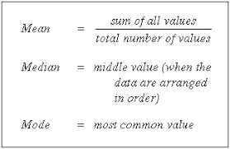
Measures of Central Tendency - It estimates the center of a data set.
3 ways of finding the center location of data
Mean
Median
Mode
Here we will demonstrate how to calculate the mean, median, and mode using the first 6 responses of our survey.
number of library visits:
15
3
12
0
24
3
Mean : 9.5
Median : 7.5
Mode: 3

Slide 10
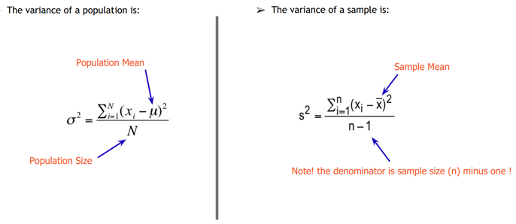
Measures of variability
Measures of variability give you a sense of how spread out the response values are. The range, standard deviation and variance each reflect different aspects of spread.
Range
The range gives you an idea of how far apart the most extreme response scores are. To find the range, simply subtract the lowest value from the highest value.
Range of visits to the library in the past year
Variance
The variance is the average of squared deviations from the mean. Variance reflects the degree of spread in the data set. The more spread the data, the larger the variance is in relation to the mean.
Standard deviation
The standard deviation (s) is the average amount of variability in your dataset. It tells you, on average, how far each score lies from the mean. The larger the standard deviation, the more variable the data set is
Inter Quartile Range (Q3-Q1)

Slide 11
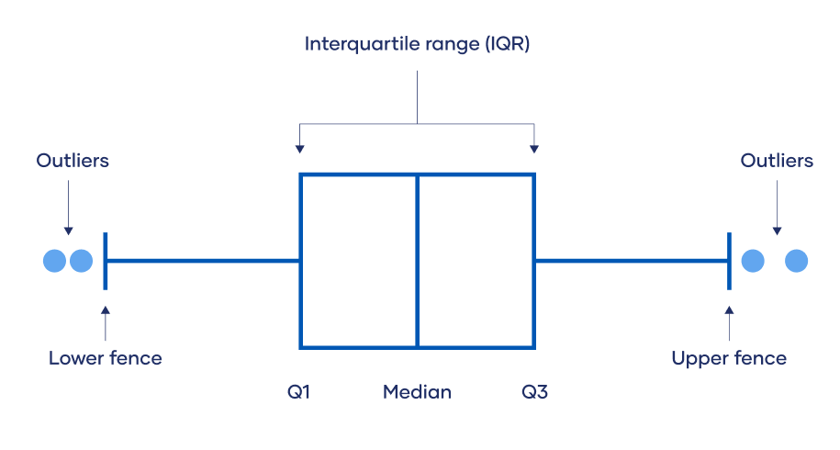
Outliers
Outliers are extreme values that differ from most other data points in a dataset. They can have a big impact on your statistical analyses and skew the results of any hypothesis tests.
There are four ways to identify outliers:
Sorting method
You can sort quantitative variables from low to high and scan for extremely low or extremely high values. Flag any extreme values that you find.
Using visualizations
You can use software to visualize your data with a box plot, or a box-and-whisker plot, so you can see the data distribution at a glance
Statistical outlier detection
Statistical outlier detection involves applying statistical tests or procedures to identify extreme values. We can convert extreme data points into z scores (x-mean/standard deviation) that tell you how many standard deviations away they are from the mean. Values with a z score greater than 3 or less than –3 are often determined to be outliers
Interquartile range method
    Sort your data from low to high
    Identify the first quartile (Q1), the median, and the third quartile (Q3).
    Calculate your IQR = Q3 – Q1
    Calculate your upper fence = Q3 + (1.5 * IQR)
    Calculate your lower fence = Q1 – (1.5 * IQR)
    Use your fences to highlight any outliers, all values that fall outside your fences.
    Outliers are any values greater than your upper fence or less than your lower fence

Slide 12
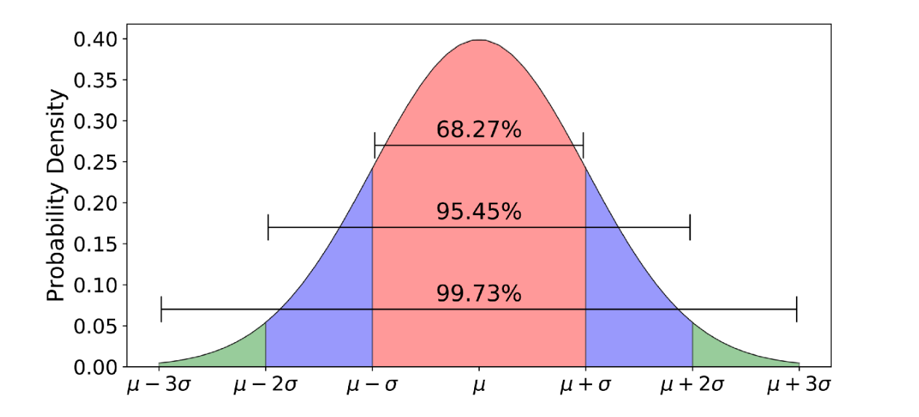
Measure of Shape
All different shapes can be divided into two major categories
Symmetrical
When we divide the data from the middle then we have equal amount of data on both the sides i.e., two sides of the distribution are a mirror image of each other
For example, Gaussian (aka Normal) distribution
Rectangular Distribution
Normal (Gaussian) distribution
  It is known to have a bell-shaped curve.
  This distribution is observed when the mean of the data is same as the median and it is same as the mode i.e., mean=median=mode
  Most of the data are clustered around the centre, About 68% of values lie within one standard deviation (σ) away from the mean; about 95% of the values lie within two standard deviations; and about 99.7% are within three standard deviations. This is known as the empirical rule or the 3-sigma rule
  Given a sufficiently large sample size, the sampling distribution of the mean for a variable will approximate a normal distribution regardless of that variable’s distribution in the population. This is known as Central limit theorem
Asymmetrical
When we divide the data from the middle then we have do not have equal amount of data on both the sides. Asymmetry is conceptualized through the concept of skewness
Skewness is the tendency for the values to be more frequent around the high or low ends of the x-axis.

Slide 13
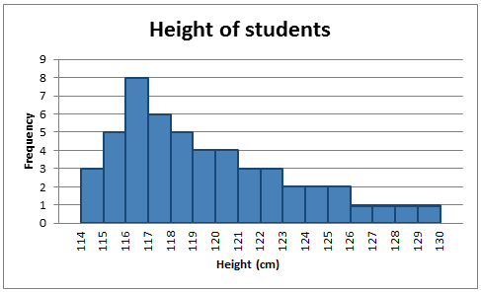
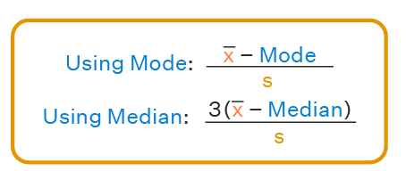
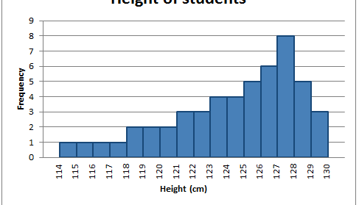
A distribution is said to be positively skewed (right skewed) when the tail on the right side of the histogram is longer than the left side. Most of the values tend to cluster toward the left side of the x-axis
A distribution is said to be negatively skewed (left skewed)when the tail on the left side of the histogram is longer than the right side. Most of the values tend to cluster toward the right side of the x-axis
Key features of the skewed distribution:
asymmetrical shape
mean and median have different values and do not all lie at the centre of the curve
there can be more than one mode
the distribution of the data tends towards the high or low end of the dataset

Slide 14
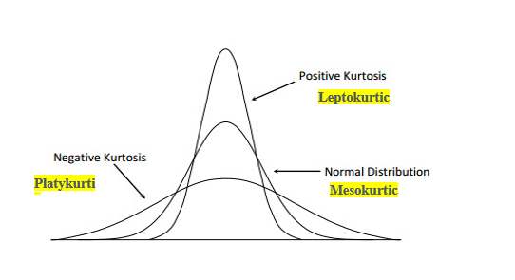
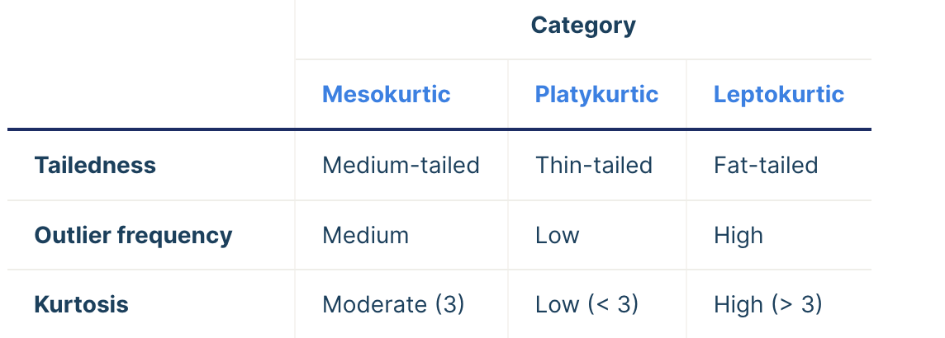
    The other common measure of shape is called the kurtosis.
    Kurtosis deals with the height of the data
    We have 3 types of kurtosis
    +ve kurtosis (Leptokurtic)
    We have an abnormally high peak (too much values of central tendency)
    -ve kurtosis (Platykurtic)
    We have an no peak i.e., it is like a plateau(no distinctive central tendency)
    Zero kurtosis (Mesokurtic)
    It is same as the normal distribution, neither high or flat peak.
    Bi-modal or Multi-Modal
    This is the case when we have more than one mode in the data
    We have wave shaped distribution commonly associated with multi-modal data

Slide 15
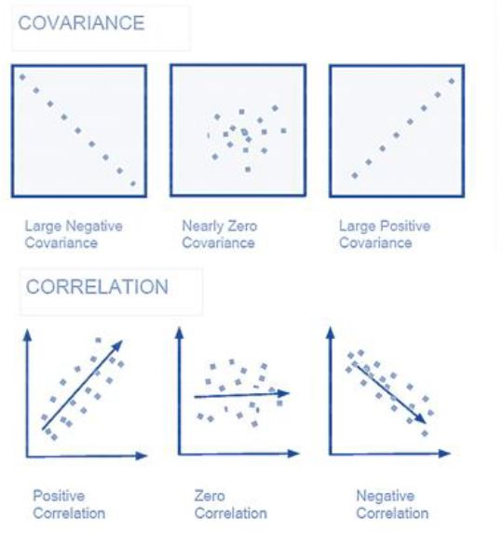

Measures of Association between Variables
We will now consider the two measures that can be
used to measure the relationship between two variables
Covariance
Correlation coefficient
If the covariance and correlation values are positive, this indicates that the two variables are positively related. In other words, when one increases, the other one generally also increases.
On the other hand, if the covariance and correlation values are negative, this indicates that the two variables are negatively related. That is, when one increases, the other will typically decrease.
Covariance and correlation values of 0 indicate that the two variables are unrelated (at least in a linear sense)
Correlation coefficient is always between -1 and 1. The closer |r| (the absolute value of r) is to 1, the stronger the linear relationship between the two variables.

Slide 16
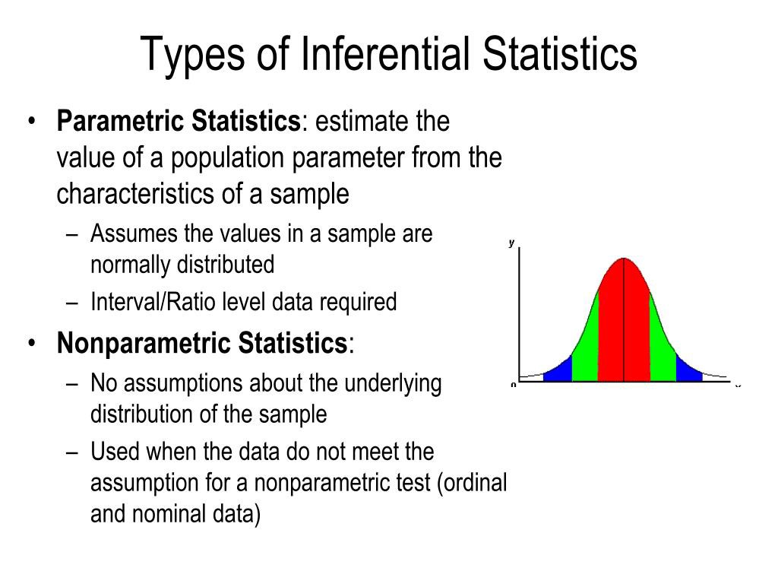
INFERENTIAL STATISTICS
Inferential statistics is a branch of statistics that makes the use of various analytical tools to draw inferences about the population data from sample data

Slide 17
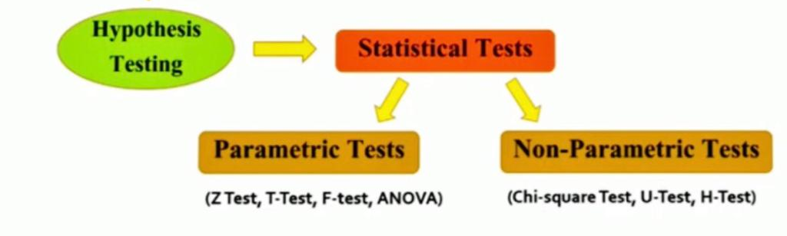
Hypothesis testing
Hypothesis testing is a type of inferential statistics that is used to test assumptions and draw conclusions about the population from the available sample data.
Null hypothesis (H0): There’s no effect in the population.
Alternative hypothesis (Ha or H1): There’s an effect in the population
Test Statistic
The test statistic is a number calculated from a statistical test of a hypothesis. It describes how far your observed data is from the null hypothesis of no relationship between variables
Critical Value
A critical value is the point on the scale of the test statistic beyond which we reject the null hypothesis
What is P value ?
The p-value, or probability value, tells you how likely it is that your data could have occurred under the null hypothesis.
It does this by calculating the likelihood of your test statistic, which is the number calculated by a statistical test using your data
What is Statistical significance level( alpha) ?
The level of significance is the measurement of the statistical significance. It defines whether the null hypothesis is assumed
to be accepted or rejected.
Notes:
In Statistics, “significance” means “not by chance” or “probably true
E.g.: If you use an alpha value (0.05) of p < 0.05 for statistical significance, then your confidence level would be 1 − 0.05 = 0.95, or 95%.

Slide 18
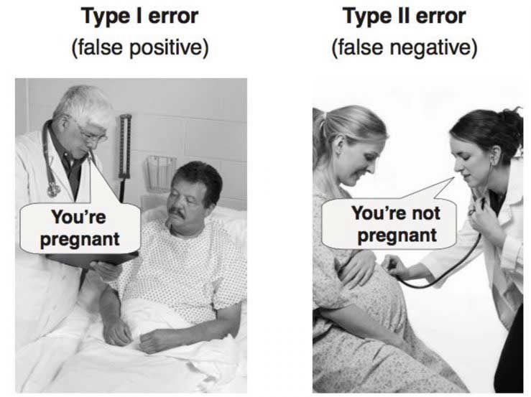
Type I (also known as ‘α’) and Type II (also known as ‘β’) errors
A type I error (false-positive) occurs if an investigator rejects a null hypothesis that is actually true in the population;
A type II error (false-negative) occurs if an investigator fails to reject a null hypothesis that is actually false in the population.
Notes:
Your desired confidence level is usually one minus the alpha (a) value you used in your statistical test
The term significance level (alpha) is used to refer to a pre-chosen probability and the term "P value" is used to indicate a probability that you calculate after a given study.

Slide 19
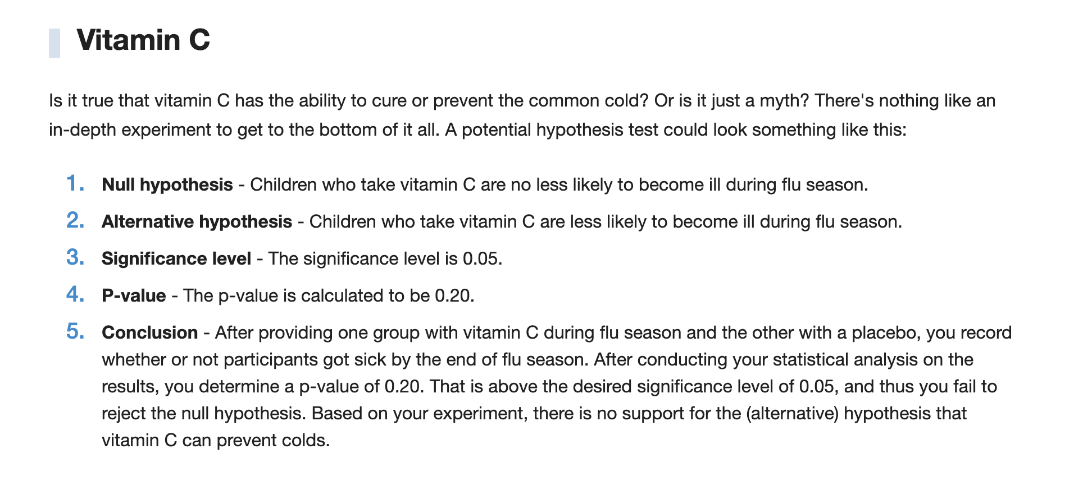

Slide 20
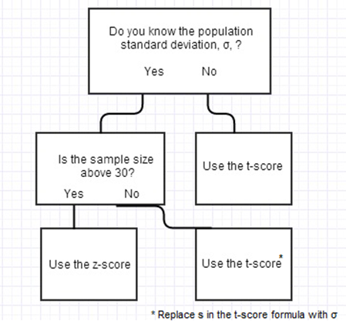
Parametric statistics
Parametric statistics is based on assumptions about the distribution of
population from which the sample was taken
Parametric statistical tests are those statistical tests that
assume the data approximately follows a normal
distribution, amongst other assumptions
(examples include z-test, t-test etc.)
Notes:
Your desired confidence level is usually one minus the alpha (a) value you used in your statistical test. Parametric tests are those that make assumptions about the parameters of the population distribution from which the sample is drawn
The term significance level (alpha) is used to refer to a pre-chosen probability and the term "P value" is used to indicate a probability that you calculate after a given study.

Slide 21
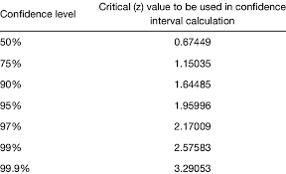
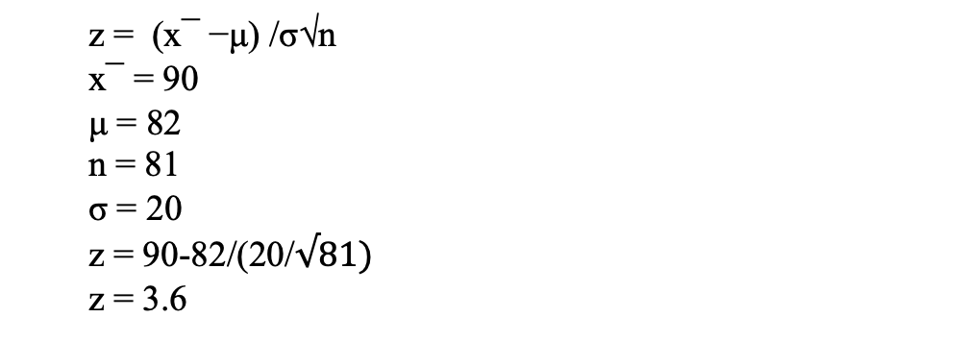
Z Test: Z test is used on data that follows a normal distribution and has a sample size greater than or equal to 30. It is used to test if the means of the sample and population are equal when the population variance is known. The right tailed hypothesis can be set up as follows:
Null Hypothesis: H0 : μ=μ0
Alternate Hypothesis: H1 : μ>μ0
Test Statistic: z = (x¯ −μ) /σ√n
Decision Criteria: If the z statistic > z critical value then reject the null hypothesis
Example 1: A teacher claims that the mean score of students in his class is greater than 82 with a standard deviation of 20. If a sample of 81 students was selected with a mean score of 90 then check if there is enough evidence to support this claim at a 0.05 significance level.
Solution: As the sample size is 81 and population standard deviation is known, this is an example of a right-tailed one-sample z test.
H0 : μ=82
H1 : μ>82
From the z table the critical value at α = 1.96
As 3.6 > 1.96 thus, the null hypothesis is rejected, and it is concluded that there is enough evidence to support the teacher's claim.
Answer: Reject the null hypothesis
  z = (x¯ −μ) /σ√n
  x¯ = 90
  μ = 82
  n = 81
  σ = 20
  z = 90-82/(20/$√81)$
  z = 3.6
α = 0.05
Then confidence level = 1- α = 1-0.05 = 0.95
Notes:
Left-tailed z-test: p-value = Φ(Z_{score})
Right-tailed z-test: p-value = 1 - Φ(Z_{score})
Two-tailed z-test: p-value = 2 * Φ(−|Z_{score}|) or. p-value = 2 - 2 * Φ(|Z_{score}|)

Slide 22
T Test: t test is used when the sample size is lesser than 30. It is used to compare the sample and population mean when the population variance is unknown. The hypothesis test for inferential statistics is given as follows:
Null Hypothesis: H0 : μ=μ0
Alternate Hypothesis: H1 : μ>μ0
Test Statistic: t = (x¯ −μ) /s√n
Decision Criteria: If the t statistic > t critical value then reject the null hypothesis.
Non-Parametric Statistics
Non-Parametric Statistics doesn’t assume anything about the population parameters. Nonparametric tests include chi-square, Fisher’s exact test and the Mann-Whitney test
Chi Square Test -(Non-Parametric Test)
When we have two categorical variables, and we want to check if they are related with each other or not.

