Slide 1



How should we define Information Flow in Neural Circuits?
Praveen Venkatesh, Sanghamitra Dutta and Pulkit Grover
Dept. of Electrical & Computer Engineering Carnegie Mellon University
“Information Flow in Computational Systems” arXiv:1902.02292 [cs.IT] (under review)
(https://praveenv253.github.io/publications)

Slide 2
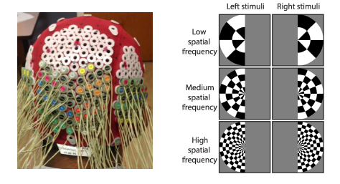
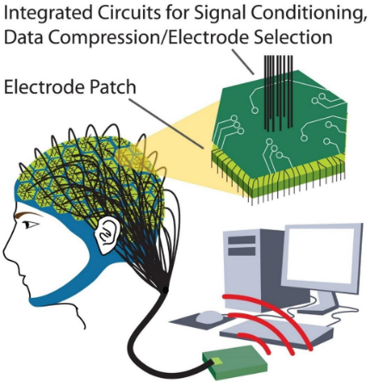
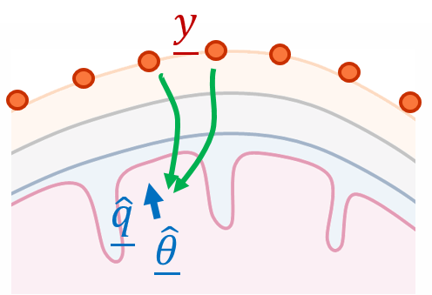
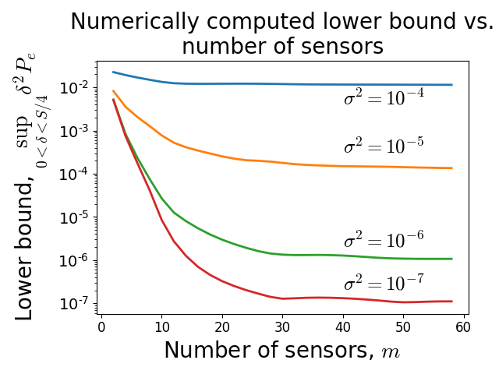

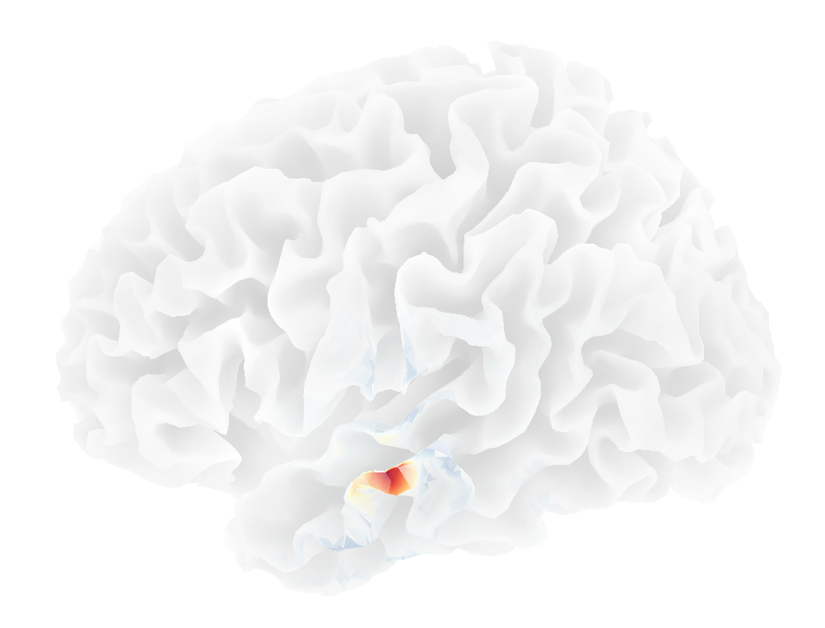
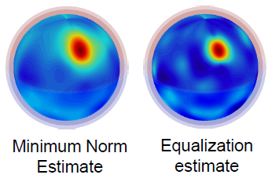
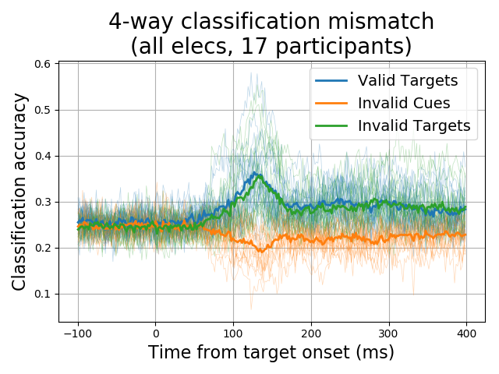
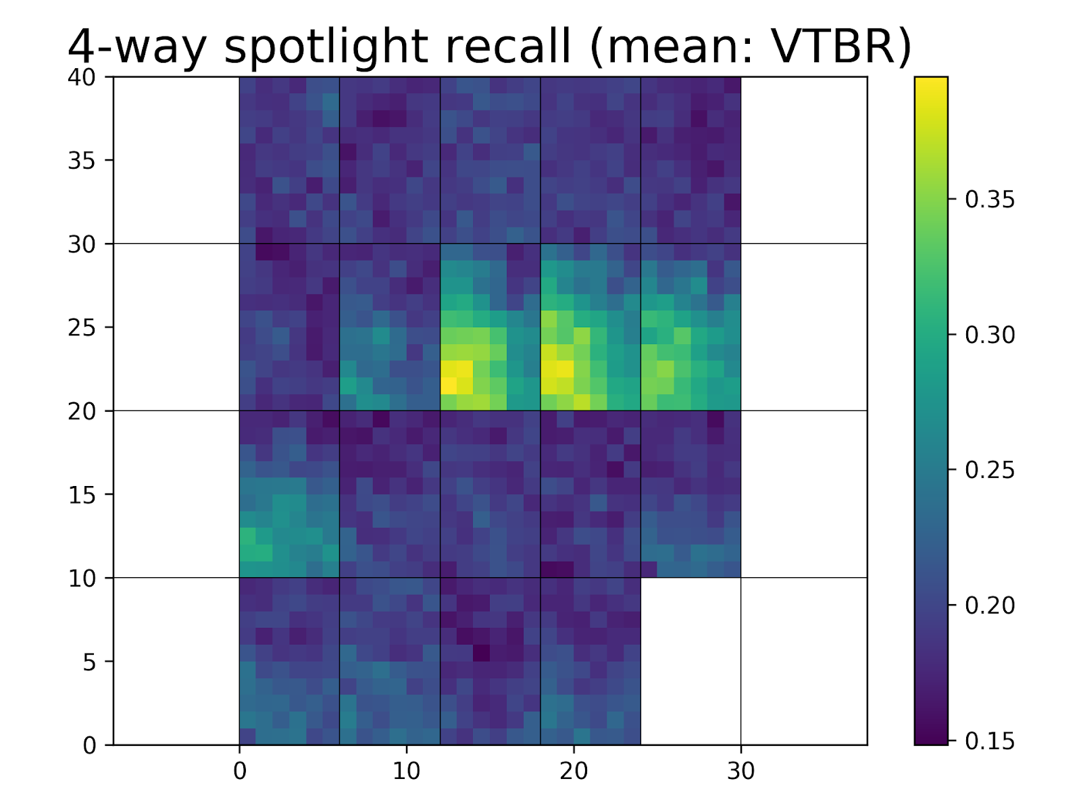
High-density EEG
Source Localization: Fundamental Limits and Algorithms
(Robinson et al., Sci. Rep. 2017)
Experimental design & Data analysis
(Venkatesh and Grover, ISIT 2017)
(ongoing)

Slide 3
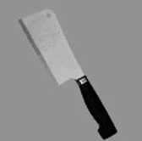
A Typical Neuroscientific Experiment
Region C
Region B
Info “flows” between brain regions
Info is usually about a stimulus
There could be feedback
Region A
(Almeida et al., Cortex, 2013)
“Stimulus”
Goal: Find a definition for information flow, so that we can track info paths

Slide 4
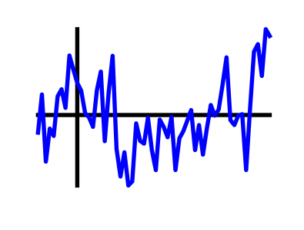
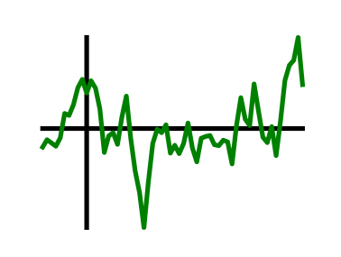




Prior Approaches to Information Flow
“Functional Connectivity”
Granger Causality (Granger, 1969; Bressler & Seth, 2011)
Transfer Entropy (Schreiber, 2000)
Directed Information (Massey, 1990; Quinn et al., 2011)
How do you get Information Flow from Granger Causality?
$$GC_{A→B}$$
A
B
$$GC_{B→A}$$
$$?$$
$$GC_{A→B}>GC_{B→A}$$

Slide 5






A Counterexample to Granger Causality
Direction of greater Granger causal influence = Direction of info flow?
A counterexample based on the Schalkwijk & Kailath feedback scheme (1966)
Message
Error in estimate
$$Z_{i} \sim N(0, σ^{2})$$
A
B
$$X_{i}$$
$$Y_{i}$$
$$M$$
$$M$$
A
+
B
Greater GC-influence
$${\hat{M}}_{i}$$
Best estimate
“Is the direction of greater Granger causal influence the same as the direction of information flow?” (Venkatesh & Grover, Allerton 2015; SfN 2015)

Slide 6
Why does Granger Causality fail?
Direction of greater GC-influence = Direction of info flow?
No!
Fundamental difficulty
GC influence is trying to be an estimator for information flow
But information flow is not formally defined
Philosophy
Let’s define information flow first, then estimate it
Use counterexamples to arrive at a definition for information flow

Slide 7



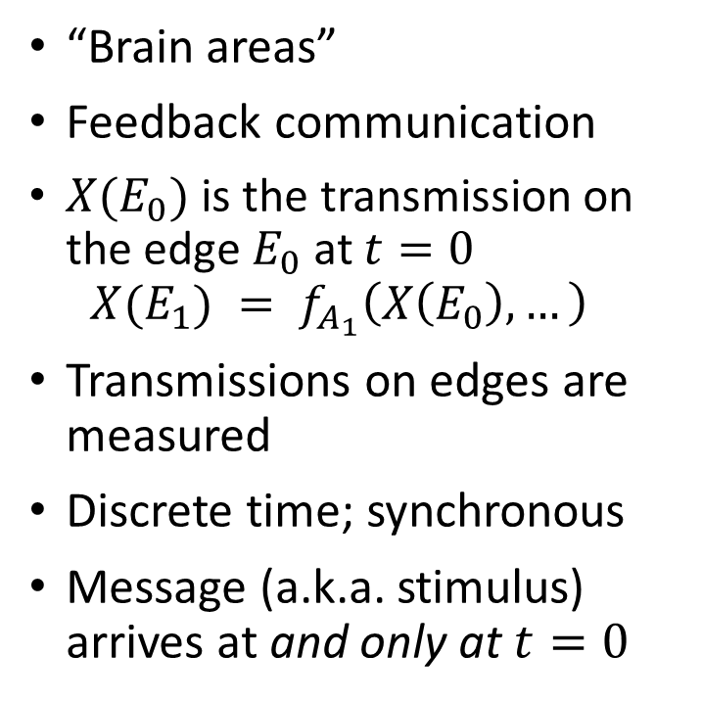



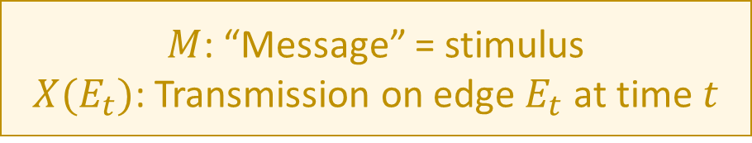


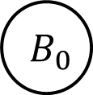


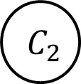



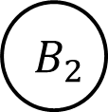
A Computational Model of the Brain
“Brain areas”
Feedback communication
$X(E_{0})$ is the transmission on the edge $E_{0}$at $t=0$ $X(E_{1}) = f_{A_{1}}\left(X\left(E_{0}\right), …\right)$
Transmissions on edges are measured
Discrete time; synchronous
Message (a.k.a. stimulus) arrives at and only at $t=0$
$$t=0$$
$$t=1$$
$$t=2$$
$$M$$
$$A_{0}$$
$$X(E_{0})$$
$$A_{1}$$
$$X(E_{1})$$
$$A_{2}$$
$$B_{0}$$
$$B_{1}$$
$$B_{2}$$
$$C_{0}$$
$$C_{1}$$
$$C_{2}$$
$$f(M)$$
(Thompson, 1980: VLSI) (Ahlswede et al., 2000: Network Info Theory) (Peters et al., 2016: Causality)
$M$: “Message” = stimulus
$X(E_{t})$: Transmission on edge $E_{t}$ at time $t$

Slide 8



A Computational Model of the Brain
“Brain areas”
Feedback communication
$X(E_{0})$ is the transmission on the edge $E_{0}$at $t=0$ $X(E_{1}) = f_{A_{1}}\left(X\left(E_{0}\right), …\right)$
Transmissions on edges are measured
Discrete time; synchronous
Message (a.k.a. stimulus) arrives at and only at $t=0$
$$t=0$$
$$t=1$$
$$t=2$$
$$M$$
$$A_{0}$$
$$X(E_{0})$$
$$A_{1}$$
$$X(E_{1})$$
$$A_{2}$$
$$B_{0}$$
$$B_{1}$$
$$B_{2}$$
$$C_{0}$$
$$C_{1}$$
$$C_{2}$$
$$f(M)$$
(Thompson, 1980: VLSI) (Ahlswede et al., 2000: Network Info Theory) (Peters et al., 2016: Causality)
Goal: Define info flow + track info path

Slide 9
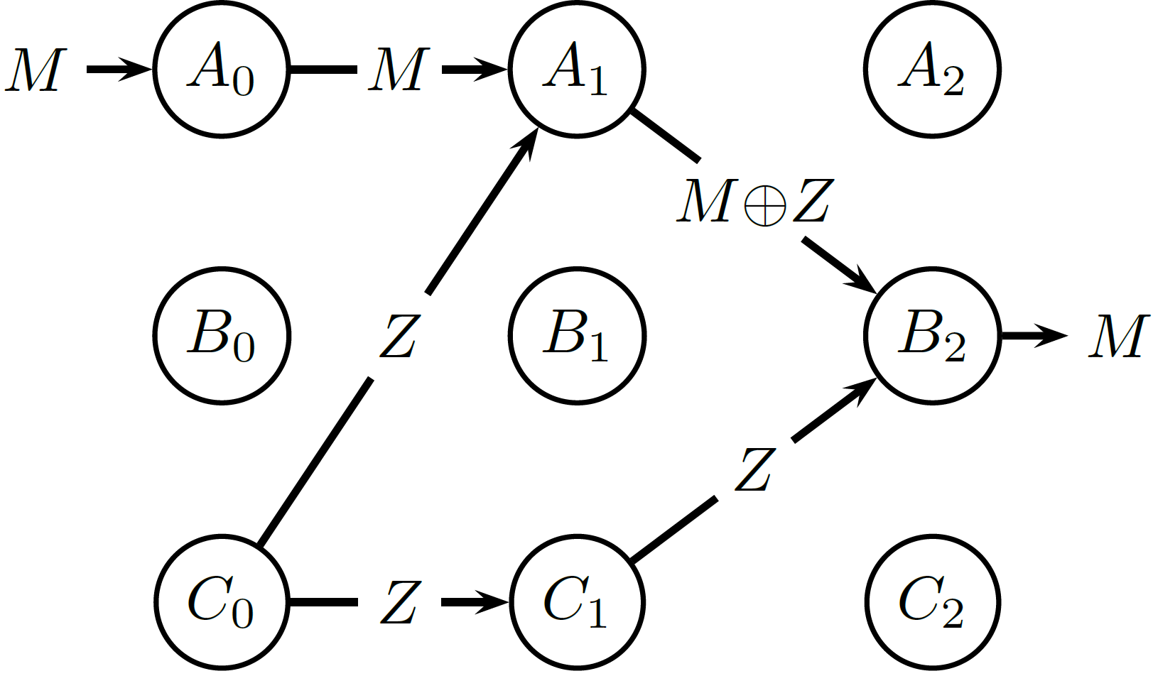
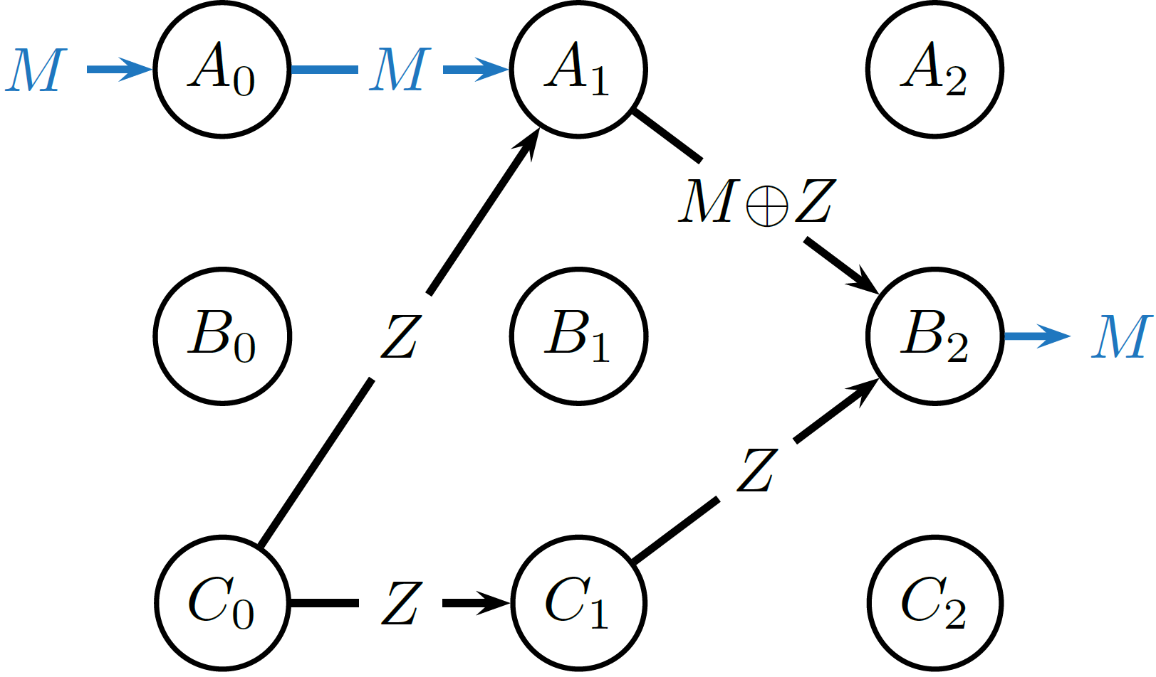




How do we define Information Flow?
1
2
3
Candidate definition 1: Dependence
Information flows on an edge $E_{t}$ if $I\left(M;X\left(E_{t}\right)\right)>0.$
✓
$$M, Z \sim iid Ber(1/2)$$
$$M⊕Z=M xor Z$$
$$I\left(M;M⊕Z\right)=0$$
(Schneidman, Bialek & Berry, 2003: Synergy in Neuroscience)
(Bertschinger et al., 2014: Partial Information Decomposition)

Slide 10
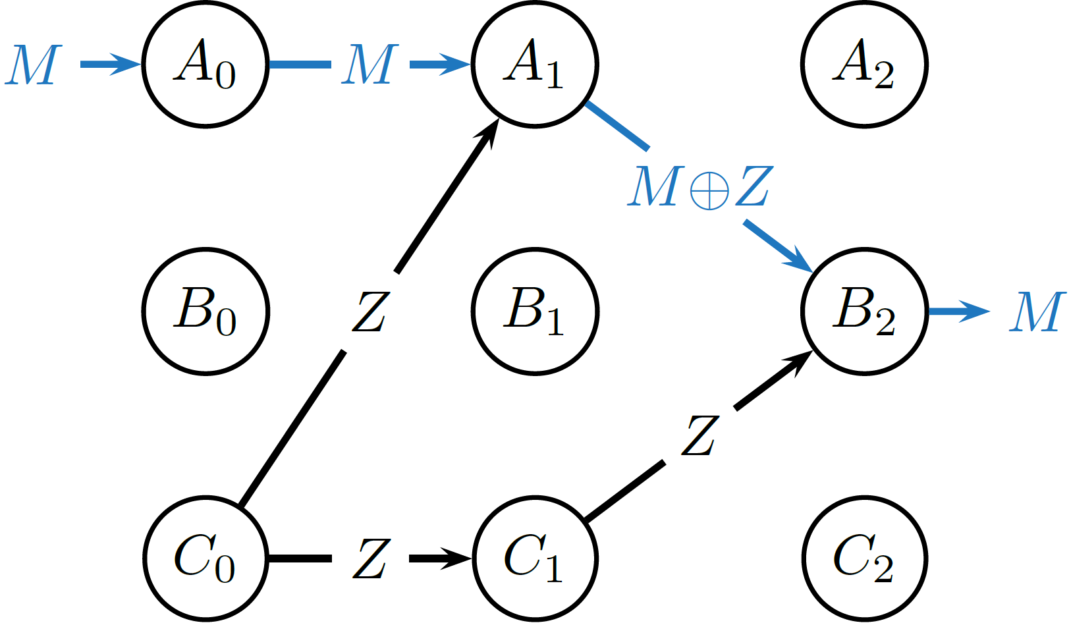

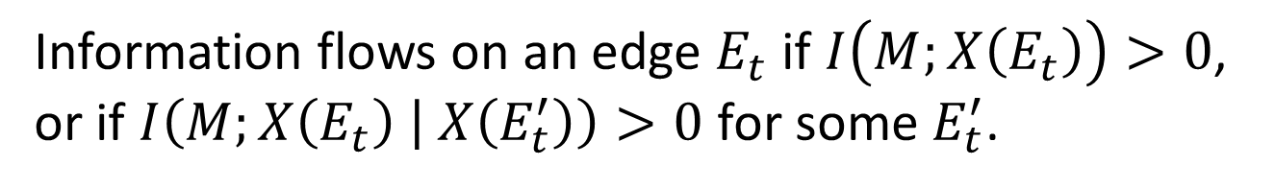
How do we define information flow?
1
2
Candidate definition 2: Condition on one edge
3
Information flows on an edge $E_{t}$ if $I\left(M;X\left(E_{t}\right)\right)>0$, or if $I\left(M;X\left(E_{t}\right) | X\left(E_{t}^{′}\right)\right)>0$ for some $E_{t}^{′}$.
✓
$$I\left(M; M⊕Z | Z\right)>0$$

Slide 11
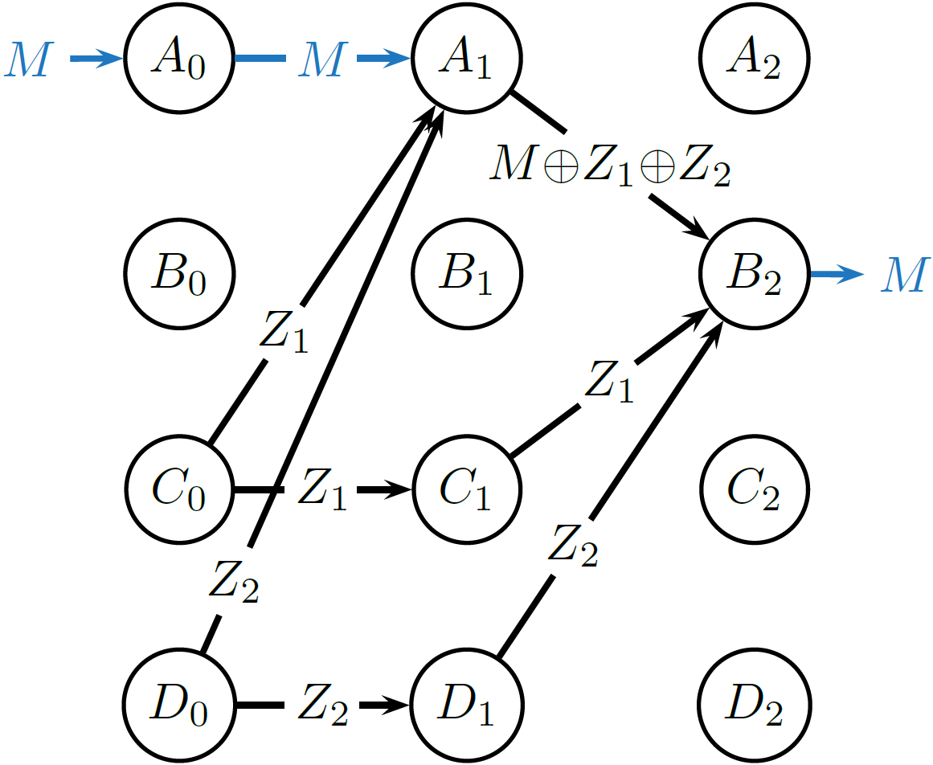


How do we define information flow?
1
2
Candidate definition 2: Condition on one edge
3
Information flows on an edge $E_{t}$ if $I\left(M;X\left(E_{t}\right)\right)>0$, or if $I\left(M;X\left(E_{t}\right) | X\left(E_{t}^{′}\right)\right)>0$ for some $E_{t}^{′}$.
✓
$$I\left(M; M⊕Z_{1}⊕Z_{2} | Z_{1}\right)=0$$
$$I\left(M; M⊕Z_{1}⊕Z_{2} | Z_{2}\right)=0$$

Slide 12
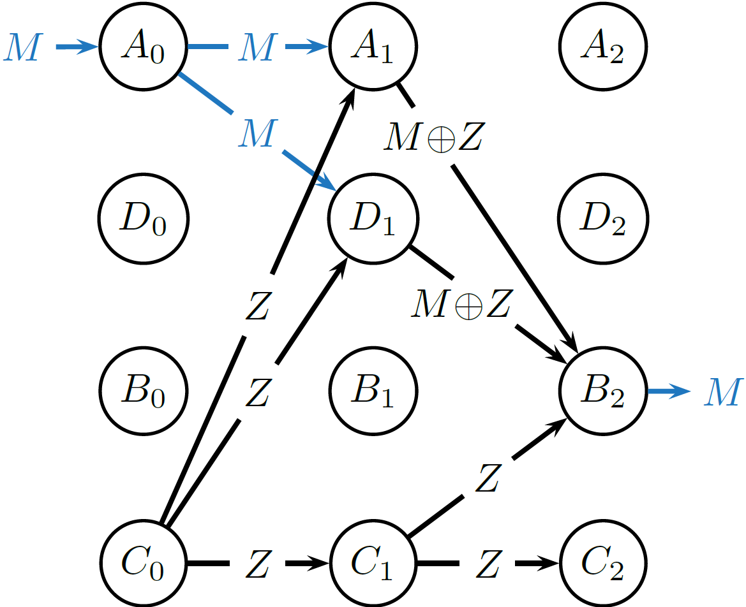
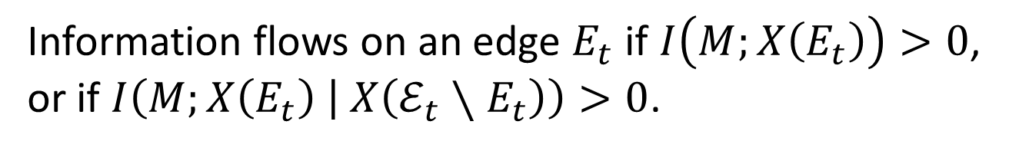

How do we define information flow?
1
2
Candidate definition 3: Condition on all other edges
3
Information flows on an edge $E_{t}$ if $I\left(M;X\left(E_{t}\right)\right)>0$, or if $I\left(M;X\left(E_{t}\right) | X\left(ℰ_{t}∖E_{t}\right)\right)>0$.
✓
$$I\left(M; M\text{⊕}Z | M⊕Z, Z\right)=0$$

Slide 13
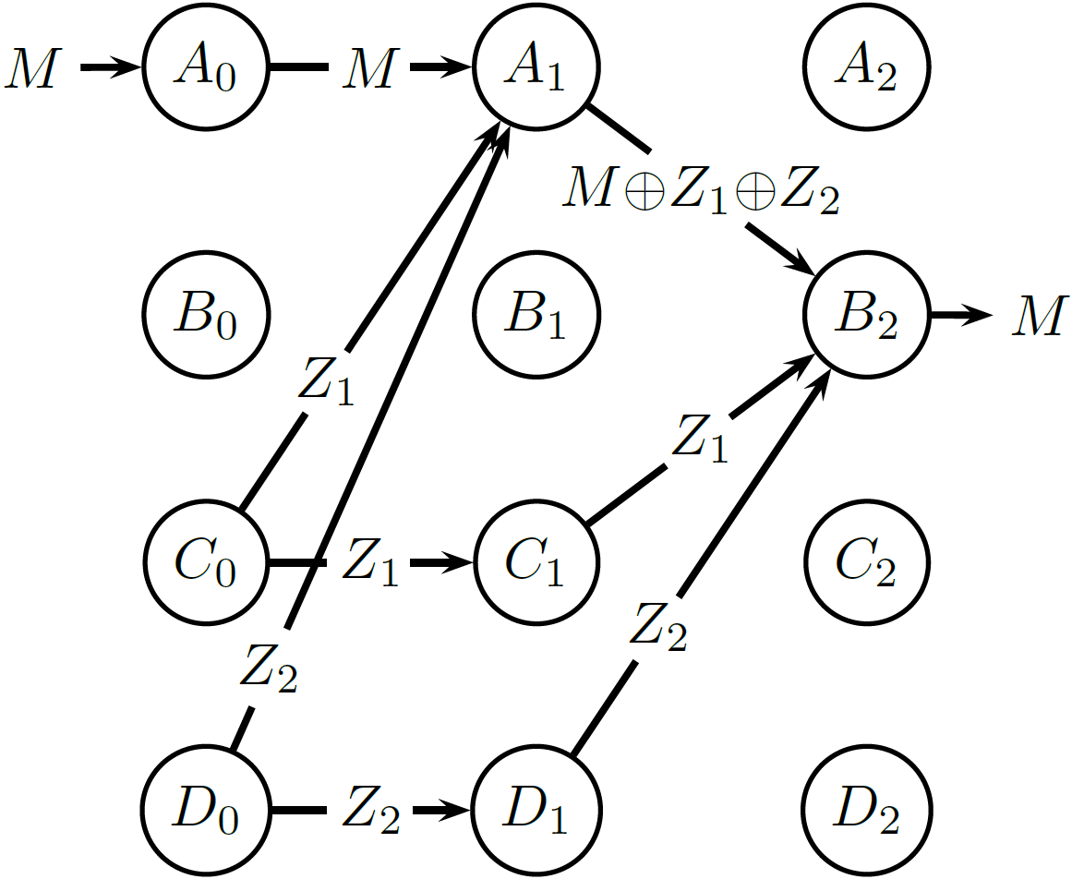
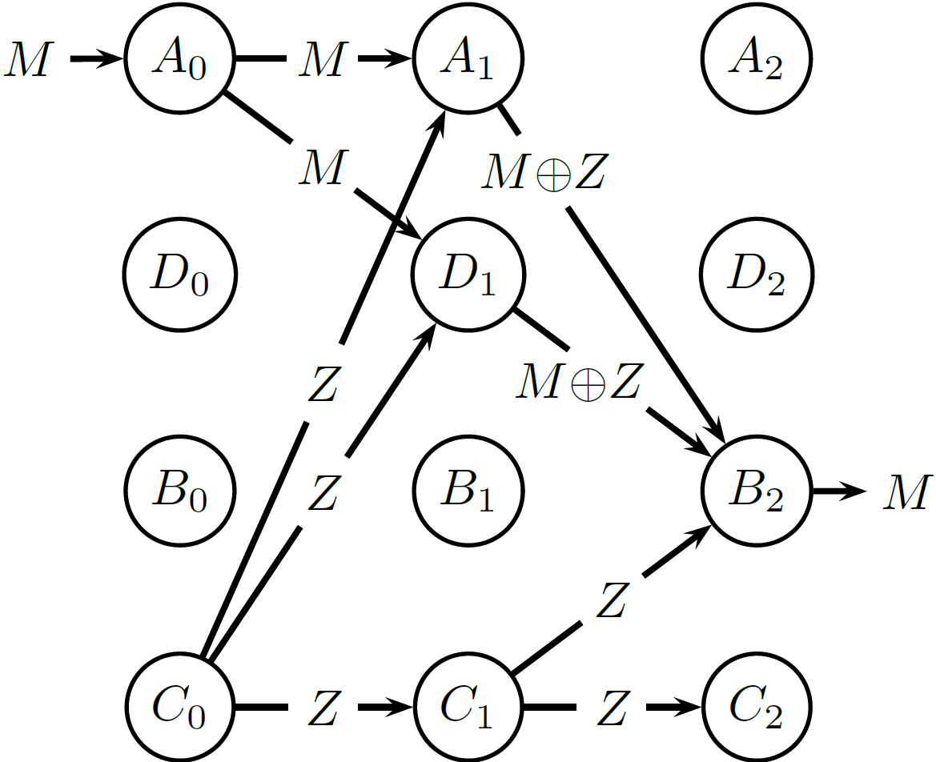
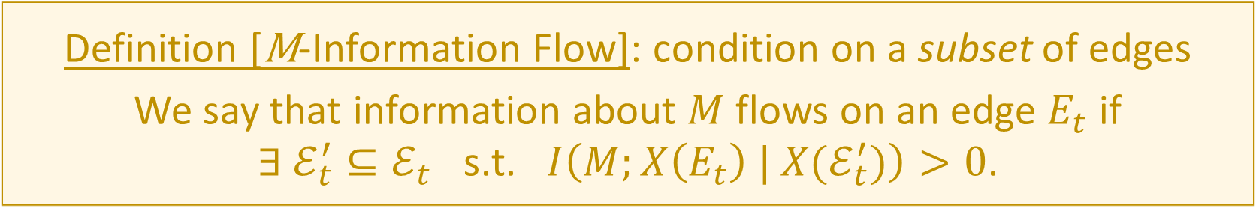
How do we define information flow?
1
2
Definition [M-Information Flow]: condition on a subset of edges
We say that information about $M$ flows on an edge $E_{t}$ if
$∃ ℰ_{t}^{′}⊆ℰ_{t}$ s.t. $I\left(M;X\left(E_{t}\right) | X(ℰ_{t}^{′})\right)>0$.
3
✓

Slide 14

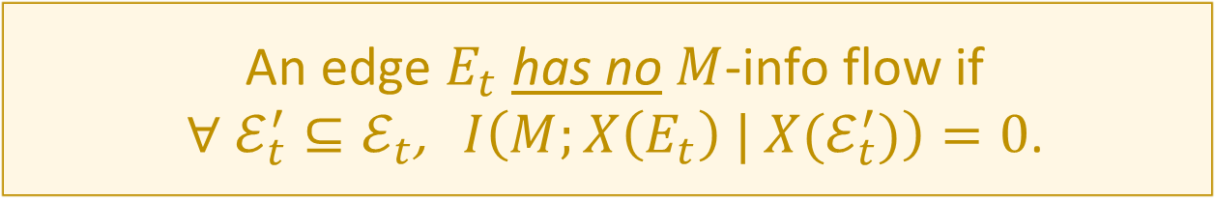
Remarks on the Info Flow Definition
An edge $E_{t}$ has $M$-info flow if $∃ ℰ_{t}^{′}⊆ℰ_{t}$ s.t. $I\left(M;X\left(E_{t}\right) | X(ℰ_{t}^{′})\right)>0$.
An edge $E_{t}$ has no $M$-info flow if $∀ ℰ_{t}^{′}⊆ℰ_{t}$, $I\left(M;X\left(E_{t}\right) | X(ℰ_{t}^{′})\right)=0$.
Condition on the empty set:
No $M$-info flow $⇒$ $I\left(M;X\left(E_{t}\right)\right)=0$ $⇒$ No dependence on $M$

Slide 15
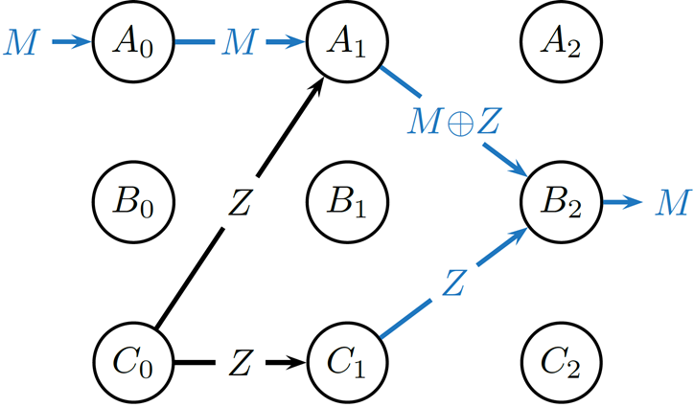


Remarks on the Info Flow Definition
An edge $E_{t}$ has $M$-info flow if $∃ ℰ_{t}^{′}⊆ℰ_{t}$ s.t. $I\left(M;X\left(E_{t}\right) | X(ℰ_{t}^{′})\right)>0$.
$M$-info flows out of a node $⇒$ $M$-info flows into the node
$$I\left(M; M⊕Z | Z\right)>0$$
$$I\left(M; Z | M⊕Z\right)>0$$

Slide 16
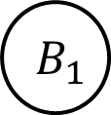



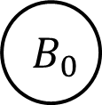


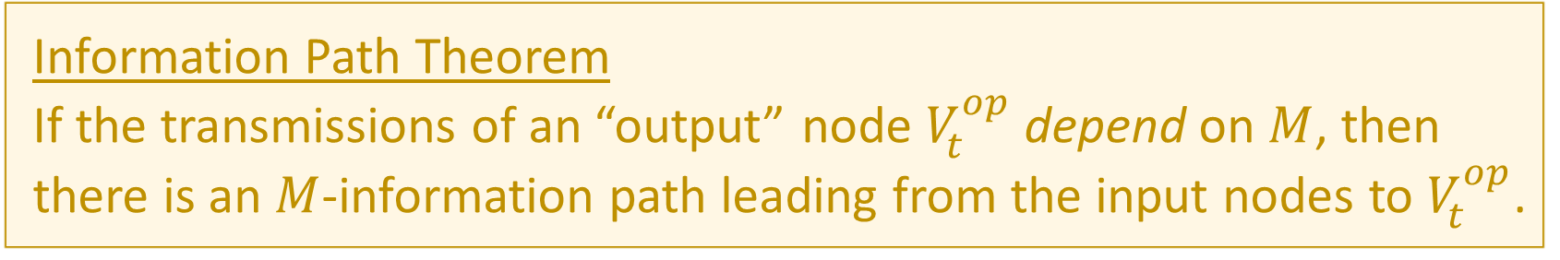







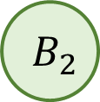

The Existence of Information Paths
Definition [$M$-Information Path]
A path, every edge of which has $M$-information flow
Information Path Theorem
If the transmissions of an “output” node $V_{t}^{op}$ depend on $M$, then there is an $M$-information path leading from the input nodes to $V_{t}^{op}$.
✗
$$V_{0}^{ip}$$
$$M$$
$$A_{0}$$
$$X(E_{0})$$
$$A_{1}$$
$$X(E_{1})$$
$$A_{2}$$
Info flow out $⇒$ Info flow in
$$V_{t}^{op}$$
$$B_{0}$$
$$B_{1}$$
$$B_{2}$$
$$⊥$$
$$⊥$$
$$f\left(M\right) M$$

Slide 17
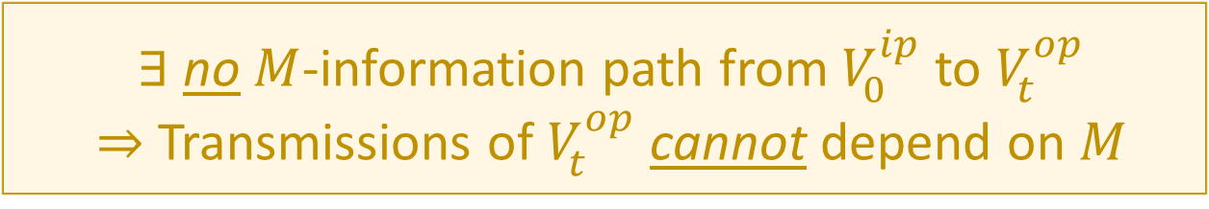
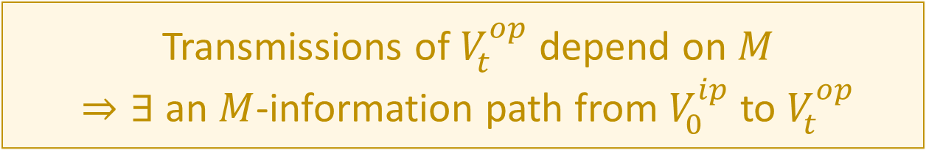
Proving the Info Path theorem
Transmissions of $V_{t}^{op}$ depend on $M$ $⇒∃$ an $M$-information path from $V_{0}^{ip}$to $V_{t}^{op}$
We’ll prove the contrapositive:
$∃$ no $M$-information path from $V_{0}^{ip}$to $V_{t}^{op}$ $⇒$ Transmissions of $V_{t}^{op}$ cannot depend on $M$

Slide 18
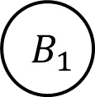


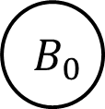
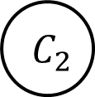

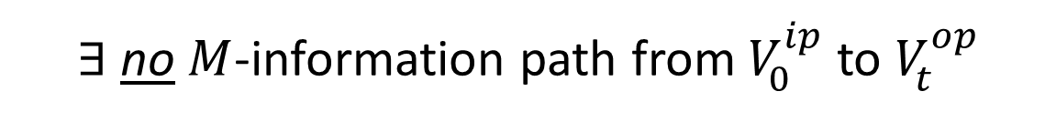







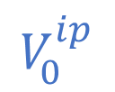



A Proof Sketch through Pictures
$∃$ no $M$-information path from $V_{0}^{ip}$to $V_{t}^{op}$
$$V_{0}^{ip}$$
$$M$$
$$A_{0}$$
$$A_{1}$$
$$A_{2}$$
Zero-$M$-information Cut
Red edges have zero $M$-info flow
$$V_{t}^{op}$$
$$B_{0}$$
$$B_{1}$$
$$B_{2}$$
$$⊥$$
$$⊥$$
$Q M$ (Claim)
$$C_{0}$$
$$C_{1}$$
$$C_{2}$$
$⇒ ∃$ a zero $M$-information cut separating $V_{0}^{ip}$and $V_{t}^{op}$

Slide 19
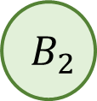

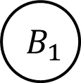



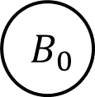
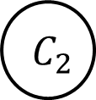





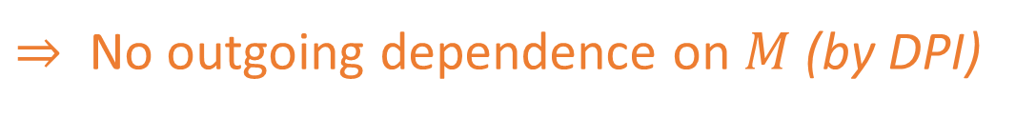
A Proof Sketch through Pictures
$$M$$
$$A_{0}$$
$$A_{1}$$
$$A_{2}$$
Zero-$M$-information Cut
Red edges have zero $M$-info flow
$$B_{0}$$
$$B_{1}$$
$$B_{2}$$
Orange edges are independent of $M$
$$C_{0}$$
$$C_{1}$$
$$C_{2}$$
No $M$-info flow $⇒$ No incoming dependence on $M$
$⇒$ No outgoing dependence on $M$ (by DPI)

Slide 20


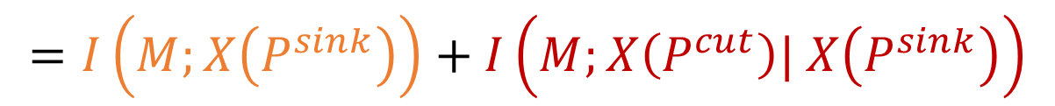

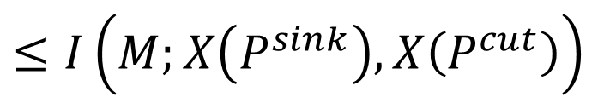



A Proof Sketch through Pictures
$$M$$
$$A_{0}$$
$$A_{1}$$
$$A_{2}$$
Zero-$M$-information Cut
$$P^{cut}$$
Red edges have zero $M$-info flow
$$B_{0}$$
$$B_{1}$$
$$B_{2}$$
$$Q$$
$$=f\left(M\right)$$
Orange edges are independent of $M$
$$P^{sink}$$
$$C_{0}$$
$$C_{1}$$
$$C_{2}$$
$$I\left(M;X\left(Q\right)\right)$$
$≤I\left(M;X\left(P^{sink}\right), X\left(P^{cut}\right)\right)$
(By DPI)
$$=I\left(M;X\left(P^{sink}\right)\right)+I\left(M;X\left(P^{cut}\right)| X\left(P^{sink}\right)\right)$$
$$=0$$

Slide 21

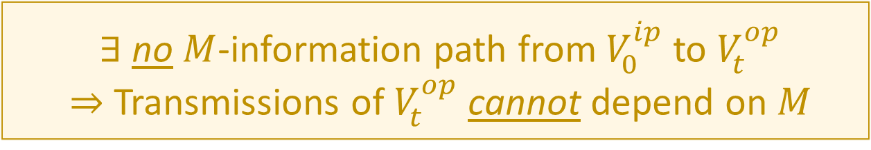
A Proof Sketch through Pictures
$$M$$
$$A_{0}$$
$$A_{1}$$
$$A_{2}$$
Zero-$M$-information Cut
$$P^{cut}$$
Red edges have zero $M$-info flow
$$B_{0}$$
$$B_{1}$$
$$B_{2}$$
$$Q$$
$$=f\left(M\right)$$
Orange edges are independent of $M$
$$P^{sink}$$
$$C_{0}$$
$$C_{1}$$
$$C_{2}$$
Transmissions of $V_{t}^{op}$ depend on $M$ $⇒∃$ an $M$-information path from $V_{0}^{ip}$to $V_{t}^{op}$
$∃$ no $M$-information path from $V_{0}^{ip}$to $V_{t}^{op}$ $⇒$ Transmissions of $V_{t}^{op}$ cannot depend on $M$

Slide 22
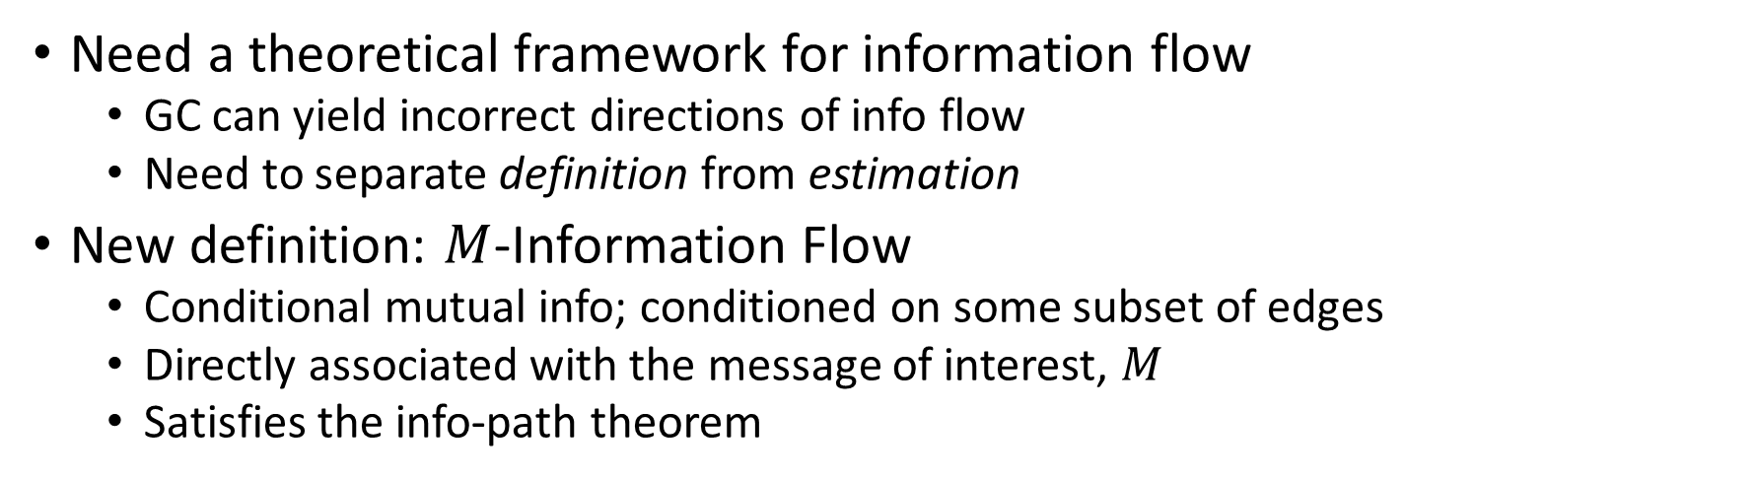
Summary
Need a theoretical framework for information flow
GC can yield incorrect directions of info flow
Need to separate definition from estimation
New definition: $M$-Information Flow
Conditional mutual info; conditioned on some subset of edges
Directly associated with the message of interest, $M$
Satisfies the info-path theorem
Other benefits
Can obtain inferences that existing tools cannot:
Tracking multiple messages
Information flow in feedback networks
Detecting hidden nodes
“Information Flow in Computational Systems” arXiv:1902.02292 [cs.IT] (under review)

Slide 23

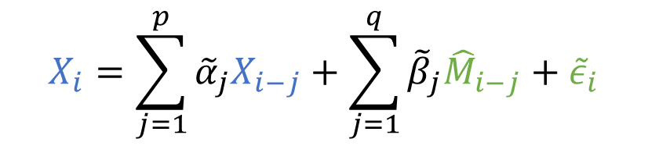







Granger Causality and Information Flow
Direction of greater Granger causal influence = Direction of info flow?
A counterexample based on the Schalkwijk & Kailath feedback scheme (1966)
Error in estimate
$$Z_{i} \sim N(0, σ^{2})$$
$$X_{i}=\sum_{j=1}^{p}{α_{j}X_{i−j}}+ε_{i}$$
$$X_{i}$$
$$Y_{i}$$
$$M$$
A
+
B
$$X_{i}=\sum_{j=1}^{p}{{\tilde{α}}_{j}X_{i−j}}+\sum_{j=1}^{q}{{\tilde{β}}_{j}{\hat{M}}_{i−j}}+{\tilde{ε}}_{i}$$
$${\hat{M}}_{i}$$
Best estimate
$$GC_{B→A}=\frac{Var\left(ε\right)}{Var\left(\tilde{ε}\right)}$$
$$X_{i}=M−{\hat{M}}_{i−1}$$
“Is the direction of greater Granger causal influence the same as the direction of information flow?” (Venkatesh & Grover, Allerton 2015; SfN 2015)

