Slide 1



Revealing Information Paths using Synergistic Information
Praveen Venkatesh
with Sanghamitra Dutta and Pulkit Grover
Dept. of Electrical & Computer Engineering Carnegie Mellon University
“Information Flow in Computational Systems” arXiv:1902.02292 [cs.IT] (under review)
(https://praveenv253.github.io/publications)

Slide 2
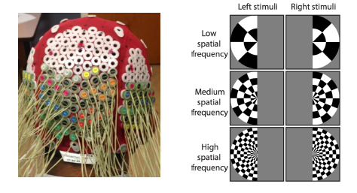
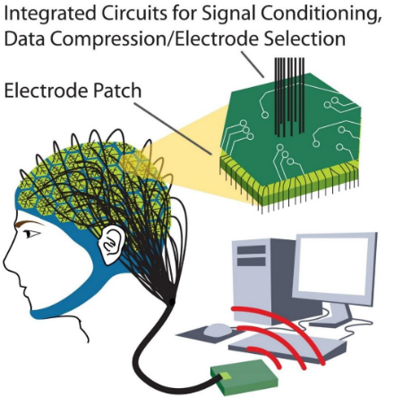
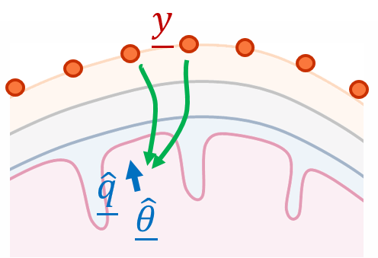
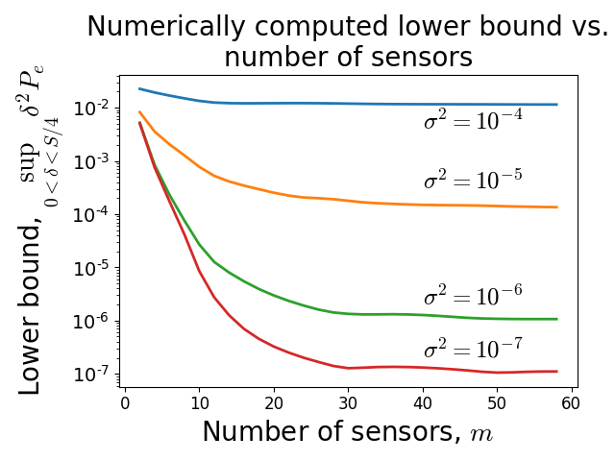

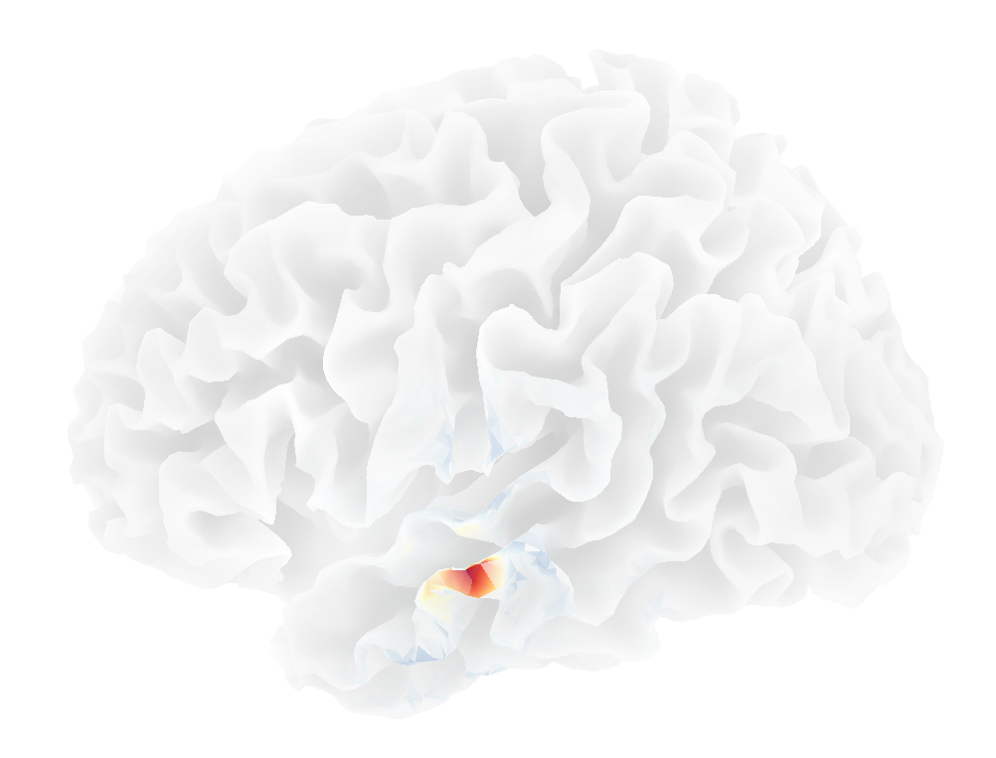
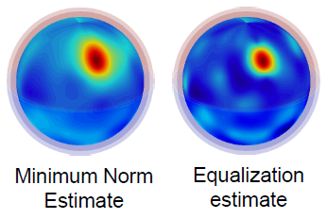
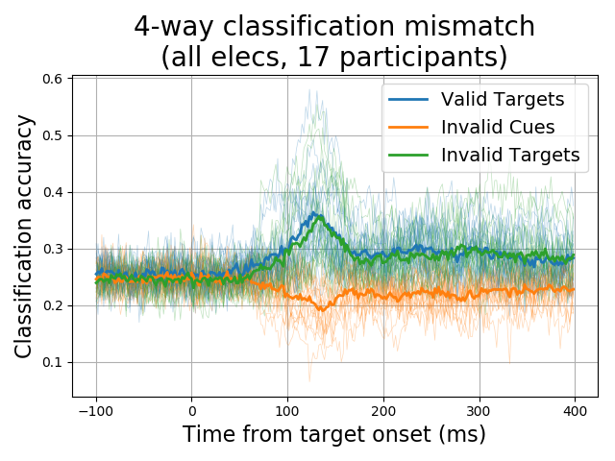
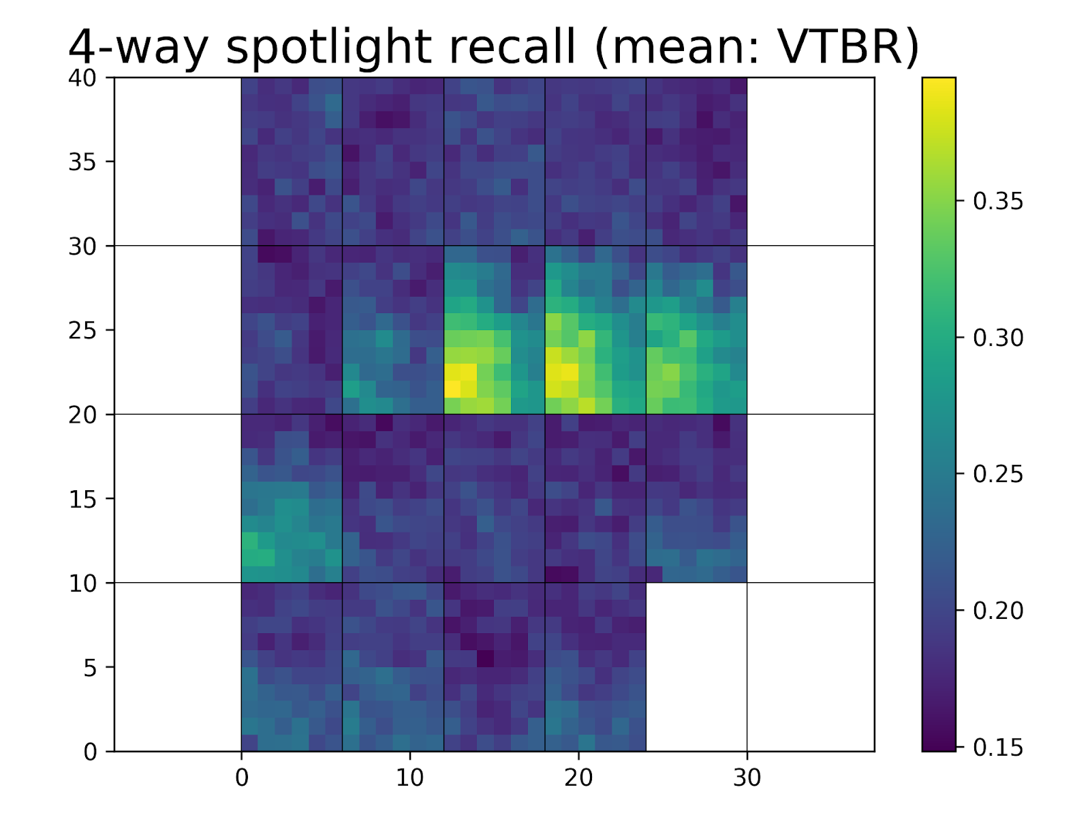
High-density EEG
Source Localization: Fundamental Limits and Algorithms
(Robinson et al., Sci. Rep. 2017)
(Grover & Venkatesh, Proc. IEEE 2016)
Experimental design & Data analysis
(Venkatesh and Grover, ISIT 2017)
(ongoing)

Slide 3
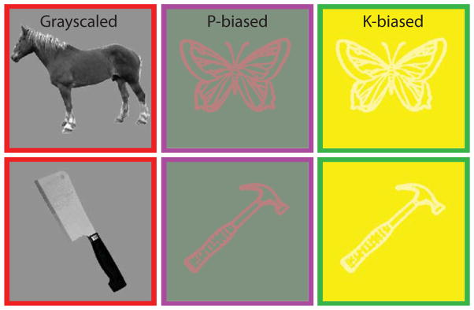
A Typical Neuroscientific Experiment
Region C
Region B
Info “flows” between brain regions
Info is usually about a stimulus
There could be feedback
Region A
(Almeida et al., Cortex, 2013)
“Stimulus”
Goal: Find a definition for information flow, so that we can track info paths

Slide 4
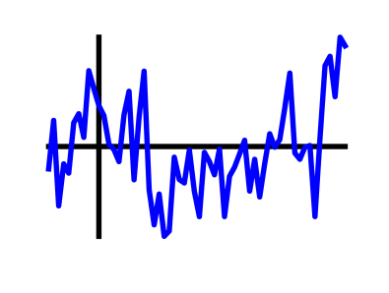
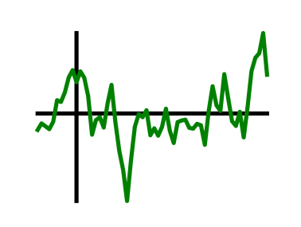




Prior Approaches to Information Flow
Functional Connectivity
Granger Causality (Granger, 1969; Bressler & Seth, 2011)
Transfer Entropy (Schreiber, 2000)
Directed Information (Massey, 1990; Quinn et al., 2011)
How do you get Information Flow from Granger Causality?
$$GC_{A→B}$$
A
B
$$GC_{B→A}$$
$$?$$
$$GC_{A→B}>GC_{B→A}$$

Slide 5






A Counterexample to Granger Causality
Direction of greater Granger causal influence = Direction of info flow?
A counterexample based on the Schalkwijk & Kailath feedback scheme (1966)
Message
Error in estimate
$$Z_{i} \sim N(0, σ^{2})$$
A
B
$$X_{i}$$
$$Y_{i}$$
$$M$$
$$M$$
A
+
B
Greater GC-influence
$${\hat{M}}_{i}$$
Best estimate
“Is the direction of greater Granger causal influence the same as the direction of information flow?” (Venkatesh & Grover, Allerton 2015; SfN 2015)

Slide 6
Why does Granger Causality fail?
Direction of greater GC-influence = Direction of info flow?
No!
Fundamental difficulty
GC influence is trying to be an estimator for information flow
But information flow is not formally defined
Philosophy
Let’s define information flow first, then estimate it
Use counterexamples to arrive at a definition for information flow

Slide 7



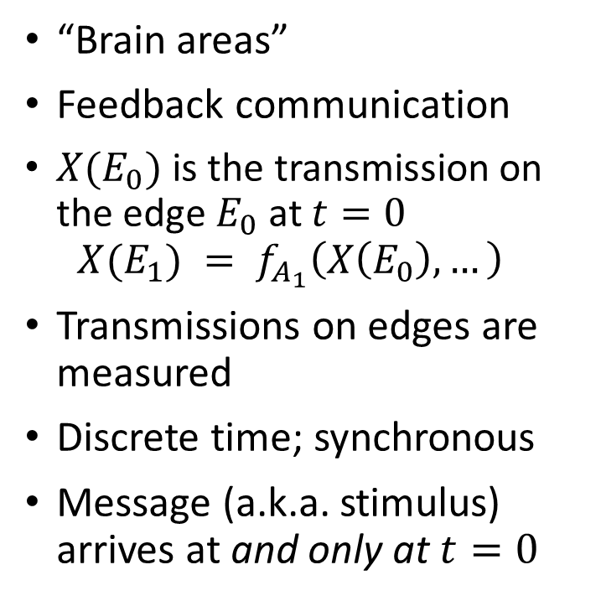



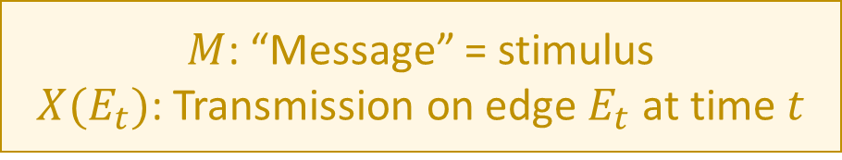


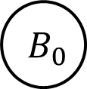


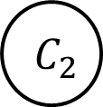



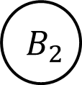
A Computational Model of the Brain
“Brain areas”
Feedback communication
$X(E_{0})$ is the transmission on the edge $E_{0}$at $t=0$ $X(E_{1}) = f_{A_{1}}\left(X\left(E_{0}\right), …\right)$
Transmissions on edges are measured
Discrete time; synchronous
Message (a.k.a. stimulus) arrives at and only at $t=0$
$$t=0$$
$$t=1$$
$$t=2$$
$$M$$
$$A_{0}$$
$$X(E_{0})$$
$$A_{1}$$
$$X(E_{1})$$
$$A_{2}$$
$$B_{0}$$
$$B_{1}$$
$$B_{2}$$
$$C_{0}$$
$$C_{1}$$
$$C_{2}$$
$$f(M)$$
(Thompson, 1980: VLSI) (Ahlswede et al., 2000: Network Info Theory) (Peters et al., 2016: Causality)
$M$: “Message” = stimulus
$X(E_{t})$: Transmission on edge $E_{t}$ at time $t$

Slide 8



A Computational Model of the Brain
“Brain areas”
Feedback communication
$X(E_{0})$ is the transmission on the edge $E_{0}$at $t=0$ $X(E_{1}) = f_{A_{1}}\left(X\left(E_{0}\right), …\right)$
Transmissions on edges are measured
Discrete time; synchronous
Message (a.k.a. stimulus) arrives at and only at $t=0$
$$t=0$$
$$t=1$$
$$t=2$$
$$M$$
$$A_{0}$$
$$X(E_{0})$$
$$A_{1}$$
$$X(E_{1})$$
$$A_{2}$$
$$B_{0}$$
$$B_{1}$$
$$B_{2}$$
$$C_{0}$$
$$C_{1}$$
$$C_{2}$$
$$f(M)$$
(Thompson, 1980: VLSI) (Ahlswede et al., 2000: Network Info Theory) (Peters et al., 2016: Causality)
Goal: Define info flow + track info path

Slide 9
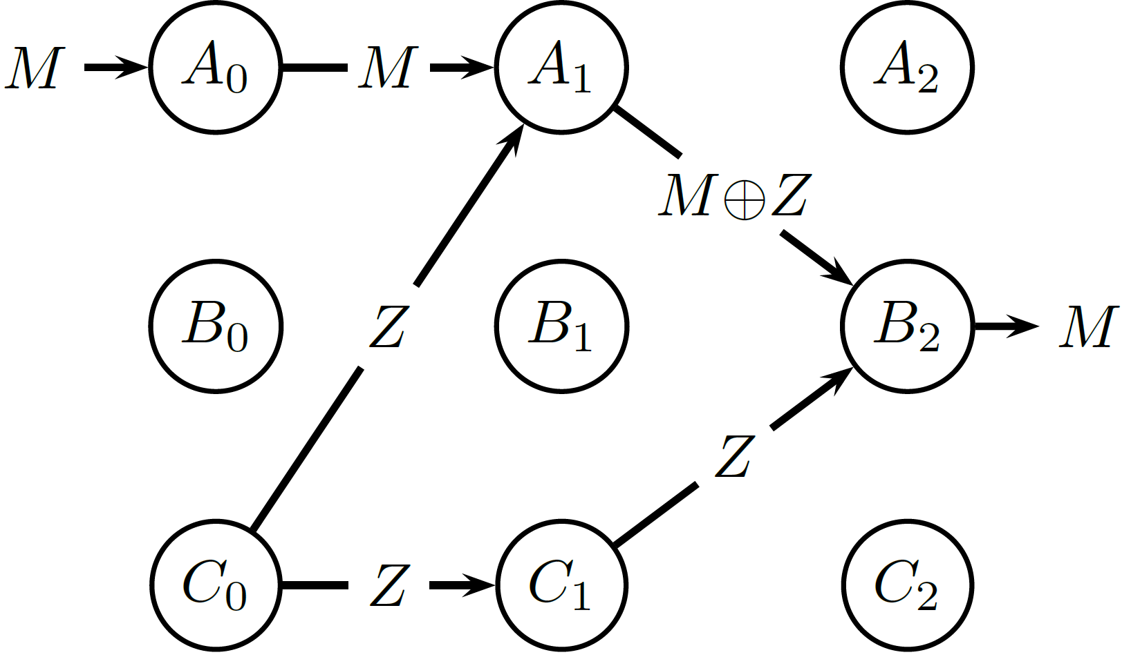
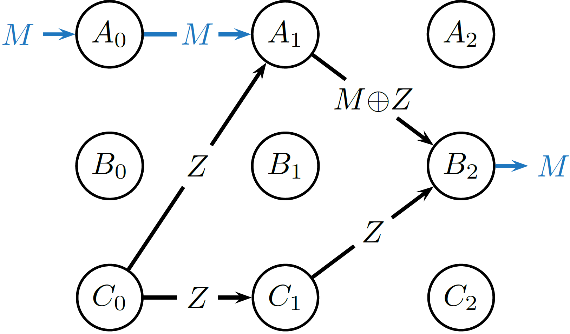




How do we define Information Flow?
1
2
3
Candidate definition 1: Dependence
Information flows on an edge $E_{t}$ if $I\left(M;X\left(E_{t}\right)\right)>0.$
✓
$$M, Z \sim iid Ber(1/2)$$
$$M⊕Z=M xor Z$$
$$I\left(M;M⊕Z\right)=0$$
Synergy!

Slide 10




Aside: Partial Information Decomposition
$$I\left(M:\left(X,Y\right)\right)=UI\left(M:X∖Y\right)+UI\left(M:Y∖X\right)+RI\left(M:X;Y\right)+SI(M:X;Y)$$
Unique to X
Unique to Y
Redundant
Synergistic
$$≥0$$
$$≥0$$
$$≥0$$
$$≥0$$
Our framework is definition-agnostic
$$I\left(M:X\right)=UI\left(M:X∖Y\right)+RI\left(M:X;Y\right)$$
$$I\left(M:X | Y\right)=UI\left(M:X∖Y\right)+SI\left(M:X;Y\right)$$
Synergy in Neuroscience: Schneidman et al. (2003); Sreenivasan & Fiete (2011); Timme & Lapish (2018); …
Partial Information Decomposition: Bertschinger et al. (2014); Wibral, Lizier & Priesemann (2015); …

Slide 11
How do we define Information Flow?
1
2
3
Candidate definition 1: Dependence
Information flows on an edge $E_{t}$ if $I\left(M;X\left(E_{t}\right)\right)>0.$
✓
$$M, Z \sim iid Ber(1/2)$$
$$M⊕Z=M xor Z$$
$$I\left(M;M⊕Z\right)=0$$
Synergy!

Slide 12
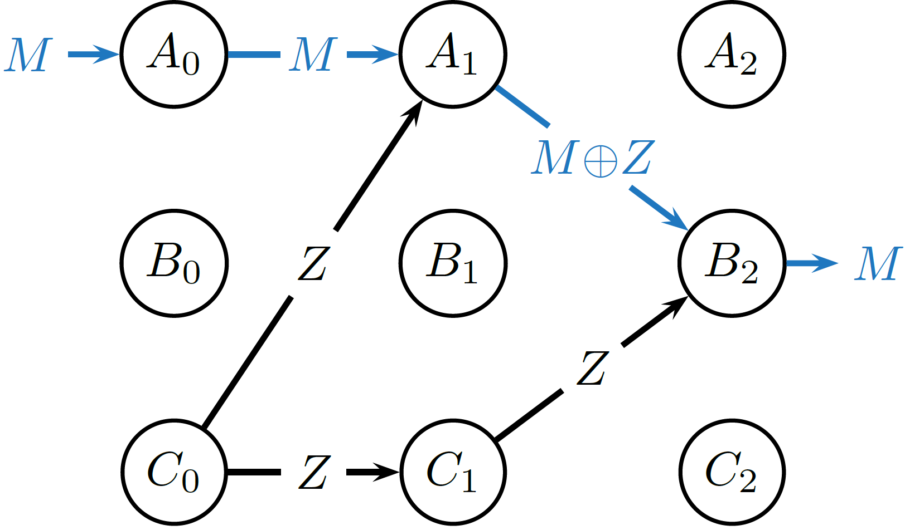

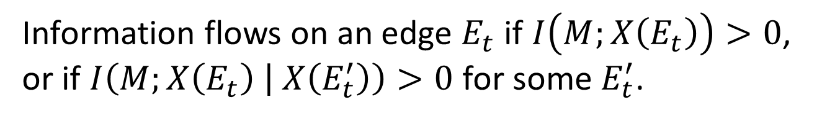
How do we define information flow?
1
2
Candidate definition 2: Condition on one edge
3
Information flows on an edge $E_{t}$ if $I\left(M;X\left(E_{t}\right)\right)>0$, or if $I\left(M;X\left(E_{t}\right) | X\left(E_{t}^{′}\right)\right)>0$ for some $E_{t}^{′}$.
✓
$$I\left(M; M⊕Z | Z\right)>0$$

Slide 13
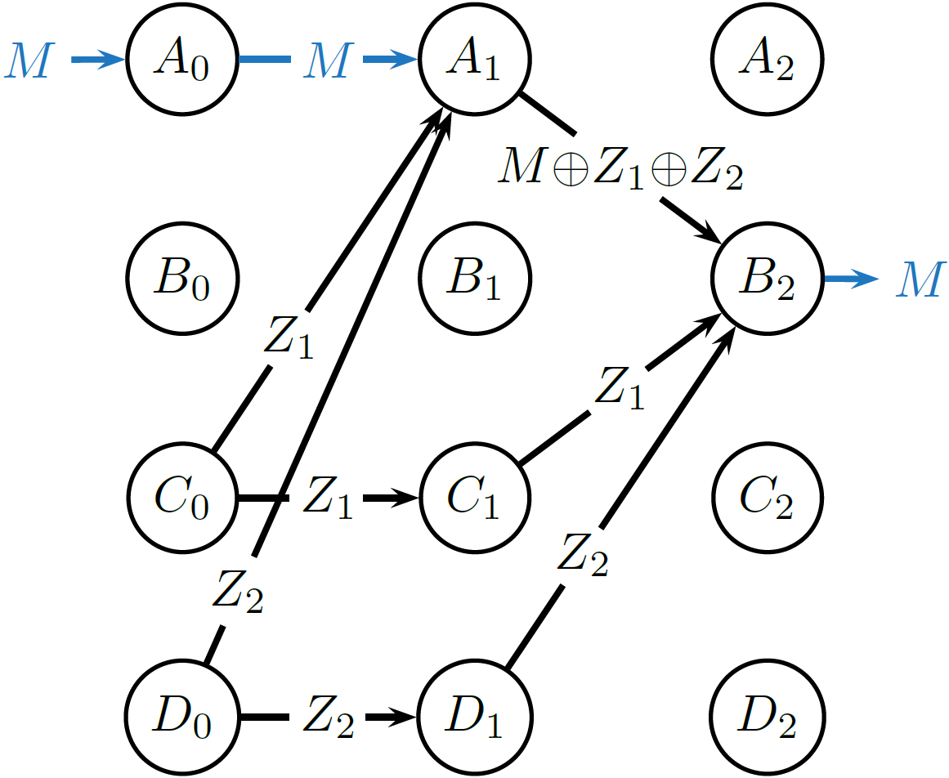


How do we define information flow?
1
2
Candidate definition 2: Condition on one edge
3
Information flows on an edge $E_{t}$ if $I\left(M;X\left(E_{t}\right)\right)>0$, or if $I\left(M;X\left(E_{t}\right) | X\left(E_{t}^{′}\right)\right)>0$ for some $E_{t}^{′}$.
✓
$$I\left(M; M⊕Z_{1}⊕Z_{2} | Z_{1}\right)=0$$
$$I\left(M; M⊕Z_{1}⊕Z_{2} | Z_{2}\right)=0$$

Slide 14
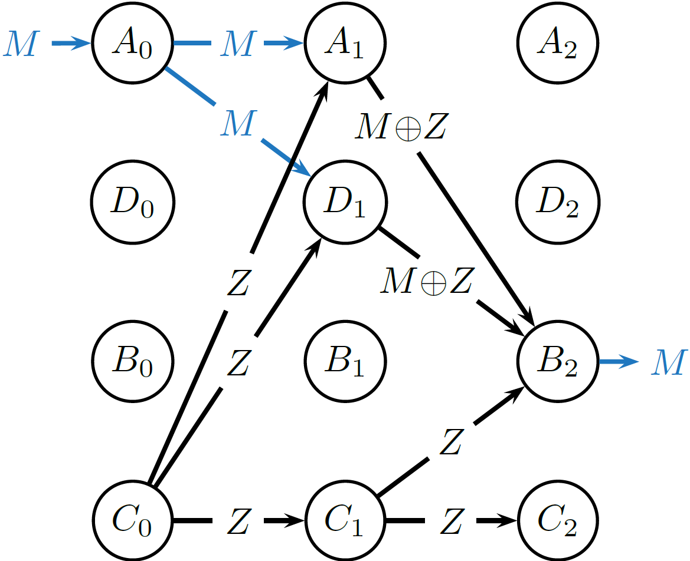
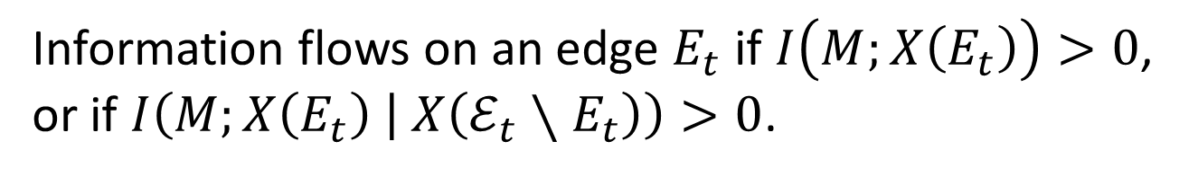

How do we define information flow?
1
2
Candidate definition 3: Condition on all other edges
3
Information flows on an edge $E_{t}$ if $I\left(M;X\left(E_{t}\right)\right)>0$, or if $I\left(M;X\left(E_{t}\right) | X\left(ℰ_{t}∖E_{t}\right)\right)>0$.
✓
$$I\left(M; M\text{⊕}Z | M⊕Z, Z\right)=0$$

Slide 15
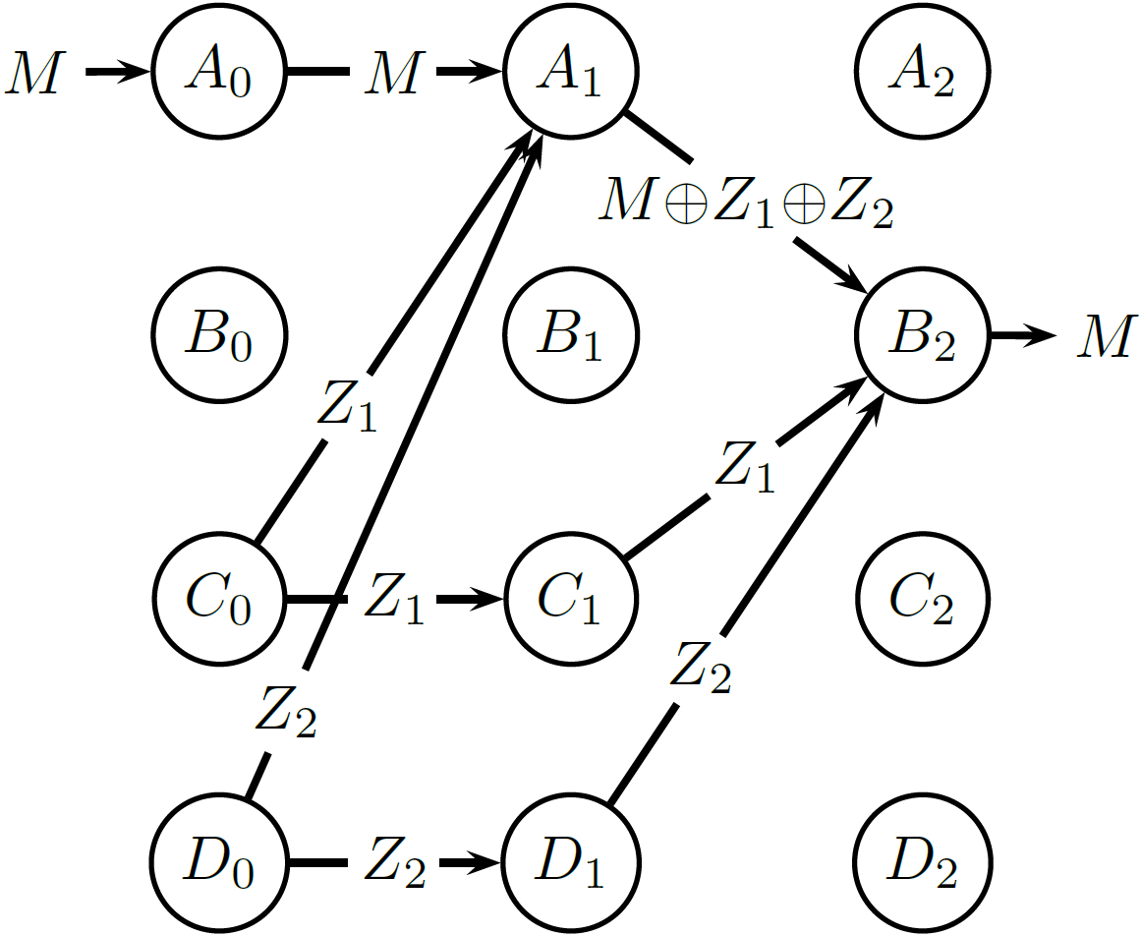
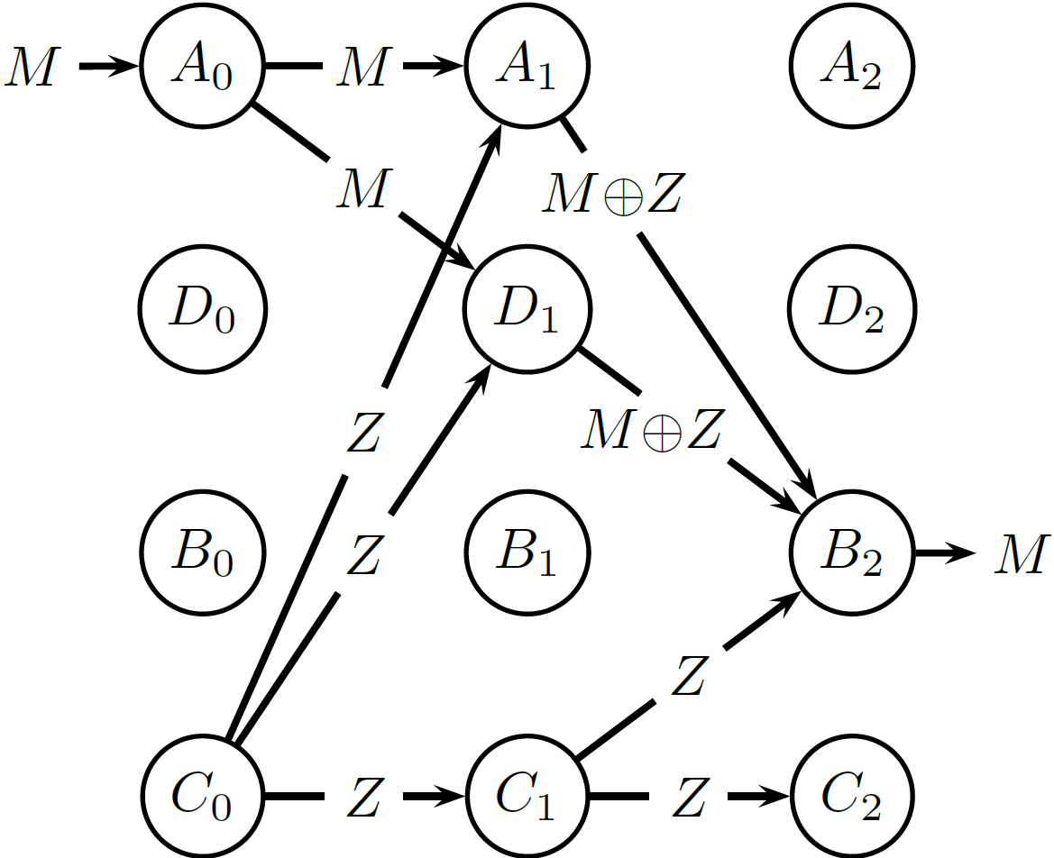
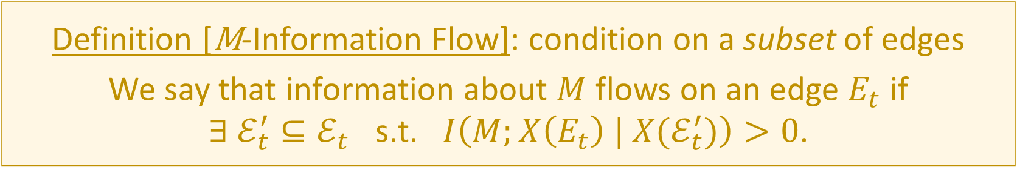
How do we define information flow?
1
2
Definition [M-Information Flow]: condition on a subset of edges
We say that information about $M$ flows on an edge $E_{t}$ if
$∃ ℰ_{t}^{′}⊆ℰ_{t}$ s.t. $I\left(M;X\left(E_{t}\right) | X(ℰ_{t}^{′})\right)>0$.
3
✓

Slide 16
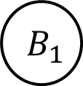


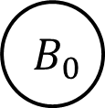


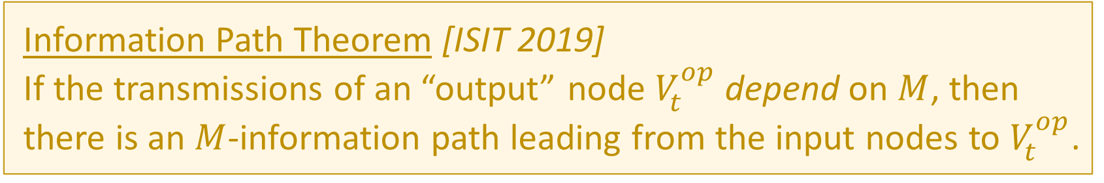
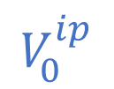






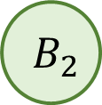

The Existence of Information Paths
Definition [$M$-Information Path]
A path, every edge of which has $M$-information flow
Information Path Theorem [ISIT 2019]
If the transmissions of an “output” node $V_{t}^{op}$ depend on $M$, then there is an $M$-information path leading from the input nodes to $V_{t}^{op}$.
$$V_{0}^{ip}$$
$$M$$
$$A_{0}$$
$$X(E_{0})$$
$$A_{1}$$
$$X(E_{1})$$
$$A_{2}$$
$$V_{t}^{op}$$
$$B_{0}$$
$$B_{1}$$
$$B_{2}$$
$$⊥$$
$$⊥$$
$$f\left(M\right) M$$

Slide 17
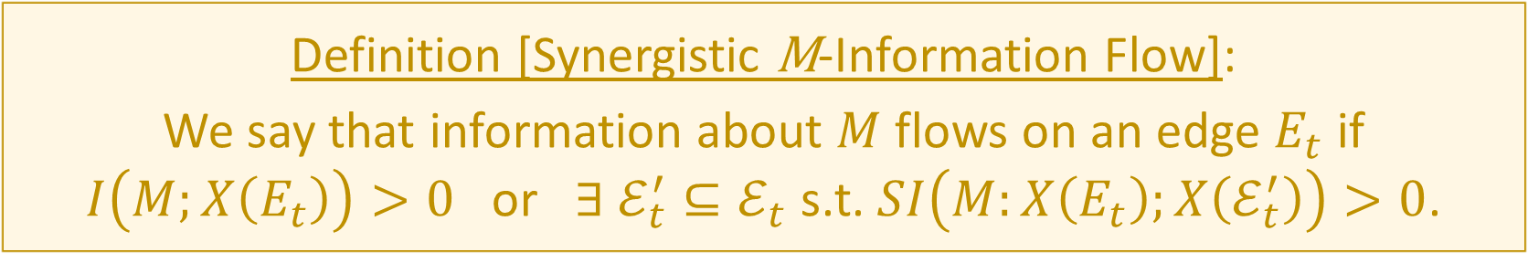
In terms of Synergistic Information
Definition [Synergistic M-Information Flow]:
We say that information about $M$ flows on an edge $E_{t}$ if
$I\left(M;X\left(E_{t}\right)\right)>0$ or $∃ ℰ_{t}^{′}⊆ℰ_{t}$ s.t. $SI\left(M:X\left(E_{t}\right);X\left(ℰ_{t}^{′}\right)\right)>0$.
Conjecture:
Any definition of information flow that allows you to track information paths must account for synergistic information.

Slide 18
Granger Causality and Information Flow
Functional Connectivity
Granger Causality (Granger, 1969; Bressler & Seth, 2011)
Transfer Entropy (Schreiber, 2000)
Directed Information (Massey, 1990; Quinn et al., 2011)
How do you get Information Flow from Granger Causality?
$$GC_{A→B}$$
A
B
$$GC_{B→A}$$
$$?$$
$$GC_{A→B}>GC_{B→A}$$

Slide 19

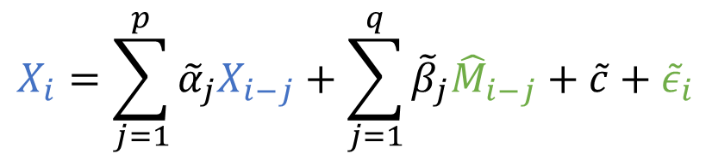

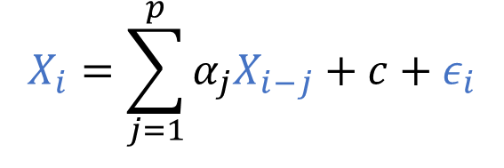

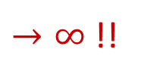


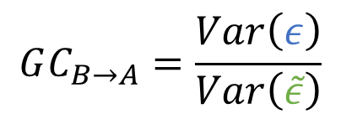

Granger Causality and Information Flow
Direction of greater Granger causal influence = Direction of info flow?
A counterexample based on the Schalkwijk & Kailath feedback scheme (1966)
Error in estimate
$$Z_{i} \sim N(0, σ^{2})$$
$$X_{i}=\sum_{j=1}^{p}{α_{j}X_{i−j}}+c+ε_{i}$$
$$X_{i}$$
$$Y_{i}$$
$$M$$
A
+
B
$$X_{i}=\sum_{j=1}^{p}{{\tilde{α}}_{j}X_{i−j}}+\sum_{j=1}^{q}{{\tilde{β}}_{j}{\hat{M}}_{i−j}}+\tilde{c}+{\tilde{ε}}_{i}$$
$${\hat{M}}_{i}$$
Best estimate
$$GC_{B→A}=\frac{Var\left(ε\right)}{Var\left(\tilde{ε}\right)}$$
$$X_{i}=M−{\hat{M}}_{i−1}$$
$→∞$ !!
“Is the direction of greater Granger causal influence the same as the direction of information flow?” (Venkatesh & Grover, Allerton 2015; SfN 2015)

Slide 20
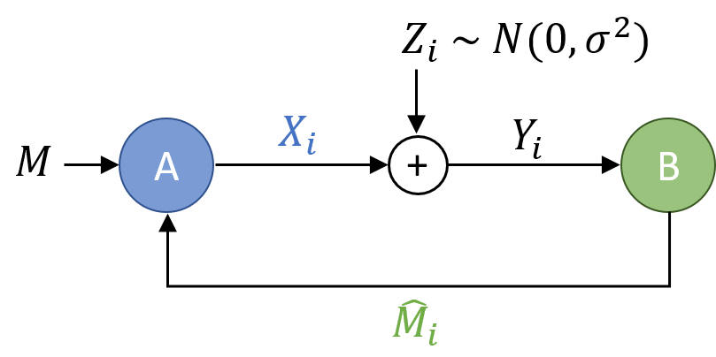
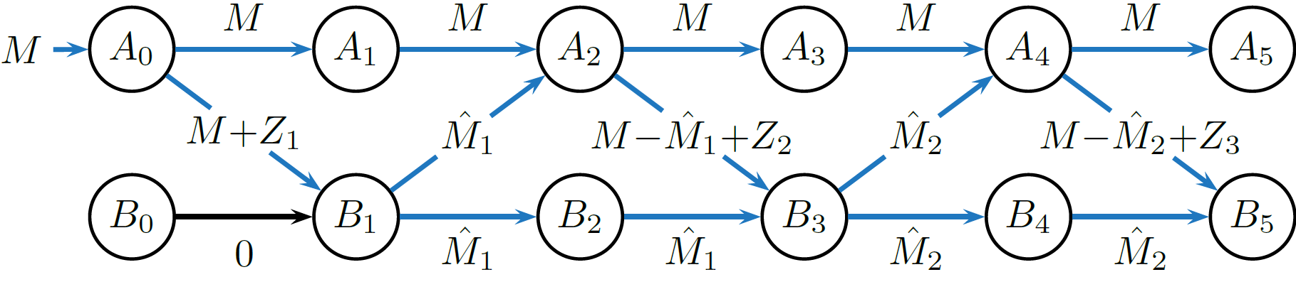
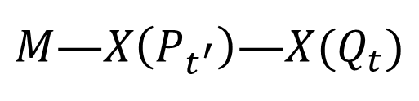
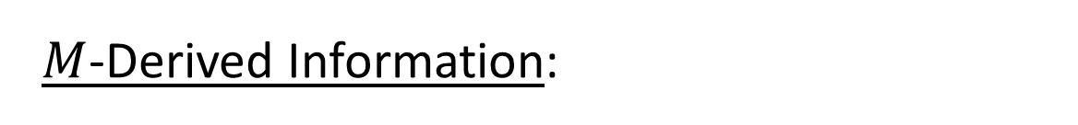
Resolving the Granger causality counterexample
$M$-Derived Information:
$M$—$X\left(P_{t^{′}}\right)$—$X(Q_{t})$
All edges have M-information flow!
Are Bob’s transmissions $M$-derived from Alice’s, or vice versa?

Slide 21
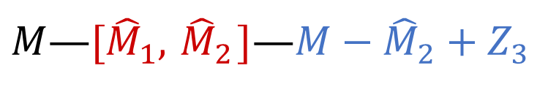
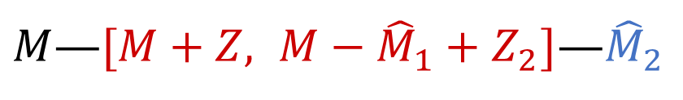
Resolving the Granger causality counterexample
$M$-Derived Information:
$M$—$X\left(P_{t^{′}}\right)$—$X(Q_{t})$
✓
✗
Bob’s transmissions are M-derived from Alice’s, but not vice versa!
$M$—$[M+Z, M−{\hat{M}}_{1}+Z_{2}]$—${\hat{M}}_{2}$
$M$—$[{\hat{M}}_{1}, { \hat{M}}_{2}]$—$M−{\hat{M}}_{2}+Z_{3}$

Slide 22
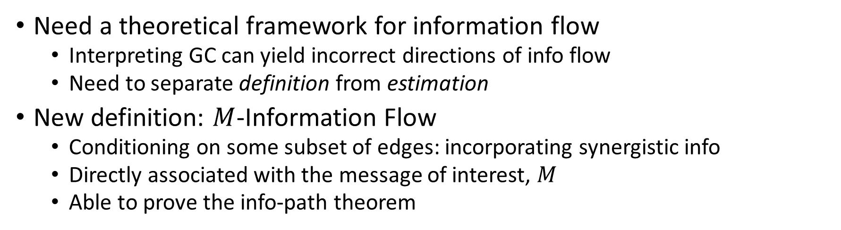
Summary
Need a theoretical framework for information flow
Interpreting GC can yield incorrect directions of info flow
Need to separate definition from estimation
New definition: $M$-Information Flow
Conditioning on some subset of edges: incorporating synergistic info
Directly associated with the message of interest, $M$
Able to prove the info-path theorem
Other benefits
Can obtain inferences that existing tools cannot:
Information flow in feedback networks
Tracking multiple messages
Detecting hidden nodes
“Information Flow in Computational Systems” arXiv:1902.02292 [cs.IT] (under review)

Slide 23

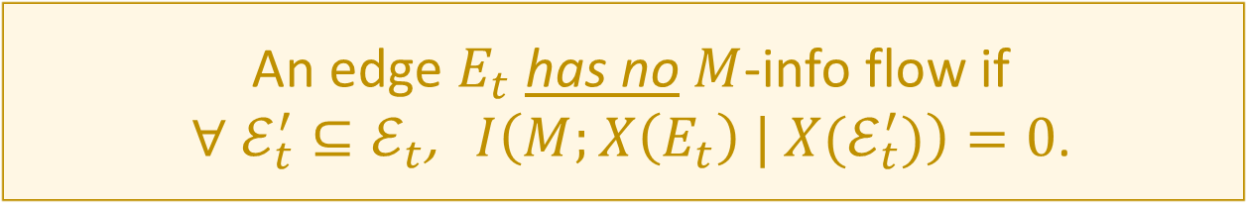
Remarks on the Info Flow Definition
An edge $E_{t}$ has $M$-info flow if $∃ ℰ_{t}^{′}⊆ℰ_{t}$ s.t. $I\left(M;X\left(E_{t}\right) | X(ℰ_{t}^{′})\right)>0$.
An edge $E_{t}$ has no $M$-info flow if $∀ ℰ_{t}^{′}⊆ℰ_{t}$, $I\left(M;X\left(E_{t}\right) | X(ℰ_{t}^{′})\right)=0$.
Condition on the empty set:
No $M$-info flow $⇒$ $I\left(M;X\left(E_{t}\right)\right)=0$ $⇒$ No dependence on $M$

Slide 24
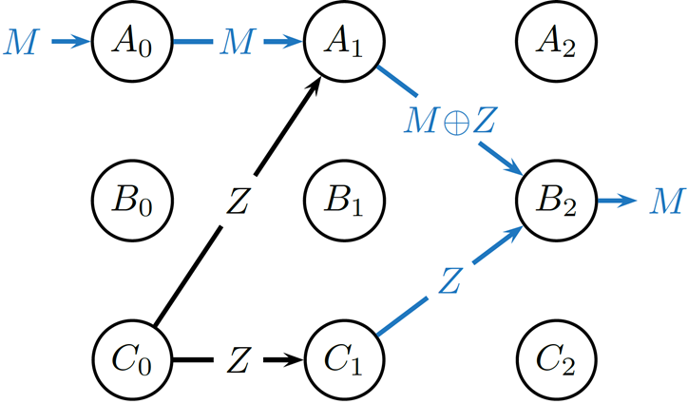


Remarks on the Info Flow Definition
An edge $E_{t}$ has $M$-info flow if $∃ ℰ_{t}^{′}⊆ℰ_{t}$ s.t. $I\left(M;X\left(E_{t}\right) | X(ℰ_{t}^{′})\right)>0$.
$M$-info flows out of a node $⇒$ $M$-info flows into the node
$$I\left(M; M⊕Z | Z\right)>0$$
$$I\left(M; Z | M⊕Z\right)>0$$

Slide 25

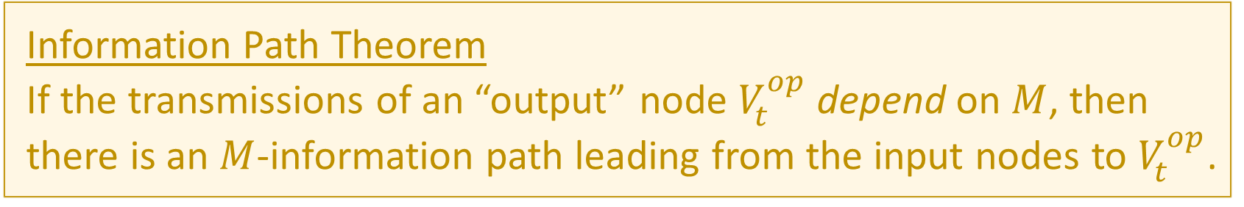
The Existence of Information Paths
Definition [$M$-Information Path]
A path, every edge of which has $M$-information flow
Information Path Theorem
If the transmissions of an “output” node $V_{t}^{op}$ depend on $M$, then there is an $M$-information path leading from the input nodes to $V_{t}^{op}$.
✗
$$V_{0}^{ip}$$
$$M$$
$$A_{0}$$
$$X(E_{0})$$
$$A_{1}$$
$$X(E_{1})$$
$$A_{2}$$
Info flow out $⇒$ Info flow in
$$V_{t}^{op}$$
$$B_{0}$$
$$B_{1}$$
$$B_{2}$$
$$⊥$$
$$⊥$$
$$f\left(M\right) M$$

Slide 26
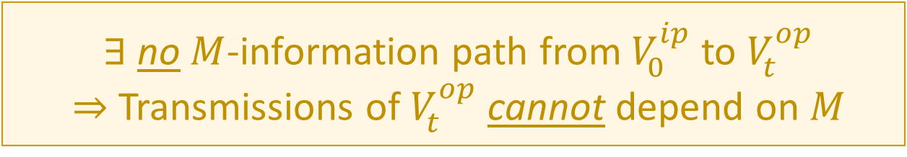
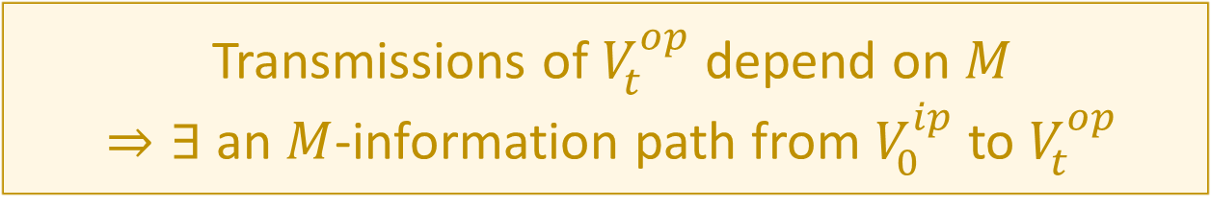
Proving the Info Path theorem
Transmissions of $V_{t}^{op}$ depend on $M$ $⇒∃$ an $M$-information path from $V_{0}^{ip}$to $V_{t}^{op}$
We’ll prove the contrapositive:
$∃$ no $M$-information path from $V_{0}^{ip}$to $V_{t}^{op}$ $⇒$ Transmissions of $V_{t}^{op}$ cannot depend on $M$

Slide 27
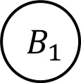


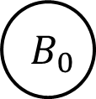














A Proof Sketch through Pictures
$∃$ no $M$-information path from $V_{0}^{ip}$to $V_{t}^{op}$
$$V_{0}^{ip}$$
$$M$$
$$A_{0}$$
$$A_{1}$$
$$A_{2}$$
Zero-$M$-information Cut
Red edges have zero $M$-info flow
$$V_{t}^{op}$$
$$B_{0}$$
$$B_{1}$$
$$B_{2}$$
$$⊥$$
$$⊥$$
$Q M$ (Claim)
$$C_{0}$$
$$C_{1}$$
$$C_{2}$$
$⇒ ∃$ a zero $M$-information cut separating $V_{0}^{ip}$and $V_{t}^{op}$

Slide 28














A Proof Sketch through Pictures
$$M$$
$$A_{0}$$
$$A_{1}$$
$$A_{2}$$
Zero-$M$-information Cut
Red edges have zero $M$-info flow
$$B_{0}$$
$$B_{1}$$
$$B_{2}$$
Orange edges are independent of $M$
$$C_{0}$$
$$C_{1}$$
$$C_{2}$$
No $M$-info flow $⇒$ No incoming dependence on $M$
$⇒$ No outgoing dependence on $M$ (by DPI)

Slide 29








A Proof Sketch through Pictures
$$M$$
$$A_{0}$$
$$A_{1}$$
$$A_{2}$$
Zero-$M$-information Cut
$$P^{cut}$$
Red edges have zero $M$-info flow
$$B_{0}$$
$$B_{1}$$
$$B_{2}$$
$$Q$$
$$=f\left(M\right)$$
Orange edges are independent of $M$
$$P^{sink}$$
$$C_{0}$$
$$C_{1}$$
$$C_{2}$$
$$I\left(M;X\left(Q\right)\right)$$
$≤I\left(M;X\left(P^{sink}\right), X\left(P^{cut}\right)\right)$
(By DPI)
$$=I\left(M;X\left(P^{sink}\right)\right)+I\left(M;X\left(P^{cut}\right)| X\left(P^{sink}\right)\right)$$
$$=0$$

Slide 30


A Proof Sketch through Pictures
$$M$$
$$A_{0}$$
$$A_{1}$$
$$A_{2}$$
Zero-$M$-information Cut
$$P^{cut}$$
Red edges have zero $M$-info flow
$$B_{0}$$
$$B_{1}$$
$$B_{2}$$
$$Q$$
$$=f\left(M\right)$$
Orange edges are independent of $M$
$$P^{sink}$$
$$C_{0}$$
$$C_{1}$$
$$C_{2}$$
Transmissions of $V_{t}^{op}$ depend on $M$ $⇒∃$ an $M$-information path from $V_{0}^{ip}$to $V_{t}^{op}$
$∃$ no $M$-information path from $V_{0}^{ip}$to $V_{t}^{op}$ $⇒$ Transmissions of $V_{t}^{op}$ cannot depend on $M$

Slide 31

Multiple messages
What if we have two independent messages?
E.g., shape and colour
(Ahlswede et al., 2000)
(Almeida et al., 2013)
We can track information flows of multiple, independent messages/stimuli

Slide 32














Hidden Nodes
Hidden
$$H_{1}$$
$$Z$$
$$Z$$
$$M$$
$$A_{0}$$
$$A_{1}$$
$$A_{2}$$
$$M$$
$$M⊕Z$$
$$M⊕Z$$
Observed
Markov properties that should (ordinarily) never be violated:
$$X(𝒫_{t})$$
$$V_{t}$$
$$X(𝒬_{t})$$
$$M−X\left(𝒫_{t}\right)−X(𝒬_{t})$$
…
…
Some hidden nodes break Local Markov Properties

