Slide 1
Indriya Platform
Praveenkumar VASUDEVAN

Slide 2
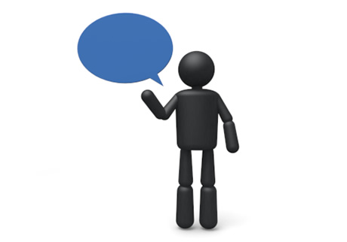
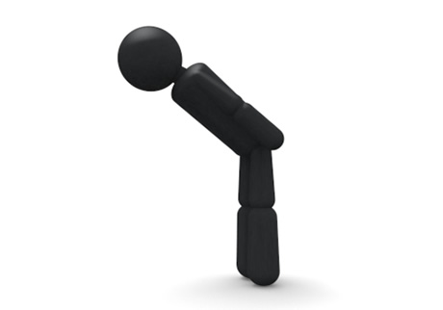
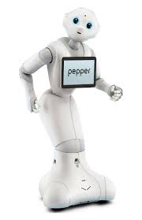
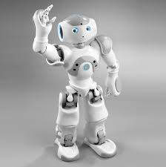
What is Indriya?
A software to design human robot interaction scenario based on human behaviors
Non-verbal communication
Verbal communication
Hello, Nao
Hello

Slide 3
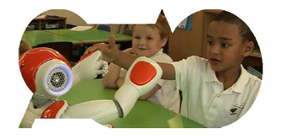
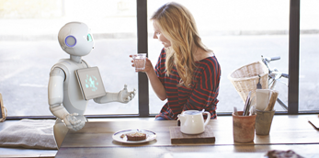
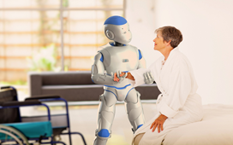
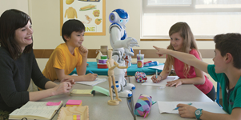
Why do we need Indriya?
Robots will be everywhere in the future closely interacting with human!
But it is not easy to program a robot without skills

Slide 4
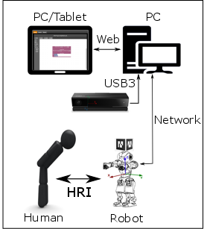
How does Indriya work?
Steps:
Choose the blocks from “Toolbox” and drop into “Designer Surface”
Save with a name
Press “RUN” button when you are done!
Check the execution of the scenario

Slide 5
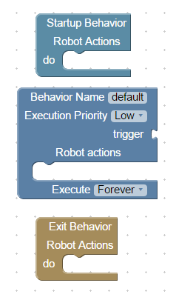
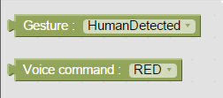
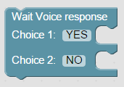
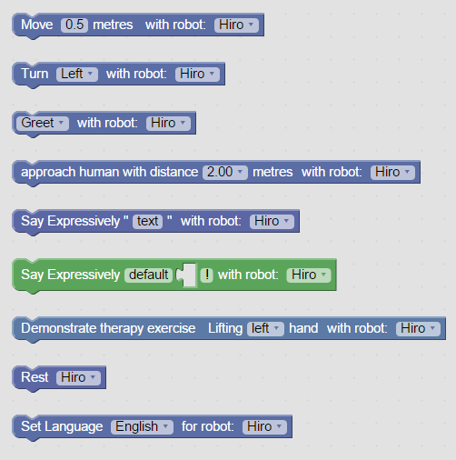
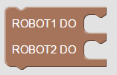
What are the blocks available?
Program structure
Triggers
Speech response
Startup
behavior
Action-1
Action-N
Nao actions
Parallel task
Trigger behavior
Lifetime: <Once, Until, Forever>
Priority: <Low, Normal, High>
Trigger
block
Action-1
Action-N
Exit
behavior
Action-1
Action-N

Slide 6
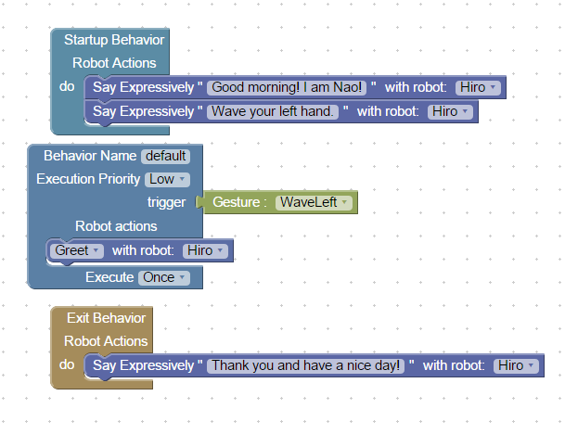
A simple program.
Can you guess what this program is doing?

