Slide 1
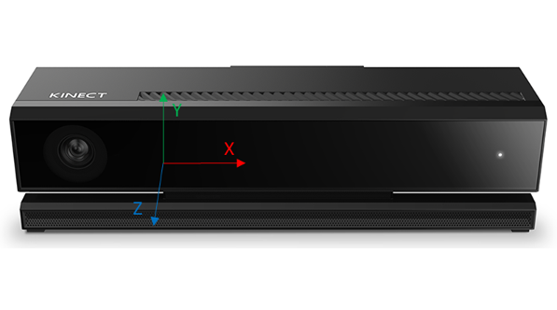
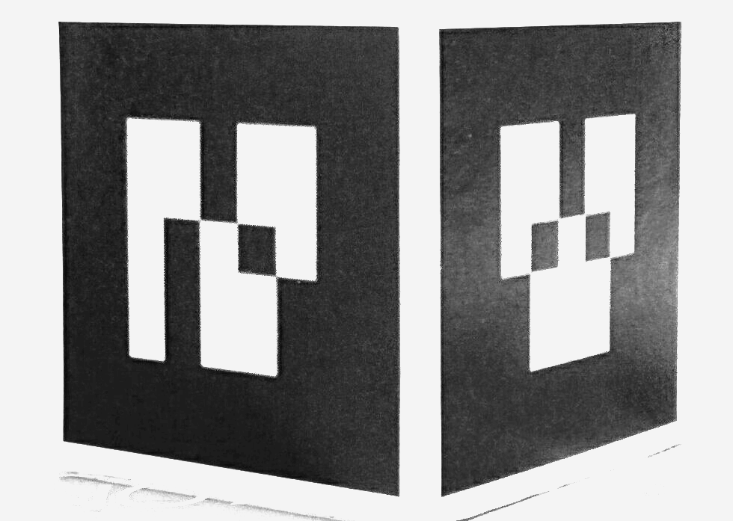
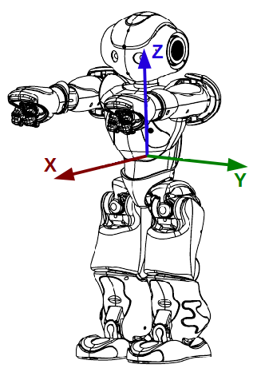
Localization node
6D Pose of robot
TCP
Static link
Robot interface node
Kinect Data capture
USB3
Ethernet
Visual Link

