Slide 1
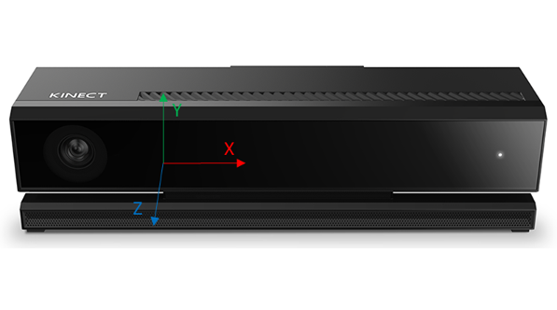
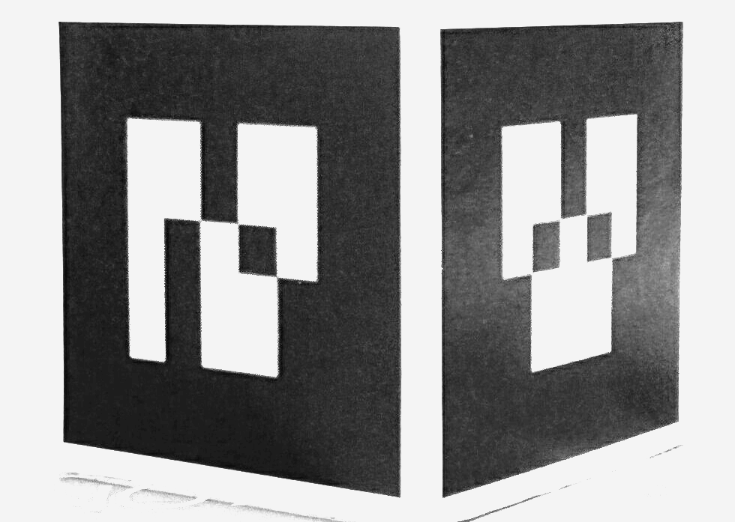
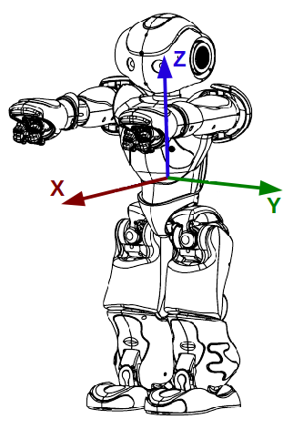
Localization node
6D Pose of robot
TCP
Static link
Robot interface node
Kinect Data capture
USB3
Ethernet
Visual Link

Slide 2
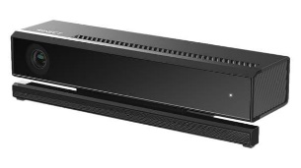

^{K}T_{M}
F_{K}
Y
^{K}T_{W}
F_{M}
Z
X
Z
X
Y
^{T}T_{M}
Z
F_{W}
F_{T}
Y
X
^{W}T_{T}

Slide 3
Startup
behavior
Action-1
Action-N
Trigger behavior
Lifetime: <Once, Until, Forever>
Priority: <Low, Normal, High>
Startup
block
Action-1
Action-N
Cyclic
block
Action-1
Action-N
Exit
block
Action-1
Action-N
Exit
behavior
Action-1
Action-N

Slide 4
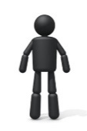
Behavior
Execution
Engine
Behavior
Program
Behavior Execution Context
Application Context
Visual Gesture Builder
Gesture
Database
Gesture Runtime
Application
Kinect Studio
Recorded Clips

Slide 5
Audio input/ Frontend
Feature extraction
Acoustic model
Backend
Grammars
Recognition algorithms
Recognition result

Slide 6
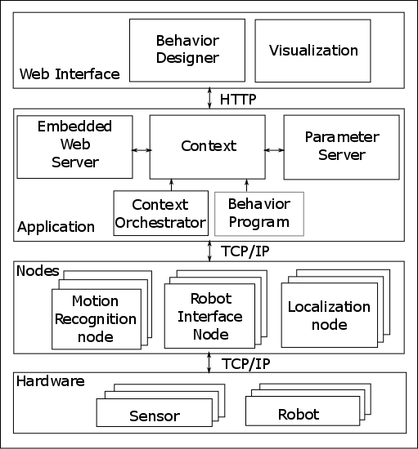
Web
Interface
Behavior designer
Visualization
HTTP
Embedded web server
Application Context
Parameter Server
Context orchestrator
Behavior execution engine
Behavior program
Application components
Motion recognition
Robot interface
Localization
Web
Interface
Speech recognition

