Slide 1
Developing an experimental platform for Human Robot Interaction based on human motions
Praveenkumar VASUDEVAN
European Master in Advanced RObotics
Supervisors : Gentiane VENTURE, Associate Professor, TUAT
Yannick AOUSTIN, Maître de Conférence à l'Université de Nantes
Co-supervisor : Armando TACCHELLA, Associate Professor, University of Genoa
2015/05/11

Slide 2
TO-DO List
Improvement of Pose estimation of marker
Removing outliers when the change in angle is large
Averaging the pose to find smooth estimate
Particle Filter approach using Bayesian filter library
Was not able to make it work as expected. Have to spend more time on it.
Collaborate with Mr. Vincent Berenz to use TDM framework for behavior execution
Made initial tests of Nao walking towards a virtual target.
The TDM module gets localization information in real time from the server however as the robot approaches the distance increases instead of decreasing.
Will get things clarified during the meeting in this week
Improve the data structure that contains the description of the world
Added required information for managing the gestures of all the active humans in the field of view.
Additionally added information about available behavior modules and motion modules.

Slide 3
TO-DO List
Natural Language representation and translation of high level representation into gesture triggers and robot behaviors
Tried integrating Stanford Natural Language Processing Library
It is good. However when given an empty paper, the user can write whatever they want and converting them into a meaningful interaction scenario is very tough
Checked out various visual programming methods for novice programmers like Scratch, TouchDevelop, Google Blockly etc.,
Google Blockly looked promising since they offer the SDK to make custom blocks and code generation capability
Develop an easy to use interface for designing behaviors using high level language
Web interface developed using a bunch of client side javascript libraries including Blockly and Threejs 3D viewer
Designing concrete scenarios and evaluate (Receptionist, Something based on IMU?)
To be done!

Slide 4
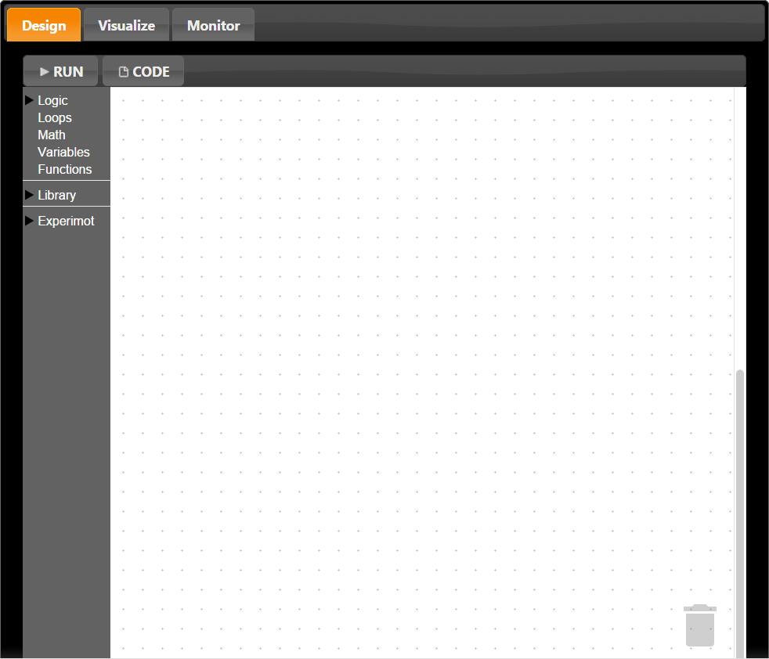
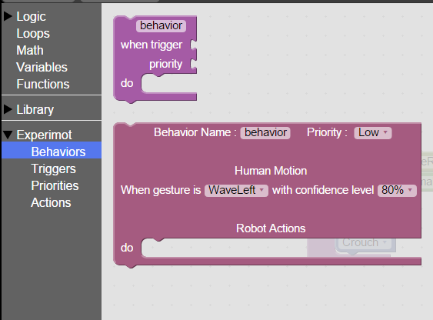
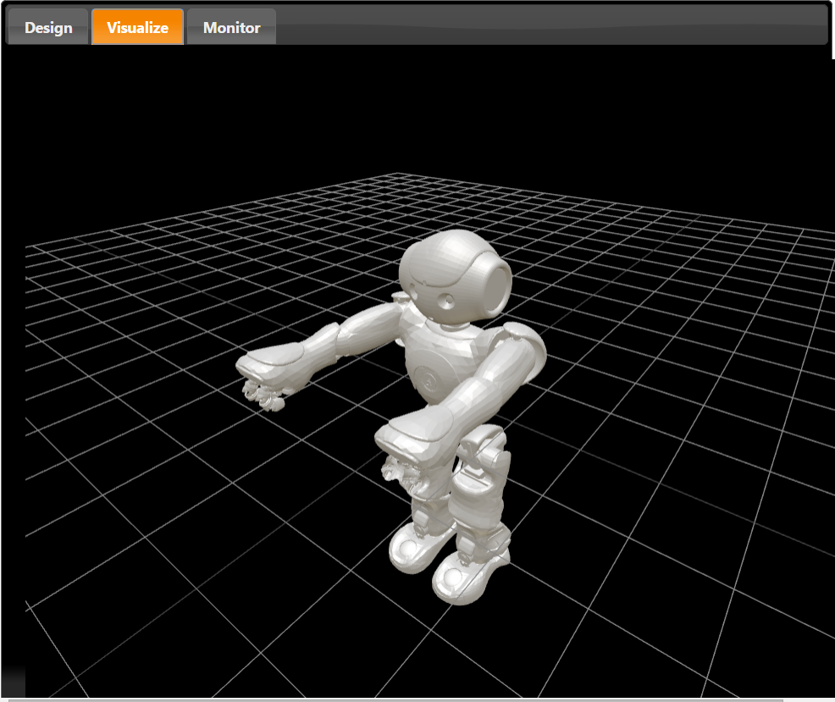
Platform – User Interface concept
Designer
Toolbox
Visualize

Slide 5
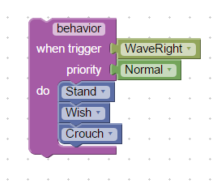
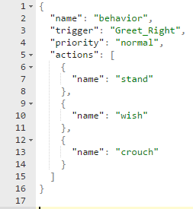

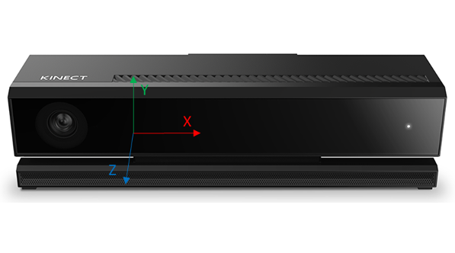
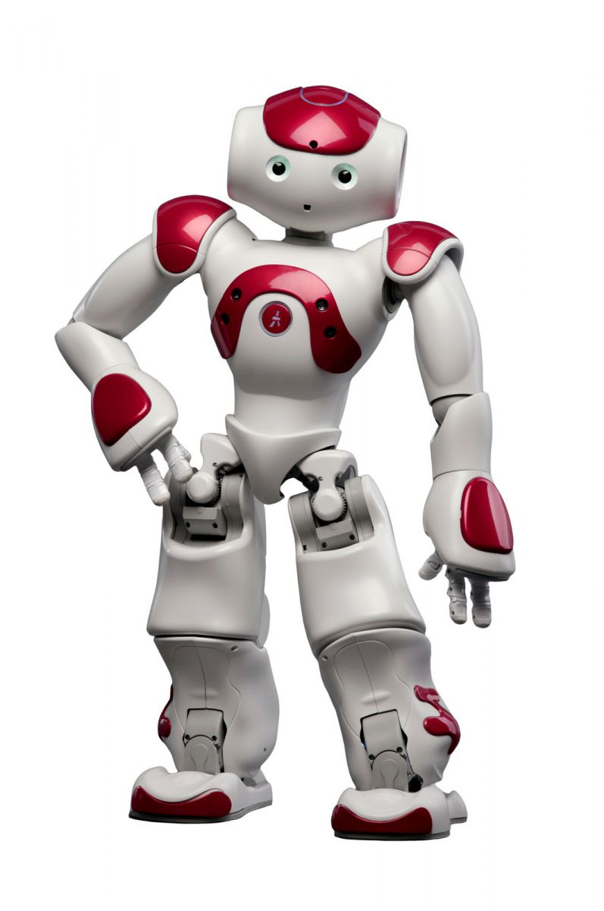

Behaviors: Design-Generate-Execute workflow
Experimot Web Interface
Experimot Application
4. Program
Generation Req
Boot strapper
Embedded
Web
Server
6. Program Start Req
3.POST
5. Dynamic Program Generation
World Description
GET
Periodic data update
7. Load Program in memory and run
1. Behavior Creation
2. Visual Program to JSON data
8.Monitor
Trigger
Motion
recognition
Robot
interface
9. Invoke
Behavior

Slide 6






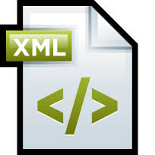



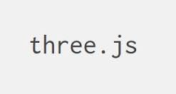








Technologies/Brands/Libraries used

Slide 7
Thank you for your attention!

