Slide 1
Indriya Platform
इन्द्रिय
Sensible
Praveenkumar VASUDEVAN

Slide 2

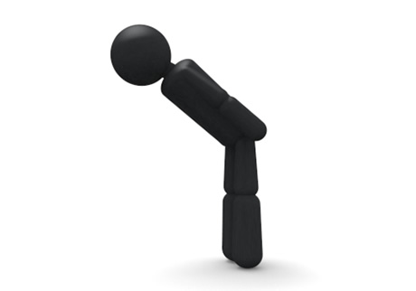
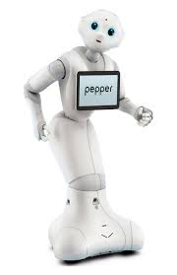
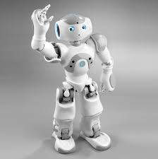
What is Indriya?
A software to design human robot interaction scenario based on human behaviors
Non-verbal communication
Verbal communication
Hello, Nao
Hello

Slide 3
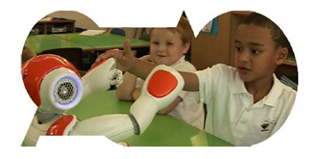
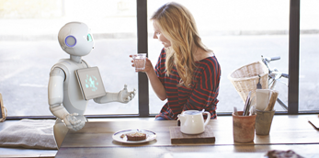
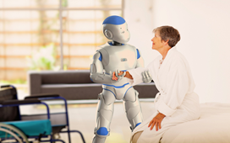
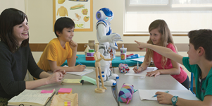
Why do we need Indriya?
Robot will be everywhere in the future closely interacting with human!
But it is very difficult to program a robot

Slide 4
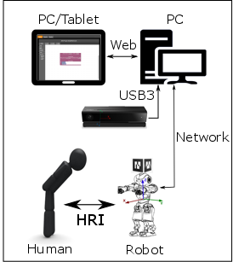
How does Indriya work?
Steps:
Choose the blocks from Toolbox and drop into designer area
Press “RUN” button when you are done!
Check the execution of the scenario

Slide 5
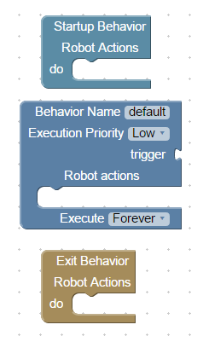
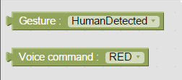
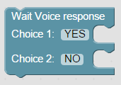
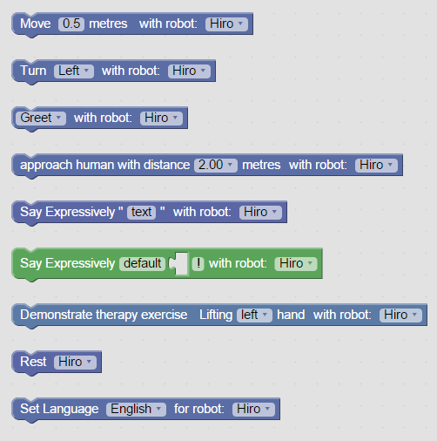
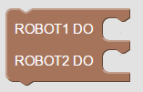
What are all the blocks available?
Program structure
Triggers
Speech response
Startup
behavior
Action-1
Action-N
Nao actions
Parallel task
Trigger behavior
Lifetime: <Once, Until, Forever>
Priority: <Low, Normal, High>
Trigger
block
Action-1
Action-N
Exit
behavior
Action-1
Action-N

Slide 6
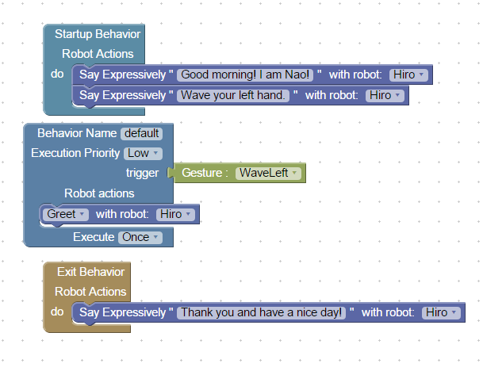
A simple program.
Can you understand it?

