Slide 1
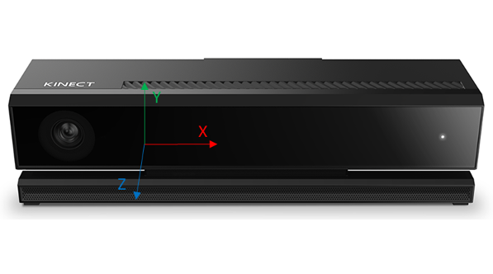
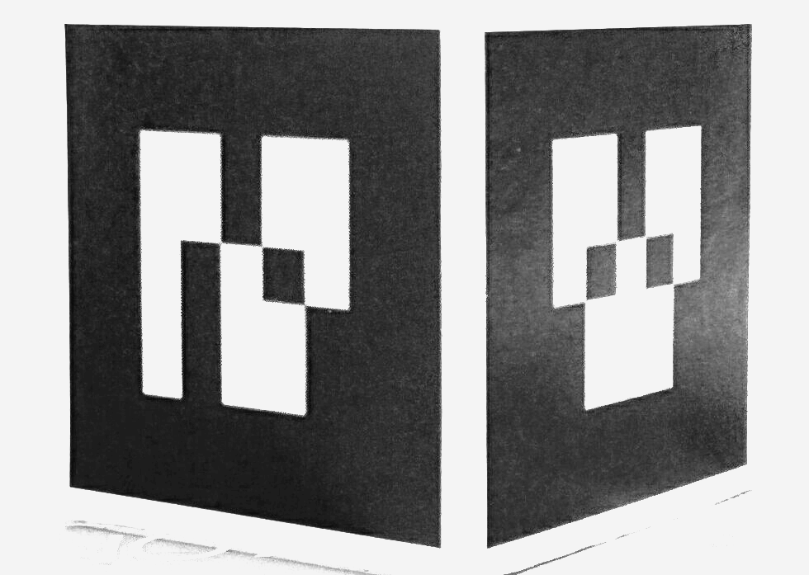
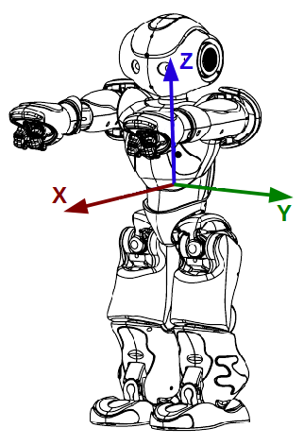
Localization node
6D Pose of robot
TCP
Static link
Robot interface node
Kinect Data capture
USB3
Ethernet
Visual Link

Slide 2
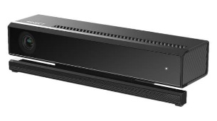

^{K}T_{M}
F_{K}
Y
^{K}T_{W}
F_{M}
Z
X
Z
X
Y
^{T}T_{M}
Z
F_{W}
F_{T}
Y
X
^{W}T_{T}

Slide 3
Action-1

