Slide 1
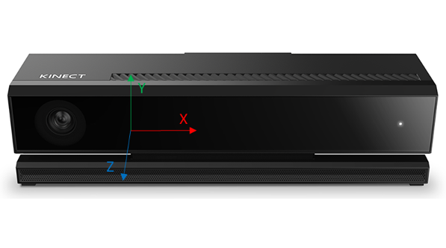
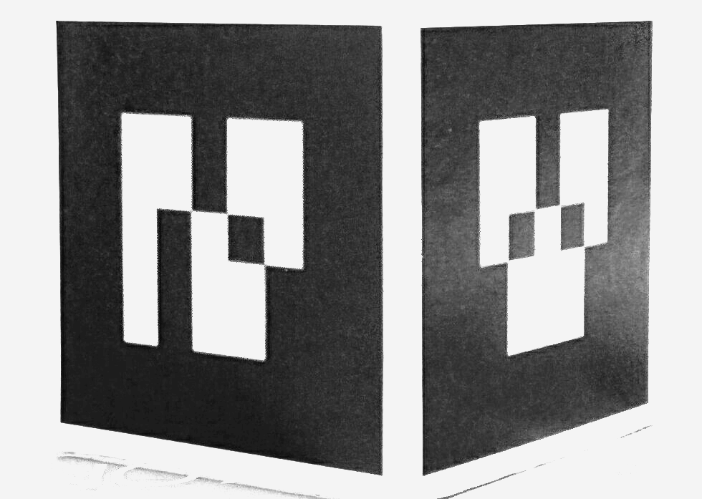
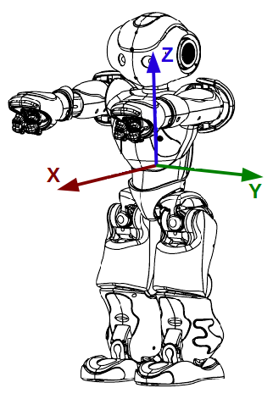
Localization node
6D Pose of robot
TCP
Static link
Robot interface node
Kinect Data capture
USB3
Ethernet
Visual Link

Slide 2


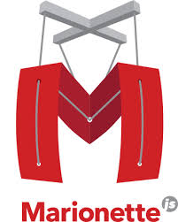





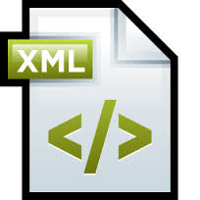



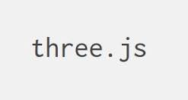







Slide 3
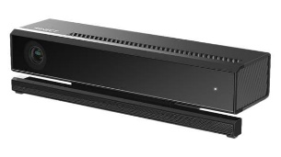

^{K}T_{M}
F_{K}
Y
^{K}T_{W}
F_{M}
Z
X
Z
X
Y
^{T}T_{M}
Z
F_{W}
F_{T}
Y
X
^{W}T_{T}

Slide 4
Startup
behavior
Action-1
Action-N
Trigger behavior
Lifetime: <Once, Until, Forever>
Priority: <Low, Normal, High>
Startup
block
Action-1
Action-N
Cyclic
block
Action-1
Action-N
Exit
block
Action-1
Action-N
Exit
behavior
Action-1
Action-N

Slide 5
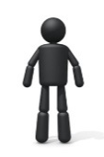
Behavior
Execution
Engine
Behavior
Program
Behavior Execution Context
Application Context
Visual Gesture Builder
Gesture
Database
Gesture Runtime
Application
Kinect Studio
Recorded Clips

Slide 6
Audio input/ Frontend
Feature extraction
Acoustic model
Backend
Grammars
Recognition algorithms
Recognition result

Slide 7
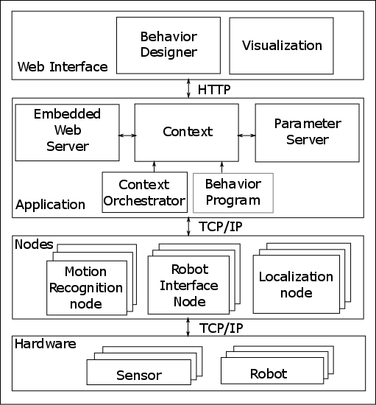
Web
Interface
Behavior designer
Visualization
HTTP
Embedded web server
Application Context
Parameter Server
Context orchestrator
Behavior execution engine
Behavior program
Application components
TCP/IP
Motion recognition
Speech recognition
Robot interface
Nodes
Localization
TCP/IP
Hardware
Sensor
Robot

Slide 10
Trigger behavior
Trigger : HumanDetected
Lifetime: Once
Priority: Normal
Approach human with
distance 2.0 metres
Robot
Actions
Greet the human
Say about the museum

