Slide 1
Indriya Platform

Slide 2

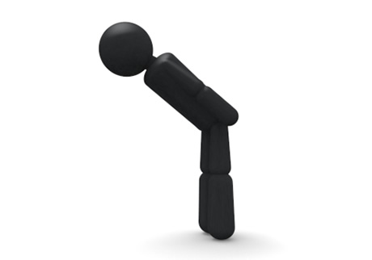
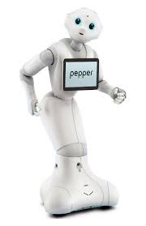
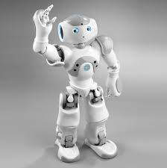
What is it?
A software to design human robot interaction scenario based on human behaviors
Non-verbal communication
Verbal communication
Hello, Nao
Hello

Slide 3
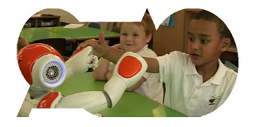
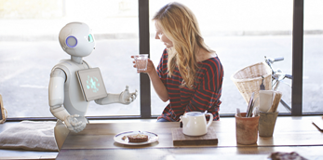
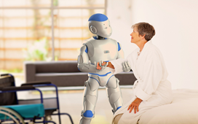
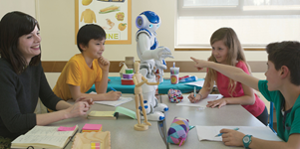
Why do we need it?
Robot will be everywhere in the future!
But it is very difficult to program a robot

Slide 4
How does Indriya work?

