Slide 1
Developing an experimental platform for Human Robot Interaction based on human motions
Praveenkumar VASUDEVAN
European Master in Advanced RObotics
Supervisors : Gentiane VENTURE, Associate Professor, TUAT
Yannick AOUSTIN, Maître de Conférence à l'Université de Nantes
Co-supervisor : Armando TACCHELLA, Associate Professor, University of Genoa
2015/06/08

Slide 2
Motivation(s)
Humans interacting with intelligent Robots has been seen as a potential game changer in the future.
Human motion (Non-verbal communication) is rich in information and understanding it is very important to improve the interaction.
Motion conveys intention, health, emotion etc.,
Existing tools for designing HRI scenarios and robot behaviors are not scalable and requires skilled roboticists’ assistance
Goal : To develop an experimental platform which
Facilitates interaction based on human motion
Is easy to use by a common user to design and execute interaction scenarios

Slide 3
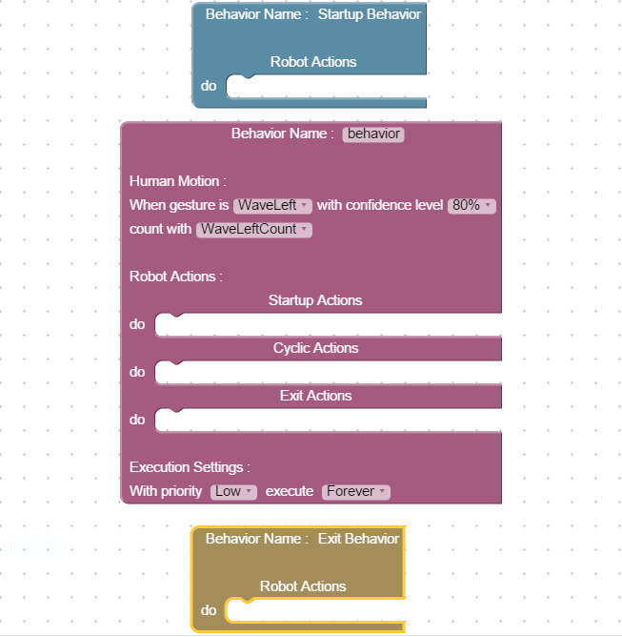
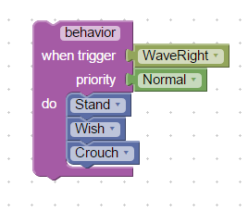
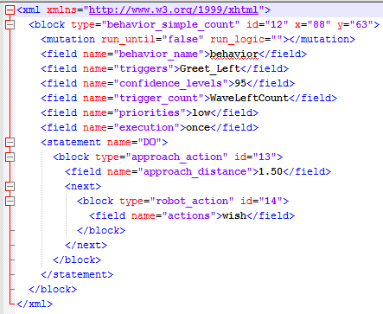
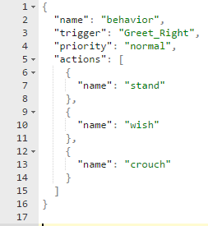

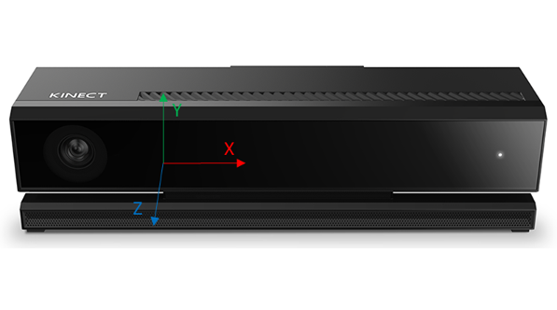
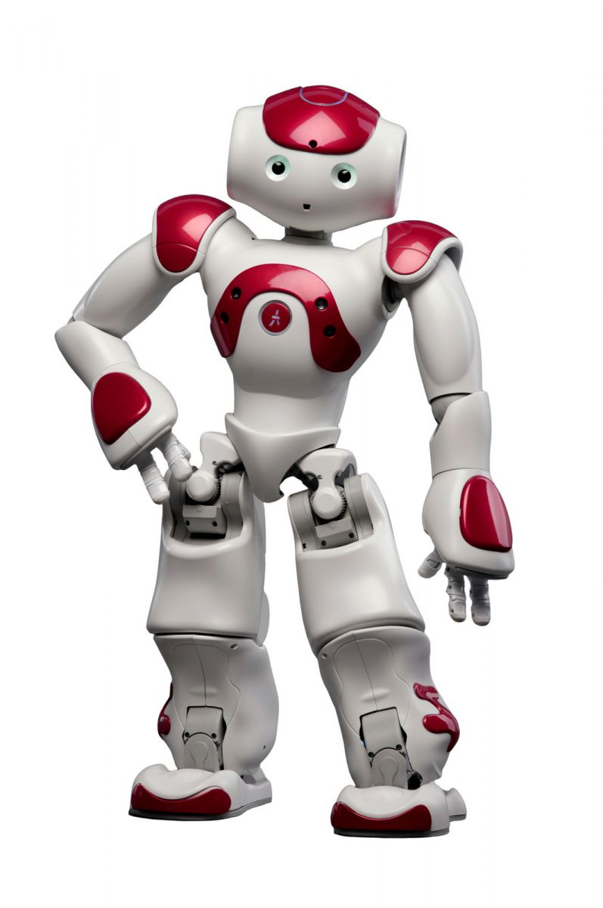

Behaviors: Design-Generate-Execute workflow
Experimot Web Interface
Experimot Application
4. Program
Generation Req
Boot strapper
Embedded
Web
Server
6. Program Start Req
3.POST
5. Dynamic Program Generation
World Description
GET
Periodic data update
7. Load Program in memory and run
2. Declarative XML
2. Declarative JSON
8.Monitor
Trigger
1. Behavior Creation
Motion
recognition
Robot
interface
9. Invoke
Behavior

Slide 4
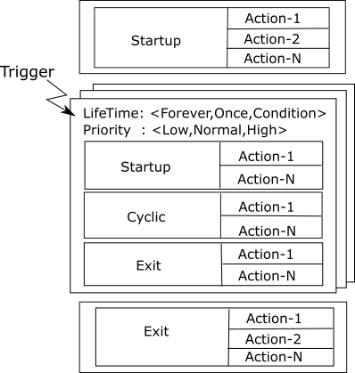
Behavior Program Structure

Slide 5

Misc Updates
Web Client side UI has been improved
LOAD/SAVE/CLEAR
Improvement to the behavior program parser.
Support for Gesture counter (Simple counting based on gesture active period)
Dynamic expression evaluator for program termination etc.,
Nao Behavior Execution module improvement
At startup, it registers a set of action capabilities to the application.
Each action is composed of <action_name,action_parameters>
Imitation support using the joint angles computed using KinectEx library - incomplete

Slide 6
Misc Updates
Documentation
Thesis documentation started
ICSORO 2015 Conference paper update
Scenario 1: NAO as a demonstrator
Scenario 2: NAO as a therapy facilitator

Slide 7
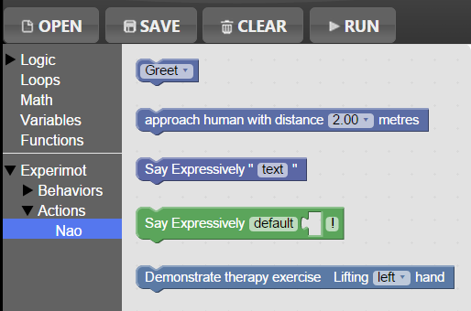
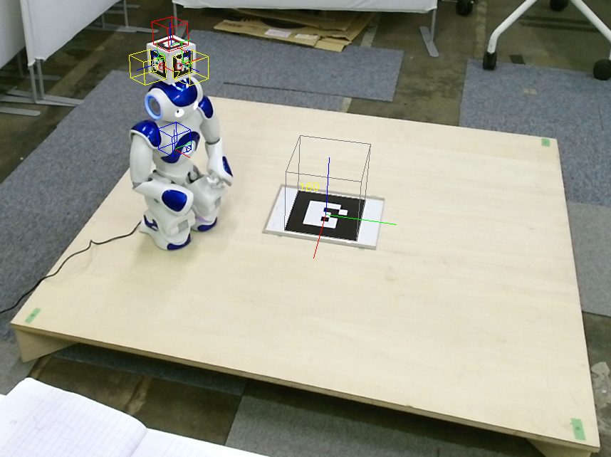
New robot actions
Approach Behavior
X
X
Y
Robot
X
Y
World
X
Y
Human

Slide 8

Results
NAO as a demonstrator in a museum
NAO as a therapy facilitator

Slide 9
TODO List
Complete conference paper – Submission June 10, 2015
Thesis Documentation
User study
Think of scenarios
Collect user data
Try to integrate with Turtlebot and Pepper?
Try to integrate IMU sensor??

Slide 10
Thank you for your attention!

