Slide 1

Data Analysis
PhonePe Pulse Data

Slide 2
PhonePe: A Digital Payment Leader Insights from PhonePe Pulse data – User Registrations, Transactions, and Insurance Trends
Objective of Analysis
Transaction Data
Digital Payments Platform
User Registration Data
Insurance Data
Identify trends, patterns, and correlations in user registrations, transaction activity, and insurance adoption over time.
Facilitates instant money transfers and various payment services.
User Registration Insights –
Growth trend analysis (2018-2022) and phone brand preferences
Transaction Insights –
Yearly, Quarterly Trends (2018–2024) and Category-wise Analysis
Insurance Insights –
Yearly, Quarterly Trends (2020–2024)

Slide 3
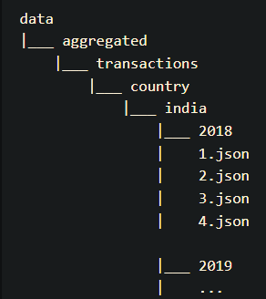
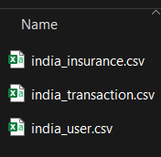
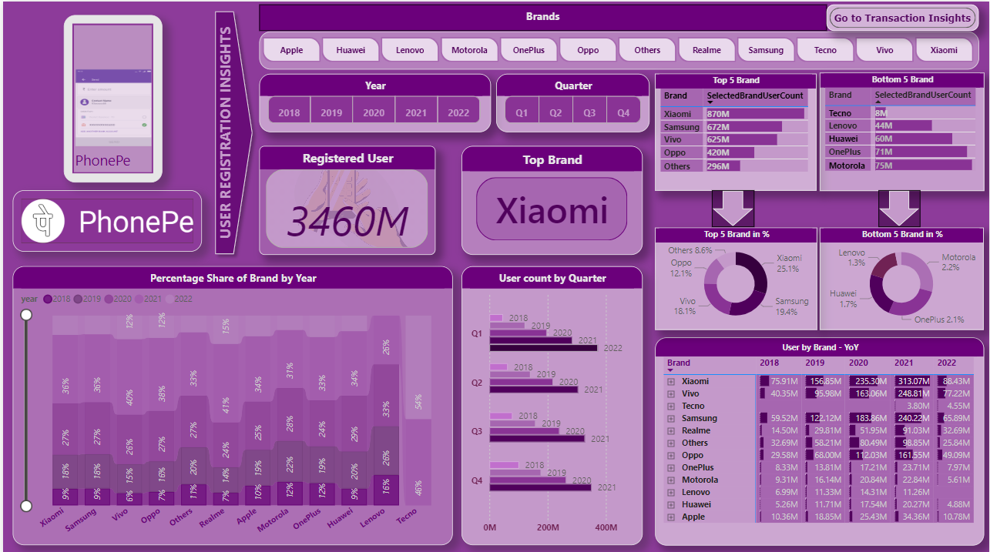
Overview of the Dataset and Data Integration Process
What does the dataset contain?
Data Integration Process (ETL Process)
User Registrations by phone brands
(2018-2022)
Transaction amounts and counts
(2018–2024)
Insurance policies taken via PhonePe
(2018-2020)
Extract
Collect PhonePe Pulse - Data
JSON Form
Transform
Clean, enrich and convert the raw data into usable format
Load
Loading PhonePe’s cleaned data into Power BI for visualization
Used Python to extract data

Slide 4
Visualization using Power BI
CLICK HERE FOR
LIVE DASHBOARD

Slide 5
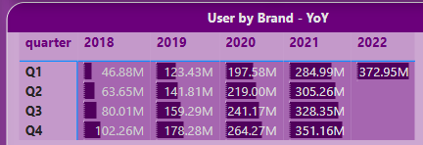
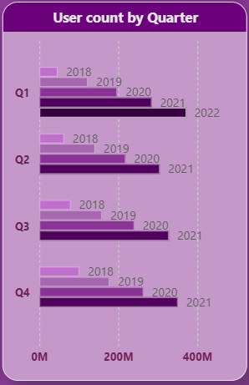
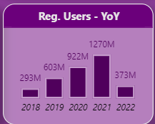
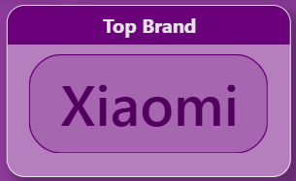
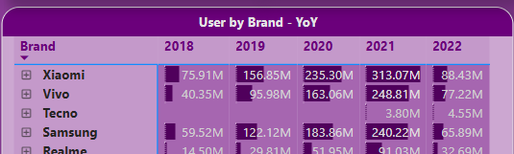
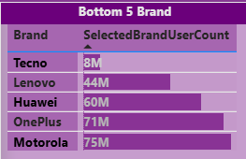
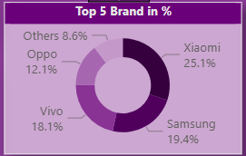
PhonePe Pulse Data - Insights
User Registration Insights
Most users registered PhonePe using Xiaomi brand.
For every year, Q1 is having less user registration
Q4 is having more user registrations
* 2022 show only Q1 data
Steady Growth in user registration from 2018 to 2021.
Xiaomi, Samsung and Vivo stands as top 3 brands across all years which shows most of the users are registered with these brands.
62% users used top 3 brands
Bottom 3 brands used for Registration are Lenovo, Huawei, OnePlus.
* Tecno brand has data for Q1 and Q2 only.

Slide 6
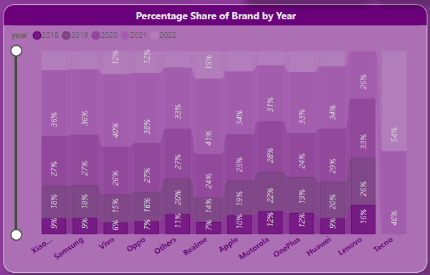
PhonePe Pulse Data - Insights
User Registration Insights
Xiaomi consistently has the highest percentage share across all years, indicating its strong market presence and sustained popularity.
Samsung holds the second position throughout most years, maintaining steady growth with slight fluctuations.
Yearly Percentage Share increased for Vivo and Realme brand by 53% and 70% respectively in 2021 compare to 2020
Yearly Percentage Share decreased for Lenevo (-21%) and Motorola (10%) in 2021 compare to 2020

Slide 7
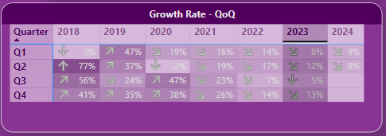
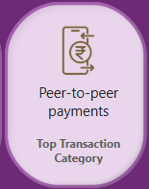
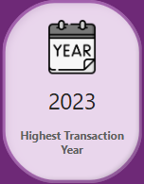
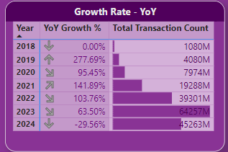
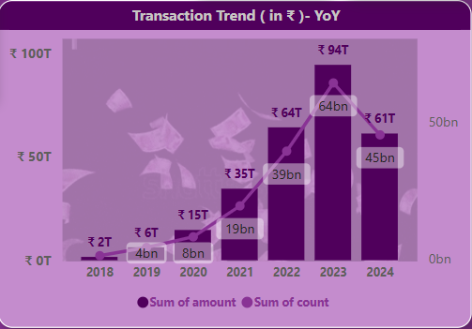
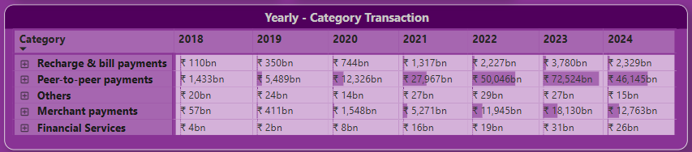
Digital Transactions Insights
High Growth Quarters: Q4 of each year shows highest growth, driven by festive shopping and end-of-year offers.
Transaction volumes grew by an average of 109% year-over-year, with the highest growth in 2019 due to increased digital adoption during the pandemic.
Reduction in QoQ transactions volumes after 2020:
The reasons could be Economic Slowdown, Inflation and Post Pandemic Effects and Market Competition.
Seasonal Impact: Q1 typically shows slower growth or declines, likely due to post-holiday reduced spending and fewer promotions. But 2019 Q1 is exceptional due to increased digital adoption during the pandemic.
Peer-To-Peer payments is the Top Transaction Category.
Highest Transaction Year is 2023. Around ₹ 94T
Strong Growth Period (2018-2023):
Transaction amounts rose from ₹2T in 2018 to ₹94T in 2023—a growth of 4,600%.
Transaction counts increased from 4 billion in 2019 to 64 billion in 2023—a significant adoption curve.
Possible Drivers:
Increased smartphone penetration.
Adoption of digital payments, especially post-2020 due to COVID-19.
Dominance of Peer-to-Peer Payments:
Peer-to-peer payments (P2P) have consistently contributed the largest share across all years.
Merchant Payments Show Strong Growth:
Merchant payments grew exponentially, from ₹57bn in 2018 to ₹18,130bn in 2023.

Slide 8
Registered User Data Interpretation
The analysis for Registered User for PhonePe Application is based on below assumptions
Duplicate Registrations ( Using multiple mobile numbers)
Many users may register multiple accounts using different phone numbers, emails, or devices.
Businesses might also create multiple accounts for different purposes, adding to the total count.
Inactive or Dormant accounts
The number may include users who registered but no longer actively use the platform.
Old accounts that are not deleted might still be part of the total.
Non-Human Entities
Some accounts could be created by bots or for testing purposes.
Business or institutional accounts might also be counted.
Non-Unique Users
A single individual may have registered multiple accounts for different purposes (e.g., personal use, business use).

Slide 9
Thank You

