Slide 1
AIRTRIBE · B2B PRODUCT STRATEGY
Earn the platform.
Don't announce it.
A 2–3 year strategy for AI-powered Customer Operations, diagnosed from why the original mid-market motion adopted slower than expected.
91
4
4
1
Public evidence
records (56 sources)
Anonymized
interviews
Vendor
teardowns
Bottom-up
market analysis
Praveen Veera · Airtribe — AI-First Product Management · September 2026
Notes:
This is built on real evidence — 91 records, 4 interviews, 4 competitor teardowns. Here's where that leads.

Slide 2
HOW TO USE THIS DECK
The 5-minute story, plus everything behind it
THE STORY · SLIDES 3–12
The decision, the diagnosis behind it, who it's for, the problem, the competitive read, what ships first, the moat, how it expands, and where it stands today. Everything needed to follow the recommendation.
APPENDIX · SLIDES 13–29
The full evidence behind every claim in the story: methodology, segment and problem detail, all four interviews, the market model, the complete four-vendor teardown, MVP sequencing, the roadmap, moat mechanisms, GTM, and the risk/decision-gate register.
B2B Product Strategy
2
Notes:
Quick note — this deck has a short story, then the full evidence in the appendix.

Slide 3
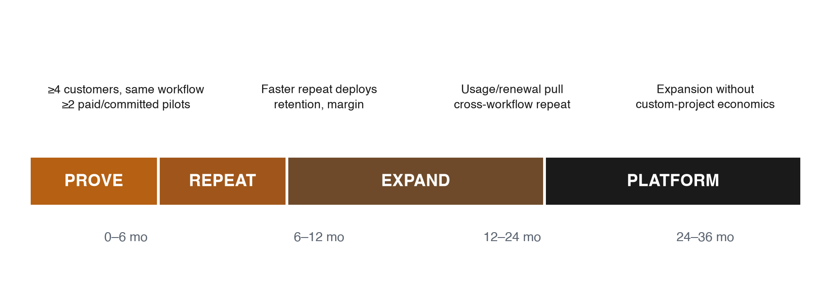
THE DECISION IN ONE LINE
Land narrow. Prove it's safe. Earn the platform.
Leadership is right that the destination is a comprehensive Customer Operations Platform — but naming it doesn't earn it. Land one narrow, low-trust workflow; prove it; expand only after it's earned.
B2B Product Strategy
3
Notes:
Here's the whole idea in one line: don't build the big platform first. Build one small thing, prove it actually helps people, and let the bigger platform earn its way in — instead of announcing it and hoping people show up.

Slide 4




THE DIAGNOSIS
Why did the original motion stall?
The brief hands us a fact: mid-sized businesses (200–1,000 employees) were targeted first, and adoption was slower than expected. Four failure modes explain it — each traceable to evidence already on file.
1
Positioning trap
2
Access-and-trust veto
Sold as “another AI chatbot.” Every incumbent already claims AI agents, integrations and governance.
IT/security can kill a deal before the product is evaluated. P03: pilot capped to 2 queues, write-back disabled.
3
Bundled-AI trap
4
Workflow mismatch
Buyers compare a new vendor to the AI they already pay for. Freshworks: 36% still stuck in pilots.
Chat deflection was sold; the pain (P01, P02, P04) is back-office context work, not failed FAQs.
B2B Product Strategy
4
Notes:
So why didn't the original idea take off? Four reasons.
One — we called it “another AI chatbot.” Every competitor — Intercom, Zendesk, Freshdesk, Salesforce — already had one. Nothing new.
Two — IT and security can kill this before anyone tries it, like hiring someone without a key to any door.
Three — these companies already pay for AI inside tools they use. We weren't competing against nothing, but against something already paid for.
Four — we built something to answer questions faster. But the real pain was digging through different systems to understand what was going on.

Slide 5
WHO THIS IS FOR
Keep the size band. Narrow hard on who.
WORKING SEGMENT B2B SaaS / tech-enabled services, ~51–1,000 employees, running a helpdesk AND a separate CRM or system of record.
ANTI-PERSONAS — NOT:
Regulated / financial services
Single-system shops
Multi-client outsourced support (BPOs)
P02 shows the compliance approval chain this triggers.
No context to reassemble means no wedge.
P01's stack changes by client; no one owns access.
Primary persona: frontline support/operations practitioner owning escalation work across several systems — searches, copies, waits, and reconstructs history; handoff context isn't durable.
B2B Product Strategy
5
Notes:
So who's this for? Not huge companies like banks — too much red tape. Not tiny companies either — they run on one tool. The sweet spot: mid-sized companies, roughly 50 to 1,000 people, running two systems that don't talk to each other.
On size — the wider category is worth tens of billions a year, too broad to mean much here. A narrower estimate of just this problem: 400 to 900 million a year — meaningful, but still an estimate.

Slide 6
THE CORE PROBLEM
One problem, aimed at the mismatch
JOB STORY
When a support agent picks up a case that needs information or action from a second system, they want a single place to see everything relevant — because today that costs 15–25 minutes of manual work per case and leaves duplicate history for the next person to reconstruct.
Two of four interviews (P01, P04) describe it — below the interview guide's own 4-participant validation threshold. Leading hypothesis, not proven, aimed directly at the mismatch diagnosed above.
B2B Product Strategy
6
Notes:
Picture this: a customer writes in with a problem, and the agent needs information sitting in a different system. So they open another tab, log in, search, copy it, and come back. That's the whole problem: too much manual digging, nowhere to see it all in one place.

Slide 7
WHERE WE COMPETE, AND WON'T
Every incumbent already claims AI. That's not the wedge.
SEVEN CAPABILITIES EVERY INCUMBENT ALREADY CLAIMS
AI agents · agent assist & summarization · human handoff · integrations & actions · analytics & governance · usage/outcome pricing · compatibility with an existing stack
Generic AI and integration claims cannot carry the strategy on their own.
THE WEDGE TO TEST
Workflow-specific completeness — assemble permissioned context, show the evidence used, route approval, preserve the full handoff, and write the result back — faster and cheaper than the incumbent's native AI.
B2B Product Strategy
7
Notes:
Every competitor already says they have AI. That's not special anymore — it's expected, like a car having air conditioning. We're not winning by saying “we have AI too.” We're winning at one thing none of them do well: connecting the dots across two systems, showing where an answer came from, with a human signing off on anything risky first.

Slide 8
FOUR INTERVIEWS, ONE DIRECTION
Different companies. The same shape of pain.
P01
Enterprise outsourced support
P02
Enterprise banking complaints
FRONTLINE PRACTITIONER
FRONTLINE PRACTITIONER
Handles 5–6 difficult cases a day; each one costs 20–25 minutes of copying context between the helpdesk and internal systems before the actual fix even starts.
Every complaint means 15 minutes of duplicate logging, then a 4–6 hour wait for formal approval — audit evidence ends up split across systems.
SHOWS QUANTIFIED CONTEXT AND HANDOFF COST
SHOWS AUDIT AND APPROVAL FRICTION
P03
Mid-market application approval
P04
Mid-market B2B SaaS/services
APPLICATION-APPROVAL STAKEHOLDER (~400 EMPLOYEES)
FRONTLINE PRACTITIONER
Approved a one-month pilot only after it was capped to two queues with write-back disabled — access had to be earned, not assumed.
Manually reassembles Zendesk history inside Jira for every engineering escalation, and explicitly warned against adding a duplicate system.
SHOWS TRUST HAS TO BE EARNED IN STAGES
SHOWS THE PATTERN REPEATS, UNPROMPTED
THE COMMON THREAD every one of these is the same root problem wearing a different costume: information stuck in a system the agent isn't in, and no fast, safe way to get it.
4 of the requested 8–12 interviews — directional evidence for the workflow pattern, not a validated sample.
B2B Product Strategy
8
Notes:
We talked to four people. One support agent spends 20 to 25 minutes gathering information per hard case, several times a day. One in banking told us a case meant 15 minutes of duplicate typing plus a four-to-six-hour wait for approval. A third only agreed to test this after we locked it to two areas with no ability to change anything. A fourth warned us against adding another separate system.

Slide 9
WHAT WE'D BUILD FIRST
One workflow, six steps, human in the loop
Where the AI actually does the work — not just automation with extra steps.
STEP | PRODUCT RESPONSIBILITY | SHIPS AT | WHAT'S AI
1. Detect | Identify a difficult or escalated case in the existing helpdesk | Land | Classifies case difficulty
2. Resolve identity | Link customer/account across helpdesk and one system of record | Land | Deterministic — not AI
3. Assemble context | Retrieve recent ticket, account and approval state, read-only, sources shown | Land | Retrieves + synthesizes across systems (RAG)
4. Recommend | Summarize history, gap and next action; draft a customer update | Expand | Drafts the update in plain language
5. Approve / hand off | Route high-risk steps to the right person with complete context | Expand | Judges its own risk/confidence
6. Write back | Record outcome, source and next step in the system of record | Expand | Executes once approved — mechanical
MVP BOUNDARY one helpdesk, one system of record, one workflow, agent-assist/shadow mode, citations, approval, audit. Not in scope: helpdesk replacement, open-ended autonomous actions, general chatbot.
B2B Product Strategy
9
Notes:
Nothing fancy at first — an AI reads the case, pulls together information from both systems, and shows it to the agent in one place, read-only, so it can't break anything. No auto-replies yet, no robot acting alone — think of it as a research assistant doing the reading and the first draft, while the person still decides. That same AI also judges how confident it is, so anything risky gets a human's eyes before it happens.

Slide 10





MOAT: WHAT COMPOUNDS
Not the model. What repeats after it.
1
Workflow evaluation data Every case this workflow handles — like P02's regulated-banking approval — becomes a labeled example of a correct answer, a safe refusal, or an escalation.
DEFEATS Competitors starting quality from zero, with no examples of their own.
2
Reliable action contracts Each system connection (helpdesk ↔ CRM, helpdesk ↔ ticketing) is versioned, scoped, audited, and reversible, so a failed write-back rolls back safely.
DEFEATS An easy-to-copy idea undermined by hard-to-copy operational hardening.
3
Operational learning loop When a context-gathering mistake like P01's happens once, it becomes a regression test — the same error can't quietly resurface in the next release.
DEFEATS Quality resetting with every new release.
4
Repeatable deployment The second customer running the same helpdesk-plus-CRM combination deploys from a template, not from scratch.
DEFEATS Slow, expensive, bespoke deployments that never get cheaper.
5
Switching cost, trusted ops Every month of use builds a customer-specific permission and evaluation profile — the same P03-style trust a capped, two-queue pilot took time to earn.
DEFEATS A competitor being swapped in easily.
None of the five above is the model, generic retrieval, or connector-catalogue size — those are copyable, not defensible.
B2B Product Strategy
10
Notes:
So what stops a bigger company from copying this? A few things, all from using it. It learns what a “good” answer looks like for that company — a new competitor starts from zero. System connections get more reliable over time. Every mistake becomes a lesson that doesn't repeat. And the longer someone uses it, the more trust is baked in — starting over elsewhere becomes a real hassle.

Slide 11
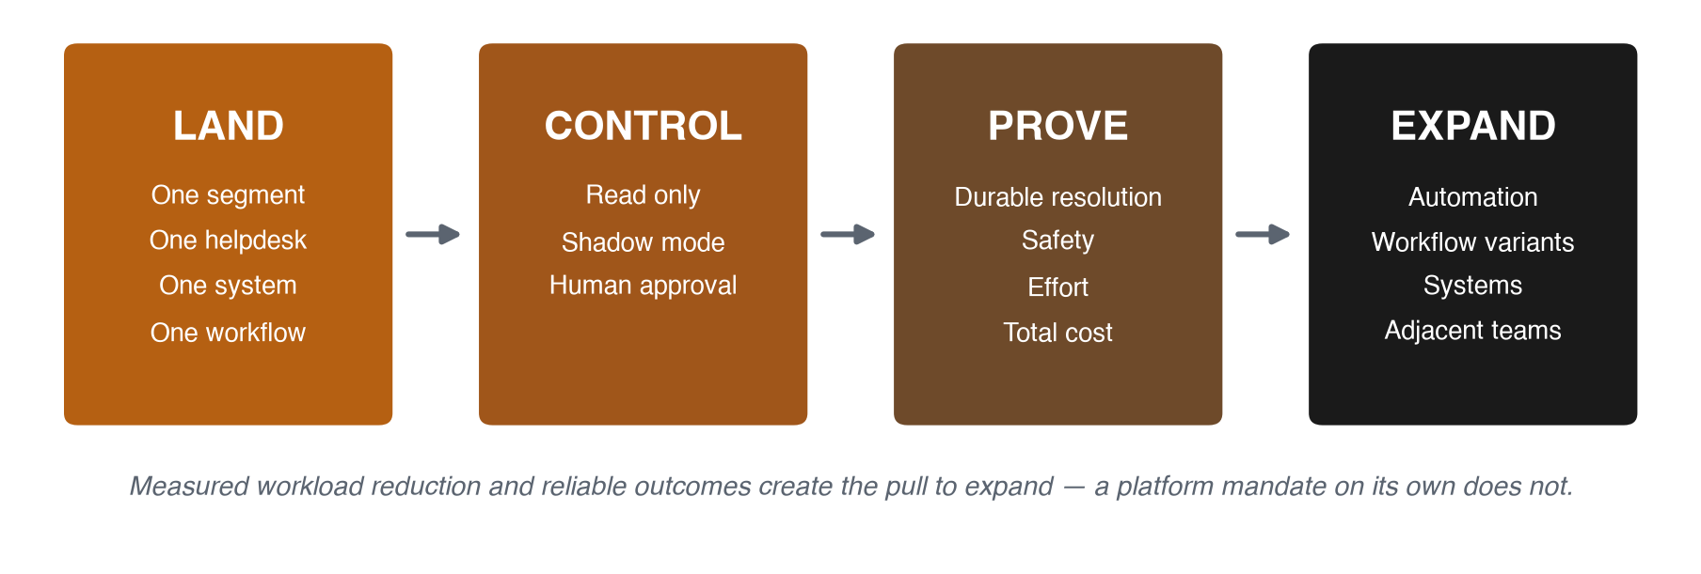
LAND AND EXPAND
Small door in. Wide footprint, only if earned.
BUYER & APPROVERS Head/VP Support or Customer Ops buys; Support Ops operates; IT/security approve. Starting read-only means the hardest approver has almost nothing to review on day one.
B2B Product Strategy
11
Notes:
It grows in stages: prove it for six months, spend the next six making it faster to set up elsewhere, stretch to nearby problems in year two, and only talk platform in year three, if it's working.

Slide 12
IN CLOSE
Four decision gates.
Zero fully met.
That's the honest starting line.
Proceed only as a bounded, assist-first hypothesis, validated through a controlled pilot. The platform ambition doesn't change — how we get there does.
Appendix follows — the full evidence behind every slide in this story.
B2B Product Strategy
12
Notes:
I want to be upfront: this isn't proven yet. We talked to four people, not the eight we wanted. And of the four checkpoints we needed to see clearly — the same problem repeating, real time saved, proof the built-in AI wasn't enough, and real interest in a paid trial — none have happened yet.
So this isn't a “we're sure, let's go” pitch. It's the smallest, most honest next step: try it small, watch closely, and build bigger only once it's earned.

Slide 13
APPENDIX
The full evidence behind every slide in the story
B2B Product Strategy — Appendix
13

Slide 14
APPENDIX · METHODOLOGY AND EVIDENCE BASE
Four layers, never mixed
COUNT | MEANING
65 | Source register entries: 64 external sources plus the assignment brief
56 | Unique source IDs referenced by the 91 evidence records
91 | Claim-level public evidence records with source URL, confidence and limitation
4 | Interview records, maintained separately from public evidence
INTEGRITY RULE no review post is treated as an interview; no vendor statistic is treated as universal market fact. The competitive teardown keeps its own register in the same discipline — V (vendor claim), R (review signal), I (interview), H (synthesis), U (unresolved).
B2B Product Strategy — Appendix
14

Slide 15
APPENDIX · SEGMENT AND PROBLEM
Who it's for, and what breaks for them today
SEGMENT | PAIN EVIDENCE | WHY NOT
Enterprise | Most acute (P01 ~100–150 min/day; P02 4–6 hr waits) | P02 is regulated banking; P01 is a multi-client BPO with no stack owner
SMB / startups | Usually one consolidated tool | No helpdesk+CRM seam — no wedge to build on
Mid-market, filtered | The seam exists; buyer is reachable | Selected — avoids all three traps at once
PROBLEM STATEMENT Across four interviews, two frontline cases show manual context transfer during complex escalation; a banking case shows duplicate audit work and approval delay; an application stakeholder shows permission and write-back barriers.
Primary persona: frontline support/operations practitioner owning L1.5, escalation or exception work across several systems.
B2B Product Strategy — Appendix
15

Slide 16
APPENDIX · INTERVIEW EVIDENCE
Four perspectives, full detail
P01
Enterprise outsourced support · frontline
P02
Enterprise banking complaints · frontline
5–6 difficult cases/day; 20–25 min context work per case. Strategic use: quantified context and handoff cost.
15 min duplicate logging; 4–6 hr formal approval wait. Strategic use: audit, approval and read-only constraints.
P03
Mid-market (~400) · application approval
P04
Mid-market B2B SaaS/services · frontline
One-month pilot, 2 queues, write-back disabled. Strategic use: least-privilege, reversible pilot design.
Manual Zendesk-to-Jira summary; warns against a duplicate system. Strategic use: second context/handoff case plus counter-evidence.
DIVERSITY AUDIT / LIMITATION 2 enterprise + 2 mid-market; 3 frontline + 1 application-approval stakeholder; no support manager or economic buyer. Sample is 4 of the requested 8–12 minimum.
B2B Product Strategy — Appendix
16

Slide 17
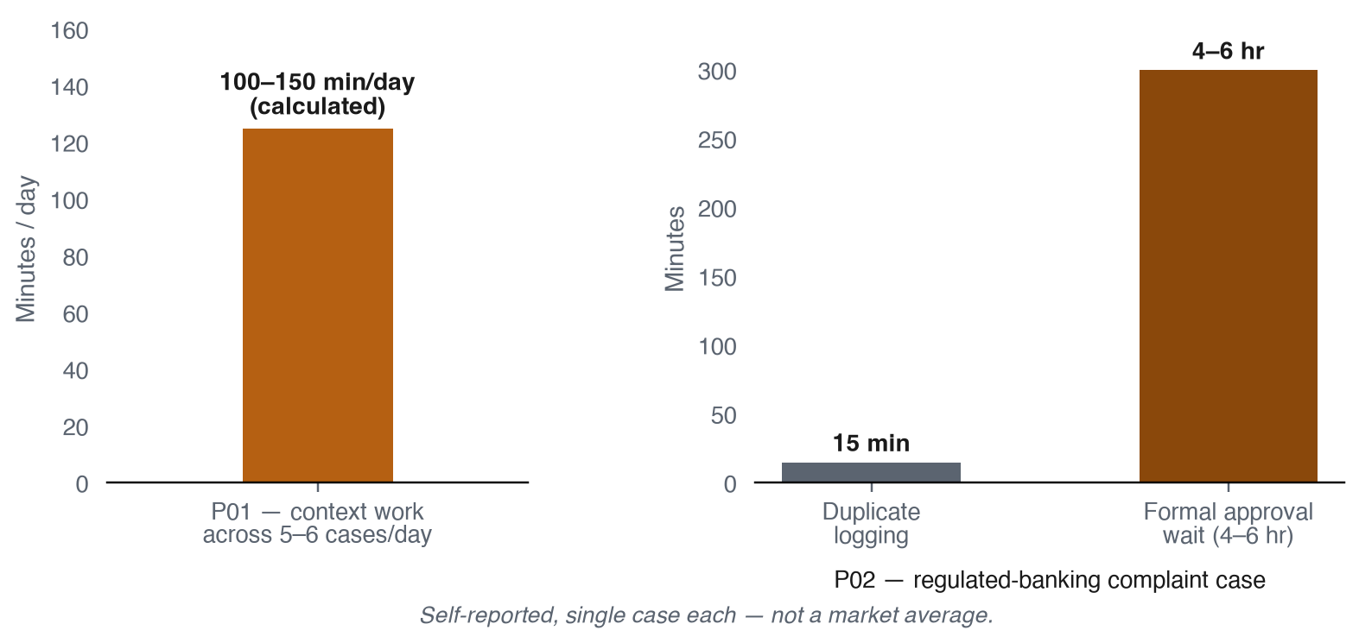
APPENDIX · INTERVIEW EVIDENCE, QUANTIFIED
Where interviews gave a number
B2B Product Strategy — Appendix
17

Slide 18
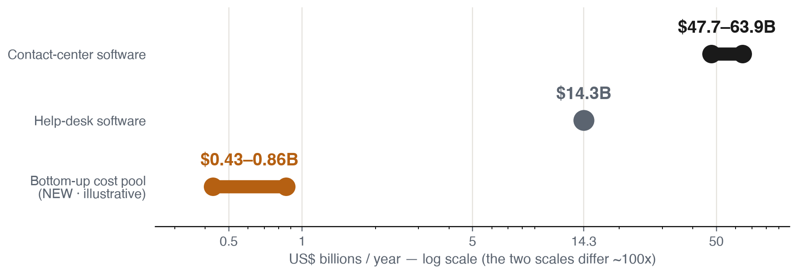
APPENDIX · MARKET OPPORTUNITY
Big category, frequent workflow, unproven price
BOTTOM-UP
COST POOL
$430–860M
/year, illustrative — a cost-of-the-problem ceiling, not a revenue forecast.
Willingness-to-pay logic: customers may pay if the product removes measurable coordination work and avoids reopens at a predictable total cost. No interview established an economic buyer, budget threshold, or purchase intent.
B2B Product Strategy — Appendix
18

Slide 19
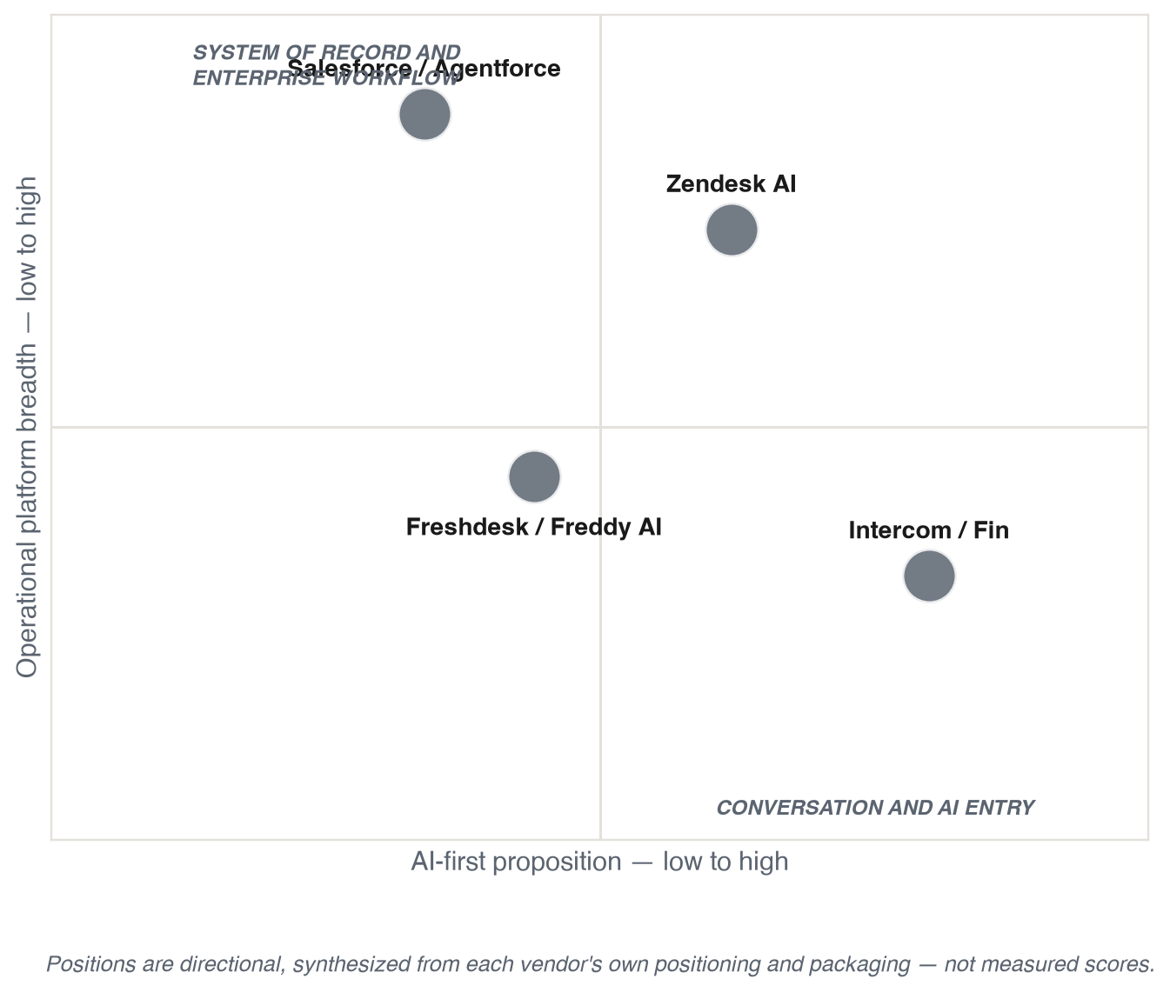
APPENDIX · COMPETITIVE MAP
Four different entry doors
B2B Product Strategy — Appendix
19

Slide 20
APPENDIX · COMPETITIVE POSITION
What each incumbent already owns
IN
Intercom / Fin
ZD
Zendesk AI
Promise (V1–V3): AI resolution, clear outcome unit. Weakness (R1, R2): complex workflows can shift work back to support ops.
Promise (V4, V5): complete service ops with embedded AI. Weakness (R3, R4): breadth raises configuration and cost complexity.
FD
Freshdesk / Freddy AI
SF
Salesforce / Agentforce
Promise (V6–V8): approachable omnichannel, packaged AI. Weakness (R5): advanced depth lags as teams mature.
Promise (V9–V11): governed AI on trusted CRM context. Weakness (R6): time to value and cross-cloud complexity.
Rejected differentiators: “uses AI,” “unifies context,” “integrates,” “governed and secure,” “vendor neutral” — necessary, none sufficient.
B2B Product Strategy — Appendix
20

Slide 21
APPENDIX · WEDGE AND VULNERABILITY
Where each incumbent is strong, and where to test
PRODUCT | ENTRY WEDGE | WHAT COMPOUNDS | VULNERABILITY TO TEST
Intercom / Fin | Standalone, outcome-priced AI agent | Conversation, knowledge, workflow, evaluation data | Tuning effort, handoff quality, cost predictability
Zendesk AI | Trusted ticketing system of record | Case history, routing, reporting, marketplace | Setup effort and workflow-specific resolution quality
Freshdesk / Freddy AI | Ease and accessible price-to-value | Configured helpdesk workflow, apps, suite | Advanced depth and integration reliability
Salesforce / Agentforce | CRM context, enterprise governance | Data, flows, permissions, partners | Time to value, fit for non-Salesforce stacks
H: derived from current vendor positioning, packaging, and workflow — not independently measured moats.
B2B Product Strategy — Appendix
21

Slide 22
APPENDIX · CROWDED CAPABILITY SPACE
Seven capabilities every incumbent already claims
1
AI agents and knowledge-grounded answers
2
Agent assistance and summarization
3
Human handoff and approvals
4
External integrations and system actions
5
Analytics, evaluation, and governance
6
Usage- or outcome-based pricing
7
Compatibility with an existing service stack
STRATEGY IMPLICATION generic AI and integration claims cannot carry the product strategy. A credible entry needs one workflow where the product proves better completion, control, effort, or cost.
B2B Product Strategy — Appendix
22

Slide 23
APPENDIX · INITIAL WORKFLOW
The six-step workflow and its trust-graduated stages
STAGE | WHAT SHIPS | ACCESS REQUIRED | EXIT SIGNAL
Land | Read-only view (steps 1–3). No draft, no write-back. | Read-only, zero write scopes | Unprompted use; time-to-context drops
Control / Prove | Same surface, same access. Measure minutes saved. | Unchanged | Sustained use, no incident
Expand (early) | Drafted suggestion (step 4), human-approved (step 5) | +1 narrow write scope | Drafts accepted often enough to save time
Expand (later) | Write-back (step 6); adjacent workflows | Scoped, audited write-back | Renewal, manager pull
Platform yr 2–3 | Adjacent Customer Ops workflows, same model replayed | Same model per workflow | Expansion without a bespoke project
B2B Product Strategy — Appendix
23

Slide 24
APPENDIX · ROADMAP
Earn the platform, one gate at a time
HORIZON | GOAL | EVIDENCE GATE
0–6 mo · Prove | One workflow in one segment | ≥4 customers show the same workflow; ≥2 paid/committed pilots
6–12 mo · Repeat | Deploy the same workflow faster | Faster repeat deploys; retention; acceptable margin
12–24 mo · Expand | Adjacent workflows for the same team | Usage/renewal pull; repeatable cross-workflow expansion
24–36 mo · Platform | Selected Customer Operations workflows | Expansion without custom-project economics
QUARTERLY STOP RULES narrow or stop if customers prefer incumbent-native AI at acceptable cost; don't call it a platform until expansion happens without services-heavy customization.
B2B Product Strategy — Appendix
24

Slide 25
APPENDIX · MOAT MECHANISMS
How each mechanism compounds
MECHANISM | CONCRETE ARTIFACT | RISK IT DEFEATS
Workflow evaluation data | Per-workflow library of correct/refuse/escalate examples | Competitors starting quality from zero
Reliable action contracts | Versioned, scoped, audited, reversible connectors | Easy-to-copy idea, hard-to-copy hardening
Operational learning loop | Corrections/reopens become regression tests | Quality resetting each release
Repeatable deployment | Templates per stack combination | Slow, costly repeat deployments
Switching cost, trusted ops | Per-customer permission + evaluation profile | Easy vendor replacement
The first three mechanisms were already visible in the competitive teardown; the last two sharpen that list further. None of the five is the model, generic retrieval, or connector-catalogue size — those are copyable, not defensible.
B2B Product Strategy — Appendix
25

Slide 26
APPENDIX · GTM, METRICS AND PRICING
How the motion is measured and priced
MOTION | WHO | OFFER | TRIGGER TO ADVANCE
Land | Head/VP Support or Customer Ops buys; Support Ops operates; IT/security approve | 30–60 day pilot for one workflow | Baseline volume, measurable pain, access approved
Control / Prove | Frontline agents and support managers | Shadow/assist workflow, read-only | No rise in reopens, unsafe actions or audit gaps
Expand (early) | Same support team | Adjacent variant or second system | Repeated usage, manager pull
Expand (later) | Customer success / operations | Adjacent workflows, shared controls | Renewal, buyer-backed ROI
METRICS primary: median context-collection minutes per difficult case. Guardrails: reopen rate, unauthorized action rate, audit completeness, connector failures, CSAT.
Pricing hypothesis: a predictable base subscription plus a capped usage tier tied to workflow volume or verified outcomes.
B2B Product Strategy — Appendix
26

Slide 27
APPENDIX · RISKS AND DECISION GATES
What has to be true before this scales
RISK | MITIGATION
Incumbents close the gap | Win only with a validated workflow, faster deployment, better economics
Poor context or unsafe action | Read-only first, citations, approval, audit, rollback, safe stop
Interview evidence is too narrow | Disclose 4/8; treat ICP and workflow as hypotheses
Bottom-up estimate overstates confidence | Vertical-share input labeled an assumption, not fact
REJECT OR NARROW IF customers can't name one urgent workflow; IT/security won't permit access; the incumbent completes it well enough already; no buyer will sponsor a pilot.
B2B Product Strategy — Appendix
27

Slide 28
APPENDIX · INTERVIEW DECISION GATES
All four gates are still unmet
GATE | THRESHOLD | OBSERVED | STATUS
Same repeated workflow | ≥4 participants | 2 | Not met
Measurable impact, leading workflow | ≥3 participants | 1 | Not met
Native tool insufficient | ≥3 participants | 2 | Not met
Strong pilot interest | ≥2 participants | 0 | Not met
EVIDENCE STILL MISSING buyer interviews across company size; recent workflow frequency and failure cost; a hands-on incumbent comparison; security/permission requirements; pilot sponsorship and a full cost model.
B2B Product Strategy — Appendix
28

Slide 29
APPENDIX · EVIDENCE REGISTER
The research record behind this deck
REGISTER | WHAT IT COVERS
General research base | 65 sources → 56 linked → 91 evidence records; 4 interviews (P01–P04), kept separate
Competitive teardown | V1–V11 (vendor claims), R1–R6 (review signals), I1–I2 (interviews), H (synthesis), U (unresolved)
secondary-research-report.md · source-inventory.csv · review-evidence.csv · interview notes P01–P04 · research/bottom-up-market-estimate.md · research/competitive-teardowns/
The two registers are related but kept distinct — never merged into one ID system.
B2B Product Strategy — Appendix
29

