Slide 1
NYKAA · UX ANALYSIS
Nykaa
User Experience Analysis
Five goals. Two real interviews. One website.
Praveen Veera · Airtribe — AI-First Product Management · September 2026
Notes:
0:00–0:20
"Hi, I'm Praveen. This is my Nykaa user-experience analysis for the Airtribe AI-First PM course.
Here's how I approached it — five real shopping goals on the Nykaa desktop website, back to back, marking every step as smooth, confusing, slow, or frustrating. Then two honest conversations with people outside product and design."

Slide 2
HOW TO USE THIS DECK
The 5-minute story, plus everything behind it
THE STORY · slides 3–8
APPENDIX · slides 9–18
1. The finding, in one line
2. Five journeys, at a glance
3. Three features, three verdicts
4. What two real people said
5. What I'd fix first
6. Close
1. How I tested this (methodology)
2. Journey A — full detail
3. Journey B — full detail
4. Journey C — full detail
5. Journey D — full detail
6. Journey E — full detail
7. Evidence — real screenshots
8. All recommendations, with metrics
9. Limitations, in full
Nykaa UX Analysis
2
Notes:
0:20–0:30
"Quick map before I start: what comes next is the five-minute story. Everything past the appendix divider goes into the same depth as my written report, in case anyone wants to go further."
(Click through to slide 3 as you say this — don't dwell.)

Slide 3
THE FINDING IN ONE LINE
Strong at the ends. Weak in the middle.
STRONG
STRONG
WEAK
WEAK
Discover
Decide
Buy
Return
696 results, ads up to ₹6,600 on a specific search
Filters work once used, but nothing suggests the fit
Bag + checkout: coupons, points, clear pricing
Logged-in home = logged-out home, even on old accounts
Nykaa UX Analysis
3
Notes:
0:30–1:00
"Here's my finding, in one line: Nykaa is strong at the start, when you're browsing and discovering, and strong at the end, in the bag and at checkout. Where it gets weak is the middle — turning a specific need into a confident choice.
The clearest example: I searched for a moisturizer for dry, sensitive skin, under 800 rupees. I got 696 results back, and the very first slot was an ad — for a set costing four to eight times my budget."

Slide 4
FIVE GOALS, ONE WEBSITE
What worked, what got in the way
GOAL | SMOOTH | STUCK
Moisturizer ≤₹800 | Rich cards; filters cut 696 → 178; clean checkout | 696 results; a ₹6,600 ad on top of a budget search
Luxury gift set | 91 curated sets; “Most Gifted” proof | Delivery date & gift wrap only shown deep in checkout
First lipstick | Huge social proof — one product at 1.4M reviews | 24–30 shades per product, no shade help
Logged-in visit (5-yr account) | Full order history, reward points in the cart | No reorder button anywhere; home = logged-out home
Casual browse | Lively, easy to wander, good for ideas | Everything shouts “Shop Now” — no calm mode
Full step-by-step for every journey, including the logged-in spot-check → appendix, slides 11–15.
Nykaa UX Analysis
4
Notes:
1:00–2:20
"Let me walk through the five journeys quickly.
First, the moisturizer search: great product cards, and filters that genuinely work once you use them — but still 696 results, and ads as high as 6,600 rupees kept showing up on top, even after I'd filtered by price.
Second, a gift set: 91 curated results, felt like a real shop. The catch is, delivery date and gift wrap only show up deep in checkout, after I've already picked something.
Third, a first lipstick: one point four million reviews on a single product, and zero help actually picking a shade.
Fourth, I logged into an account with five years of order history to see if that changes anything. It doesn't — full order history, still no reorder button anywhere, home page identical to a stranger's. I even reran Journey A's exact search on that account to check — identical results, down to the review counts.
And fifth, just browsing, no goal at all — genuinely pleasant. Which is exactly the point: that's the one visitor Nykaa's home page is actually built for."
How to say this: five short beats, not one list to memorize — breathe between each. "First… Second… Third… Fourth… And fifth…" is the scaffolding; the rest can drift from this wording without losing anything.

Slide 5
THREE FEATURES, THREE VERDICTS
Where the product helps — and doesn’t
GOOD
GOOD IDEA, BADLY USED
BAD
Product cards
Beauty filters
Logged-in home
Photo, price, offer price, rating, review count and a fit badge in one glance. You can shortlist without opening a single product.
Skin type, concern, ingredient — the right model, and it works. But nothing pre-applies or suggests the fit, and mobile guests hit a login wall first.
Byte-for-byte the same as logged-out — even on a five-year account. No “buy again,” no recently viewed, nothing personal.
Nykaa UX Analysis
5
Notes:
2:20–2:55
"Now, three features, and my quick take on each.
Product cards — good. Everything I need to shortlist a product, in one glance.
Beauty filters — good idea, badly used. Skin type and concern match how people actually shop for this, and the filters work. But nothing ever suggests the obvious combination, and mobile guests hit a login wall before they can even try.
Logged-in home page — bad. Identical to logged out, even on an account with five years of history."

Slide 6
TWO CONVERSATIONS
Neither person doubted the product
Person 1 — my wife
Person 2 — my sister
Shops less often
Shops most often
LIKES Trusts Nykaa more than Amazon for beauty — products always arrive in good condition, and she doesn’t worry about counterfeits.
LIKES No complaints about the products themselves — same theme: the quality is trusted.
DISLIKES Delivery dates slip with no warning. Delivery partners have marked “customer not home” with no call ever made.
DISLIKES Customer support, and the app mislabelling orders — items marked “cancelled” or “returned” when they weren’t.
Neither doubted the product. Both doubted whether the app was telling them the truth about their order.
Nykaa UX Analysis
6
Notes:
2:55–3:35
"I spoke to my wife and my sister — one shops rarely, one shops often. Both are fully convinced buyers; my wife actually trusts Nykaa's products more than Amazon's. But neither of them complained about finding things. What they both brought up, completely unprompted, was what happens after checkout — delivery dates slipping with zero warning, and orders mislabelled 'cancelled' or 'returned' by the app.
Different frequency, same wall — and that's a layer I never reached in my own testing."

Slide 7
WHAT I WOULD SHIP
Fix the middle, then the follow-through
P0
Guided narrowing after a concern search.
Skin type → concern → budget, pre-filled, one tap. Turn 696 into ~40 — the filters already exist.
P1
“Buy again” for logged-in shoppers.
A reorder row on home and a one-tap reorder in Orders. A five-year account has none today.
P1
Let mobile guests filter without logging in.
Desktop already allows it. Ask for login at wishlist or checkout, not the filter panel.
P1
Honest, proactive delivery status.
From the interviews, not my own testing — warn before a date slips; stop mislabelling orders.
P2
Stop ranking over-budget ads above the best fit.
Keep sponsored items several times over budget out of the top slot on a priced search.
Not now: an AI chat assistant. The filters already fit the category — the fix is using them at the right moment.
Full table with problem-solved and metrics per row → appendix, slide 16.
Nykaa UX Analysis
7
Notes:
3:35–4:25
"So if I owned this, here's what I'd prioritize.
Top of the list, P0 — a one-tap strip right after a concern search, narrowing by skin type, concern, and budget in one move. That alone could turn 696 results into about 40.
P1 — a 'Buy again' row for logged-in shoppers, plus one-tap reorder in Orders. Also P1 — let mobile guests filter without logging in. And one more P1, from the interviews, not my own testing — honest, proactive delivery status.
P2 — stop ranking way-over-budget ads above the best-fit product.
And one thing I'd deliberately not build — an AI chat assistant. The filters already exist and fit the category; the fix is using them at the right moment, not adding something new to learn."

Slide 8
IN CLOSE
Nykaa is a great shop window,
and a weaker personal shopper.
The fastest wins are about using the data it already has — not adding a new surface.
Thank you — Praveen Veera
Appendix follows — full detail behind every claim in this story.
Notes:
4:25–4:45
"That's my analysis. Nykaa is a great shop window, and a weaker personal shopper. It's strong at discovering, strong at checkout — the gaps are the choice in the middle, and the trust in the follow-through. The fastest wins here are about using the data it already has, not adding a new surface. Thank you."
[End of the 5-minute cut — appendix slides follow for reference.]

Slide 9
APPENDIX
The full detail behind every slide in the story
Methodology · all five journeys, step by step · real screenshots · the complete recommendations table · limitations
Notes:
Backup section — not narrated in the 5-minute cut. Skip ahead to Q&A, or use these slides if asked for more detail.

Slide 10
APPENDIX · METHODOLOGY
How I tested this
1
Journeys A, B, C, E — as a guest.
Deliberately: a large share of real visits start before anyone logs in. This is what a first-time or occasional shopper actually sees.
2
Journey D, and everything about personalization — logged in.
On my own account, and with permission on a family member's account with several years of order history — so the finding doesn't rest on one thin account.
3
Verified, not assumed.
Re-ran the Journey A search logged in on that same five-year account, to test whether login changes discovery. It didn't — identical down to the exact review counts (see Journey A).
4
Every number re-checked live on the day of writing.
Result counts, prices and ad placements were confirmed in real time, not pulled from memory or an earlier run.
5
Two interviews, outside product and design.
About their own real Nykaa experience — one frequent shopper, one occasional.
Nykaa UX Analysis — Appendix
10
Notes:
Methodology detail — how the guest/logged-in split was decided, and the direct evidence that login state doesn't change discovery.

Slide 11
APPENDIX · JOURNEY A
Moisturizer for dry, sensitive skin, under ₹800
1
Opened home, then searched “moisturizer dry sensitive skin”
CONFUSING Home is noisy first — banners, app QR, a countdown timer. Search itself is fast, query stays visible.
2
Looked through the results — 696 of them
FRUSTRATING Top result: a ₹3,565 ad; further down, ads up to ₹6,600 — 4–8× my budget. Cards themselves are strong: badge, rating, price at a glance.
3
Applied a price filter
SMOOTH Worked immediately, no login wall — 696 dropped to 178. But nothing suggested that combination, and an ad still sat in position 1.
4
Added to bag and went to checkout
SMOOTH Instant add-to-bag, a clear bag (coupons, points, ₹424 + ₹5 fee), a clean 3-step checkout.
5
Re-ran the same search logged in on the 5-year account
FRUSTRATING Identical: same 696, same ₹3,565 ad, same 137,185 reviews on Dot & Key. Five years of history changed nothing.
My read Discovery and trust signals are strong, filters work once used, bag/checkout is genuinely good. The weak link is the middle — the platform makes me do all the narrowing, keeps ads on top even filtered, and being a known logged-in shopper doesn't change any of that.
Nykaa UX Analysis — Appendix
11

Slide 12
APPENDIX · JOURNEY B
Luxury gift set for a birthday, ₹2,000–₹5,000
1
Searched “luxury skincare gift set”
SMOOTH 91 results — feels like a shelf I can actually look through, not a warehouse.
2
Scanned the cards
SMOOTH “MOST GIFTED” and “BESTSELLER” badges, nice gift photography — reassuring when buying for someone else.
3
Checked prices
CONFUSING Wide spread: ~₹600 to over ₹9,000. Several sets below my ₹2,000 floor; the ₹3,650 item on top is an ad, at least in budget.
4
Looked for delivery date and gift wrap
CONFUSING Neither shown on the results page or product card — only found deep in checkout, after already picking a set. Backwards timing for a gift.
My read The best of the five for finding. A loose intent (“a gift set”) is exactly what Nykaa's curation and social proof are built for. The gap: the two gift-specific questions — arrival time, can it be wrapped — are answered too late.
Nykaa UX Analysis — Appendix
12

Slide 13
APPENDIX · JOURNEY C
My first everyday lipstick, under ₹500
Searched “lipstick everyday wear” — 108 results
1
SMOOTH A manageable number, rich cards: “Available in 24–30 shades”, “MOST REORDERED”, huge review counts (one at 1.4M).
Looked for shade help — undertone guide, a quiz, “which shade suits me”
2
FRUSTRATING Nothing on the results page. Popularity tells me it's a good product, not that it's the right colour for me.
Realised I'd need to open each product page just to compare shades
3
SLOW An extra step per product, for the exact decision a beginner is least sure about.
My read A personalization gap — same root problem as Journey D, at the product level instead of the account level. Nykaa can tell me what's popular; it can't tell me what's right for me. A wrong shade becomes a return later.
Nykaa UX Analysis — Appendix
13

Slide 14
APPENDIX · JOURNEY D
Come back as a logged-in shopper
1
Opened the home page, logged in
FRUSTRATING On both accounts, the exact same page a logged-out visitor sees — no “Buy again”, no recently viewed, nothing tied to the shopper.
2
Opened My Account → Orders (the account with history)
FRUSTRATING Full order history, going back years, same staples recurring — but no “Reorder” or “Buy again” button anywhere. Tapping a past item opens the normal product page.
3
Searched a category the shopper re-buys
FRUSTRATING Same popularity + sponsored order everyone gets. Her usual brand is not surfaced.
4
Opened the bag, then went to checkout
SMOOTH Slide-out with coupons, reward points, a clear price breakdown; a simple 3-step flow. Stopped before paying.
My read The clearest version of the personalization gap in this report. Nykaa knows exactly who the returning shopper is — name, full order history, what she buys again and again — and spends none of it. A five-year customer gets the same experience as a stranger.
Nykaa UX Analysis — Appendix
14

Slide 15
APPENDIX · JOURNEY E
Casual browse, no goal
Landed on home, just looking
1
SMOOTH Pretty. Easy to tap into Makeup, Skin, or Offers.
Looked at brand cards and the “Beauty Advice” tab
2
SMOOTH Good for ideas and inspiration.
Noticed the pop-ups: app QR, countdown timer, “spend ₹7,000” nudge
3
CONFUSING Everything nudges “buy now.” No calm “just looking” mode.
My read The one visitor the home page is designed for. But even she isn't personalized to — nothing remembers a repeat visit, no saved items resurfaced. The personalization gap is missing for all five personas, including this one.
Nykaa UX Analysis — Appendix
15

Slide 16
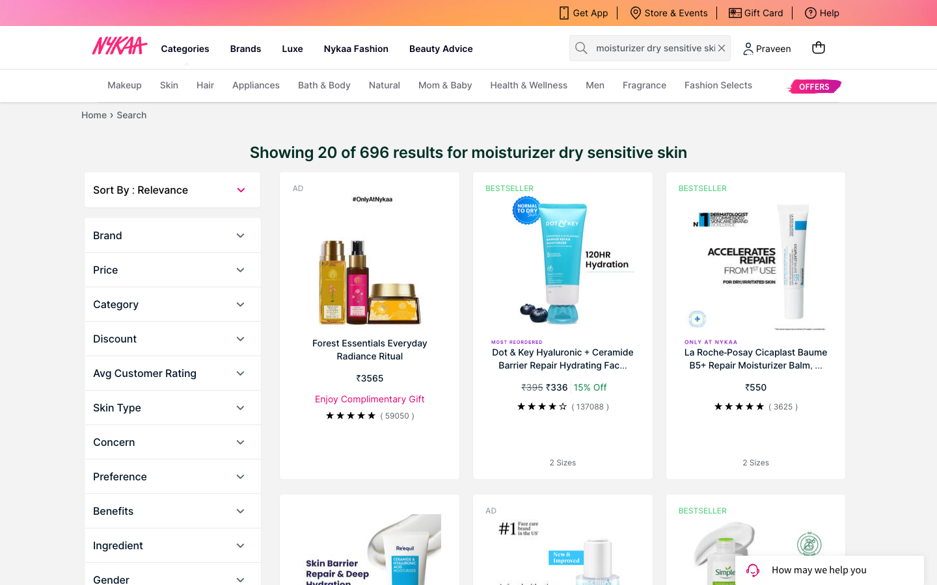
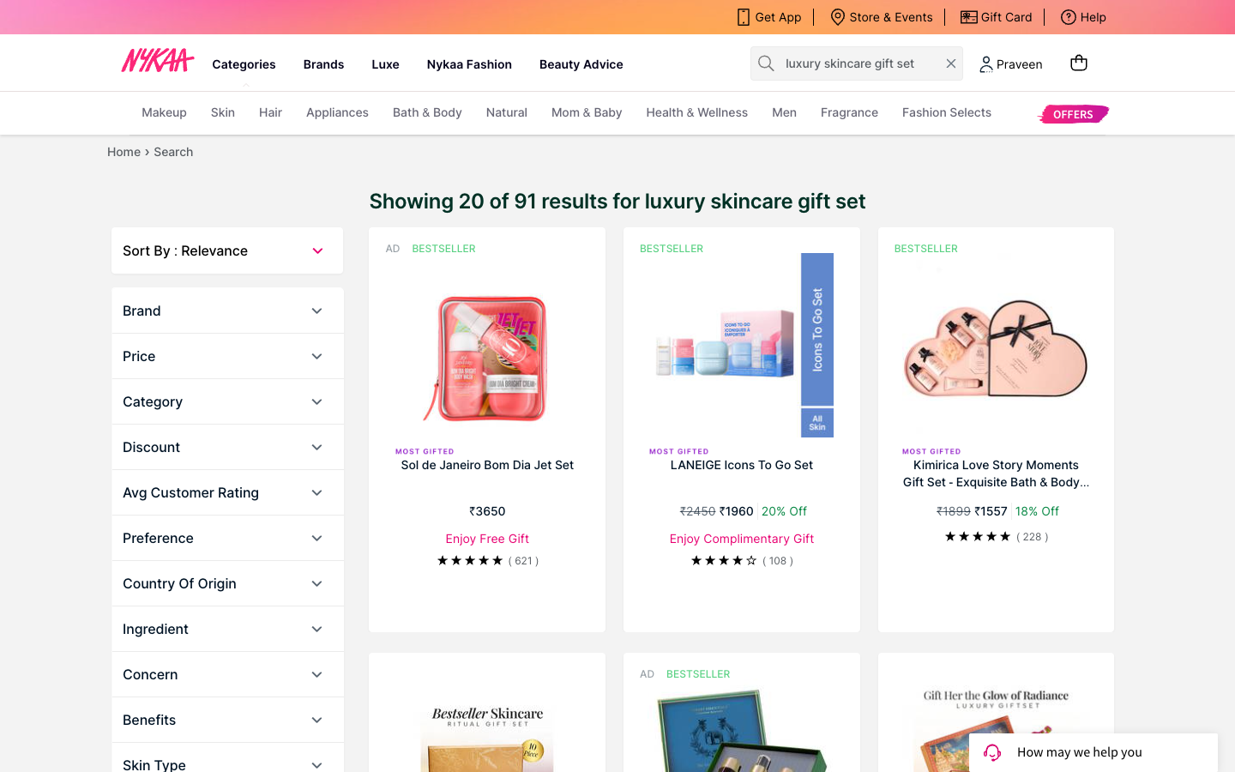
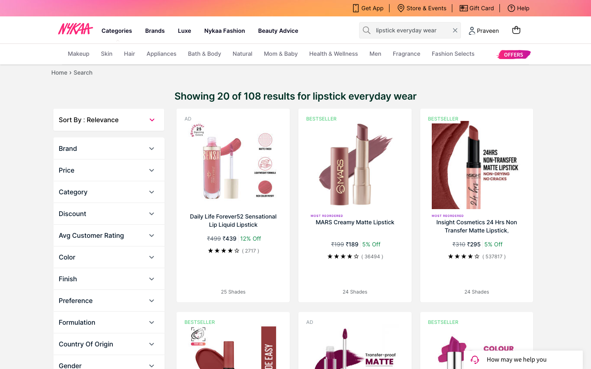
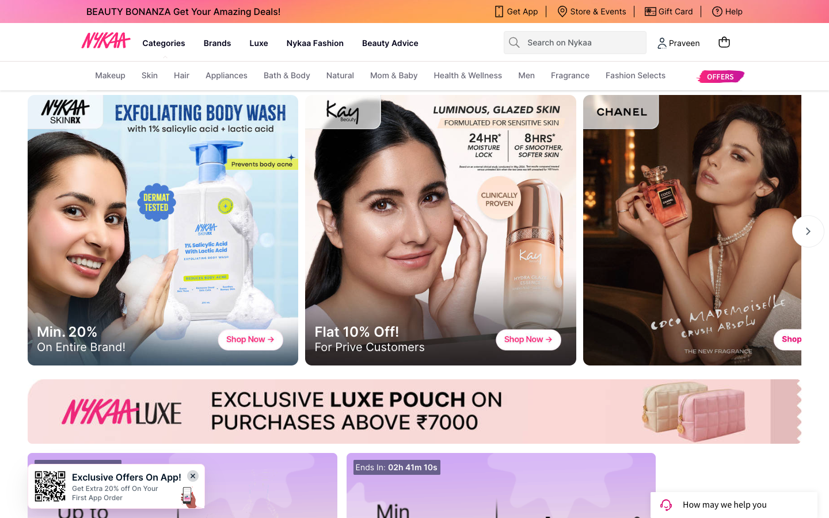
APPENDIX · EVIDENCE
What it actually looked like
Real screenshots from the sessions above — not mockups.
Journey A — 696 results, a ₹3,565 ad on top
Journey B — 91 curated sets, “Most Gifted”
Journey C — 24+ shades, no shade help
Journey D/E — the home page (identical either way)
Everything in this report is grounded in what the site actually showed, in real sessions on 4 Sep 2026 — the numbers above (696, ₹3,565, 91, 24+ shades) came off these screens, not a summary of them. The one exception: cart and checkout were verified live during this session but not screenshotted, since I stopped before payment on purpose.
Nykaa UX Analysis — Appendix
16
Notes:
Real screenshots backing the four sharpest claims — have these ready if anyone asks 'can I actually see that'.

Slide 17
APPENDIX · RECOMMENDATIONS
Every fix, with the problem and the metric
Each row ties to something seen or heard above, not a guess — ranked by reach and cost to ship, not a formal score. Limit worth naming: one exploration, one day, desktop only, no access to Nykaa's real traffic, conversion or return data.
P | FIX | PROBLEM IT SOLVES | METRIC
P0 | One-tap narrow strip after a concern search (skin type → concern → budget, pre-filled). | 696 results for a cautious purchase (Journey A). | Search → add-to-bag on concern searches.
P1 | “Buy again” row on home + 1-tap Reorder in My Orders. | 5-yr account, same staples, no reorder path (Journey D). | Repeat purchase rate; time to add-to-bag.
P1 | Let mobile guests filter without logging in. | Login pop-up blocks the filter panel on mobile (Feature 2). | Filter apply rate; guest bounce rate.
P2 | Stop ranking over-budget ads above the best fit. | ₹3,565–₹6,600 ads above a ₹336 fit (Journey A). | Top-3 organic CTR; skincare return rate.
P1* | Honest, proactive delivery status; stop mislabelling orders. | Both interviews, unprompted, complained about only this. | Delivery-date accuracy; status-correction rate.
P1* — from the interviews, not my own testing.
Nykaa UX Analysis — Appendix
17
Notes:
Full recommendations table with problem-solved and metric per row, plus the reasoning and limits behind the list.

Slide 18
APPENDIX · BEING HONEST
Limitations
Desktop website only, not the native app.
•
Mobile-web notes (the filter login pop-up) are from an earlier check on the same site.
Stopped at the address step of checkout.
•
Added one item, opened the bag, went to the address step — did not enter an address or pay.
One reproducible server error.
!
Loading the bag by its direct URL (nykaa.com/shoppingbag/) — not the bag icon — returns HTTP 503 every time. Confirmed across three separate sessions over several hours; the in-app bag drawer works fine every time. Cause unknown; consistent enough to flag.
The second account was read-only.
•
Used only to check personalization, Orders, and search. No order details are reproduced anywhere in this report.
Nykaa UX Analysis — Appendix
18
Notes:
Full limitations list, including the exact evidence behind the HTTP 503 finding.

