Slide 1

HTML
Component
Designer
Developed by
Suresh Chandrasekar & Praveen VR

Slide 2
How it is done today
Scenario 1
Scenario 2
Creating Mockups
Getting approval
Converting into HTMLs
Implementation by Backend developers
Adding Features or updates
Developers depends on designers for even a minor update. (When they are in tight schedule, that’s where things getting ugly.)
Changes in Design guidelines
Updating it in all over the applications

Slide 3
Why HCD and what we are trying to solve?
Designs will be implemented as per guidelines
Clean code (No Style Duplication)
Easy to update styles (all the custom styles can be available as a single file, hence a single update will fix the design update across all applications)
Components are available in a single page (Don’t need to search in the exiting code for getting the code of the component )
Hence lot of time saved
Designs will be uniform / consistent across all our applications

Slide 4
Features

Slide 5
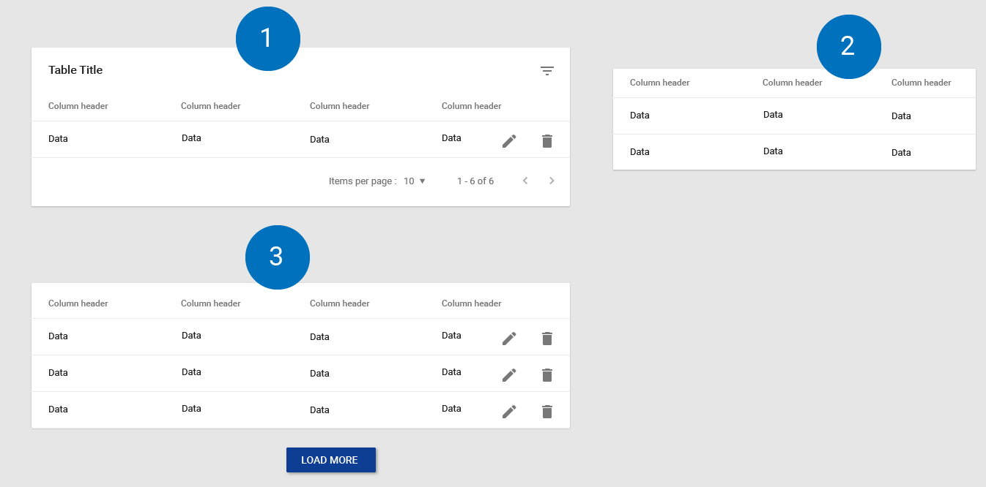
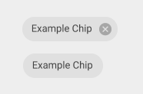

One Component – Multiple Forms

Slide 6
360 degree customization for html components
You can play around with options and get the code, Hence no chance of deviating away from the guidelines
Design modes (comfort / cozy)
Universal icon search and add (Material and AMS custom icons)
Add or remove items
Codes of HTML , CSS and JS are available
Typography can be taken care off automatically

Slide 7
Road Map
Can extend the support for more html components
Color theme configurator
Support for responsive design
Layout designer
Form Builder
Drag and drop, Rearranging items
Custom data inside the component
Suggestions based on Scenearios

Slide 8
Q & A

