Slide 1
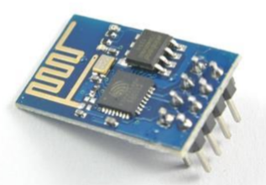
ESP8266 Wi-Fi Module

Slide 2
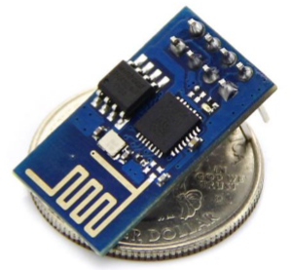
Features
Small
Cheap
Powerful
Low Power Requirement
Multiple Variants
Wi-Fi + Micro-controller

Slide 3
Characteristics
802.11 b / g / n
Wi-Fi Direct(P2P)
Soft-AP
Built-in TCP/IP stack
SDIO 2.0
Ultra Low Power Tech.
WPA/WPA2 Security
SPI
UART

Slide 4
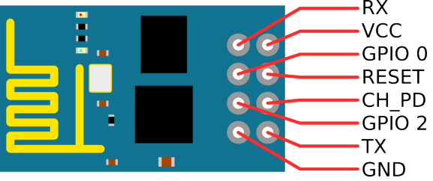
Pin-Out of ESP8266
Tx
3.3V
GND
3.3V
3.3V
Rx
GND

Slide 5
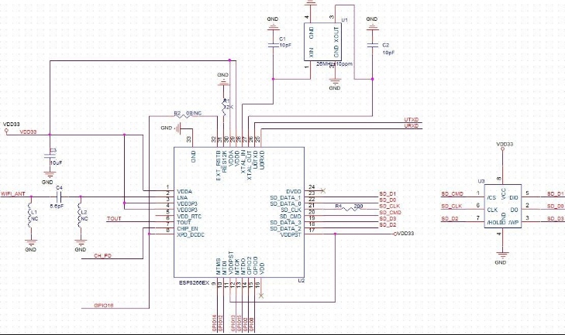
Circuit Diagram of ESP8266

Slide 6
ESP8266 can act as:
Web Server- (Serve Webpages)
Access Point-(Serve Webpages + Wi-Fi)
Web Client-(Communicate with Web-Servers over internet)

Slide 7
Working OF ESP8266
ESP8266 has a Microcontroller
ESP8266 has an on chip Wi-Fi
It can be used for TCP/IP, DHCP, as well as can work as a Web Server.

Slide 8
Basic AT Commands for ESP8266
Basic | Wi-Fi Layer | TCP/IP Layer
AT | AT+CWMODE | AT+CIPSTATUS
AT+RST | AT+CWJAP | AT+CIPSTART
AT+GMR | AT+CWLAP | AT+CIPSEND
AT+GSLP | AT+CWQAP | AT+CIFSR
ATE | AT+CWSAP | AT+CIPMUX
 | AT+CWLIF | AT+CIPSERVER
 | AT+CIPSTAMAC | AT+CIPMODE
 | AT+CIPAPMAC | AT+CIPSTO
 | AT+CIPSTA | AT+CIUPDATE
 | AT+CIPAP | +IPD

Slide 9
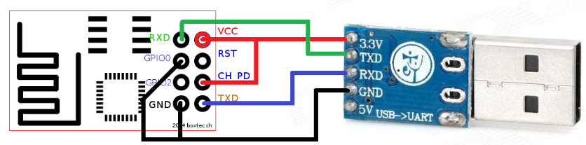
Connecting ESP8266 with USB-TTL

Slide 10
Connecting ESP8266 with USB-TTL
ESP8266-01 | USBB-TTL
Rx | Tx
Vcc | 3.3V
GPIO0 | NO/GND
RST | NO/Vcc
GPIO2 | -
CH_PD | Vcc
GND | GND
Tx | Rx

Slide 11
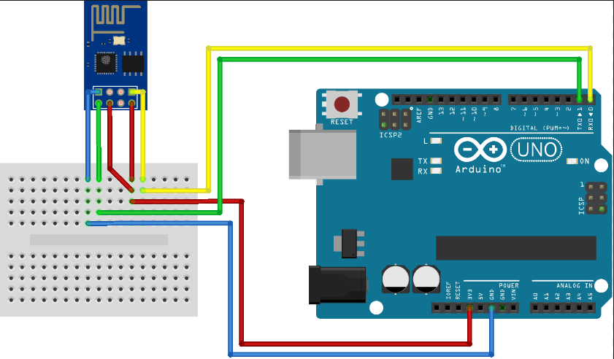
Connecting ESP8266 with ARDUINO Uno

Slide 12
Connecting ESP8266 with ARDUINO Uno
ESP8266-01 | ARDUINO Uno
Rx | Tx0(1)
Vcc | 3.3V
GPIO0 | NO/GND
RST | NO/Vcc
GPIO2 | -
CH_PD | 3.3V
GND | GND
Tx | Rx0(0)

Slide 13
THANK YOU…

