Slide 1
NYC
IST 722 — Data Warehouse Project
NYC Yellow Taxi
Analytics
Under the Guidance of Prof. Joseph Kin
Praveer Byndoor
April 2026

Slide 2
Table of Contents
01
Introduction & Objectives
07
KPI Dashboard
02
Project Plan
08
Hourly Demand & Daily Trends
03
Data Overview
09
Payment & Zone Analysis
04
Bus Matrix & High-Level Design
10
Weekday vs. Weekend
05
Star Schema & Dimensional Model
11
Challenges & Solutions
06
Data Warehouse Implementation (ELT)
12
Reflection & Next Steps

Slide 3
Introduction
About This Project
Objectives
A full-cycle data warehousing project built on 2.87 million NYC Yellow Taxi trips from January 2024.
Using the Kimball dimensional modeling approach on Snowflake, we designed a star schema with a central fact table and four conformed dimensions.
Tableau serves as the BI reporting layer on top of the warehouse.
1
Design a star schema data warehouse using Snowflake and Kimball methodology
2
Execute a full ELT pipeline from raw TLC Parquet files to dimensional tables
3
Build a Bus Matrix and conformed dimension model for multi-subject analysis
4
Enable analysis across time, location, payment type, and day-type dimensions
Tech Stack
5
Deliver Tableau BI dashboards as the reporting outcome of the warehouse
Snowflake (DW) • SQL (ELT) • Tableau (BI)
Prof. Joseph Kin | IST 722 — Data Warehouse | April 2026

Slide 4
Project Plan
M1
M2
M3
Bus Matrix &
High-Level Design
→
Dimensional Modeling &
ELT Implementation
→
BI Dashboard Creation
& Demonstration
Deliverables
Bus Matrix & Star Schema Diagram
Data Warehouse (Snowflake)
Dimensional model design validated across all analytical subject areas
Verified star schema: 2,872,007 fact rows, 4 dimension tables
ELT Pipeline Scripts (Snowflake SQL)
BI Dashboard (Tableau)
Raw ingestion, dimension population, and fact table construction scripts
KPI tiles, trend charts, zone analysis, payment and day-type breakdowns

Slide 5
Data Overview
Source: NYC TLC Yellow Taxi Trip Records — January 2024 | Format: Parquet | Platform: Snowflake
Key Source Columns
~2,872,007 rows
Valid trips after filtering (fare > 0, distance > 0)
tpep_pickup_datetime
Source for dim_date & dim_time keys
PULocationID
FK → dim_location (pickup zone)
~1% NULL payment_type
Resolved via COALESCE to 'Unknown' in fact load
payment_type
FK → dim_payment (method code)
fare_amount
Additive measure — base meter fare
Parquet via Snowflake Stage
COPY INTO raw_trips with ON_ERROR = 'CONTINUE'
tip_amount
Additive measure — $0 for cash trips
Jan 1 – Jan 31, 2024
total_amount
Additive measure — total trip charge
Single month; full-year expansion planned
trip_distance
Additive measure — miles travelled

Slide 6
Challenges & Solutions
Challenge
Solution
Raw TLC data in Parquet format required Snowflake stage setup before ingestion.
→
We set up a Snowflake internal stage to accept the Parquet format, then loaded the data with fault tolerance enabled so any bad rows were skipped without stopping the entire load.
Challenge
Solution
~1% of payment_type values were NULL, causing FK violations on dim_payment.
→
We handled the NULLs by defaulting them to an 'Unknown' payment category we had pre-loaded in the dimension table, so no trips were lost.
Challenge
Solution
Trip duration not stored in source — required derivation as a computed measure.
→
We calculated trip duration on the fly during the load by taking the difference between the pickup and dropoff timestamps and converting it to minutes.
Challenge
Solution
Not all 265 NYC taxi zones were initially available in the zone lookup file for dim_location.
→
We sourced the complete official TLC zone reference file, which covered 262 of the 265 zones. The remaining 3 edge-case IDs are handled gracefully in queries so no trips get dropped.

Slide 7
Bus Matrix & High-Level Design
Business Process
dim_date
dim_time
dim_location
dim_payment
Key Metrics
Trip Revenue Analysis
✓
✓
✓
✗
Total Revenue, Avg Fare
Demand & Volume
✓
✓
✓
✗
Total Trips, Passengers
Zone Performance
✗
✗
✓
✗
Revenue/Zone, Avg Fare
Payment Behavior
✗
✗
✗
✓
Trips, Revenue, Avg Tip
Weekday vs. Weekend
✓
✗
✗
✗
Trips, Revenue, Fare, Tip
Time-of-Day Demand
✗
✓
✗
✗
Hourly Trips & Revenue
Conformed dimensions (dim_date, dim_location) are shared across multiple business processes, enabling drill-across analysis between subject areas.

Slide 8
Star Schema — Dimensional Model
dim_date
dim_location
date_id (PK)
full_date
day_name
day_type
week_number
month_num
location_id (PK)
borough
zone_name
fact_trips
trip_id (PK)
date_id (FK)
time_id (FK)
pickup_location_id (FK)
payment_id (FK)
trip_distance
duration_mins
fare_amount
tip_amount
total_amount
dim_time
dim_payment
time_id (PK)
hour_of_day
time_label
period_of_day
payment_id (PK)
payment_name

Slide 9
Data Warehouse Implementation — ELT
SOURCE
RAW LAYER
STAGING LAYER
STAR SCHEMA
BI EXPORT
1. Extract
2. Load Raw
3. Transform
4. Load Star
5. Verify
Download NYC TLC Yellow Taxi Parquet file from the TLC open data portal.
Upload Parquet file into Snowflake RAW layer (raw_taxi table) — no changes, data as-is.
SQL inside Snowflake: fix timestamps, remove bad rows, compute trip duration, decode payment codes.
Populate 4 dimension tables + fact_trips with 2,872,007 clean rows into STAR schema.
Row count checks on all tables. Run 7 analytical queries for BI export to Tableau.
Why ELT? Raw data lands in Snowflake first (Load), then all transformations happen inside Snowflake using SQL (Transform). We never processed data outside the warehouse — this is the modern cloud approach.

Slide 10
KPI Dashboard — Warehouse Output (January 2024)
2,872,007
$78.49M
$27.33
Total Trips
Total Revenue
Avg Fare
3.73 mi
15.75 min
$3.40
Avg Distance
Avg Duration Mins
Avg Tip

Slide 11
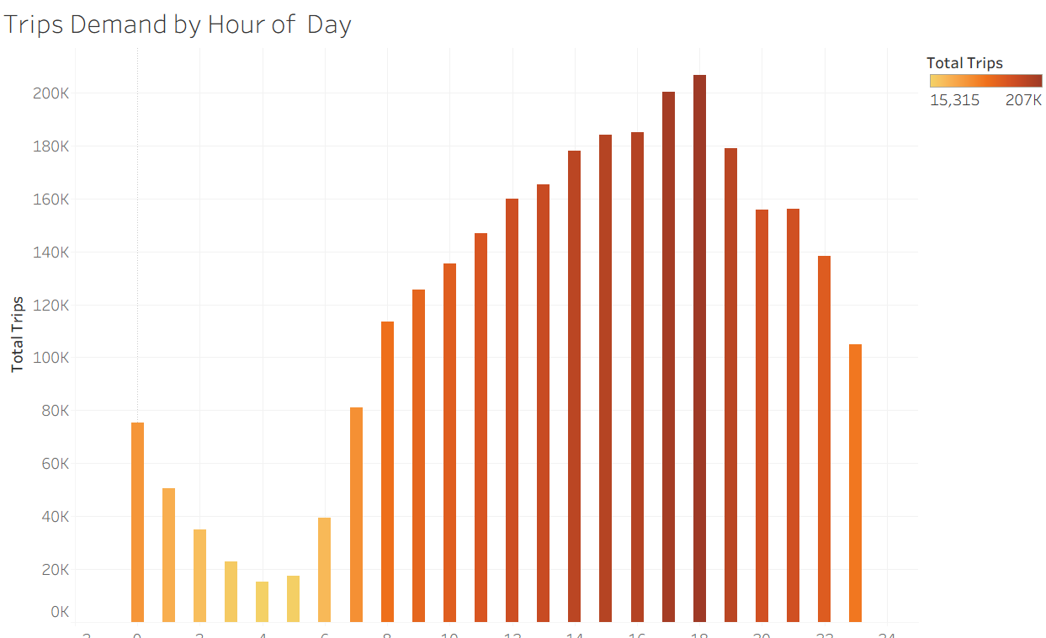
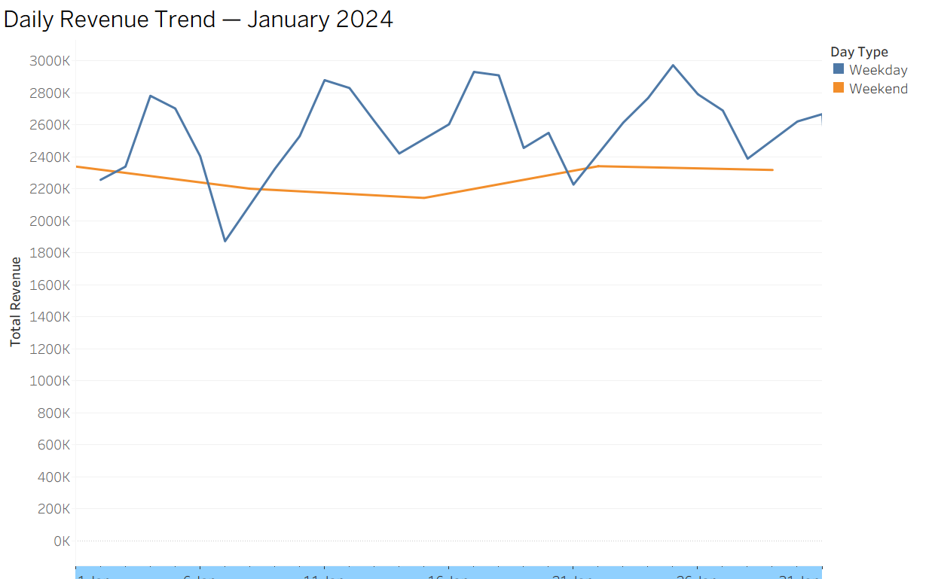
Hourly Demand & Daily Revenue Trends
Peak Hour: 6 PM
206,511 trips & $5.54M revenue at hour 18 — the single highest hour of the day.
Low Volume: 3–5 AM
Fewest trips (15K–23K) but highest avg fares ($32–$38) — airport & long-haul runs.
Morning Surge: 7 AM
Trip volume climbs steeply as commuter demand enters the market.
Peak Day: Thursdays
Thursdays and Fridays consistently exceed 100K+ trips and $2.8M+ in daily revenue.

Slide 12
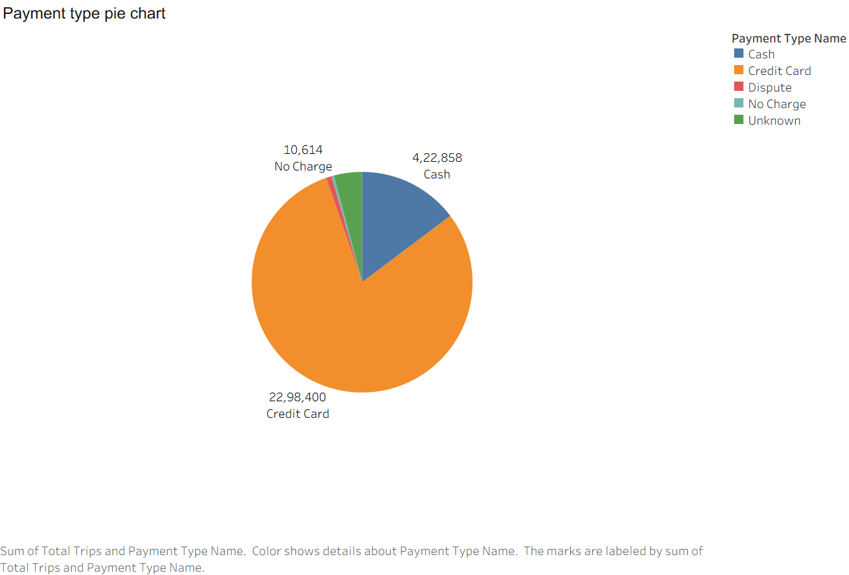
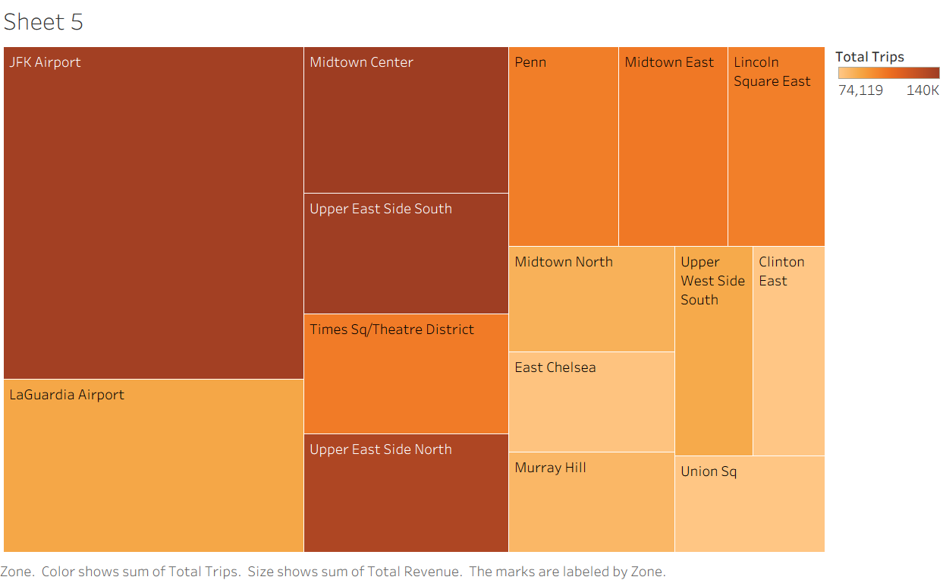
Payment Behavior & Top Pickup Zones
Credit Card: 80% of Trips
Airport Zones = Premium Revenue
Generates 82% of total revenue ($64.5M). Avg tip $4.16 — only card payers are metered for tips.
JFK ($80.86 avg fare) and LaGuardia ($66.37) are 3x the city average — key revenue generators.

Slide 13
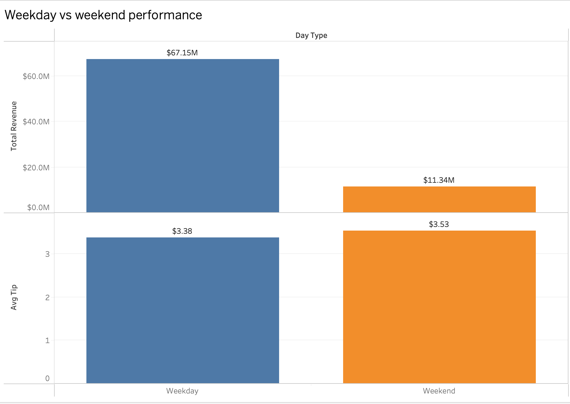
Weekday vs. Weekend Analysis
Query: fact_trips JOIN dim_date ON date_id — grouped by day_type
86% Weekday Volume
2.47M of 2.87M total trips occur on weekdays — driven by commuter and business demand.
86% Weekday Revenue
$67.1M of $78.5M total revenue generated on weekdays.
Weekend Fare +6%
$28.82 vs $27.09 avg fare — weekend leisure trips tend to cover greater distances.
Weekend Tip +4%
$3.53 vs $3.38 avg tip — marginally higher tipping on leisure trips.

Slide 14
Reflection & Next Steps
Lessons Learned
Future Enhancements
Starting with a clear dimensional model before writing any code saves significant rework downstream
Extend to multi-year data for seasonal trend analysis and Integrate weather dimension.
Data quality issues surface late if not profiled early.
Connect directly to a live data source to eliminate manual CSV export dependencies
Iterative testing at each ELT layer is far more efficient than end-to-end debugging
Build automated anomaly detection to flag unusual trip patterns or revenue drops
Integrate machine learning models to predict peak demand by zone and time of day
Business questions should drive schema design and not the other way around

Slide 15
Thank You

