Slide 1
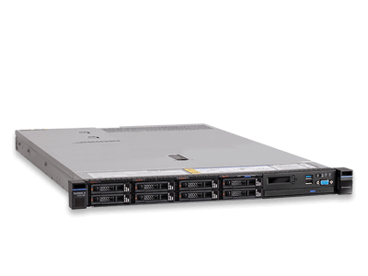


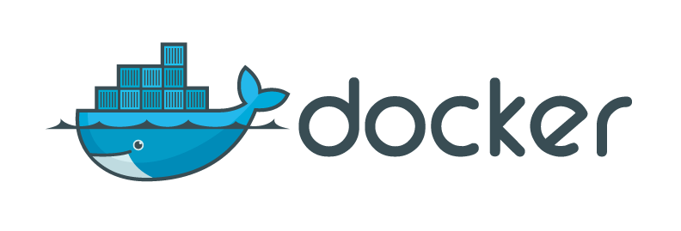


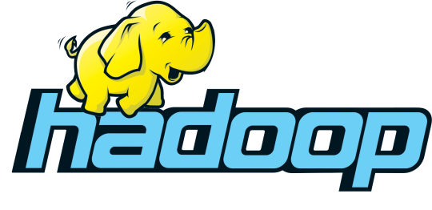



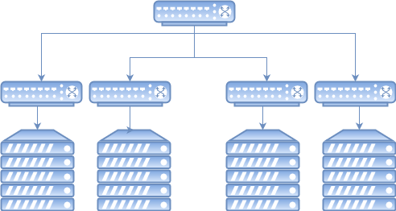
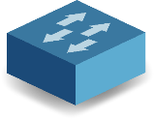
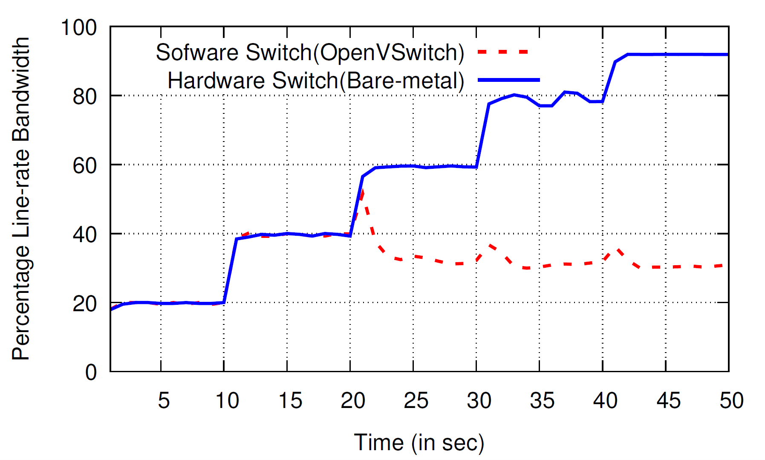
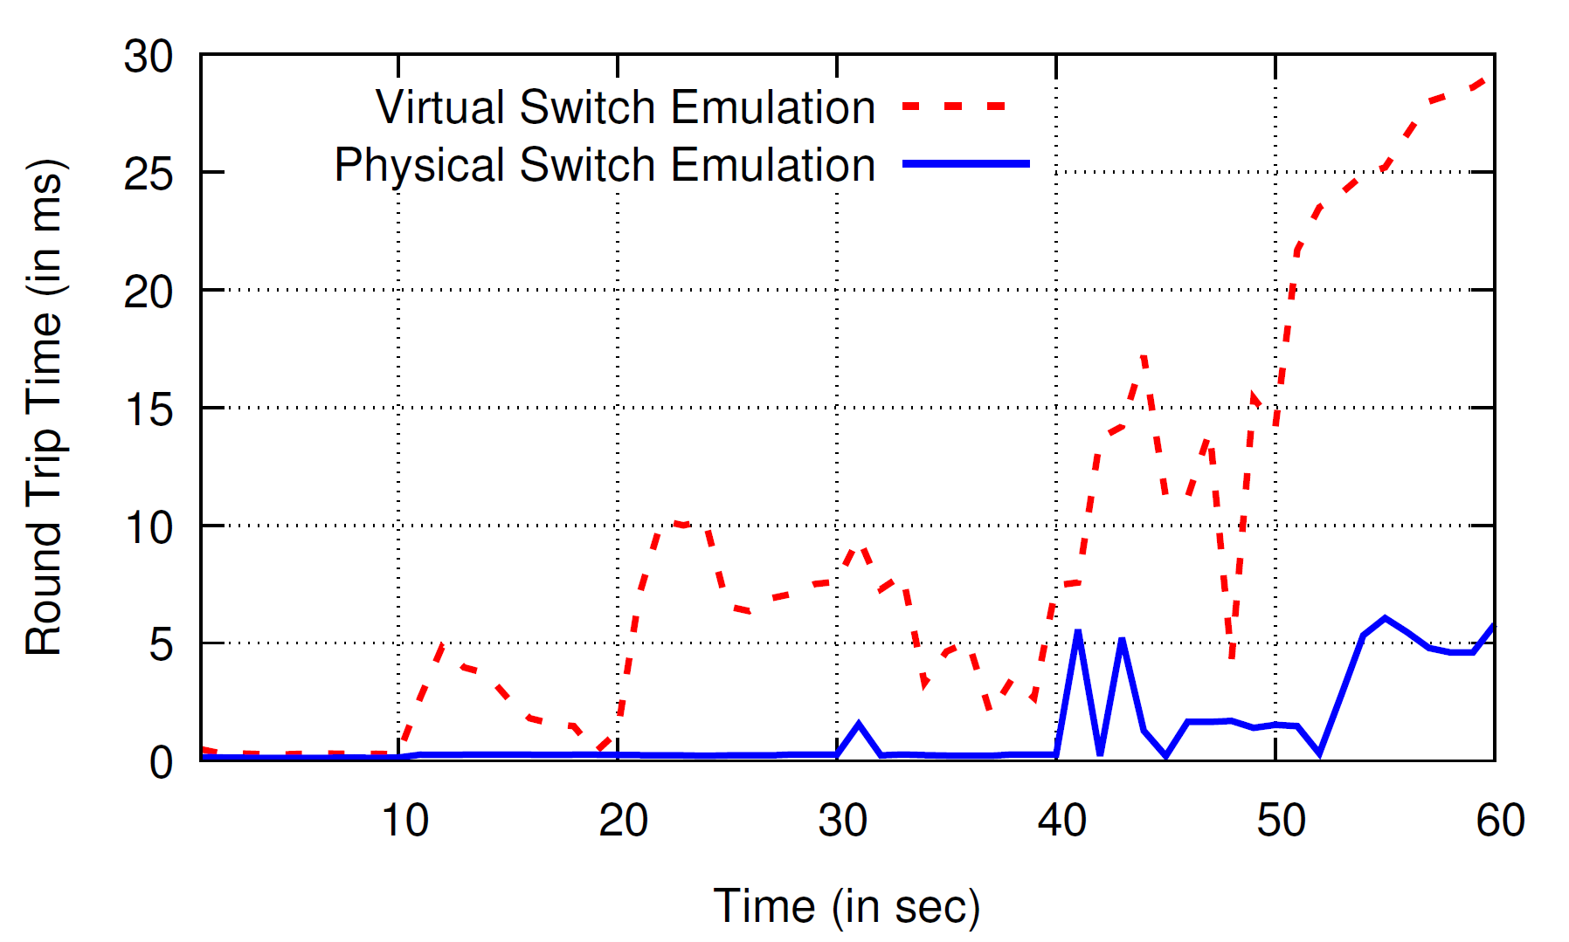
Bare-Metal Cloud Services
Our Solution: BNVirt
VM7
VM6
VM5
VM4
Cloud Providers provide the critical infrastructure (Compute, Network and Storage) that many companies rely on.
Cloud Providers support two kinds of provisioning : 1) VM-Based, and 2) Bare-Metal Hardware.
“When a VM in a public cloud is not good enough, some turn to physical servers” [1]
Bare-Metal cloud services are increasing due to following:
a) Data-Isolation & Privacy concerns over Sharing Compute/Storage.
b) Regulatory Reasons.
c) Performance Guarantees.
VM3
VM2
VM1
Guarantee Isolation/ Sandbox
Vmware or QEMU
Flexible Hardware accelerated Topologies with Bare-metal Switching.
Low Cost and Easy to provision.
Provide Software Defined Networking to Customers.
Tenant 2
Tenant1
Tenant 2
Tenant 3
Virtual Topology
Virtual Topology
BNVirt
Virtual Topology
Tenant 1
Tenant 3
Network Provisioning Challenges I : Supporting arbitrary topologies
Software Defined Networking has become the next Big Thing!! And seeing lots of movement towards it.
Tenant 1
Tenant 2
Tenant 3
Deployment & Evaluation
OpenDaylight Controller
ONOS Controller
POX Controller
The Current SDN Network Hypervisors either cannot virtualize the substrate network into any arbitrary network topologies.
OpenFlow
Existing SDN Network Hypervisors
OpenFlow
Switch1
Switch2
Network Provisioning Challenges II : Providing Bare-Metal Network
To provide arbitrary topologies, Software Based switches such as OpenVswitch can be used. However, they are limited by performance.
References
We increase the traffic load of a topology with bare-metal servers every 10 seconds, and observe Performance is limited while using software switches compared toHardware switches.
We increase the traffic load of a topology with bare-metal servers every 10 seconds, and also measure the Latency of the path. Using Software switches, the RTT variance is extremely high and not good for latency-sensitive applicatons.

