Slide 1
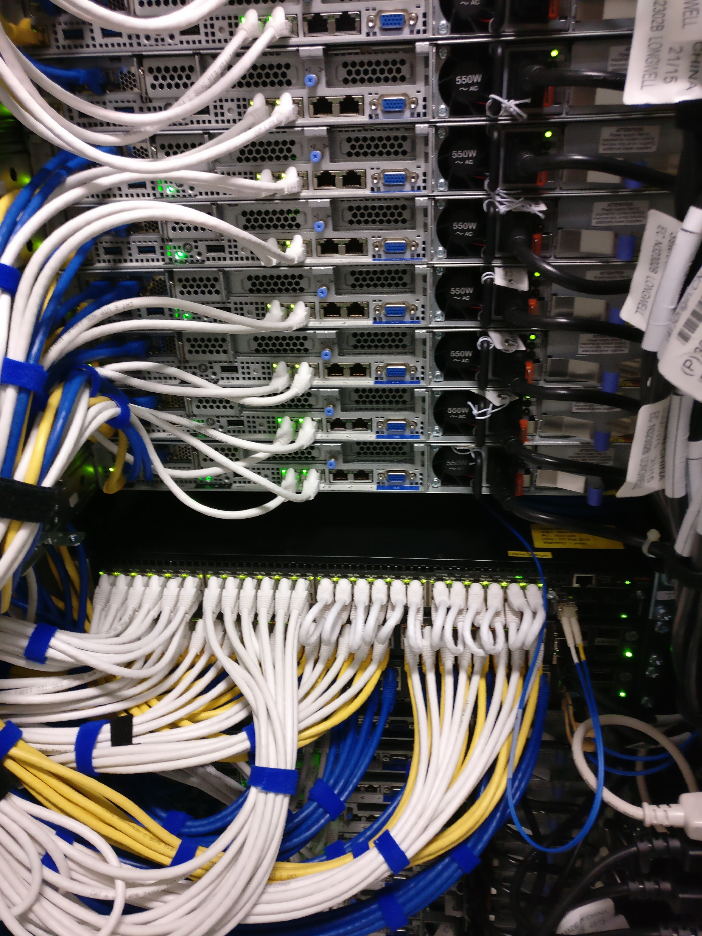
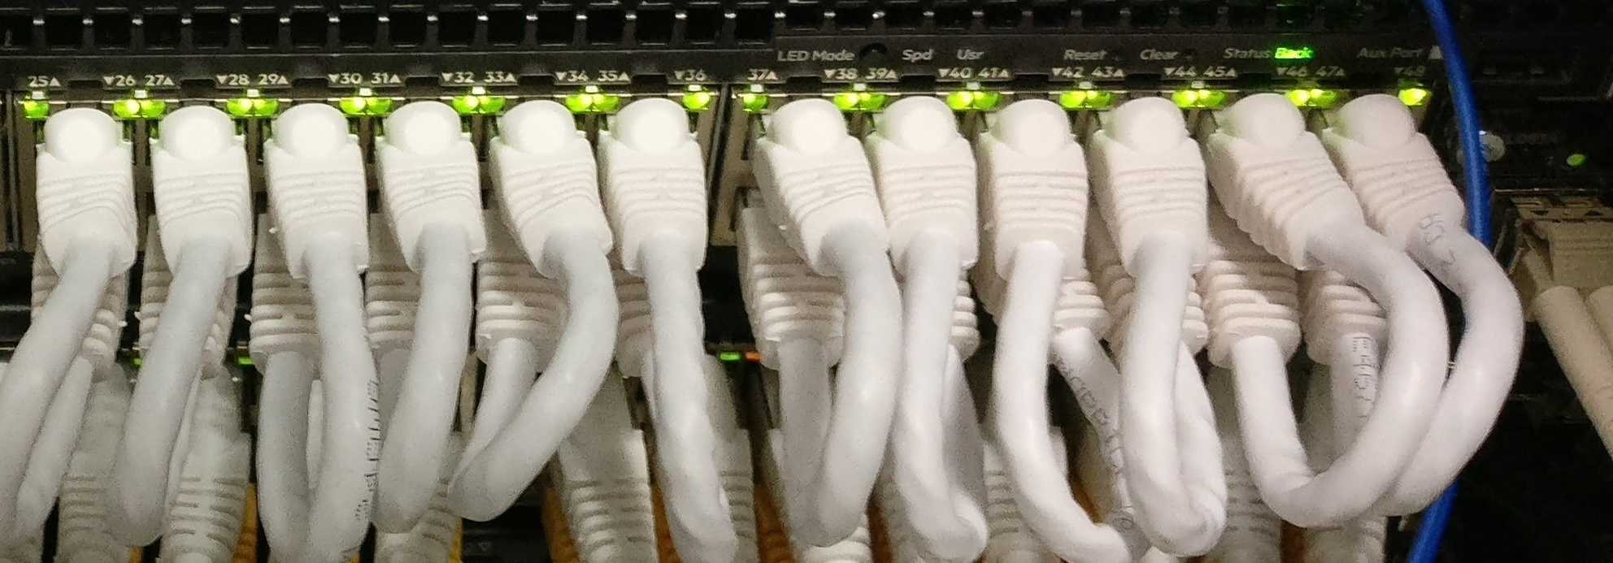
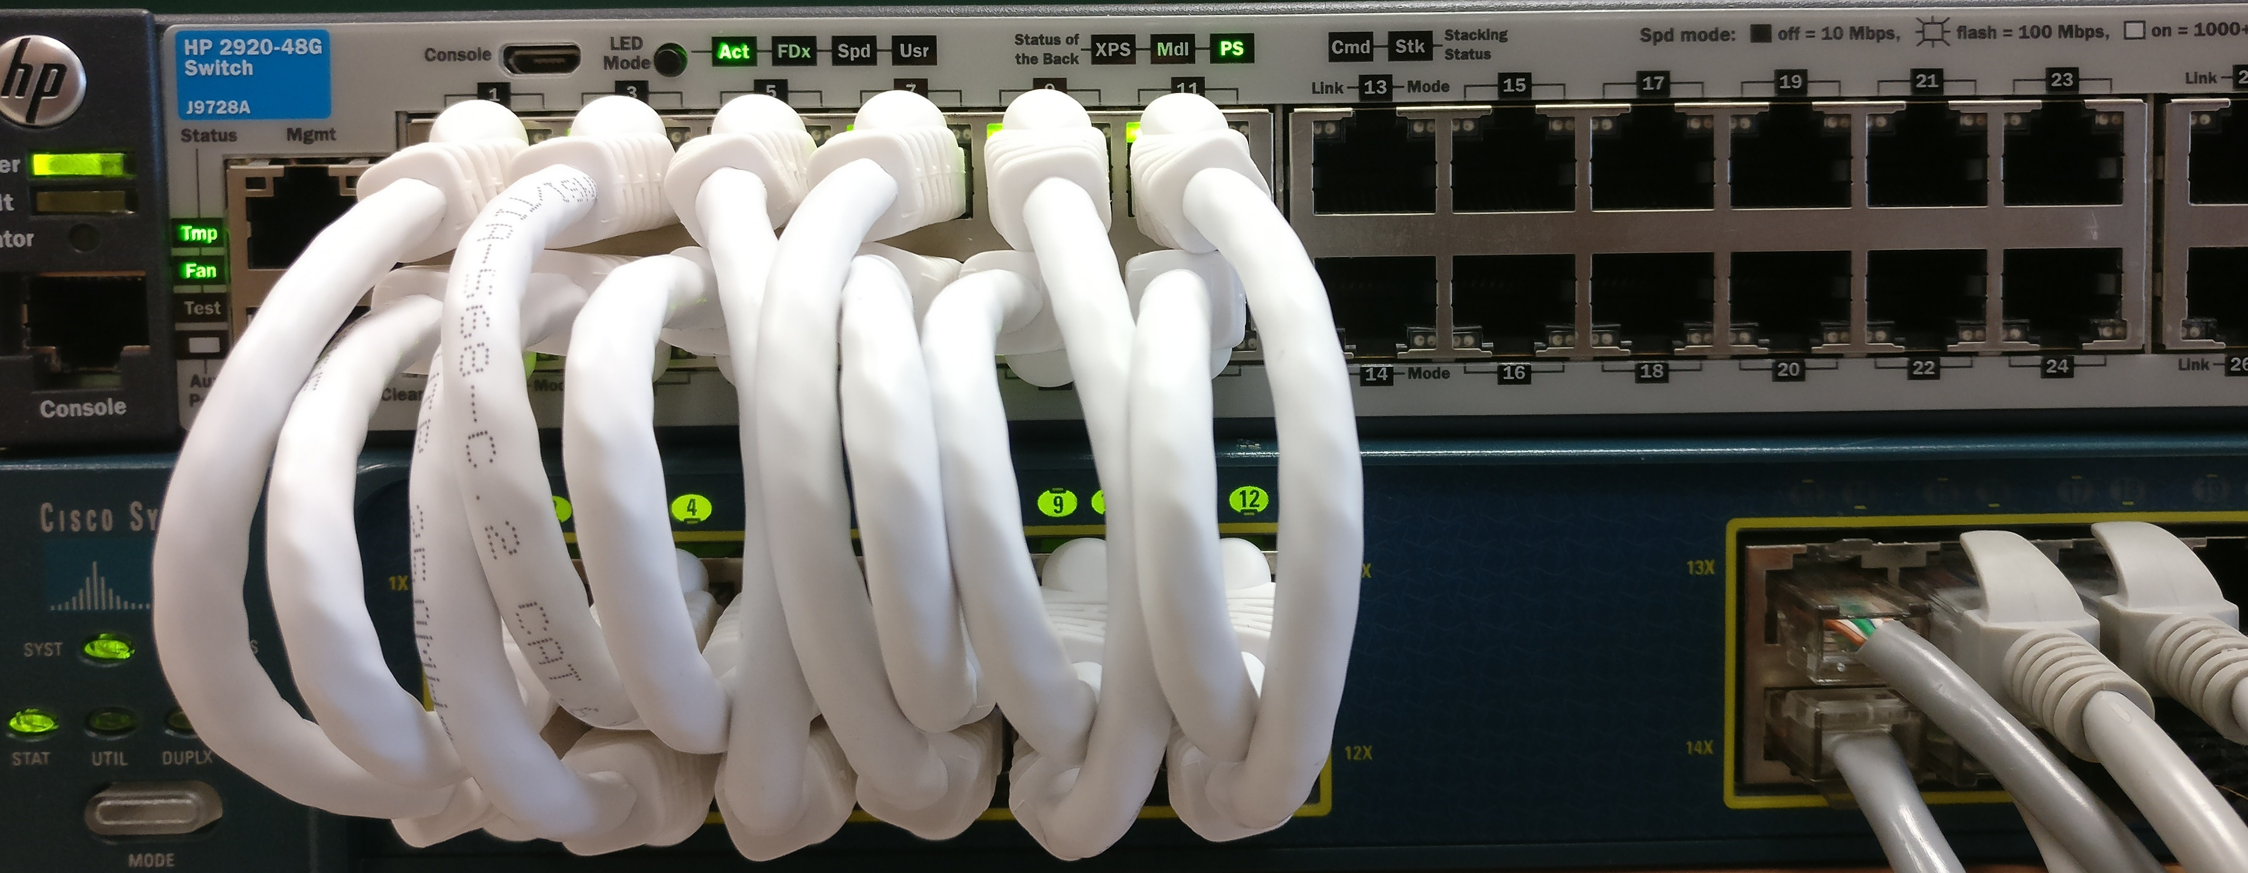
Static loopback wiring
24-ports of SDN Switch
Dynamic Loopback Wiring
using L2 intermediate Switch

