Slide 1
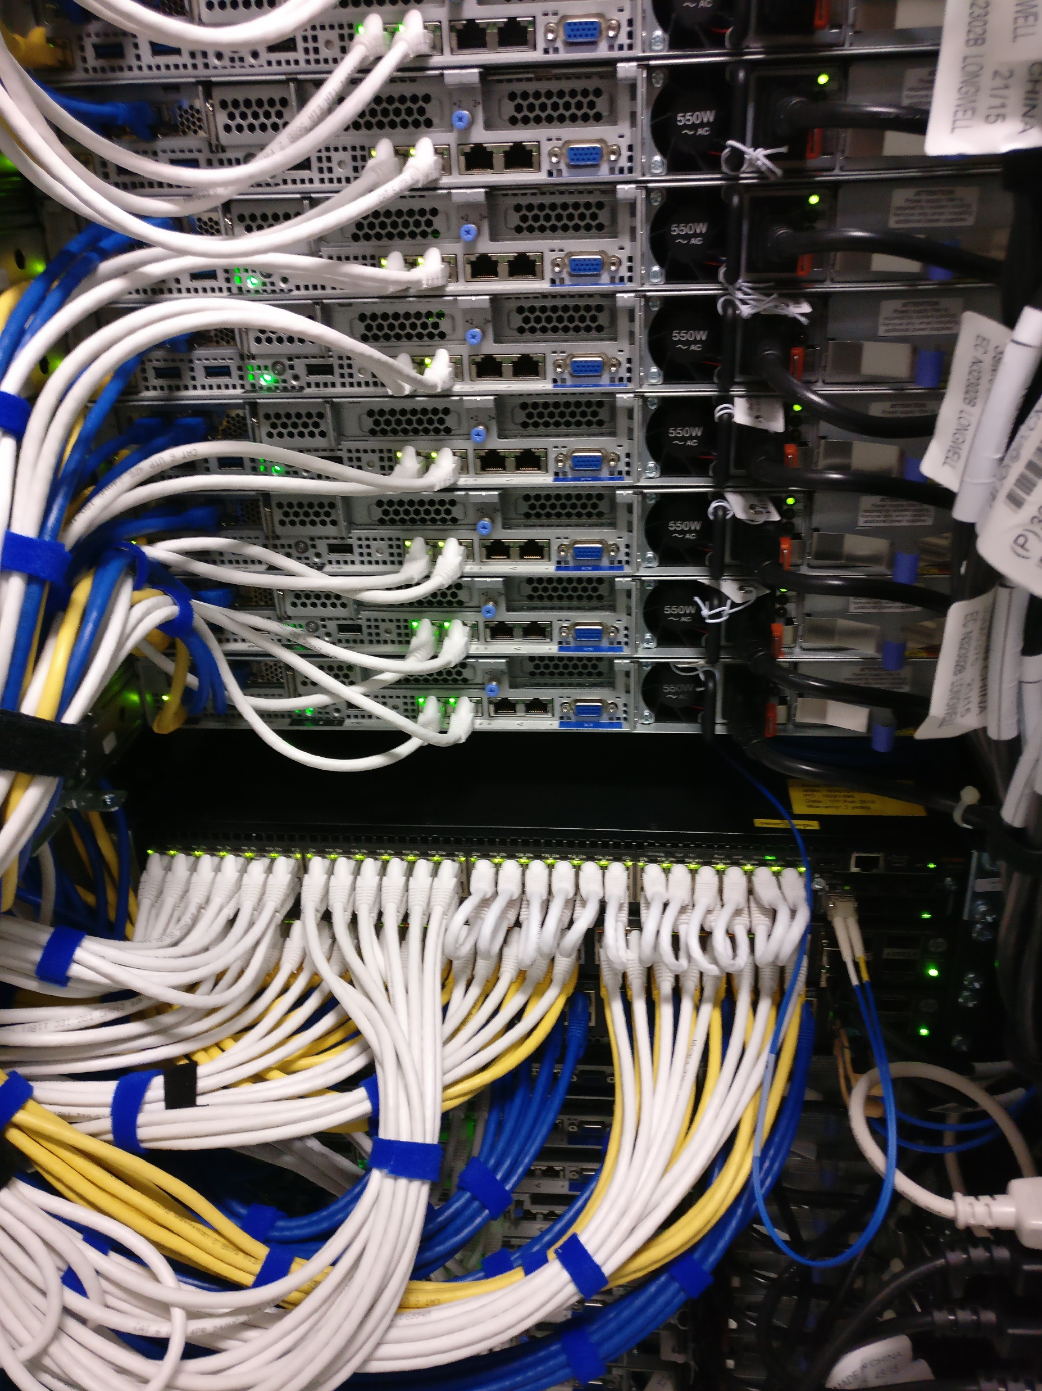
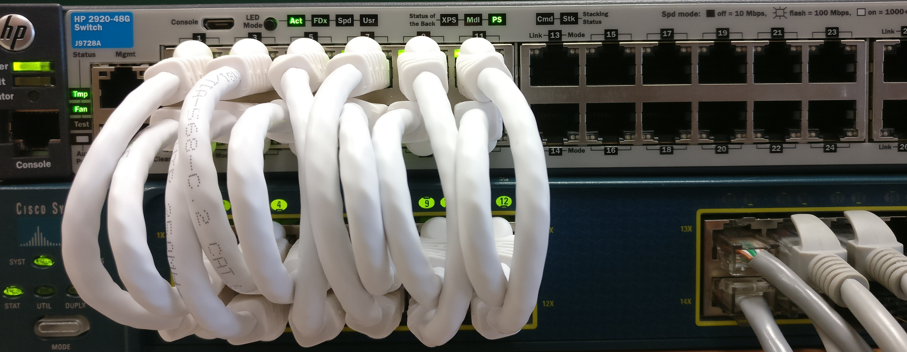
Static Loopback wiring
Dynamic Loopback Wiring using L2 intermediate Switch

