Slide 1

Bare Metal Network Virtualization (BNV)

Slide 2

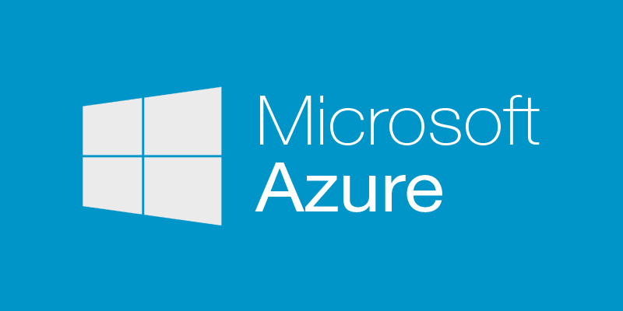












Slide 3
Virtual Machines vs BareMetal

Slide 5
