Slide 1
Today’s agneda
Project recap
Problem
The Analytics team
Process
Insights
summary

Slide 2
Project Recape
Social buss is a fast growing technology unicorn that need to adapt quickly to it’s global scale.
Accenture has begun a 3 month POC focusing on these tasks.
An audit of social Buzz’s Big data practice
Recommandations for a successful IPO
Analysis to find Social Buzz’s top most popular categories of cotent

Slide 3
Problem
Over 100000 posts per day
36500000pieces of content per year
But how to capitalize on it when there is so much?
Analysis to find Social Buzz’s top 5 most popular Categories to content

Slide 4
The Analytics Team
Andrew Fleming
(CTA)
Marcus Rompton
(Senior Principal)
Rampravesh V
(Data Analust)

Slide 5
Reaction Types Analysis
Most Used Reaction Types
Heart: The most frequent reaction with a total count of 1,622.
Other Popular Reactions: Scared, Peeking, Hate, Interested.
Implications: Understanding which reactions are most common helps in tailoring content to elicit desired emotional responses.

Slide 6
Sentiment Analysis by Score
Sentiment Breakdown
Positive Sentiment: Highest count, indicating a generally favorable audience reception.
Negative Sentiment: Slightly lower than positive, but still significant.
Neutral Sentiment: Lowest, indicating fewer ambivalent reactions.
Implications: Identifies the emotional tone of the audience, enabling adjustments in content to enhance positive engagement and mitigate negative feedback.

Slide 7
Category Analysis by Total Score
Top Performing Categories
Animal: Highest total score, suggesting strong audience interest.
Science: High engagement, indicating a trend towards educational content.
Healthy Eating: Significant interest, reflecting health-conscious audience behavior.
Technology: High scores, pointing to audience fascination with tech advancements.
Food: Popular category, driven by universal appeal.
Implications: Focus on high-scoring categories can guide content creation to align with audience preferences and interests.

Slide 8
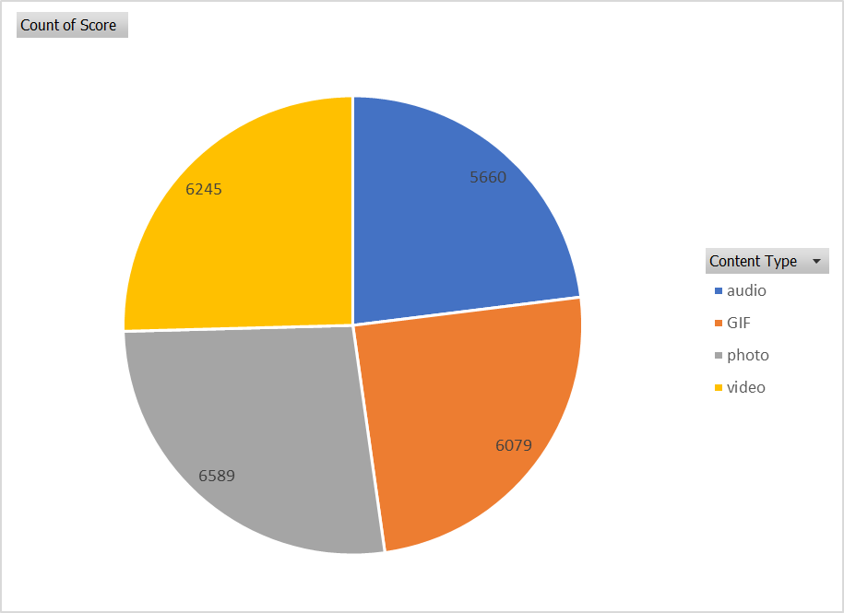
Content Type Analysis
Most Used Content Types
Photo: Widely used, highly engaging visual content.
Video: High engagement, especially for dynamic and informative content.
GIF: Popular for quick, engaging animations.
Audio: Used for podcasts and audio clips, growing in popularity.
Implications: Diversifying content types can keep the audience engaged and cater to different preferences.

Slide 9
Trend Analysis by Month
High Scoring Months
January: Strong engagement at the beginning of the year.
May: Mid-year peak, potentially due to seasonal content.
August: High engagement during summer months.
December: Significant spike during the holiday season.
Implications: Planning content around these high-engagement months can maximize reach and interaction.

Slide 10
Conclusion
Summarize key insights: Popular reaction types, sentiment distribution, top-performing content categories, most used content types, and trend analysis by month.
Recommendations for strategy adjustments based on data insights.
Importance of continuous data monitoring and analysis to keep content strategy aligned with audience preferences.

Slide 11
Thank you for your attention.

