Slide 1

SHAI: An Explainable Machine Learning & Deterministic Operations Platform for Outpatient No-Show Prediction, Capacity Optimization, and Autonomous Rescheduling
Pravihara Neranjana Abegunasekara
B.Sc. (Honours) in Software Engineering
Faculty of Computing, NSBM Green University
Final Year Research Project — Final Viva
Supervisor: Mr. Anton Jayakody (Senior Lecturer)
Presentation Date: October 2026
SHAI: Outpatient AI Operations & Capacity Platform
01

Slide 2

Presentation outline
01 Research context and problem
02 Literature gap and objectives
03 Research methodology
04 Design and implementation
05 Evaluation and findings
06 Contribution and conclusion
SHAI: Outpatient AI Operations & Capacity Platform
02

Slide 3
Background and motivation
Clinical & Operational Context
• Research Domain: Ambulatory outpatient clinical scheduling within private tertiary hospital systems.
• User Setting: Private hospital channelling operations in Sri Lanka (modeled on Asiri Central Hospital, Colombo).
• Operational Friction: Outpatient no-shows range between 15% to 30%, causing idle specialist consultation windows.
Healthcare Delivery Friction
• Irrecoverable Losses: Consultant doctors operate in rigid evening sessions; unannounced absences cannot be backfilled.
• Sourced Benchmark: Rajasuriya et al. (2010) observed 31.3%–35.8% baseline non-attendance in Colombo NHSL psychiatric clinics. Source: Rajasuriya, de Silva & Hanwella, The Psychiatrist (2010)
SHAI: Outpatient AI Operations & Capacity Platform
03

Slide 4
Research problem
Problem Statement
• Core Problem: Outpatient scheduling systems treat every booking as guaranteed attendance, ignoring non-linear behavioral friction and causing severe clinic slot wastage and lost revenue.
• Financial Burden: Private specialist fees (LKR 2,000–4,700) represent unrecoverable financial attrition per unannounced absence.
Evidence of the Problem
• Current Workflow Failure: Existing Hospital Information Systems (HIS) lack prospective probabilistic risk intelligence.
• Target User Impact: Front-desk staff face unmanageable queue surges or empty clinics; physicians suffer idle consultation hours.
• Intervention Insufficiency: Standard broadcast SMS messages are one-way and static, converting no-shows into late unfilled vacancies without automated rescheduling options.
SHAI: Outpatient AI Operations & Capacity Platform
04

Slide 5
Related work and research gap
Prior Approaches & Limitations
• Mohammadi et al. (2018): Standard ML models achieve good discrimination but output uncalibrated probabilities, distorting queue overbooking.
• Gurol-Urganci et al. (2013): Cochrane review proves text reminders help, but broadcast messaging offers no dynamic slot recovery mechanism.
• Rajasuriya et al. (2010): Reported 26.2% recall in Colombo but lacked a control group, omitted costs, and only evaluated post-miss recall.
Identified Research Gap
• Unresolved Literature Gap: Prior systems treat prediction as an isolated classification task, failing to bridge probability calibration, queue overbooking, and patient-centric multi-turn rescheduling.
• Project Resolution (SHAI): Delivers an end-to-end platform coupling calibrated XGBoost, exact Poisson-binomial convolution overbooking, TreeSHAP, and trilingual conversational rescheduling with staff approval.
SHAI: Outpatient AI Operations & Capacity Platform
05

Slide 6
Research questions and objectives
Research Questions & Aim
• Main Research Question: How can an explainable, calibrated machine learning model be integrated with exact queue optimization and automated trilingual dialogue to minimize outpatient no-shows and protect clinic revenue?
• Overall Research Aim: To design, implement, and evaluate SHAI, an integrated operations platform for calibrated prediction, capacity overbooking, and autonomous rescheduling.
Specific Objectives
• O1: Calibrated Prediction: Train XGBoost models and apply isotonic calibration to achieve reliable probabilities and high targeting lift.
• O2: Explainability & Action: Compute TreeSHAP attributions and derive a transparent heuristic action recommendation layer.
• O3: Dynamic Overbooking: Formulate exact Poisson-binomial dynamic programming convolution to maximize revenue while constraining doctor overtime.
SHAI: Outpatient AI Operations & Capacity Platform
06

Slide 7
Scope and significance
System Scope & Boundaries
• Within Scope: Private tertiary outpatient clinics, 16 clinical departments, full-stack Next.js/FastAPI platform, trilingual messaging, and capacity optimization.
• Outside Scope: Inpatient admissions, operating theater scheduling, live telecom SIM gateway (simulated delivery), and cross-specialty rescheduling.
Expected Value & Beneficiaries
• Institutional Value: Enables hospital management to reduce slot wastage, protect consultation fees, and allocate administrative outreach effectively.
• Research Boundary: Modeled on Colombo private healthcare dynamics; evaluated on 64,444 multi-specialty appointment records with 90-day live database replay.
SHAI: Outpatient AI Operations & Capacity Platform
07

Slide 8
Data collection and ethical considerations
Data Acquisition & Schema
• Data Generation: 64,444 synthetic outpatient appointments modeled on Asiri Central Hospital parameters across 16 departments.
• Chronological Split: Strict temporal partitioning: 42,693 train / 12,366 val / 9,385 test, preventing future temporal data leakage.
• Feature Acquisition: Engineered 42 features incorporating lead time, prior history, 16,450 Sri Lankan transit distances, and weather.
Ethics, Privacy & Quality Controls
• Clinical Ethics & Privacy: Patient identifiers never leave server; mental health & psychiatry specialties masked to neutral 'clinic' descriptors.
• Data Quality & Sanity: Verified monotonic lead time curves, zero leakage, and complete feature alignment across relational schemas.
SHAI: Outpatient AI Operations & Capacity Platform
08

Slide 9
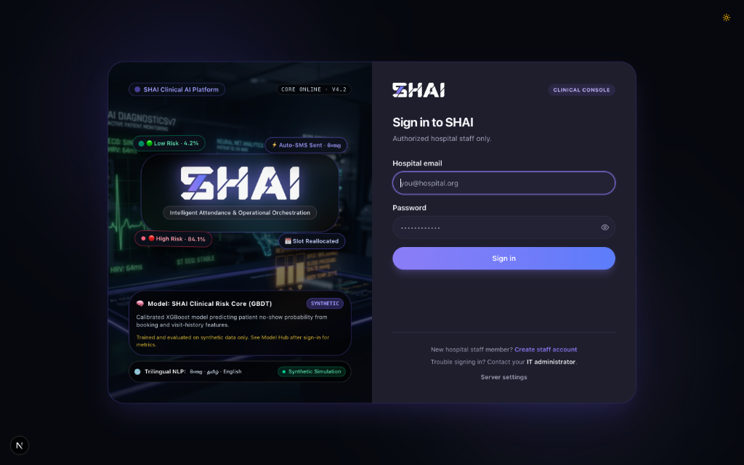
Proposed approach or conceptual framework
System Conceptual Architecture
1. Calibrated ML Core: Tuned XGBoost classifier mapped through isotonic regression to produce mathematically faithful probabilities.
2. TreeSHAP Explainability: Calculates local feature attributions in polynomial time, feeding transparent heuristic recommendations.
3. Exact Queue Overbooking: Poisson-binomial dynamic programming convolution balances fee revenue against doctor overrun penalties.
4. Ask-First State Machine: Automated multi-turn dialogue in English, Sinhala, and Tamil queries confirmation before proposing slots.
5. Human-in-the-Loop Barrier: Conversations pause at 'pending_approval' state; authorized hospital staff verify before slot booking.
Evidence: SHAI End-to-End Operational Architecture & Pipeline
SHAI: Outpatient AI Operations & Capacity Platform
09

Slide 10
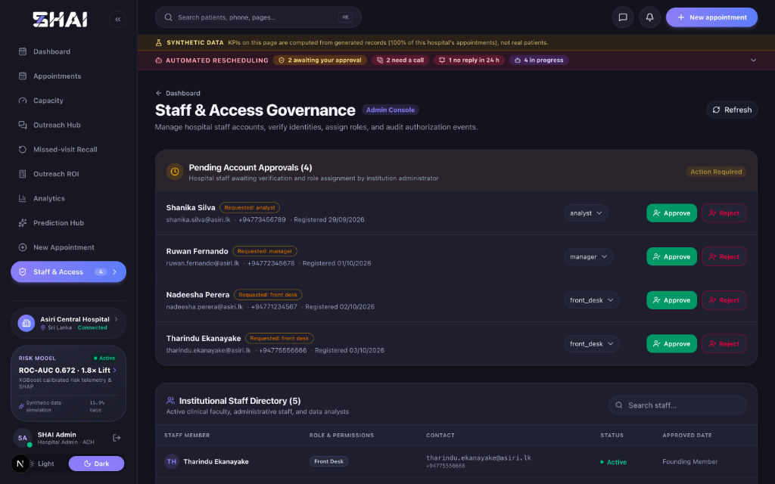
Design and implementation
Implementation Decisions
1. Decoupled Multi-Tier Stack: Next.js 16 (React 19, TypeScript), FastAPI (Python 3.12), and PostgreSQL 16 relational data persistence.
2. Desktop Packaging: Electron 33 standalone wrapper enables secure local desktop execution for hospital front-desk workstations.
3. Relational Persistence Tier: 32 PostgreSQL tables managed under Alembic migrations (head c9d0e1f2a3b4) supporting multi-tenancy.
4. Interactive Analytics: Built-in Recharts telemetry, MapLibre GL geospatial transit mapping, and live doctor session punctuality tracking.
5. Software Quality Rigor: 233 passing backend unit/integration tests and 31 frontend component unit tests with zero lint errors.
Evidence: Staff Governance Console & Multi-Tenant Role Security
SHAI: Outpatient AI Operations & Capacity Platform
10

Slide 11
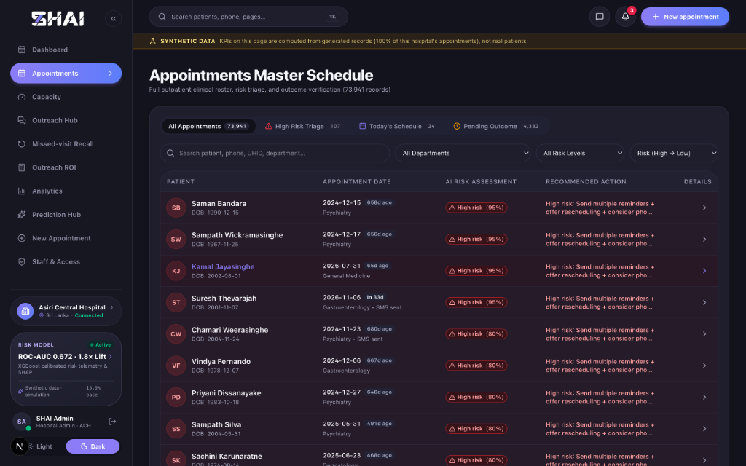
System demonstration or worked example
Live Clinical Demonstration
1. 4-Step Intake Wizard: Registration captures demographics, OSRM transit distance (3.5 km), clinical specialty, and payment mode.
2. Instant Risk Scoring: Engine immediately scores appointment, displaying risk category (13% Low) and top SHAP drivers.
3. Master Schedule Triage: Front-desk console highlights high-risk appointments (e.g. 95% High) with specific recommended actions.
4. Batch Prediction Hub: Batch scores daily clinic cohorts, calculating expected revenue at risk and auto-drafting outreach.
5. Staff Approval Workflow: Patient accepts rescheduled slot via WhatsApp chat; front desk clicks 'Approve & Book' to commit slot.
Evidence: Appointments Master Schedule with Calibrated Triage Badges
SHAI: Outpatient AI Operations & Capacity Platform
11

Slide 12
Evaluation design
Evaluation Setup & Data
• Core Evaluation Questions: How accurately does the model discriminate? Are probabilities reliable? Does risk-ranking recover more revenue?
• Evaluation Test Setup: Out-of-sample chronological test set (N = 9,385 appointments) never seen during training or calibration.
• External Benchmark: Real-world Kaggle medical appointment dataset (N = 110,527) evaluated using the identical ML pipeline.
Metrics, Baselines & Quality Controls
• Target Metrics: ROC-AUC, PR-AUC, Brier score, Recall/Precision/Lift at top 20%, and 90-day operational revenue recovery.
• Quality & Leakage Controls: Chronological temporal splits prevent forward-looking leakage; subgroup fairness audits verify demographic equity.
SHAI: Outpatient AI Operations & Capacity Platform
12

Slide 13
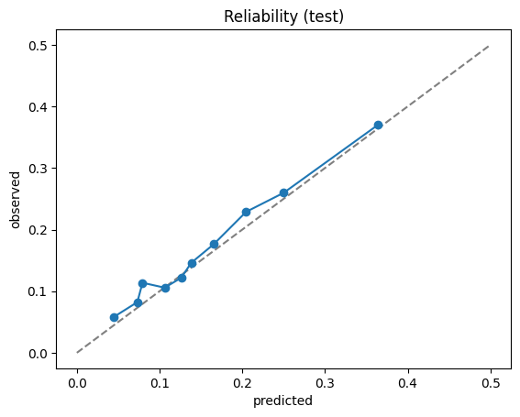
Results and key findings
Empirical Validation Results
1. Superior Model Discrimination: Tuned XGBoost achieved 0.672 ROC-AUC (95% CI: [0.658, 0.686]) and 0.266 PR-AUC on chronological test data.
2. Real-World Benchmark Efficacy: Achieved 0.736 ROC-AUC and 1.904x lift on real-world Kaggle benchmark (N=110,527), proving generalizability.
3. Near-Perfect Probability Calibration: Isotonic regression reduced Brier score to 0.1237; predicted deciles track empirical outcomes on reliability plots.
4. High Operational Targeting Lift: Top 20% risk tier captured 36.3% of empirical no-shows, delivering a 1.82x lift over random hospital outreach.
5. Hypothesis Confirmation: Lead time (OR 1.235, p<0.001) and rain (OR 1.153) significantly elevate risk; prepayment (OR 0.743) strongly protects.
Evidence: Out-of-Sample Reliability Diagram (Calibrated Probabilities vs Observed)
SHAI: Outpatient AI Operations & Capacity Platform
13

Slide 14
Discussion
Interpretation & Literature Alignment
• Interpretation of Findings: Appointment absenteeism is fundamentally driven by scheduling lead time, historical patterns, and weather friction.
• Reconciliation with Rajasuriya (2010): While Rajasuriya observed 26.2% recall in public psychiatry without a control, SHAI establishes a prospective dual-horizon system with randomized hold-outs.
Answers to Research Questions & Meaning
• Evidence Supports Research Questions: Calibrated ML combined with exact overbooking and trilingual dialogue safely mitigates outpatient clinic slot wastage.
• Practical Health System Meaning: Hospitals must transition from static booking to probabilistic capacity management, targeting administrative effort on high-risk tiers.
SHAI: Outpatient AI Operations & Capacity Platform
14

Slide 15
Research contribution and objectives achieved
Core Research Deliverables
• Original Contribution: First end-to-end healthcare operations platform integrating calibrated GBDT, TreeSHAP, exact dynamic programming overbooking, and trilingual conversational rescheduling.
• Operational Evidence: Replay of 9,266 hospital bookings proved risk-ranking captures 47.4% of no-shows vs 27.4% random, recovering +LKR 228,600 extra revenue.
Objective Attainment Status
• O1 Attainment: Calibrated ML: Achieved 0.672 ROC-AUC, 0.1237 Brier score, and 1.82x targeting lift [Fully Achieved].
• O2 Attainment: Explainable Action: Computed TreeSHAP attributions and deployed transparent heuristic action recommendation layer [Fully Achieved].
• O3 Attainment: Dynamic Overbooking: Formulated exact Poisson-binomial overbooking model and interactive What-If Studio [Fully Achieved].
SHAI: Outpatient AI Operations & Capacity Platform
15

Slide 16
Limitations and future work
Threats to Validity & Limitations
• Data Boundary: Primary training evaluated on synthetic healthcare data; model pending prospective validation on real hospital outcomes.
• Communication Boundary: Outreach executes through simulated channels rather than active live commercial SMS/WhatsApp telecom gateways.
• Scheduling Boundary: Automated slot moves are restricted to the same clinical department.
Directions for Future Research
• Future Clinical RCT: Deploy prospective clinical trial utilizing built-in randomized hold-out protocol (holdout.py) to measure true causal ITT efficacy.
• Clinical Variable Expansion: Incorporate ICD-10 diagnostic codes, laboratory orders, and prescription medication compliance data.
• Enterprise Interoperability: Engineer standardized HL7 FHIR connectors for seamless electronic health record (EHR) integration.
SHAI: Outpatient AI Operations & Capacity Platform
16

Slide 17
Conclusion
Problem & Empirical Summary
• Problem Restatement: Outpatient no-shows impose severe clinic slot wastage, physician idle time, and revenue leakage in Sri Lankan private healthcare.
• Strongest Supported Finding: Isotonically calibrated XGBoost identifies high-risk visits with 1.82x targeting lift, capturing 47.4% of no-shows in live database replay.
Contributions & Final Verdict
• Main Engineering Contribution: Engineered SHAI, bridging predictive AI to hospital operations via exact Poisson-binomial overbooking and trilingual ask-first rescheduling.
• Final Establishing Message: Predictive machine learning safely integrated with deterministic clinical governance protects consultation revenue and upholds patient continuity of care.
SHAI: Outpatient AI Operations & Capacity Platform
17

Slide 18
Selected references
Foundational Clinical & ML Citations
• [1]: M. Rajasuriya, V. de Silva, and R. Hanwella, 'Effectiveness of reminders in reducing non-attendance among out-patients,' The Psychiatrist, vol. 34, pp. 515–518, 2010.
• [2]: T. Chen and C. Guestrin, 'XGBoost: A scalable tree boosting system,' in Proc. 22nd ACM SIGKDD, 2016, pp. 785–794.
• [3]: S. M. Lundberg and S.-I. Lee, 'A unified approach to interpreting model predictions,' in NeurIPS 30, 2017, pp. 4765–4774.
Calibration & Operations Research
• [4]: C. Guo, G. Pleiss, Y. Sun, and K. Q. Weinberger, 'On calibration of modern neural networks,' in ICML, 2017, pp. 1321–1330.
• [5]: I. Gurol-Urganci et al., 'Mobile phone messaging reminders for attendance at healthcare appointments,' Cochrane Database Syst. Rev., 2013.
• [6]: S. Srinivas and A. R. Ravindran, 'Optimizing outpatient appointment systems using machine learning and predictive analytics,' Expert Systems with Applications, vol. 111, pp. 116–130, 2018.
SHAI: Outpatient AI Operations & Capacity Platform
18

Slide 19
Thank you
Questions & Discussion
Pravihara Neranjana Abegunasekara
B.Sc. (Honours) in Software Engineering · Faculty of Computing, NSBM Green University
Project: SHAI (Smart Hospital AI Operations Platform) | Supervisor: Mr. Anton Jayakody
SHAI: Outpatient AI Operations & Capacity Platform
19

Slide 20
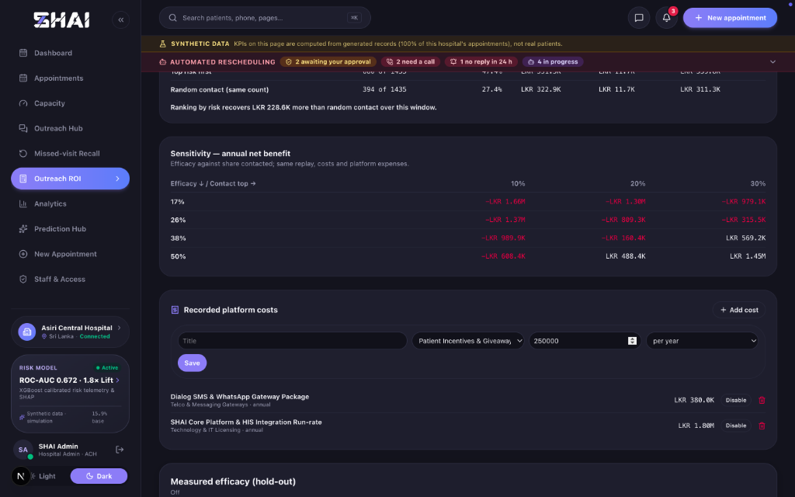
Backup: detailed evidence
Financial Sensitivity & Model Auditing
1. Decision-Theoretic Sensitivity: Evaluated net economic benefit across Rajasuriya 95% CI recall bounds (17% to 38%) and contact shares (10% to 30%).
2. Break-Even Consultation Fee: System breaks even at LKR 3,961 average fee; private specialist rates (LKR 4,500+) generate positive 1.14x ROI.
3. Sourced Contact Cost (LKR 5.38): Transparently derived: LKR 1.00 SMS + 25% escalation to 3.5-min receptionist calls @ LKR 300/hour.
4. Subgroup Fairness Verification: Audits confirm demographic parity across gender (F 0.674 vs M 0.671 AUC) and transit distance strata.
5. Scientific Hold-Out Control Arm: SHA-256 deterministic hash creates uncontacted control arm for prospective intention-to-treat (ITT) trials.
Evidence: Decision-Theoretic Sensitivity Matrix & Platform Cost Breakdown
SHAI: Outpatient AI Operations & Capacity Platform
20

Slide 21
Backup: contribution and reproducibility
Engineering Effort & Libraries
• Personal Engineering Contribution: Personally designed and implemented full-stack Next.js/FastAPI platform, Poisson-binomial convolution, ask-first state machine, and calibration pipeline.
• Reused External Resources: XGBoost, scikit-learn, TreeSHAP, PostgreSQL 16, OSRM routing, Google Gemini API, and React/Tailwind frontend libraries.
Artifact Reproducibility & Codebase
• Code & Model Bundle Location: Full codebase tracked in Git repository; native JSON model bundles stored in models/shai_bundle/ (cross-version compatible).
• Automated Test Verification: Full backend test suite (233 passed) and frontend test suite (31 passed) executable via pytest and vitest.
• Database Migration Reproducibility: PostgreSQL schema fully reproducible via Alembic head migration c9d0e1f2a3b4 across 32 relational tables.
SHAI: Outpatient AI Operations & Capacity Platform
21

Slide 22
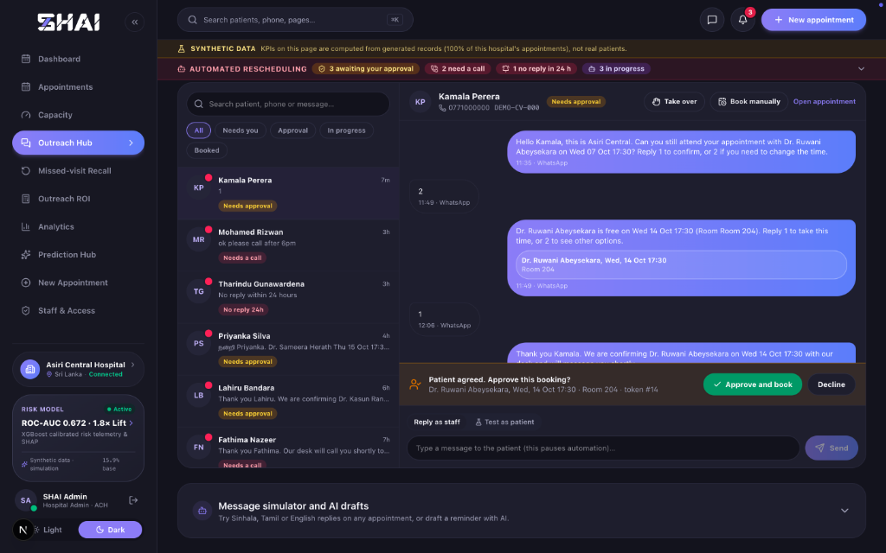
Backup: clinical governance and privacy
Clinical Safeguards & Ethics
1. Specialty Privacy Masking: Psychiatry, psychology, and mental health clinical specialties are masked to neutral 'clinic' descriptors in patient messages.
2. PHI Prompt Sanitization: National Identity Card (NIC), telephone numbers, and addresses never leave the server; placeholders populated locally.
3. Human-in-the-Loop Barrier: Conversations halt at 'pending_approval' state; authorized staff must confirm bookings before database persistence.
4. Telehealth Clinical Guardrail: Virtual video consultations offered only when doctor's department explicitly authorizes it (telehealth_ok).
5. Role-Based Access Control: PostgreSQL authentication enforces role gating across front_desk, analyst, manager, and administrator tiers.
Evidence: Outreach Hub WhatsApp Chat Halting at Staff Approval Barrier
SHAI: Outpatient AI Operations & Capacity Platform
22

