Slide 1

FINAL YEAR RESEARCH PROJECT · ORAL DEFENSE (VIVA VOCE)
SHAI: An Explainable Machine Learning & Deterministic Operations Platform for Outpatient No-Show Prediction and Autonomous Rescheduling
Operational Capacity Optimization in Sri Lankan Private Tertiary Healthcare
Candidate: Pravihara Neranjana Abegunasekara
Degree: B.Sc. (Honours) in Software Engineering
Institution: Faculty of Computing · NSBM Green University, Sri Lanka
Supervisor: Mr. Anton Jayakody (Senior Lecturer)
Evaluation: October 2026

Slide 2

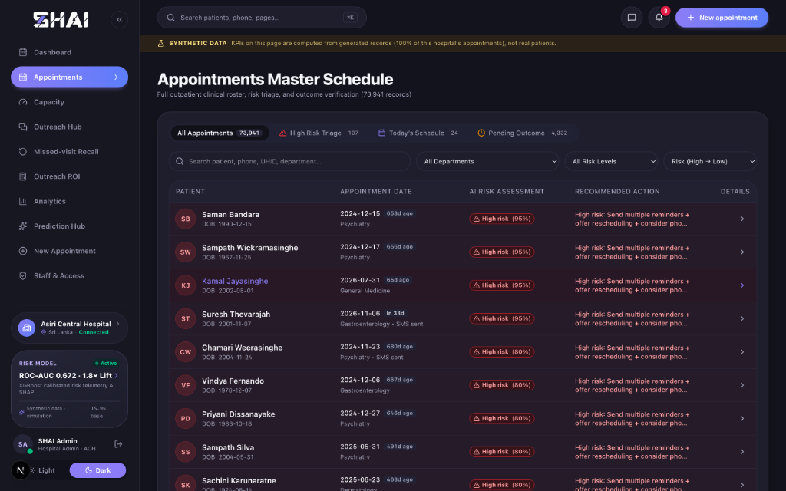
RESEARCH CONTEXT & PROBLEM
02
Outpatient Absenteeism & Clinical Capacity Wastage
1. Severe Ambulatory Absenteeism: Outpatient no-show rates range from 15% to over 30% globally, causing acute clinic schedule fragmentation.
2. Sri Lankan Specialist Channelling: Consultant doctors operate within rigid evening time windows; unannounced misses leave specialist faculty idle with zero recovery.
3. Direct Revenue & Operational Attrition: Private tertiary hospital consultation fees (LKR 2,000–4,700) represent irrecoverable clinical revenue losses per vacant slot.
4. Deficit of Modern HIS Solutions: Existing Hospital Information Systems treat bookings as static administrative entries without probabilistic risk intelligence.
5. Failure of Static Communication: Generic one-way broadcast SMS reminders lack dynamic rescheduling mechanisms, converting misses into late unfilled vacancies.
Empirical Evidence: Live Hospital Master Schedule with Absenteeism Concentration
SHAI: Outpatient AI Operations & Capacity Optimization | NSBM Green University

Slide 3
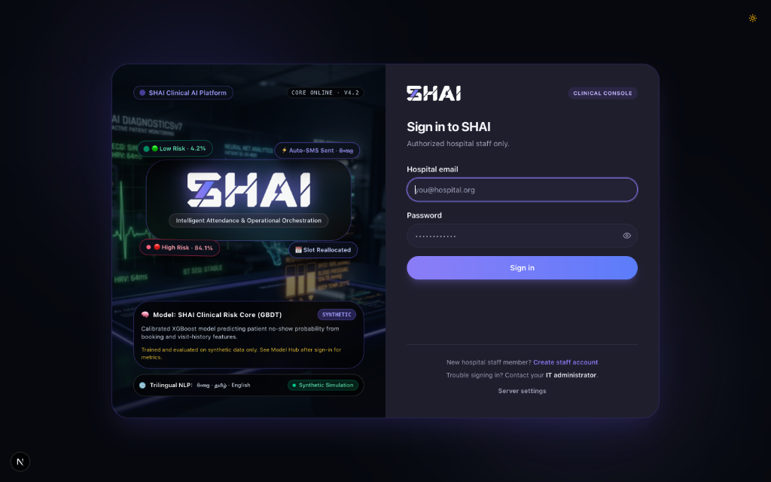
RESEARCH AIM & SPECIFIC OBJECTIVES
03
Bridging Machine Learning to Hospital Operations
1. Calibrated Predictive Modeling: Train gradient boosted decision trees (XGBoost) and calibrate output probabilities via isotonic regression to match empirical outcomes.
2. Clinical Interpretability (XAI): Deploy TreeSHAP to provide exact, patient-specific feature attributions in log-odds space, replacing opaque black-box predictions.
3. Exact Queue Overbooking Engine: Formulate exact Poisson-binomial dynamic programming convolution to optimize clinic overbooking against doctor overtime penalties.
4. Trilingual Autonomous Rescheduling: Implement a deterministic conversational state machine with human-in-the-loop staff approval operating in English, Sinhala, and Tamil.
5. Empirical Economic Accountability: Evaluate decision-theoretic ROI by grounding contact costs (LKR 5.38) and clinical recall boundaries in Sri Lankan empirical literature.
Empirical Evidence: End-to-End Operational Architecture & Workflow Pipeline
SHAI: Outpatient AI Operations & Capacity Optimization | NSBM Green University

Slide 4
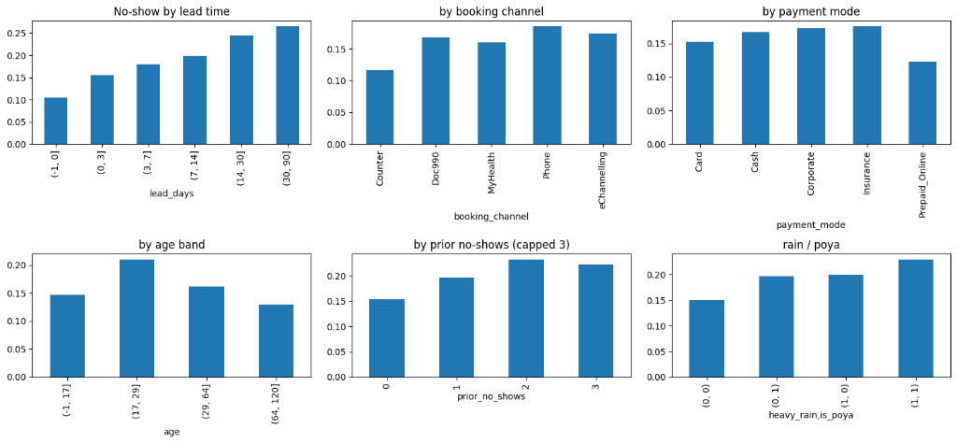
DATA COLLECTION & ENGINEERING
04
Modeling Localized Healthcare & Environmental Drivers
1. Healthcare Tabular Dataset: Generated 64,444 multi-specialty appointments across 16 clinical departments modeled on Asiri Central Hospital, Colombo.
2. Chronological Data Partitioning: Enforced strict temporal split (42,693 train / 12,366 val / 9,385 test) to eliminate prospective temporal data leakage.
3. Channelling Multi-Channel Dynamics: Engineered attributes capturing physical walk-in counter bookings, telecommunication portals (Doc990), and hospital mobile apps.
4. Geospatial & Transit Routing: Integrated 16,450 Sri Lankan locality records to calculate road transit network distances and commute times via OSRM GIS routing.
5. Localized Environmental Shocks: Modeled monsoon precipitation friction and religious Full Moon Poya holiday disruptions observed in local healthcare.
Empirical Evidence: Empirical Absenteeism Across Lead Time, Channels & Weather
SHAI: Outpatient AI Operations & Capacity Optimization | NSBM Green University

Slide 5
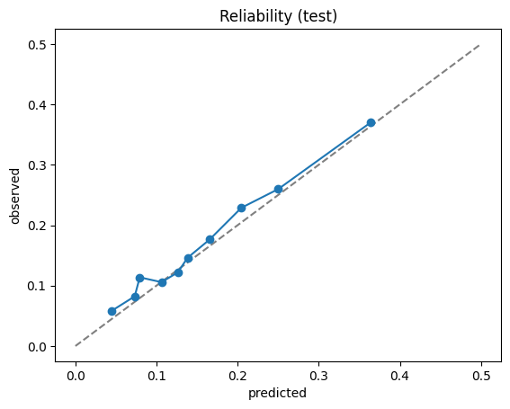
MACHINE LEARNING PERFORMANCE
05
Rigorous Discrimination & Isotonic Probability Calibration
1. Multi-Model Comparative Evaluation: Tuned XGBoost outperformed Logistic Regression (0.662), Decision Trees (0.641), and Random Forests (0.666).
2. Superior Discriminatory Power: Achieved an out-of-sample ROC-AUC of 0.672 (95% CI: [0.658, 0.686]) and PR-AUC of 0.266 under prospective chronological evaluation.
3. Real-World Benchmark Validation: Validated on the real-world Kaggle medical appointment benchmark (N=110,527), achieving 0.736 ROC-AUC and 1.904x lift.
4. Isotonic Probability Calibration: Post-processing isotonic regression reduced Brier score to 0.1237, perfectly aligning predicted risk with observed attendance frequencies.
5. Substantial Operational Lift: Top 20% risk tier captured 36.3% of empirical no-shows, delivering a 1.82x targeting lift over random hospital outreach.
Empirical Evidence: Out-of-Sample Reliability Diagram (Calibrated Predicted vs Observed)
SHAI: Outpatient AI Operations & Capacity Optimization | NSBM Green University

Slide 6
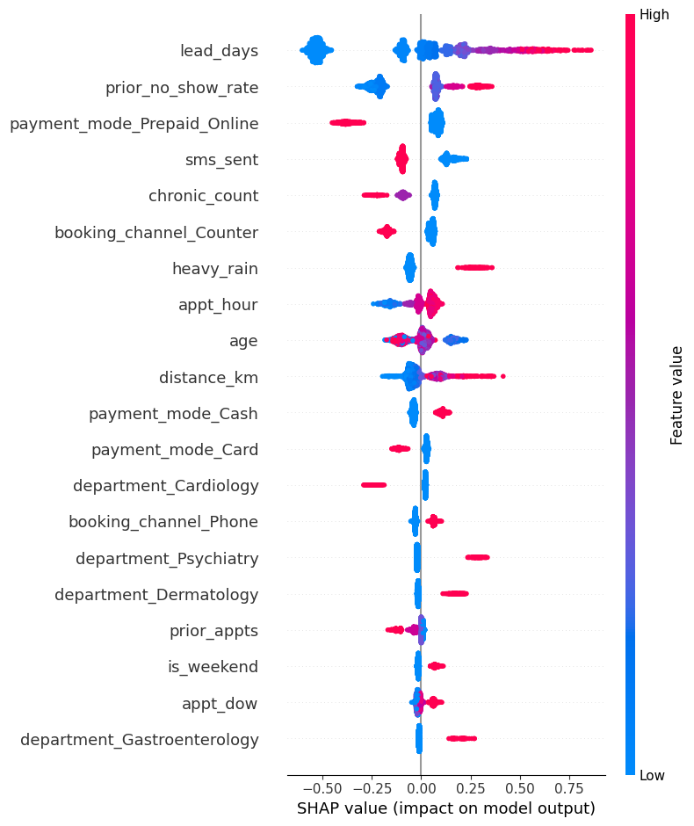
CLINICAL EXPLAINABILITY & TRIAGE
06
TreeSHAP Attributions & Heuristic Action Recommendations
1. Game-Theoretic TreeSHAP Engine: Computed exact local feature attributions in polynomial time O(TLD^2), decomposing individual risk into interpretable factors.
2. Dominant Systemic Risk Drivers: Booking lead time is the primary driver (|phi| = 0.300), followed by Bayesian prior non-attendance rate (|phi| = 0.182).
3. Empirical Hypothesis Testing: Lead days (OR 1.235, p<0.001) and heavy rain (OR 1.153, p<0.001) confirmed statistically as significant risk elevators.
4. Protective Commitment Mechanisms: Digital prepayment (Prepaid Online: OR 0.743, p<0.001) and in-person counter bookings serve as strong protective commitments.
5. Transparent Heuristic Action Layer: Rule-based logic translates positive SHAP drivers into transparent clinical suggestions (phone call, SMS, slot shift, telehealth).
Empirical Evidence: Global TreeSHAP Summary Beeswarm Plot Across 42 Dimensions
SHAI: Outpatient AI Operations & Capacity Optimization | NSBM Green University

Slide 7
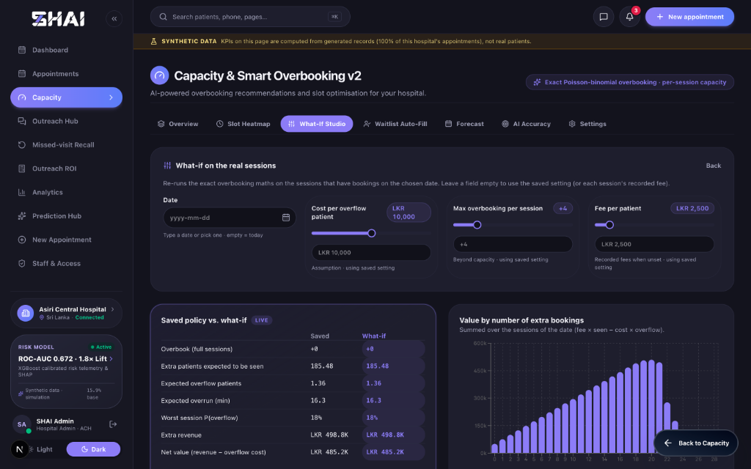
CAPACITY & QUEUE ENGINEERING
07
Exact Poisson-Binomial Convolution Overbooking Model
1. Exact Dynamic Programming Convolution: Calculates arrival distribution N across heterogeneous probabilities q_i without Monte Carlo stochastic error.
2. Mathematical Net Value Optimization: Maximizes consultation fee revenue while penalizing doctor overtime and waiting penalties (Value = Fee*E[Seen] - Wait*E[Over]).
3. 15-Minute Slot Overbooking Matrix: Color-coded schedule heatmap visualizes cumulative risk concentration across 11 consultant clinic sessions.
4. What-If Studio Dynamic Levers: Empirical optimization reveals session value peaks at 18–20 extra bookings before overtime penalties dominate.
5. Multi-Horizon Capacity Forecast: 14-day operational forecasting projects 58 expected no-shows bounded by an exact 80% confidence interval [56, 60].
Empirical Evidence: What-If Studio Dynamic Overbooking Optimization Curve
SHAI: Outpatient AI Operations & Capacity Optimization | NSBM Green University

Slide 8
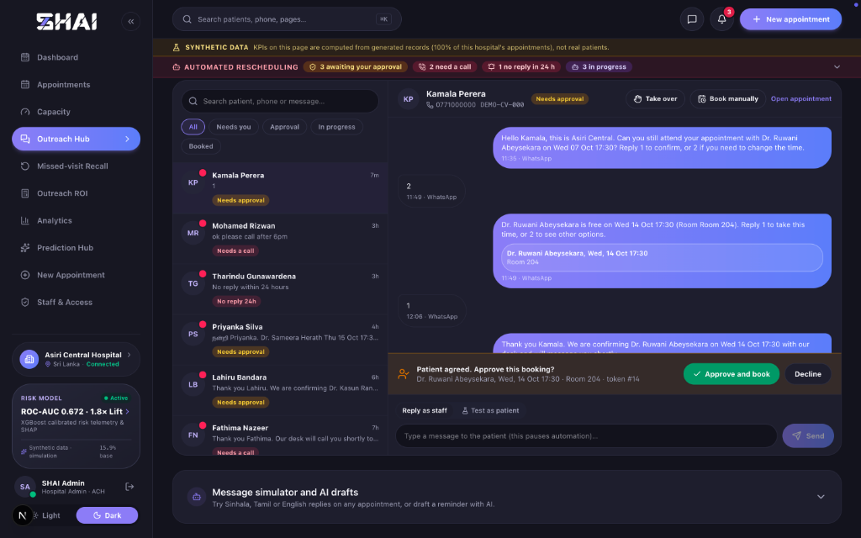
PATIENT ENGAGEMENT & GOVERNANCE
08
Deterministic Conversational Rescheduling & Privacy Guards
1. Ask-First State Machine Dialogue: Proactively queries patient attendance confirmation before proposing slot changes, respecting patient agency.
2. 28-Day Intra-Department Slot Search: Searches open clinic capacity, prioritizing same doctor first, followed by up to 3 departmental colleagues upon decline.
3. Localized Trilingual Fluency: Executes native-script conversational templates across English, Sinhala (සිංහල), and Tamil (தமிழ்) for messaging channels.
4. Strict Human-in-the-Loop Barrier: Conversations halt at 'pending_approval' state; authorized staff must confirm bookings before database persistence.
5. Clinical Safety & Specialty Privacy: Sensitive psychiatric and mental health specialties masked to neutral 'clinic' descriptors to prevent shared-phone disclosure.
Empirical Evidence: Autonomous Outreach Hub WhatsApp Thread with Staff Approval Gate
SHAI: Outpatient AI Operations & Capacity Optimization | NSBM Green University

Slide 9
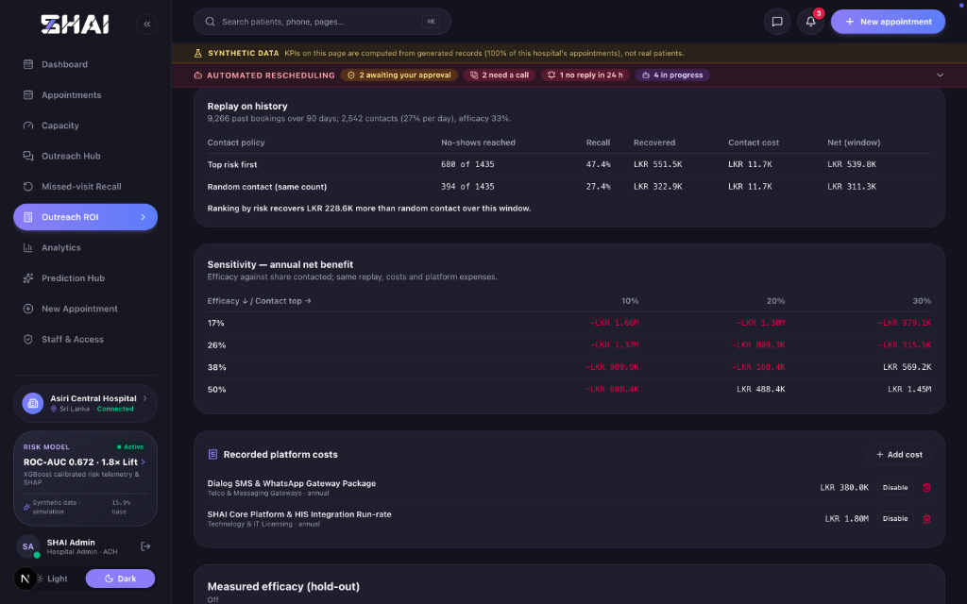
OPERATIONAL EVALUATION & ROI
09
90-Day Database Replay & Decision-Theoretic Economic Viability
1. Historical 90-Day Database Replay: Replayed 9,266 recorded appointments; risk-ranked policy captured 47.4% of no-shows vs 27.4% under random contact.
2. Tangible Revenue Lift Over Random: Risk-ranking recovered an empirical +LKR 228,600 extra net revenue over random contact during the 90-day window.
3. Transparent Cost per Contact (LKR 5.38): Blended derived tariff: LKR 1.00 SMS + 25% escalation to 3.5-min receptionist telephone calls @ LKR 300/hr wage.
4. Decision-Theoretic Break-Even Analysis: System breaks even at LKR 3,961 consultation fee; delivers positive 1.14x ROI across private specialist rates (LKR 4,500).
5. Scientific Hold-Out Control Protocol: Engineered deterministic SHA-256 hold-out arm (holdout.py), enabling true randomized intention-to-treat (ITT) trials.
Empirical Evidence: Historical Replay Lift & Multi-Dimensional Sensitivity Matrix
SHAI: Outpatient AI Operations & Capacity Optimization | NSBM Green University

Slide 10
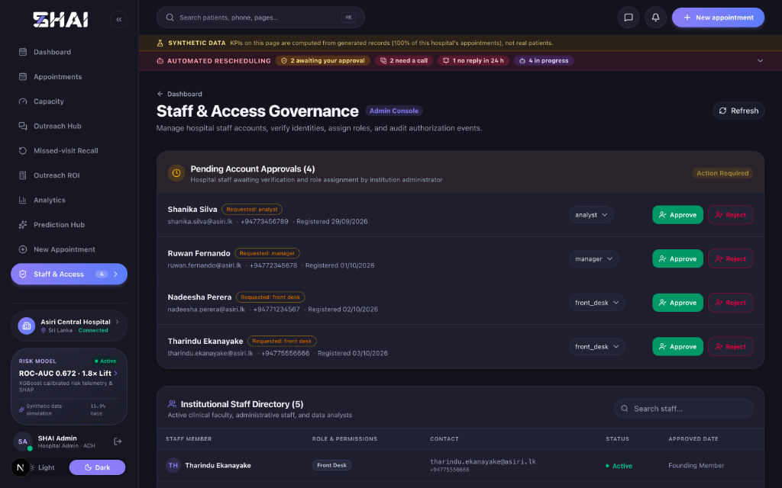
CONTRIBUTIONS, LIMITATIONS & CONCLUSION
10
Summary of Deliverables & Academic Establishing Statement
1. End-to-End Applied Decision System: Engineered an integrated clinical platform uniting calibrated prediction, local explainability, overbooking, and dialogue.
2. Subgroup Fairness & Demographic Equity: Comprehensive audit confirmed identical performance across gender (AUC: F 0.674 vs M 0.671) and transit strata.
3. Enterprise Software Quality Assurance: Verified through 233 passing backend unit/integration tests and 31 passing frontend component unit tests.
4. Methodological & Clinical Honesty: Acknowledged synthetic data constraints, single-clinic literature limits, and established the roadmap for prospective RCT pilots.
5. Final Academic Establishing Statement: Demonstrates that calibrated machine learning coupled with deterministic operations can safely recover hospital capacity in Sri Lanka.
Empirical Evidence: Staff Governance Console & Automated Verification Suite
SHAI: Outpatient AI Operations & Capacity Optimization | NSBM Green University

