Slide 1
Cardboardtronics and Microbits
Pravin Vaz (Resource page)

Slide 2
Basics components of circuits
This table summarizes essential components used in electronics. Understanding each component's role is crucial for effective circuit design.
COMPONENT | FUNCTION | EXAMPLE
Resistor | Limits current flow | 220 Ohm resistor
LED | Light emitting diode | Standard LED
Battery | Power source | CR2032 button cell
Switch | Controls circuit flow | Push button switch
Capacitor | Stores electric charge | 10µF capacitor

Slide 3
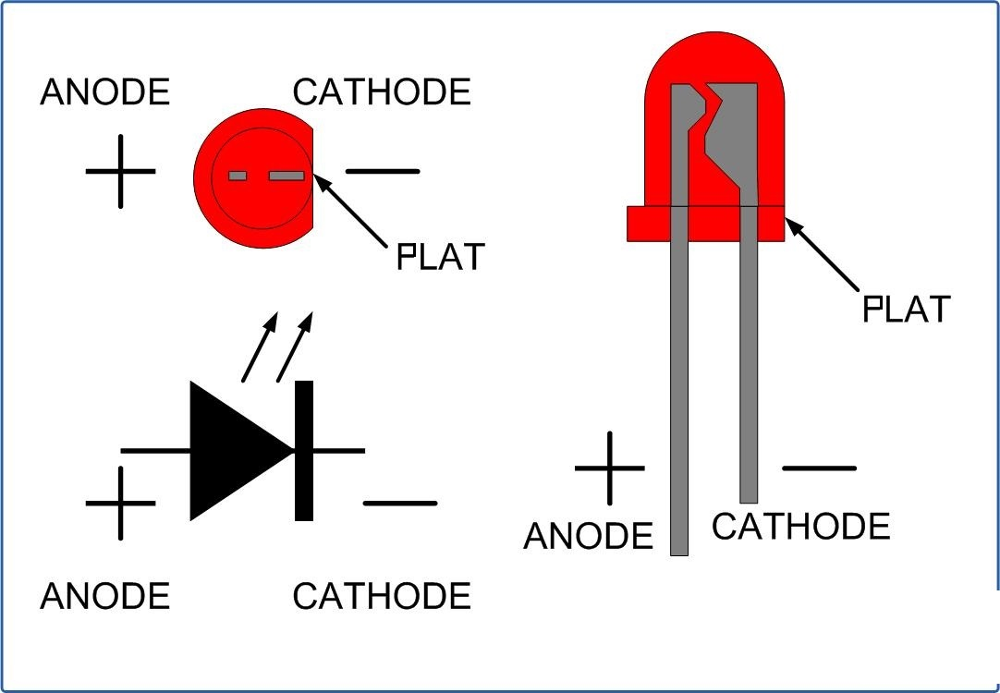
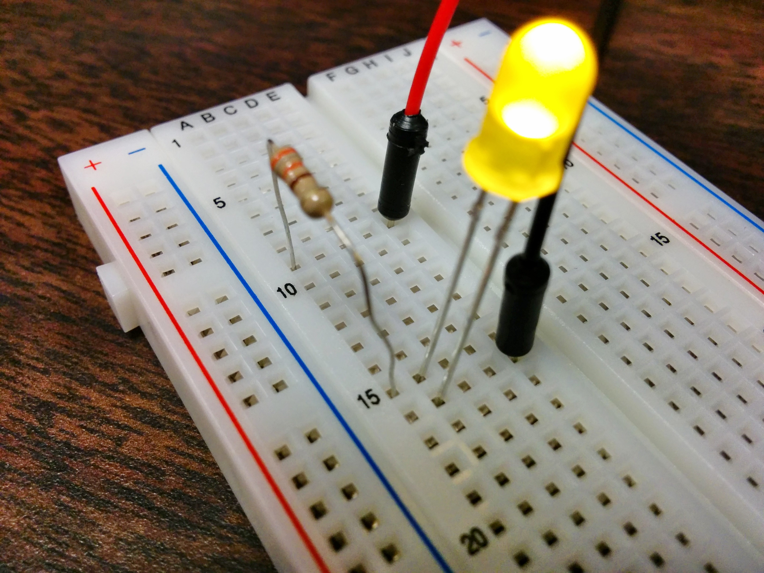
Wiring an LED
CONNECTING THE LED
To connect an LED, use a button cell battery. Align the longer leg of the LED (anode) to the positive side of the battery and the shorter leg (cathode) to the negative.
This Photo by Unknown Author is licensed under CC BY-SA
USING A RESISTOR
To prevent burning out the LED, include a resistor in the circuit. The resistor limits the current flowing to the LED, ensuring it operates safely.
This Photo by Unknown Author is licensed under CC BY-NC-ND

Slide 4
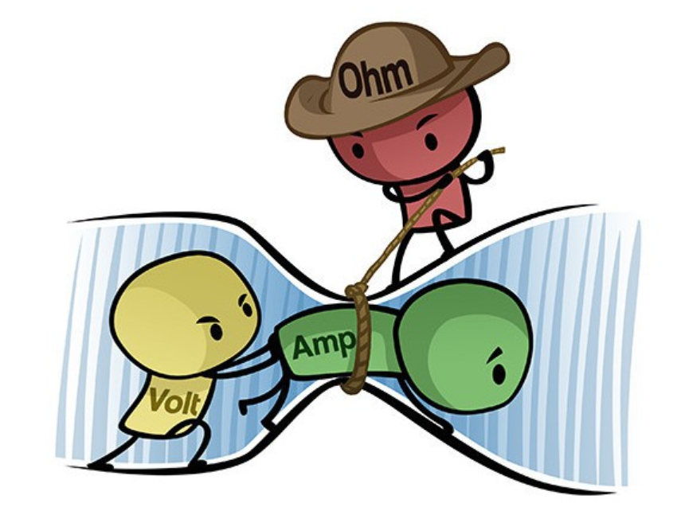
Energy Flow in Circuits
CURRENT DIRECTION
VOLTAGE AND CURRENT
POWER CONSUMPTION
Electric current flows from the positive to the negative terminal in a circuit. Understanding this flow is essential for effective wiring.
Voltage provides the push that drives electricity through the circuit, while current measures the flow. The relationship between them is fundamental to circuit design.
Power indicates how much energy is used in a circuit, calculated by multiplying voltage and current. Monitoring power consumption is vital in circuit applications.

Slide 5
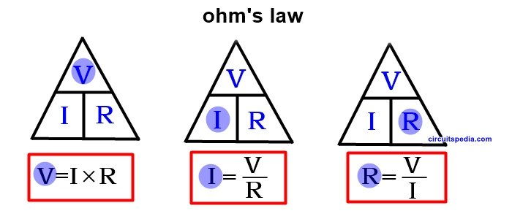
Ohm's Law Basics
UNDERSTANDING OHM'S LAW
Ohm's Law states that V = I × R, where V is voltage, I is current, and R is resistance. This principle helps in calculating missing values in electric circuits.
This Photo by Unknown Author is licensed under CC BY-SA

Slide 6
Things to do today:
Make a simple circuit
Make a circuit using an LED (pick a color) – This you get to keep
Wire it up and test it with a power pack – limited quantities unfortunately so you might have to work together
Test other available modules and look on the web resource to see how to make others.
Ask questions and share your knowledge.
Things to do when you go back:
DIY PROJECTS
Make an LED based project
RC car using motors
Wire up to a Microbit and control via coding
Collect old toys and see what can be salvaged

