Slide 1
PROJECT REVIEW 3
Smart UV Risk Classification and Ambient Light Monitoring System Using ESP8266 with ThingSpeak Cloud Connectivity
STUDENT NAME
REGISTER NUMBER
YEAR / DEPT / SECTION
COURSE CODE & NAME
Pravin A
722824106121
III Year / ECE / C
U23EC492 - IoT and Application
SDG ADDRESSED
TECHNOLOGY READINESS LEVEL
REVIEW & DATE
SDG 3 - Good Health & Well-being
SDG 7 - Affordable & Clean Energy
TRL 4 - Experimental Proof of Concept
Review 3 |
Supervisor: Dr. S. Ramalingam, AP/ECE | Sri Eshwar College of Engineering, Coimbatore

Slide 2
Introduction
BACKGROUND
MOTIVATION & IMPORTANCE
UV radiation (100-400 nm) is invisible; UVA and UVB reach the ground
Causes sunburn, photokeratitis, skin ageing, cataracts, skin cancer
Strong year-round UV in tropical India; outdoor workers and students exposed
Forecasts are regional; calibrated meters are costly
TECHNICAL CONTEXT
PROJECT OBJECTIVES
ESP8266 NodeMCU reads an analog UV sensor (10-bit ADC, 0-1023)
LDR light state, TFT + LEDs, ThingSpeak upload over Wi-Fi
Measure, filter and classify UV into 4 levels with hysteresis
Local TFT/LED alert; 16 s cloud upload; works offline; test mode

Slide 3
Problem Statement
THE PROBLEM
IMPACT
NEED FOR THE SOLUTION
UV cannot be seen or felt, so safe/unsafe levels cannot be judged by eye
No affordable, local, real-time notification between forecasts and costly meters
Hobby designs print raw values: no risk level, advice or light context
Exposure is underestimated, even on hazy or cloudy days
Risk of sunburn, eye damage and skin cancer for outdoor workers and students
Uncalibrated 'UV Index' claims can mislead users
Low-cost, portable, local UV measurement
Named risk levels with colour, LEDs and advice
Stable readings; no display flicker
Works offline; cloud monitoring optional

Slide 4
Literature Survey
Approach | Methodology | Findings / strengths | Limitations
Professional UV meters | Calibrated detector with erythemal weighting | Most trustworthy local readings | High cost; needs trained interpretation
Forecast apps / websites | UV Index estimated from solar elevation, ozone, cloud | Free and widely available | Regional; ignores shade, reflection, altitude
Wearable UV sensors | Body-worn sensors or patches with phone link | Personal exposure tracking | Orientation-dependent accuracy; consumer products
Microcontroller UV monitors | Analog/digital UV sensor on Arduino/ESP; serial, LCD/OLED; ThingSpeak or Blynk | Low cost and flexible | Raw voltages shown as UV Index; calibration not described
IoT environmental stations | Multi-sensor node (UV, temperature, humidity, pressure) to cloud | Long-term records | Needs network to view; no local alert

Slide 5
Existing Solutions & Gaps Analyzed
EXISTING APPROACHES AND LIMITS
GAPS ADDRESSED BY UV GUARD
Professional meters: accurate but costly, number only
Forecast apps: regional, not at the user's spot
Wearables: placement-dependent, single-purpose
Hobby monitors: raw values, uncalibrated, basic UI
IoT stations: network-dependent, no local alert
Unfiltered ADC noise; full-screen redraw flicker
Local, low-cost UV sensing at the device
Four named levels with colour and advice
Instant green/red LED alert
Averaging, smoothing, hysteresis, partial redraw
LDR bright/dark context for readings
Local operation continues without Wi-Fi
Value labelled as raw ADC until calibrated

Slide 6
Proposed Solution
Sample UV on A0 every 25 ms
1 s mean + exponential filter
Classify L1-L4 with hysteresis
Update TFT and LEDs
Upload to ThingSpeak every 16 s
IMPLEMENTED
PLANNED
4 levels: LOW, MODERATE, HIGH, VERY HIGH (placeholder thresholds 100/200/300)
LDR bright/dark with 3 s debounce
3-screen TFT dashboard; green (L1-2) / red (L3-4) LEDs
NO SIGNAL / SATURATED sensor checks
Serial test mode (levels forced 15 s)
ThingSpeak upload; offline operation
Calibration against a reference UV meter, then real UV Index
Richer dashboard: history, daily maximum

Slide 7
Proposed Work Plan
REVIEW 1
REVIEW 2
REVIEW 3
Objectives & planning
Design & prototype
Integration & testing
COMPLETED
COMPLETED
COMPLETED*
Problem identification, objectives
Literature survey, gap analysis
Component and sensor selection
Alternatives compared (sensor, MCU, display)
Block diagram and circuit design
Breadboard assembly; TFT, LDR, UV tests
Firmware: filter, hysteresis, 4 levels
LEDs, TFT screens, serial test mode
ThingSpeak upload and offline tests
Field tests in 5 conditions
Report written; calibration still pending

Slide 8
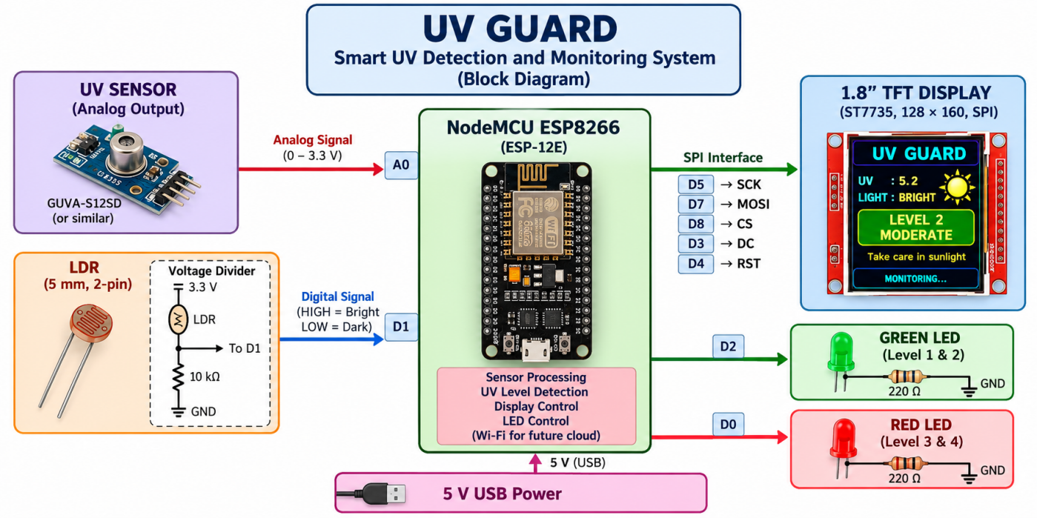
Block Diagram

Slide 9
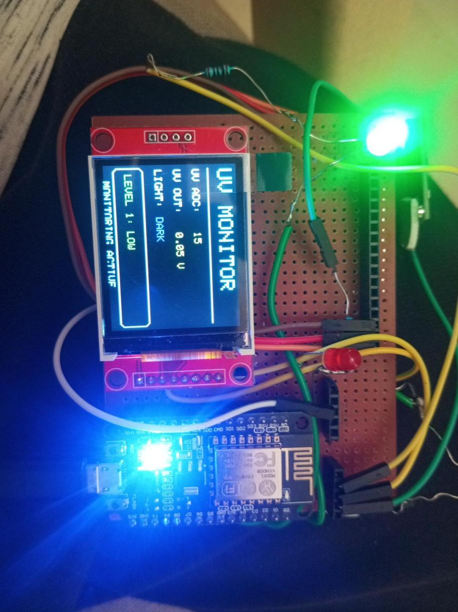
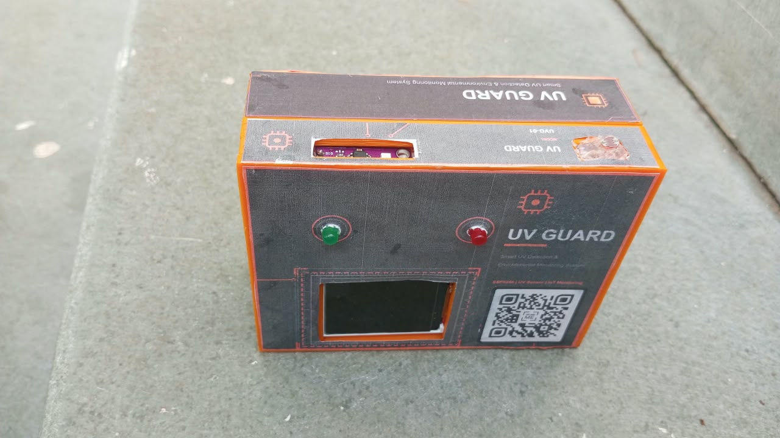
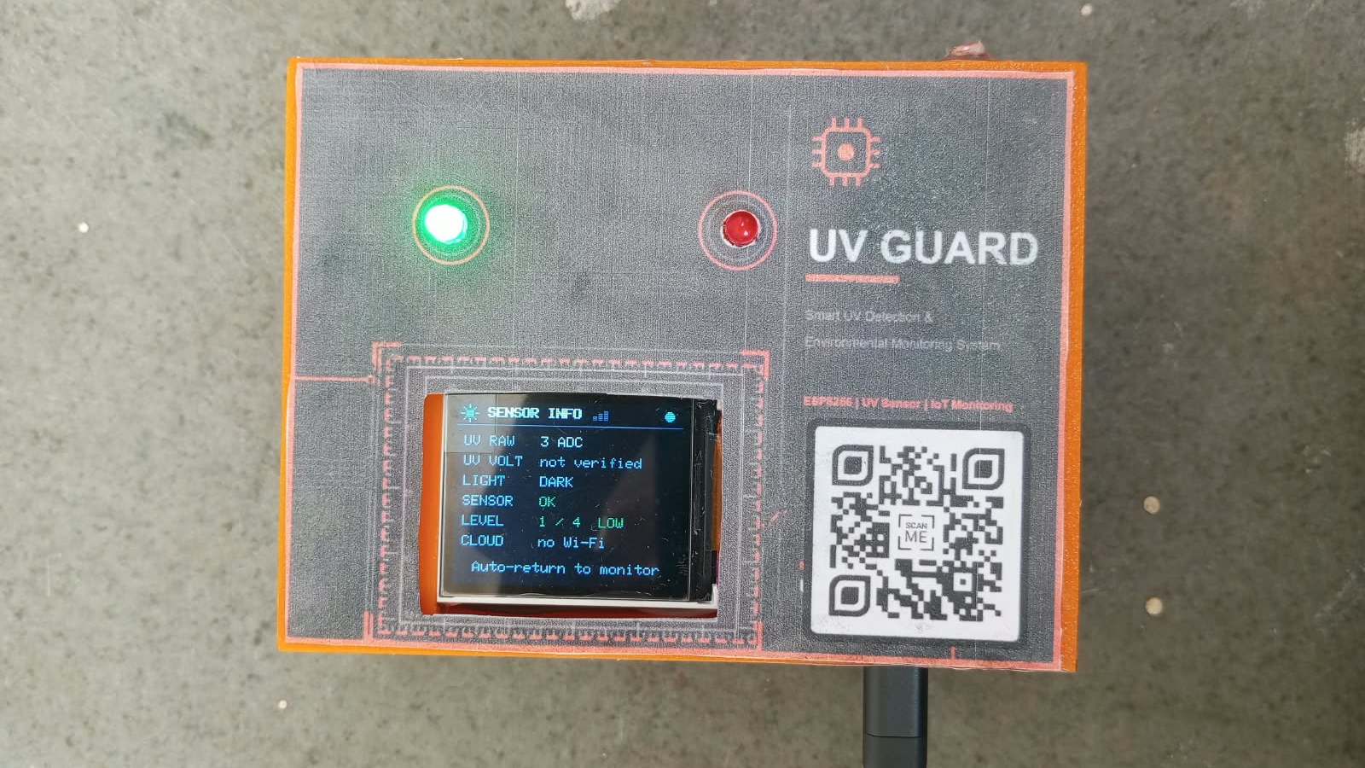
Prototype Image (Hardware)
VISIBLE IN PHOTOS
NodeMCU ESP8266
1.8" ST7735 TFT
UV sensor and LDR
Green and red LEDs
3D-printed case with QR label
USB power cable
Enclosed prototype: TFT window, green and red LEDs, QR label
Display running inside the enclosure (portrait view)
Report lists an enclosure as future work, but the cost sheet includes a 3D-printed case. Confirm.
Breadboard prototype: NodeMCU, TFT, UV sensor, LDR, LEDs

Slide 10
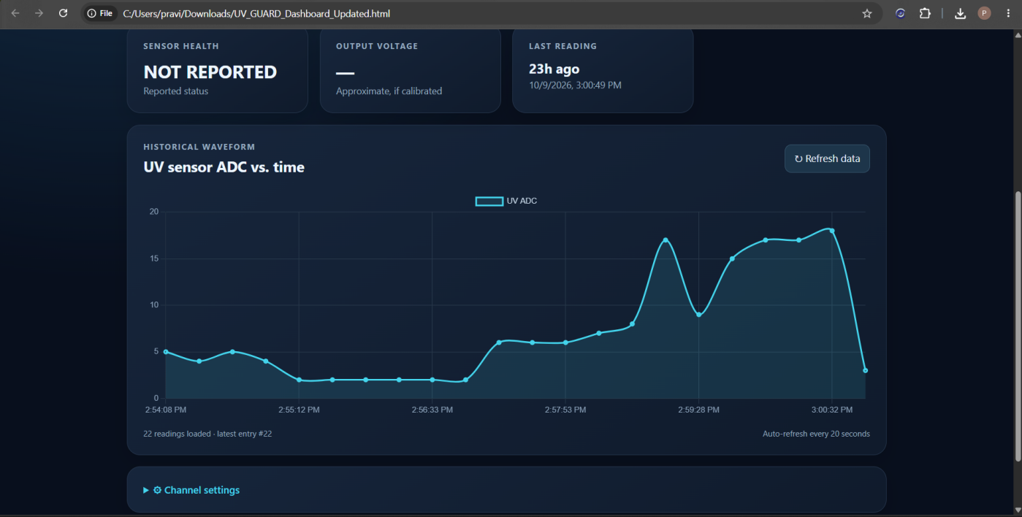
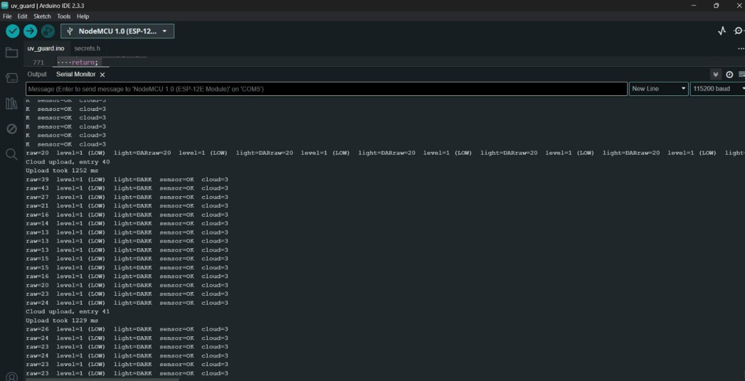
Prototype Image (Software)
Cloud dashboard: UV sensor ADC vs time. Report calls it ThingSpeak; the UI looks like a custom page - confirm.
Arduino IDE serial monitor: raw, level, light, sensor, cloud status; cloud upload entries
No simulation outputs are in the report. Circuit diagram (Fig. 6) and block diagram (Fig. 4) appear in the report.

Slide 11
Technology Stack Used
CONTROLLER & SENSORS
DISPLAY & ALERTS
COMMUNICATION
NodeMCU ESP8266 (ESP-12E), 80 MHz, Wi-Fi
Analog UV sensor (GUVA-S12SD or similar)
5 mm LDR with 10 k divider
1.8" 128x160 ST7735 SPI TFT
Green and red LEDs (220 ohm)
3D-printed enclosure (cost sheet)
ADC (A0), GPIO, hardware SPI
UART / USB serial, 115200 baud
Wi-Fi 802.11 b/g/n; HTTP over TCP/IP
SOFTWARE
CLOUD
SIMULATION TOOLS
C++ on Arduino framework; Arduino IDE
ESP8266 core, ESP8266WiFi, HTTPClient
Adafruit GFX, ST7735/ST7789, SPI
ThingSpeak channel (3 fields)
Upload every 16 s (free tier limit)
Credentials kept in secrets.h
None stated in the report
Testing by serial monitor and field readings

Slide 12
Uniqueness Claimed
Feature | Forecast apps | Typical microcontroller UV monitors | UV Guard (this project)
Where UV is sensed | Regional estimate | At the device | At the device
Result shown | UV Index forecast | Often raw sensor value | 4 named levels, colour, advice
Immediate local alert | App must be opened | Serial / LCD output | Green / red LEDs and TFT
Noise handling | Not applicable | Often unfiltered | Averaging, smoothing, hysteresis
Ambient-light context | No | Rarely | LDR bright/dark (debounced)
Works offline | Needs internet | Depends on design | Yes; cloud optional
Calibration honesty | Not applicable | Raw often shown as UV Index | Labelled raw ADC; not a certified meter
Demonstrated (bench/field tests in report): filtered, flicker-free 4-level display, LED agreement, offline operation, 16 s uploads. Expected, not yet validated: accuracy as a true UV Index after calibration. Not claimed as a new sensing method.

Slide 13
Specifications: Hardware Components
S.No. | Hardware Components | Specifications | Cost (Rs.)
1 | NodeMCU ESP8266 (ESP-12E) x1 | 80 MHz, integrated Wi-Fi, USB, 10-bit ADC (A0) | 350
2 | Analog UV sensor x1 | Analog output to A0; exact model to be confirmed | 200
3 | 1.8" TFT, ST7735 x1 | 128 x 160, SPI, 3.3 V, landscape use | 370
4 | 5 mm LDR x1 | Two-terminal; bright/dark input on D1 | 40
5 | Resistors: 10 k x1, 220 ohm x2 | LDR divider; LED current limiting | 10
6 | Green LED x1, Red LED x1 | On D2 (levels 1-2) and D0 (levels 3-4) | 10
7 | Jumper wires | As required | 100
8 | Dotboard | 1 piece, circuit assembly | 100
9 | USB cable | Programming and 5 V power | 100
10 | 3D-printed case x1 | Enclosure (cost sheet only) | 150
11 | Product sticker x1 | Label | 20
 | Total (sum of line items) |  | 1,400

Slide 14
Specifications: Software
Category | Item / specification | Remarks
Development | Arduino IDE; board NodeMCU 1.0 (ESP-12E Module) | Version not stated
Language / firmware | C++ (Arduino framework, ESP8266 core) | Non-blocking loop using millis()
Libraries | ESP8266WiFi, ESP8266HTTPClient, WiFiClient, SPI | Wi-Fi, HTTP upload, display bus
Display libraries | Adafruit GFX; Adafruit ST7735 and ST7789 | Version not stated
Cloud platform | ThingSpeak: field 1 ADC, 2 level, 3 light | Upload every 16 s; HTTP timeout 2 s
Signal processing | 25 ms samples; 1 s mean; exponential filter | Hysteresis 8 counts
Thresholds | 100 / 200 / 300 raw ADC counts (placeholders) | Calibration pending

Slide 15
Conclusions
UV Guard: a low-cost ESP8266 device that measures UV, classifies it into four risk levels, alerts locally on a TFT and LEDs, and uploads to ThingSpeak.
ACHIEVED AND TESTED
LIMITATIONS
FUTURE WORK
All 8 objectives met per report (Table 18)
Levels and LEDs verified in test mode
Field readings 2 to 400 raw ADC across 5 conditions
Uploads about every 16 s; local alerts continue offline
Raw ADC only; thresholds are placeholders
Not a certified UV Index meter
LDR gives bright/dark only
Plain HTTP upload, not encrypted
Calibrate against a reference UV meter
HTTPS or MQTT; richer dashboard
Analog light via external ADC
Battery operation, mobile app

Slide 16
References
[1] WHO, WMO, UNEP and ICNIRP, Global Solar UV Index: A Practical Guide. Geneva: WHO, 2002.
[2] Espressif Systems, ESP8266EX Datasheet.
[3] ESP8266 Community, "Arduino core for ESP8266 WiFi chip," GitHub. https://github.com/esp8266/Arduino
[4] Adafruit Industries, "Adafruit GFX Graphics Library," GitHub. https://github.com/adafruit/Adafruit-GFX-Library
[5] Adafruit Industries, "Adafruit ST7735 and ST7789 Library," GitHub. https://github.com/adafruit/Adafruit-ST7735-Library
[6] The MathWorks, "ThingSpeak IoT Analytics Platform." https://thingspeak.com
[7] GenUV, GUVA-S12SD UV Light Sensor Datasheet.
[8] LAPIS Semiconductor, ML8511 UV Sensor with Voltage Output Datasheet.
[9] Vishay Semiconductors, VEML6075 UVA and UVB Light Sensor with I2C Interface Datasheet.
[10] Lite-On Technology, LTR-390UV-01 Ambient and UV Light Sensor Datasheet.
[11] Silicon Laboratories, Si1145/46/47 Proximity, UV and Ambient Light Sensor IC Datasheet.
[12] Sitronix Technology, ST7735R 262K Color Single-Chip TFT Controller/Driver Datasheet.

Slide 17
Work Progress to Date
COMPLETED
✓
Hardware assembly and unit tests
✓
Firmware: sampling, filter, hysteresis
✓
TFT dashboard (3 screens), LEDs, test mode
✓
ThingSpeak upload; offline operation
✓
Field tests in 5 conditions
✓
Integration if website
IN PROGRESS
The report
Final product sticker
Values are raw ADC counts; thresholds are placeholders, so levels are 'sensor risk', not UV Index. Report lists the shade reading (120) with light state 'off' - confirm.
Hosting of website and qr generation

Slide 18
Thank You
Questions and suggestions are welcome
UV Guard | Pravin A | 722824106121

