Slide 1
Time racers
Team Name

Slide 2
25
Team Number

Slide 3
Prasanth kumar. p pravin. S ritesh. s
Team Members

Slide 4
Mr. joel anandraj
Academic Mentor

Slide 5
Industry Mentor

Slide 6
ABSTRACT
We have successfully developed a Pygame named “Dead Shot”, which involves a single player mode. This involves shooting down a rock into a several small pieces it gets demolished. The player can move around and accelerate. Player can fire missiles. When a missile hits a big rock, it breaks it into two medium sized ones. Your score goes up by 20.- When a missile hits a medium sized rock, it breaks it into two small ones. Your score goes up by 50.- When a missile hits a small rock, it destroys it completely and your score goes up by 100. The game gets more difficult for each 20 seconds you survive. The player has 3 lives, which are displayed at the top left corner.

Slide 7
MODULES
Pygame
Math
Sys
Os
Datetime
Random

Slide 8
REQUIREMENTS
HARDWARE
SOFTWARE
Processors: Intel® Core™ i5 processor 4300M at 2.60 GHz or 2.59 GHz (1 socket, 2 cores, 2 threads per core), 8 GB of DRAM. ...
Disk space: 2 to 3 GB.
Operating systems: Windows® 10
Python 3.7.1
Pygame Module

Slide 9
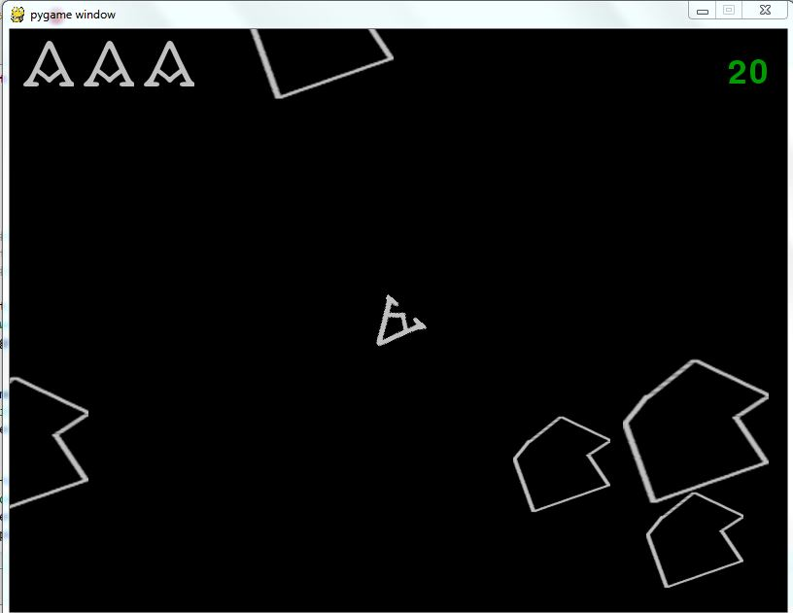
SCREENSHOT OF PYGAME

Slide 10
SAMPLE CODE

Slide 11
CONCLUSION
Thus a Pygame “Dead Shot” is developed successfully.

