Slide 1
Time racers
Team Name

Slide 2
25
Team Number

Slide 3
Prasanth kumar. p pravin. S ritesh. s
Team Members

Slide 4
Mr. joel anandraj
Academic Mentor

Slide 5
MS. SUBASHINI kgisl, gss
Industry Mentor

Slide 6
ABSTRACT
The title of the pygame is “Dead Shot”, which involves a single player mode. The main objective is shooting down a rock into a several small pieces it gets demolished. The player can move around and accelerate. Player can fire missiles. When the missile hits a big rock, it breaks into two medium sized ones. Your score incerases by 20. When the missile hits a medium sized rock, it breaks into two small rocks. Your score goes up by 50. When a missile hits a small rock, it is destroyed completely and your score goes up by 100. The game gets little difficult for each 20 seconds the player survives. The player has only 3 lives, which are displayed at the top left corner of the window.

Slide 7
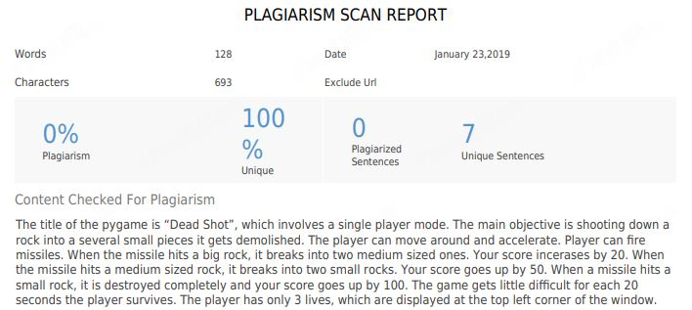
PLAGIARISM

Slide 8
MODULES
Do_welcome
Run : The spaceship moves around
Missile : It shoots missiles when spacebar is clicked
Sound
Game_over

Slide 9
REQUIREMENTS
HARDWARE
SOFTWARE
Processors: Intel® Core™ i5 processor 4300M at 2.60 GHz or 2.59 GHz (1 socket, 2 cores, 2 threads per core), 8 GB of DRAM. ...
Disk space: 2 to 3 GB.
Operating systems: Windows® 10
Python 3.7.1
Pygame Module

Slide 10
MODEL ARCHITECTURE
START
MOVES AROUND
FIRES MISSILES
GAME OVER
AFTER 3 LIVES
ROCK BREAKS DOWN

Slide 11
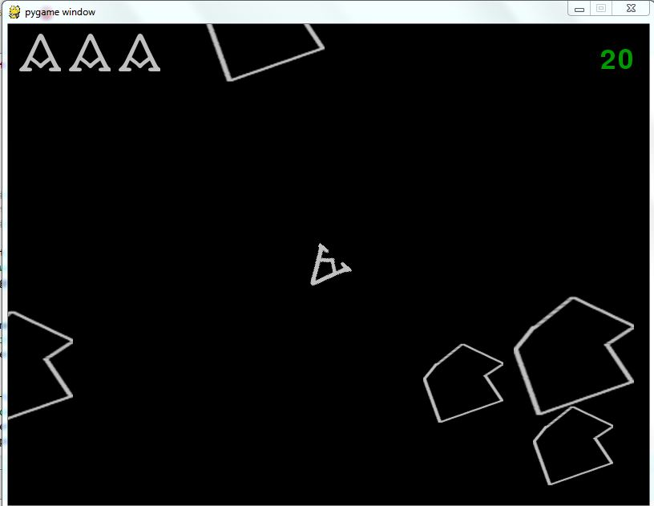
SCREENSHOT OF PYGAME

Slide 12
SAMPLE CODE

Slide 13
REFERENCE
https://github.com/aminb

Slide 14
CONCLUSION
Thus a Pygame “Dead Shot” is developed.

Slide 15
Thank You

