Slide 1


K.RAMAKRISHNAN COLLEGE OF TECHNOLOGY (AUTONOMOUS), TRICHY
Cleaning and Organizing Student Attendance Records in R
PRESENTED BY
PRAVINA M – ADB23084

Slide 2
PRESENTATION OVERVIEW
Problem Identification
Objective
Proposed system
Block diagram of proposed system
R data structures used
Advantages of proposed system
Modules

Slide 3
PRESENTATION OVERVIEW
Module Description
Module Implementation
Source Code
Result

Slide 4
PROBLEM IDENTIFICATION
Missing and Inconsistent Data – Attendance records often have missing values and varied formats, requiring standardization.
Duplicate and Erroneous Entries – Repeated records and incorrect data distort tracking accuracy.
Manual Processing Effort – Cleaning data manually is time-consuming and error-prone, needing automation.
2/7/20

Slide 5
OBJECTIVE
It is used to develop an R-based automated solution to clean, organize, and standardize student attendance records. This includes handling missing values, removing duplicates, correcting inconsistencies, and ensuring uniform formatting. By automating data processing, the system enhances accuracy, consistency, and efficiency, making attendance tracking and analysis more reliable and insightful.

Slide 6
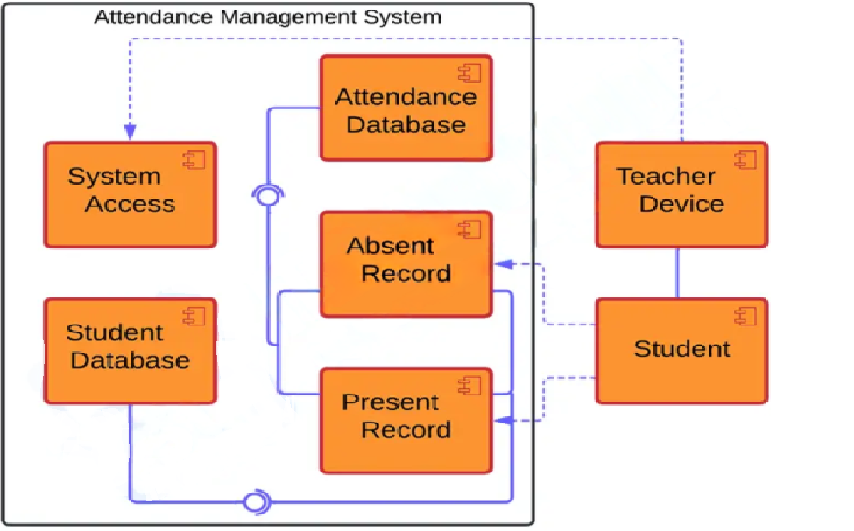
PROPOSED SYSTEM
BLOCK DIAGRAM

Slide 7
R DATA STRUCTURES USED
Data Frame – The primary structure for storing attendance data, allowing easy manipulation of rows and columns.
Vector – Used for handling individual columns like attendance status or dates.
List – Stores multiple data objects, such as summaries and processed results.
Matrix – Occasionally used for structured tabular data operations.
Factor – Helps categorize attendance status (e.g., "Present", "Absent") for efficient processing.

Slide 8
ADVANTAGES OF PROPOSED SYSTEM
Improved Data Accuracy – Eliminates errors, duplicates, and inconsistencies for reliable attendance tracking.
Efficient Data Processing – Automates cleaning, reducing manual effort and saving time.
Standardized Formatting – Ensures uniform date formats and attendance status for easy analysis.

Slide 9
ADVANTAGES OF PROPOSED SYSTEM
.
Better Data Visualization – Provides graphical insights into attendance trends using R packages like (ggplot2).
Enhanced Decision-Making – Clean and organized data helps in generating meaningful reports for better policy decisions

Slide 10
MODULES OF THE SYSTEM
Data Collection Module
Data Cleaning Module
Data Standardization Module
Data Analysis & Reporting Module
Visualization Module

Slide 11
MODULES DESCRIPTION
Data Collection Module Allows users to upload attendance CSV files. Ensures required columns are present for processing.
Data Cleaning Module Removes duplicates and fills in missing values. Converts inconsistent attendance entries to standard form.
Data Standardization Module Formats dates and normalizes text values. Prepares data for consistent analysis and visualization.

Slide 12
MODULES DESCRIPTION
Analysis & Reporting Module Generates summaries like class-wise student counts. Helps identify overall attendance patterns.
Visualization Module Displays interactive graphs using ggplot2 and plotly. Shows trends and daily attendance comparisons.

Slide 13
MODULES IMPLEMENTATION
Data Collection Module
Implementation:
Uses fileInput() to upload CSV files via the UI.
CSV is read using read.csv() inside a reactive() function.
Validates presence of required columns like Student_ID, Name, Class, etc..
fileInput("file", "Upload CSV File", accept = ".csv")
df <- read.csv(input$file$datapath, stringsAsFactors = FALSE)

Slide 14
MODULES IMPLEMENTATION
Data Cleaning Module
Implementation:
Handles missing values by replacing with "Absent".
Removes duplicate records using !duplicated(df).
Converts inconsistent attendance values (e.g., "p", "pres") to "Present".
df[is.na(df)] <- "Absent" df <- df[!duplicated(df), ] df$Attendance <- tolower(df$Attendance)

Slide 15
MODULES IMPLEMENTATION
Data Standardization Module
Implementation:
Converts date strings to proper Date format using as.Date().
Normalizes text (e.g., "pres" becomes "Present").
Ensures all attendance entries follow the same format.
df$Date <- as.Date(df$Date, format="%d/%m/%Y") df$Attendance[df$Attendance %in% c("p", "pres", "present")] <- "Present"

Slide 16
MODULES IMPLEMENTATION
Visualization Module
Implementation:
Plots interactive graphs using ggplot2 + plotly.
Charts include:
Class-wise Distribution (bar chart)
Attendance Trends (stacked bar)
Daily Attendance (dodged bar)
plot <- ggplot(df, aes(x=Date, fill=Attendance)) + geom_bar(position="stack") output$attendance_trend <- renderPlotly(ggplotly(plot))

Slide 17
MODULES IMPLEMENTATION
Analysis & Reporting Module
Implementation:
Summarizes data using dplyr (e.g., count students per class).
Outputs summary tables using renderDT().
summary_table <- df %>% group_by(Class) %>% summarise(Count = n()) output$data_summary <- renderDT(datatable(df))

Slide 18
SOURCE CODE
helpText("Ensure the CSV file has 'Student_ID', 'Name', 'Class', 'Section', 'Date', and 'Attendance' columns."),
actionButton("process", "Process Data")
),
mainPanel(
tabsetPanel(
tabPanel("Student Summary", DTOutput("data_summary")),
tabPanel("Class-wise Distribution", plotlyOutput("class_distribution")),
tabPanel("Attendance Trends", plotlyOutput("attendance_trend")),
tabPanel("Daily Attendance", plotlyOutput("daily_bar"))))))
library(shiny)
library(dplyr)
library(ggplot2)
library(plotly)
library(DT)
# Data Collection Module – Imports attendance data from CSV files
ui <- fluidPage(
titlePanel("Interactive Student Records Management"),
sidebarLayout(
sidebarPanel(
fileInput("file", "Upload CSV File", accept = ".csv"),

Slide 19
SOURCE CODE
# Data Cleaning Module – Handles missing values, removes duplicates, and corrects inconsistencies
student_data <- reactive({
req(input$file)
df <- read.csv(input$file$datapath, stringsAsFactors = FALSE)
if (!all(c("Student_ID", "Name", "Class", "Section", "Date", "Attendance") %in% colnames(df))) {
stop("Error: Missing required columns.")
}
df$Date <- as.Date(df$Date, format="%d/%m/%Y")
df$Attendance <- tolower(df$Attendance)
df$Attendance[df$Attendance %in% c("p", "pres", "present")] <- "Present"
# Data Standardization Module – Formats dates, normalizes attendance status, and standardizes student names
output$data_summary <- renderDT({
req(input$process)
df <- student_data()
datatable(df)
})

Slide 20
SOURCE CODE
# Data Analysis & Reporting Module – Summarizes attendance trends
output$class_distribution <- renderPlotly({
req(input$process)
df <- student_data()
summary_table <- df %>% group_by(Class) %>% summarise(Count = n())
plot <- ggplot(summary_table, aes(x = Class, y = Count, fill = Class)) +
geom_bar(stat = "identity") +
labs(title = "Class-wise Student Distribution", x = "Class", y = "Count") +
theme_minimal()
ggplotly(plot)
# Visualization Module – Uses ggplot2 to create graphs for attendance trends
output$attendance_trend <- renderPlotly({
req(input$process)
df <- student_data()
df$Attendance <- as.factor(df$Attendance)
plot <- ggplot(df, aes(x=Date, fill=Attendance)) +
geom_bar(position="stack") +
labs(title="Attendance Trends", x="Date", y="Count") +
theme_minimal()
ggplotly(plot)
})

Slide 21
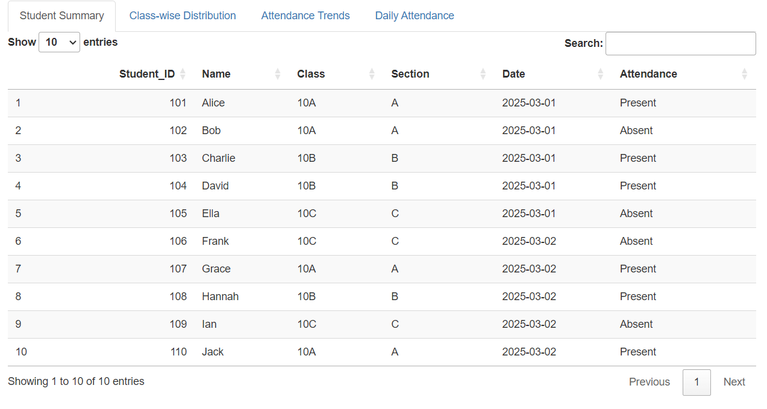
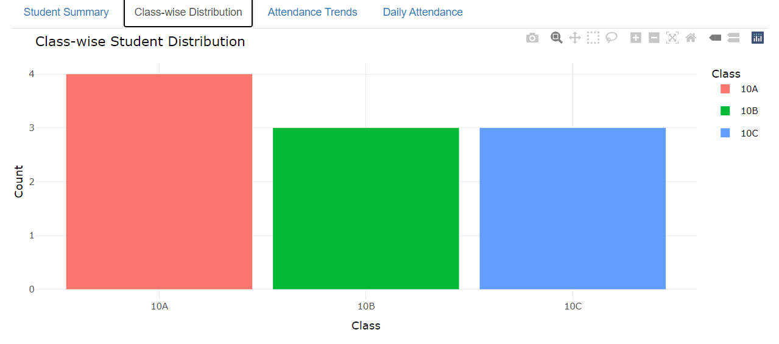
RESULTS

Slide 22
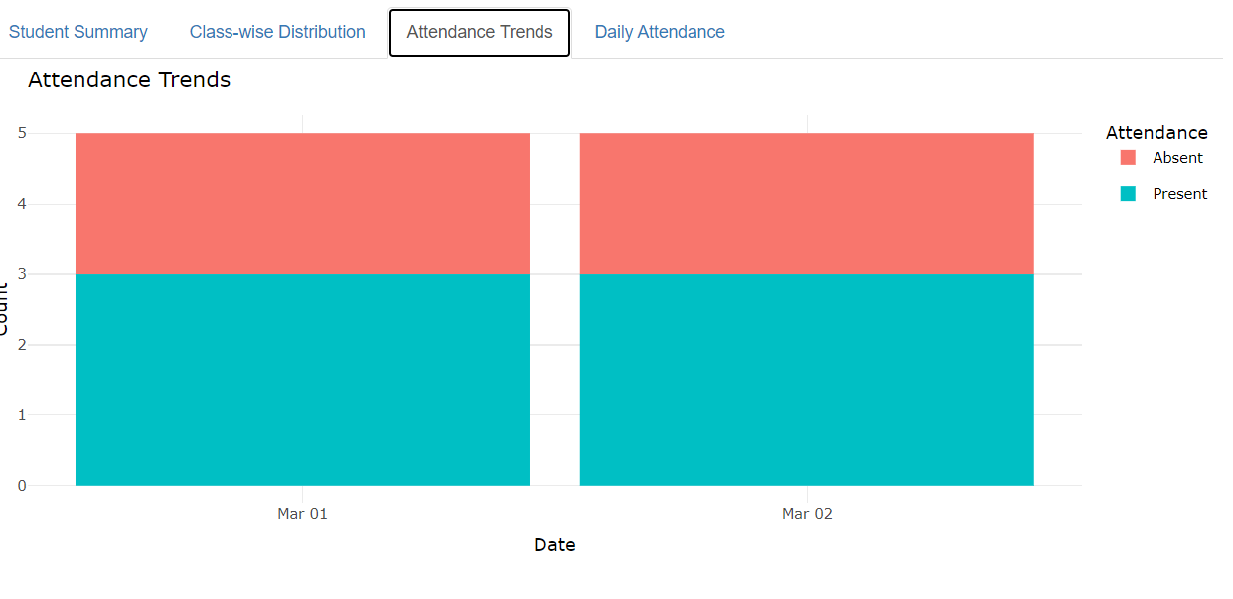
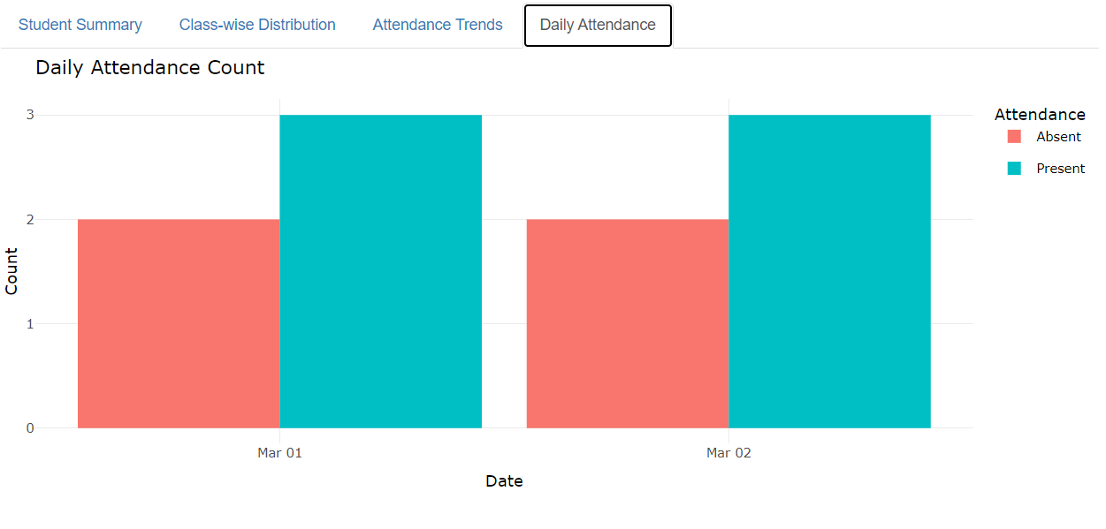
RESULTS

Slide 23
THANK YOU

