Slide 1
INTERNET OF THINGS FIRE ALARM SYSTEM
PRAVINBABU B
2018115075

Slide 2
COMPONENTS
ESP8266
FIRE SENSOR
RED LED
GREEN LED
5V RELAY
WATER MOTOR PUMP
BUZZER
BATTERY

Slide 3
DEMO Link
https://drive.google.com/file/d/11uo7XTgCxCus6FLLuKqJeVJ51mBW42fc/view?usp=sharing

Slide 4
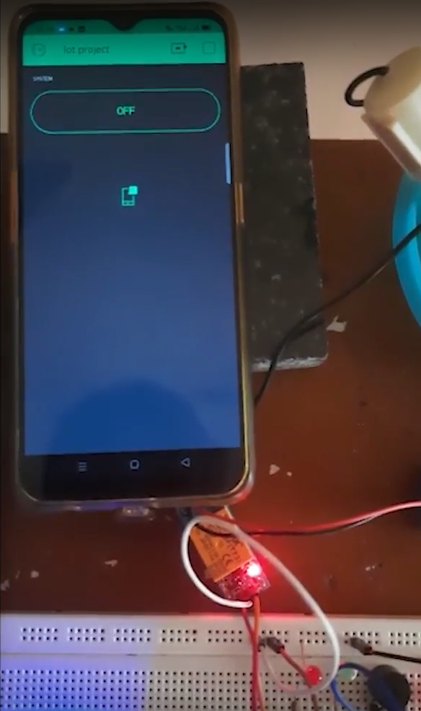
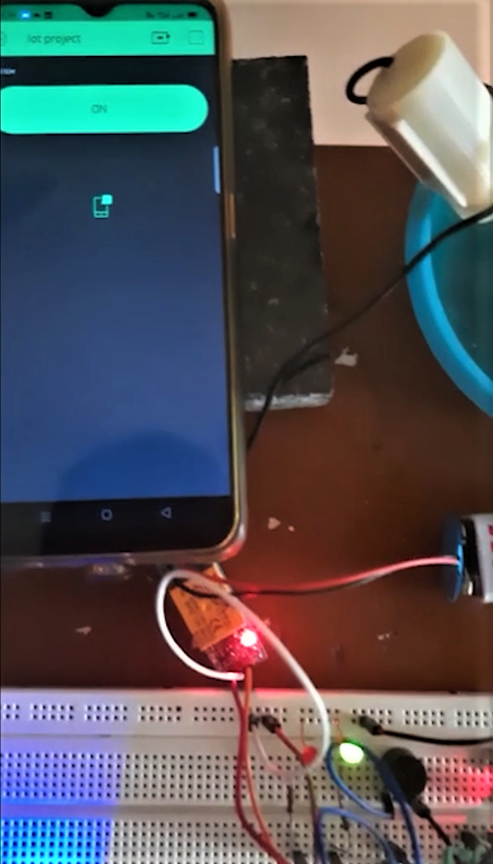
OUTPUT

Slide 5
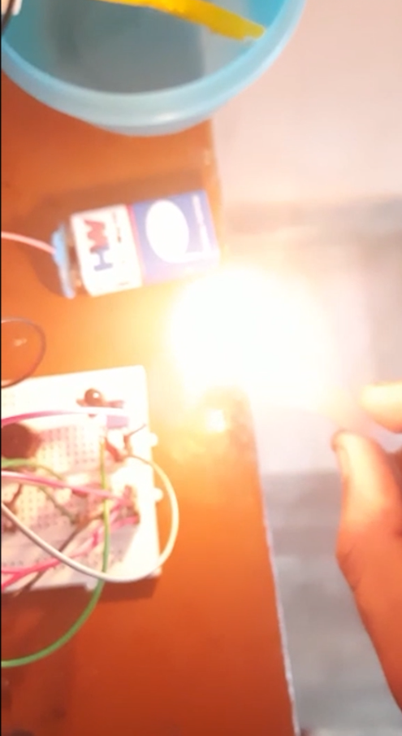
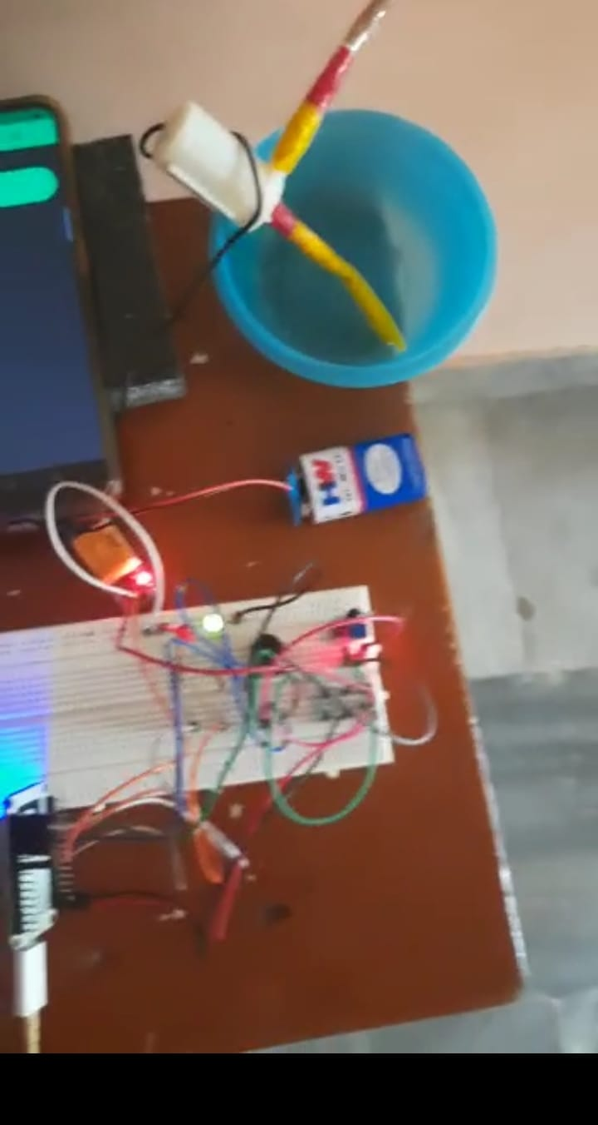

Slide 6
