Slide 1
Metro Failure Detection
Group Member:-
1- Suraj Suryavanshi [252549]
2- Pravin Bodke [252535]

Slide 2
01
Problem Statement
02
Background and Objectives
03
Data Description
04
EDA Conclusion
05
Tools & Technologies
CONTENTS

Slide 3
01
Problem Statement
Unexpected failures of the Air Production Unit (APU) in metro trains disrupt services and increase costs. A predictive maintenance system using real-time sensor data is essential to detect faults early, prevent breakdowns, and enhance reliability while reducing expenses.

Slide 4
Background and objectives :-
Detecting faults in public transport vehicles during regular operations is
crucial, as such issues can lead to trip interruptions and disappointment for
passengers. The Air Production Unit (APU), located on the roof of Metro
vehicles, plays a vital role in feeding various units, including the secondary
suspension responsible for maintaining vehicle height. The failure of APU
necessitates immediate train removal for repair.
Predictive Maintenance (PDM) has emerged as a solution to minimize
operational problems, reduce unforeseen stops, and shift from reactive to
predictive maintenance strategies The ultimate goal of PDM is to predict
Failure in a timely manner.

Slide 5
Data Description :-
Source:
UCI Machine Learning Repository
Dataset: MetroPT-3 Sensor
DataLink: https://archive.ics.uci.edu/dataset/791/metropt+3+dataset
real-world sensor data from metro trains with labeled anomalies from
maintenance reports
15,169,480 data points collected at 1 Hz frequency from February to August 2020 Features described by 15 sensors:
-> 7 analog sensors (1–7)
-> 8 digital sensors (8–15)

Slide 6
Data Description :-
Analog Signal Sensors:
TP2
TP3
H1
DV pressure
Reservoirs
Motor Current
Oil Temperature
Digital Signal Sensors:
COMP
DV electric
TOWERS
MPG
LPS
Pressure Switch
Oil Level
Caudal Impuls

Slide 7
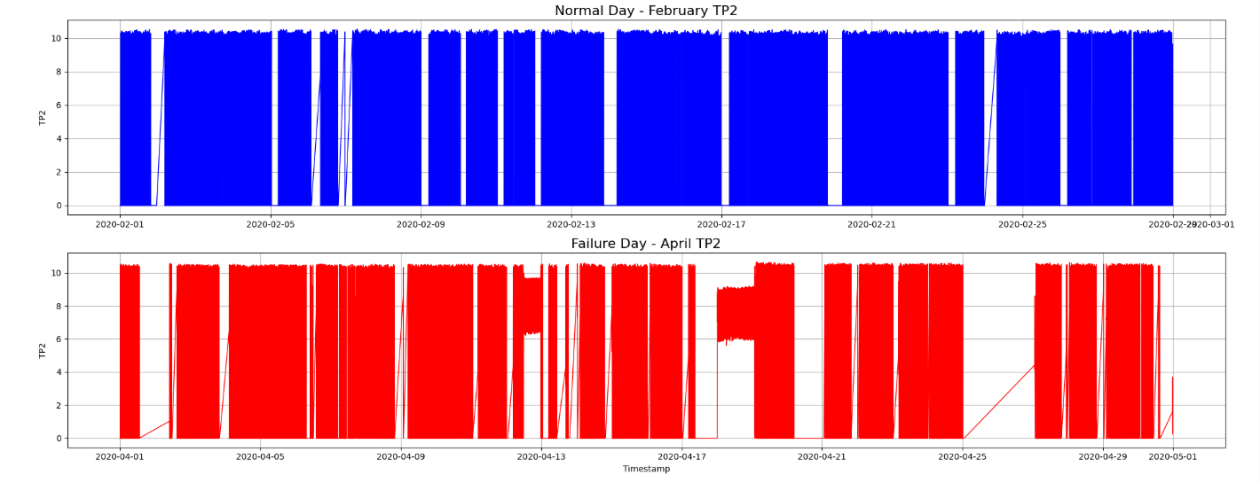
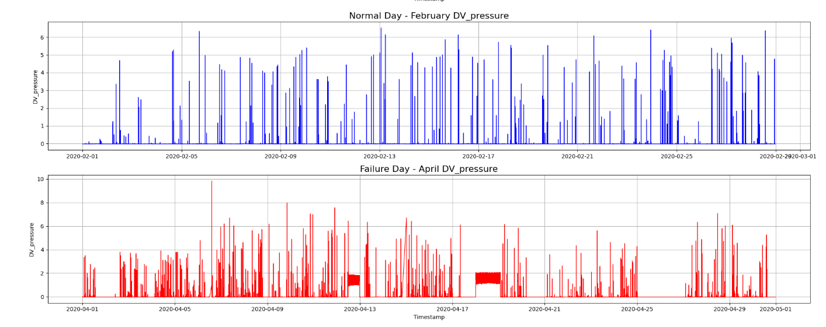
Exploratory Data analysis (EDA)
Fig. 1. TP2 Normal vs Failure Day Comparison
Fig. 2. DV Pressure Normal vs Failure Day Comparison

Slide 8

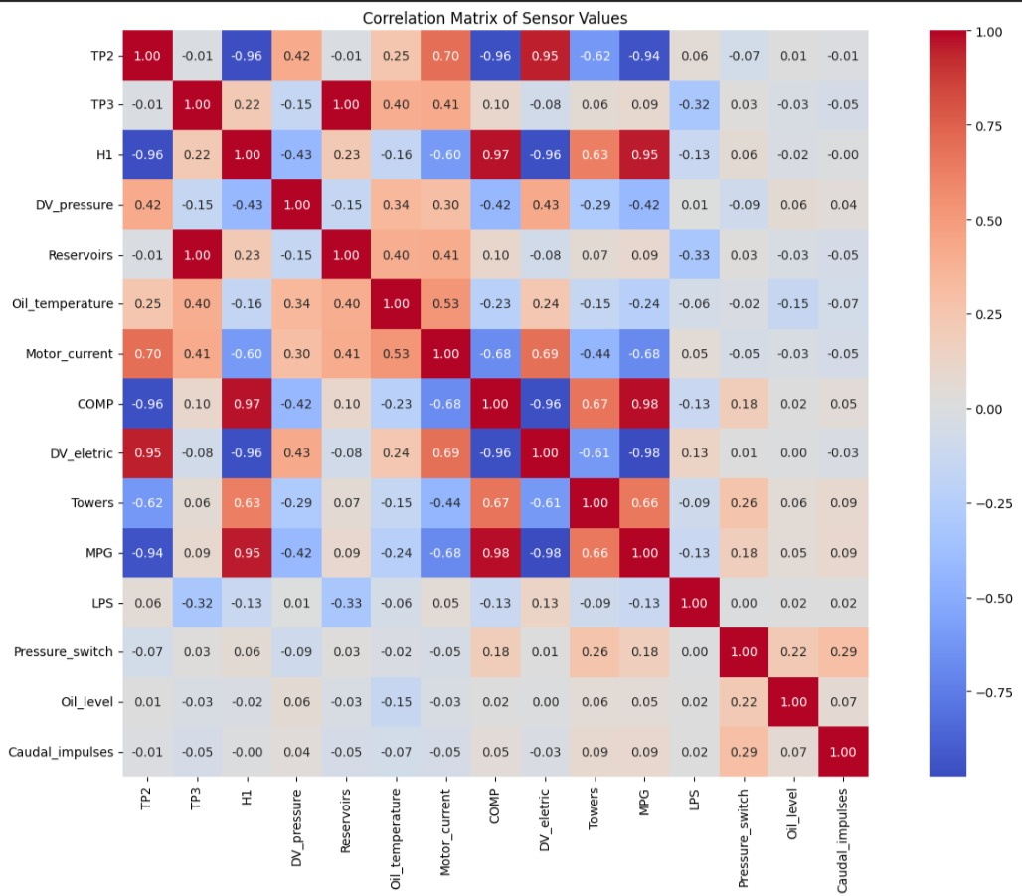
Fig. 3. Cor-relation Matrix of Sensor Values

Slide 9
Conclusion
Exploratory Data Analysis uncovered distinct differences between normal and
faulty sensor readings, with visualizations and statistical summaries revealing
early anomaly signs and key patterns. These insights formed a strong basis for
feature selection and building accurate predictive models for metro fault
detection.

Slide 10
Tools & Technologies
Python: Primary programming language for the project.
Pandas: Efficiently cleans and manages large sensor datasets.
NumPy — for numerical operations and array handling, often used alongside Pandas
Matplotlib & Seaborn: Create clear visualizations to analyse data patterns.
TensorFlow & Keras: Frameworks for building and training deep learning models.
LSTM Models: Predict faults before failures occur.
Scikit-learn — for preprocessing, evaluation metrics, or traditional ML techniques.
Data preprocessing techniques — like normalization, scaling, or feature engineering
if relevant.
Model evaluation metrics — such as accuracy, precision, recall, F1-score, if you want
to highlight analysis techniques.
Git/GitHub — for version control and collaboration.
Google Colab: Cloud-based platform for coding and model training.
ChatGPT: Assisted in code development and problem-solving.

Slide 11
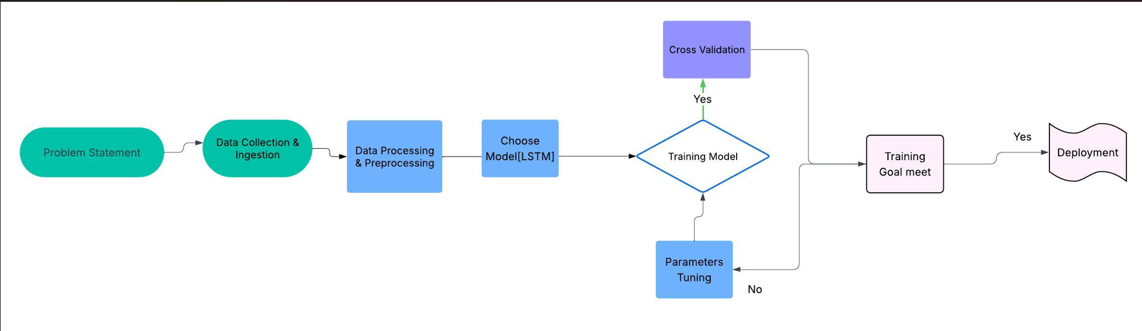
Workflow
Fig. 4. ML Project WorkFlow

Slide 12
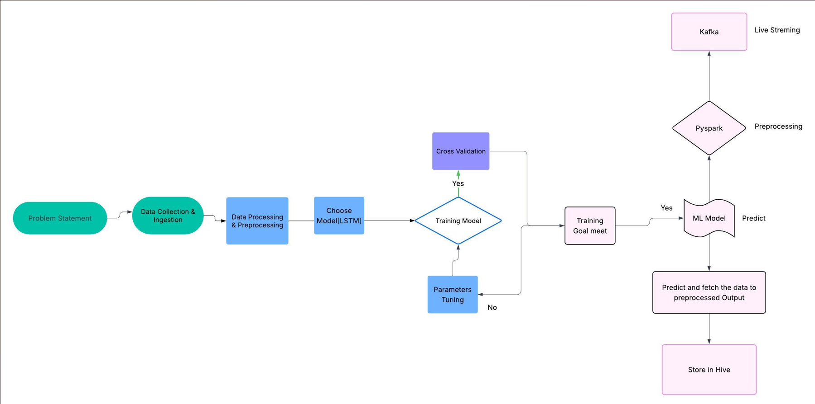
Workflow
Fig. 5. Big-Data Project WorkFlow

Slide 13
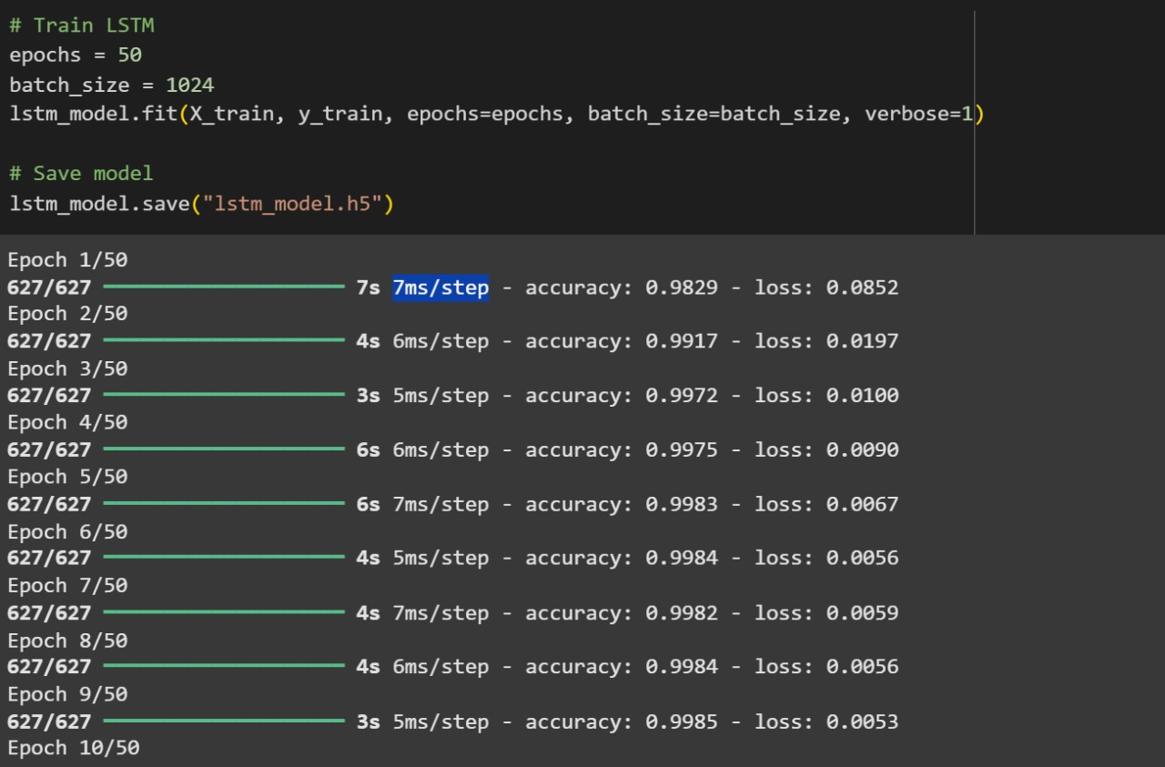
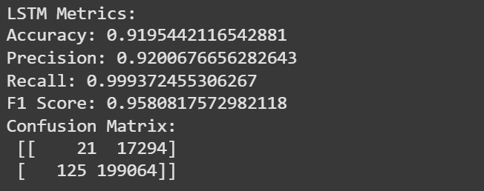
Deployment and Screenshots
Fig. 7. Training model
Fig. 8. LSTM Confusion Matrix

Slide 14
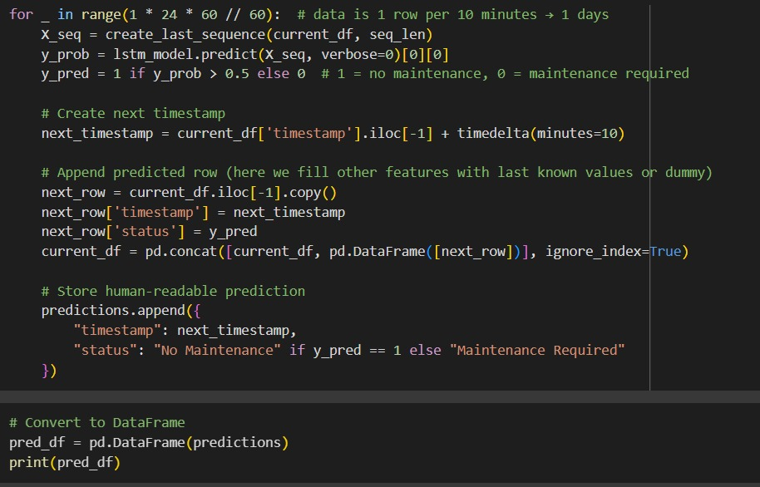
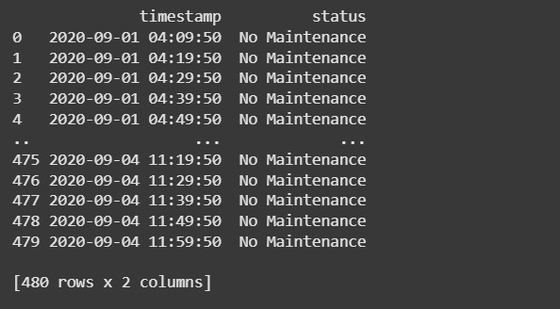
Deployment and Screenshots
Fig. 9. Prediction Code
Fig. 10. Predicted Output

Slide 15
Features and Advantages
Features :-
Predict APU faults early using real-time sensor data analysis.
Detect anomalies to identify unusual metro system behavior.
Forecast maintenance needs to prevent unexpected breakdowns.
Advantages :-
Reduce unplanned downtime and operational costs.
Improve overall train reliability and passenger experience.
Enable dynamic scheduling based on failure severity.
Why We Used Them :-
These tools integrate seamlessly to deliver fast, accurate metro fault detection, ideal for predictive maintenance in our machine learning project.

Slide 16
THANK YOU

