Slide 1
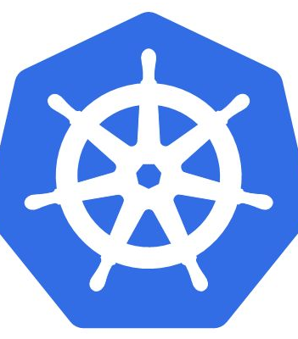
Introduction to Kubernetes $ whoami - Shashank Pai

Slide 2
Kubernetes Background
Kubernetes is an orchestrator. More specifically it is an orchestrator of containerized apps.
It does scaling ,self-healing, load-balancing, rolling updates and lots more.
Like many of the container-related projects its written in Go(Golang)

Slide 3
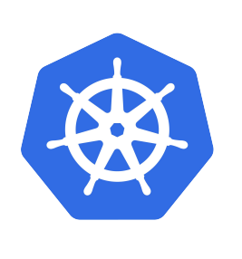
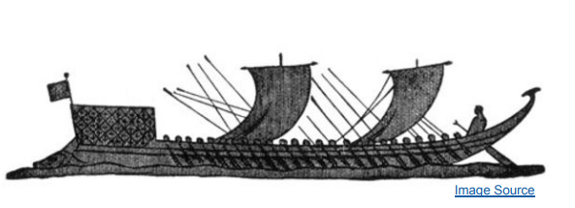
What does Kubernetes mean
Greek for “pilot” or “Helmsman of a ship”

Slide 4
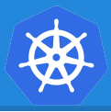
What is Kubernetes?
Originally sprung out of decades of container experience from inside Google (Borg, Omega, LMCTFY, etc.)
Independent OSS project within the CNCF
Production ready since July 2015.
Automates deployment, scaling, and management of application containers

Slide 5

Kubernetes Principles of operations
Kubernetes from 40k feet
Masters and nodes
Declarative model and desired state
Pods
Services
Deployments

Slide 6
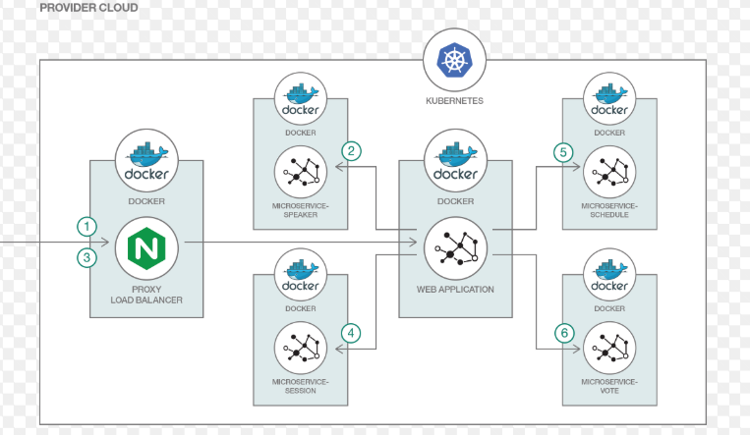
Kubernetes from 40K feet
At the highest level, Kubernetes is an orchestrator of containerized apps.
Ideally microservice apps. Microservice app is just a fancy name for an application that’s made of lots of small and independent parts
These small independent services work together to create a meaningful/useful app.

Slide 7
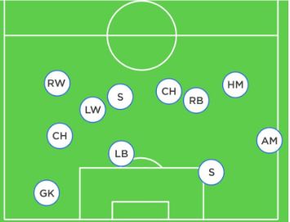
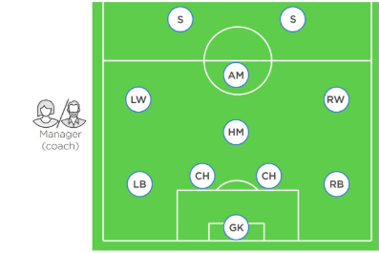
Quick analogy to understand kubernetes

Slide 8
Role of Coach in football team

Slide 9
Microservices apps in Kubernetes world
We start out with an app made up of multiple services.
Each service is packaged as a Pod and no two services are the same.
Some might be load-balancers, some might be web servers, some might be for logging…
Kubernetes comes along - a bit like the coach in the football analogy – and organizes everything into a useful app.

Slide 10
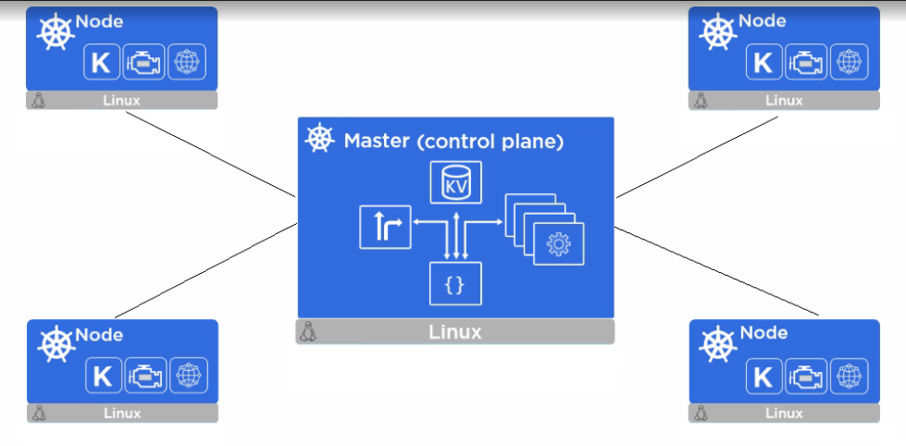
Orchestration
In the application world, we call this “orchestration”.
To make this all happen, we start out with our app, package it up and give it to the cluster (Kubernetes).
The cluster is made up of one or more masters, and a bunch of nodes.
The masters are in-charge of the cluster and make all the decisions about which nodes to schedule application services on.
nodes are where our application services run.
They also report back to the masters and watch for changes to the work they’ve been

Slide 11
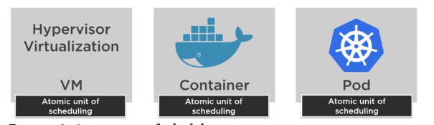
What is Pod
In the VMware world, the atomic unit of deployment is the virtual machine (VM).
In the Docker world, it’s the container.
In Kubernetes world it is Pod

Slide 12
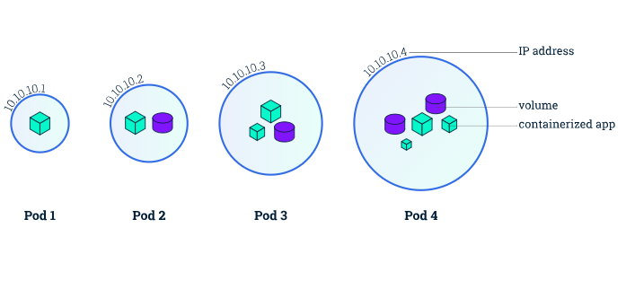
Pods and Containers
Kubernetes runs containerized apps.
But those containers always run inside of Pods!
You cannot run a container directly on a Kubernetes cluster.
Notes:
The simplest model is to run a single container inside a Pod, but there are advanced use-cases where you can run multiple containers inside of a single Pod.

Slide 13
Core Objects
Namespaces
Pods
Labels
Selectors
Services

Slide 14
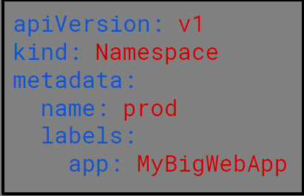
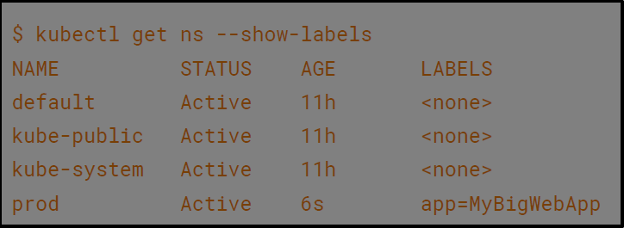
Namespaces
Namespaces are a logical cluster or environment, and are the primary method of partitioning a cluster or scoping access.
Notes:
apiVersion: v1
kind: Namespace
metadata:
name: prod
labels:
app: MyBigWebApp
$ kubectl get ns --show-labels

Slide 15
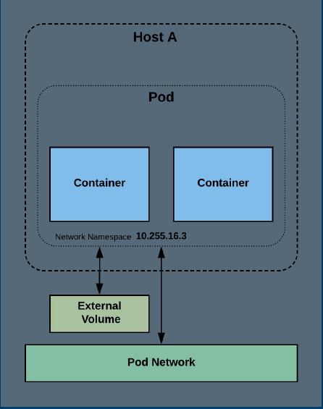
Pods
A pod is the atomic unit of Kubernetes
It is the foundational building block of Kubernetes Workloads.
Pods are one or more containers that share volumes, a network namespace, and are a part of a single context.
Notes:
At the highest-level, a Pod is a ring-fenced environment to run containers. The Pod itself doesn’t actually run anything, it’s just a sandbox to run containers in.

Slide 16
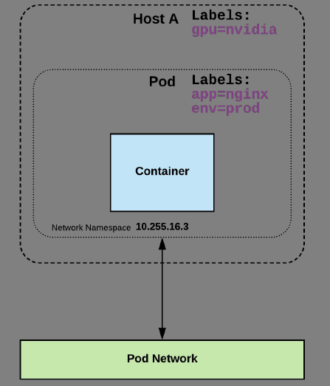
Labels
Labels are key-value pairs that are used to identify, describe and group together related sets of objects or resources.

Slide 17
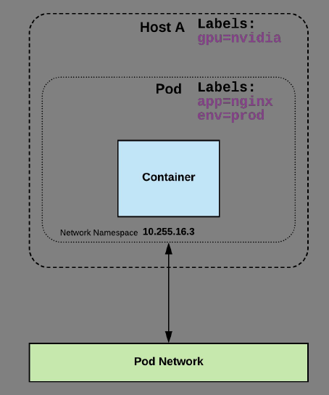
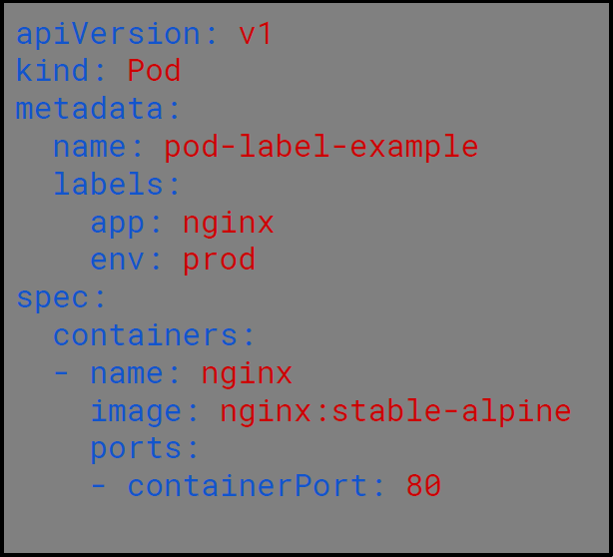
Label Example

Slide 18
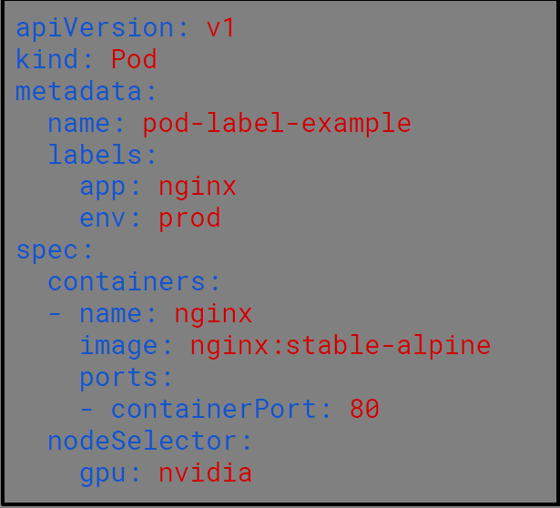
Selectors
Selectors use labels to filter or select objects, and are used throughout Kubernetes
Notes:
Selectors can then be used to filter objects using label data as criteria

Slide 19
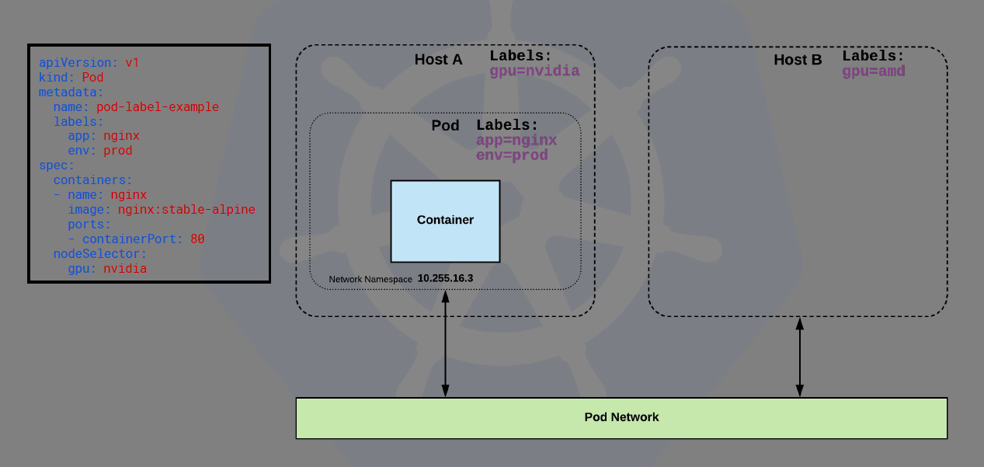

Slide 20
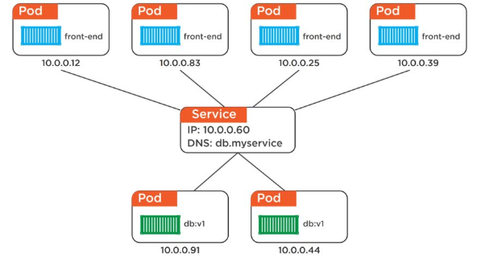
Services
Services provide stable DNS, IP address and UDP
They also perform simple randomized load-balancing across Pods, though more advanced load balancing algorithms may be supported in the future.
Pods can come and go, the Service observes this, automatically updates itself, and continues to provide that stable networking endpoint.

Slide 21
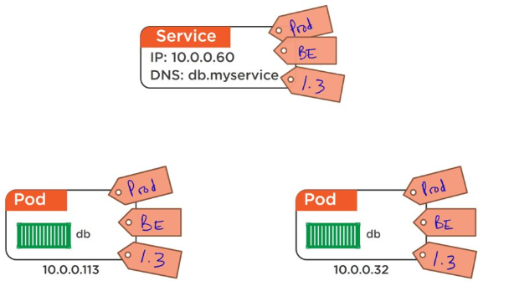
Connecting pods to services
The way that a Service knows which Pods to load-balance across is via labels.
Figure shows a set of Pods labelled as prod, BE (short for backend) and 1.3. These Pods are loosely associated with the Service because they share the same labels as the Service.

Slide 22
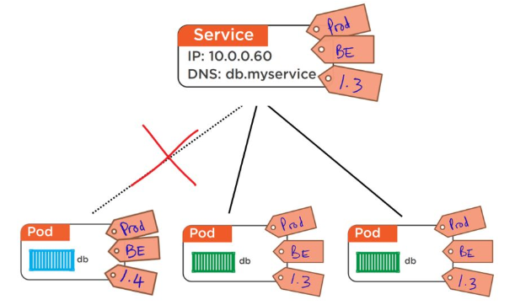
Connecting pods to services
This figure shows similar setup, but with an additional Pod that does not share the same labels as the Service. Because of this, the Service will not load balance requests to it.
They only send traffic to healthy Pods. This means a Pod that is failing health-checks will not receive traffic from the Service.

Slide 23
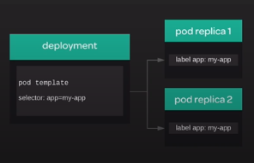
Deployments
Deployments provide a way to declaratively manage a dynamic set of replica pods.
They provide powerful functionality sucha as scaling and rolling updates
A deployment defines a desired state for the replica pods
The cluster will constantly work to maintain that desired state creating removing and modifying the replica pods.

Slide 24
Masters and Nodes
A Kubernetes cluster is made up of masters and nodes.
These are Linux hosts running on anything from VMs, bare metal servers, all the way up to private and public cloud instances.

Slide 25
Masters (control plane)
A Kubernetes master is a collection of small services that make up the control plane of the cluster.
The simplest (and most common) setups run all the master services on a single host.
However, multi-master HA is becoming more and more popular, and is a must have for production environments
This is why many of the public cloud providers, such as AWS, GCP and Azure, are deploying highly available masters as part of their Kubernetes-as-a-Service offerings (EKS, GKE, and AKS respectively).

Slide 26
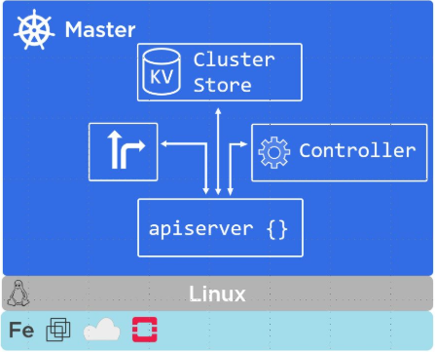
Master(Control Plane) components
The API server
Cluster store
The Scheduler
The Controller Manager

Slide 27
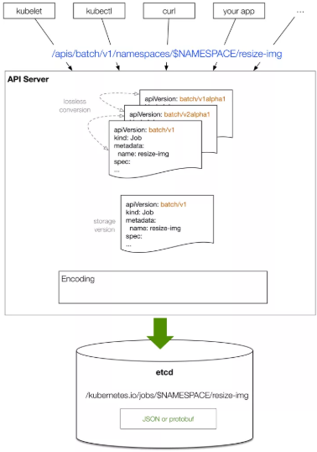
API Server
The API Server (apiserver) is the frontend into the Kubernetes control plane.
It exposes a RESTful API that preferentially consumes JSON.
We POST manifest files to it, these get validated, and the work they define gets deployed to the cluster.
You can think of the API server as the brains of the cluster.

Slide 28
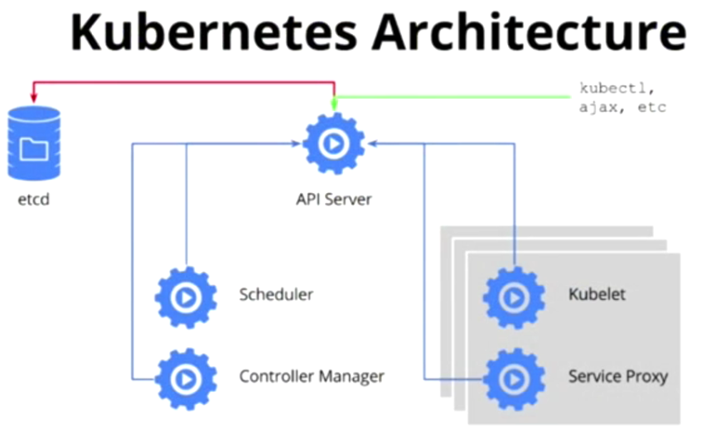
The Cluster Store
If the API Server is the brains of the cluster, the cluster store is its memory.
The config and state of the cluster gets persistently stored in the cluster store, no cluster store, no cluster!
The cluster store is based on etcd, the popular distributed, consistent and watchable key-value store.
You should take care to protect it and provide adequate ways to recover it

Slide 29
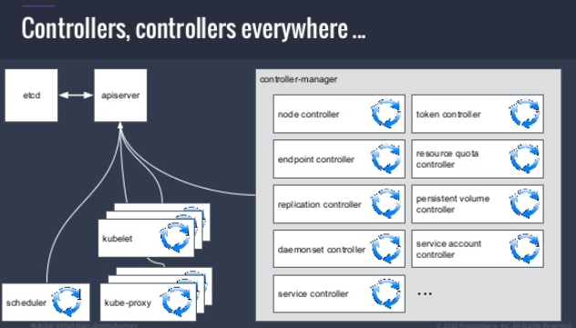
Controller Manager
The controller manager (kube-controller-manager) is currently a bit of a monolith - it implements a few features and functions that’ll probably get split out and made pluggable in the future.
It includes things like the node controller, endpoints controller, namespace controller etc.
They tend to sit in loops and watch for changes – the aim of the game is to make sure the current state of the cluster matches the desired state

Slide 30
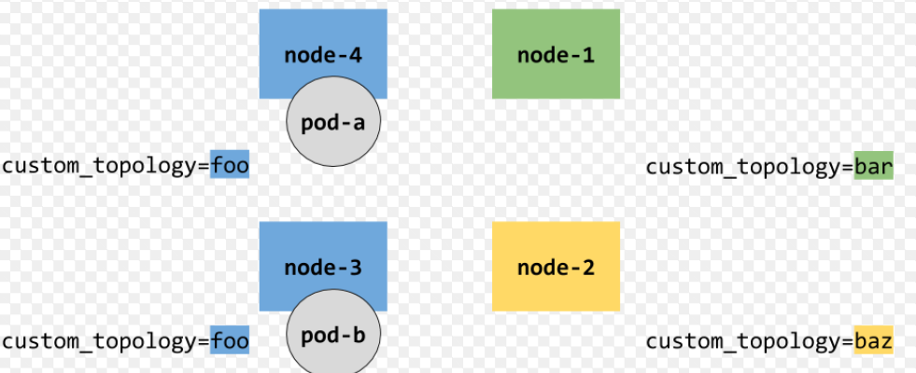
The Scheduler
At a high level, the scheduler (kube-scheduler) watches for new workloads and assigns them to nodes.
Behind the scenes, it does a lot of related tasks such as evaluating affinity and anti-affinity, constraints, and resource management.
Notes:
Kubernetes masters run all of the cluster’s control plane services.
This is the brains of the cluster where all the control and scheduling decisions are made.
Behind the scenes, a master is made up of lots of small specialized services. These include the API server, the cluster store, the controller manager, and the scheduler.

Slide 31
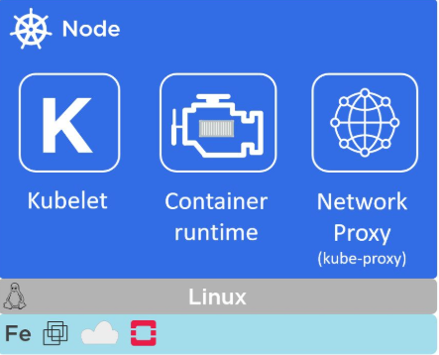
Components of Kubernetes Nodes
Kubelet
Container Runtime
Kube-proxy

Slide 32
Kubelet
The Kubelet is the main Kubernetes agent that runs on all cluster nodes.
You install the kubelet on a Linux host and it registers the host with the cluster as a node.
Any time it sees one, it carries out the task and maintains a reporting channel back to the master.
Notes:
For example, if a Pod fails on a node, the kubelet is not responsible for restarting it or finding another node to run it on. It simply reports back to the master. The master then decides what to do.

Slide 33
Container runtime
The Kubelet needs to work with a container runtime to do all the container management stuff – things like pulling images and starting and stopping containers.
More often than not, the container runtime that Kubernetes uses is Docker.

Slide 34
Kube-proxy
This is like the network brains of the node.
One of its jobs is to make sure that every Pod gets its own unique IP address.
It also does lightweight load-balancing on the node.

