Slide 1
Voyager Hub
By:-
Saurabh Nikam
Pravin Nirmal
Guided By:- Mrs. Rupali Thorat

Slide 2
CONTENTS
INTRODUCTION
PROBLEM STATEMENT
OBJECTIVE
PLAN OF METHODOLOGY
FEATURE SCOPE AND EVALUATION
FEATURE SCOPE

Slide 3
7. CONCLUSION
8. REFERENCES

Slide 4
INTRODUCTION
In a world brimming with opportunities to explore, we understand that planning customers dream getaway should be seamless and enjoyable. Introducing our innovative Voyager Hub Management Project for Travelling – a solution designed exclusively for you, the modern traveler seeking convenience, choice, and unforgettable experiences.
Gone are the days of complicated booking processes. With our Voyager Hub, reserving, accommodations, tours, and more is a breeze. Secure payment gateways ensure that your financial transactions are safe and convenient, allowing you to focus on the excitement of your upcoming journey.

Slide 5
PROBLEM STATEMENT
In the contemporary travel landscape, the process of planning, booking, and managing travel services is riddled with inefficiencies and complexities. Travel agencies and tour operators often struggle with manual, disjointed systems that lead to errors, time-consuming tasks, and a less-than-optimal customer experience. As a result, there is a pressing need for a comprehensive Tours and Travels Management Project that addresses these challenges and revolutionizes the way travel services are offered and managed.

Slide 6
OBJECTIVE
Create a user-friendly online platform that enables customers to easily search, compare, and book flights, accommodations, tours, and transportation services in a single integrated interface.
Develop a feature that allows travelers to customize their itineraries based on their preferences, interests, and travel constraints, providing a tailored and flexible experience.
Our objective is to make strong relationship with customers so that they can enjoy holiday of their dreams.

Slide 7
PLAN OF OBJECT METHODOLOGY
Making of front end.
Creating various table in database as needed.
Connection of front end to back end (connection of forms to database).
Updating of candidates detail by admin.
Doing respective jobs.

Slide 8
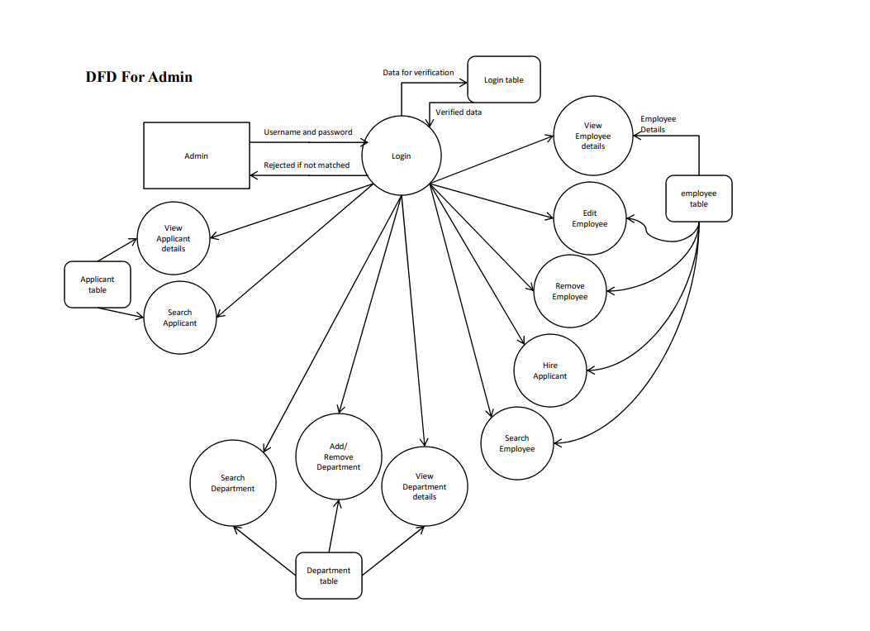

Slide 9
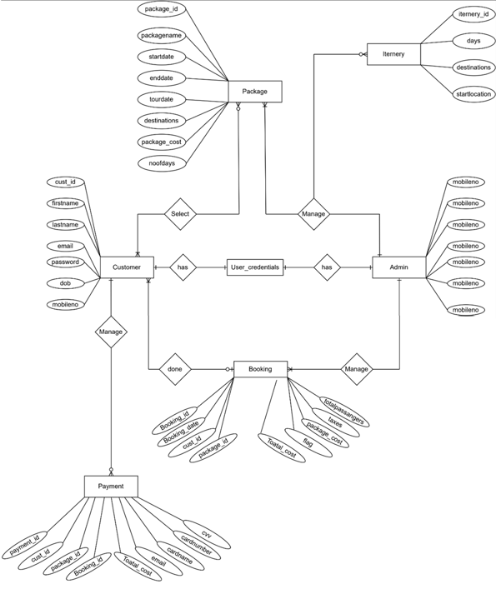
Fig-System Diagram

Slide 10
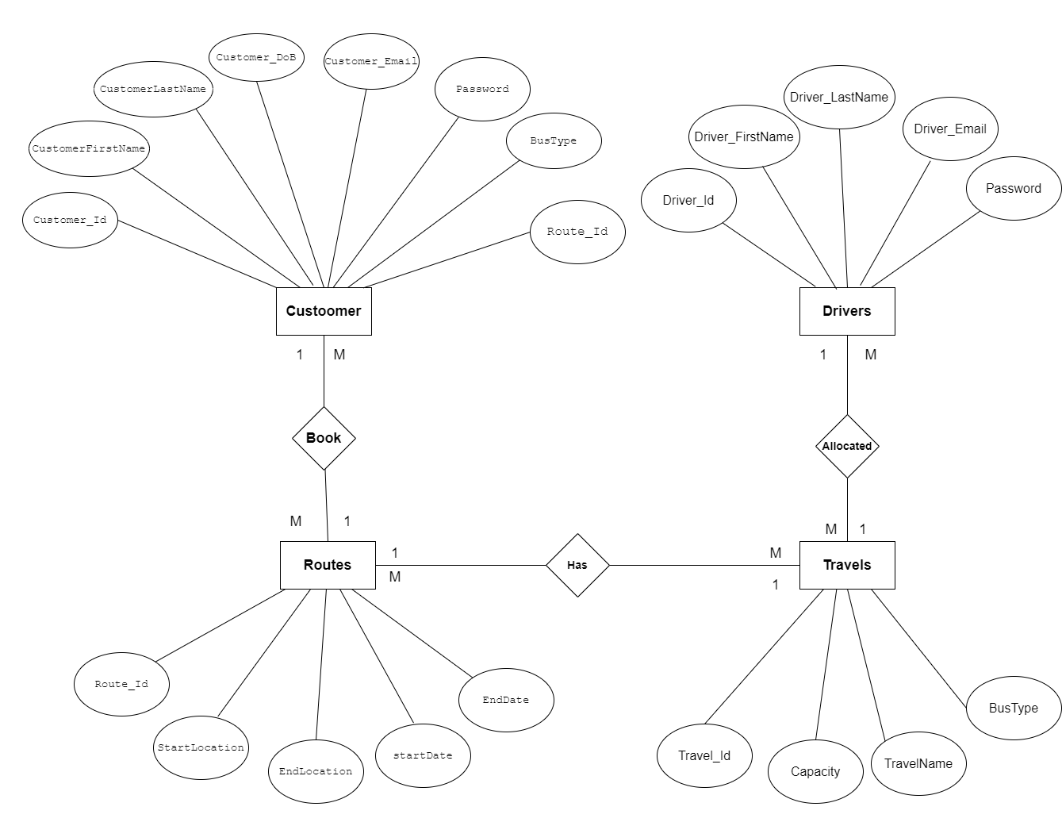
Figure:-E-R Diagram

Slide 11
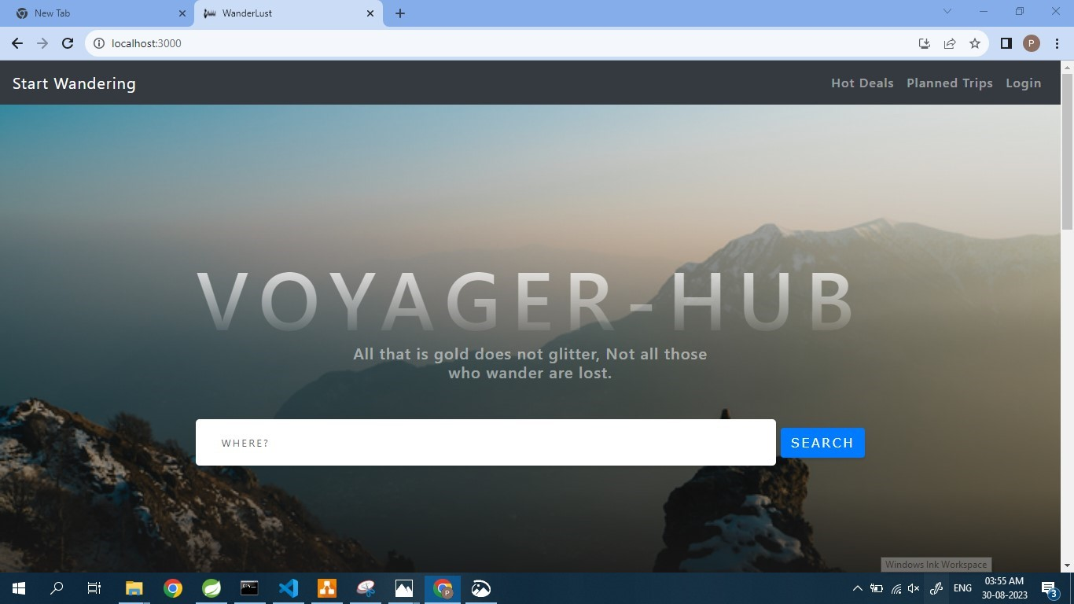
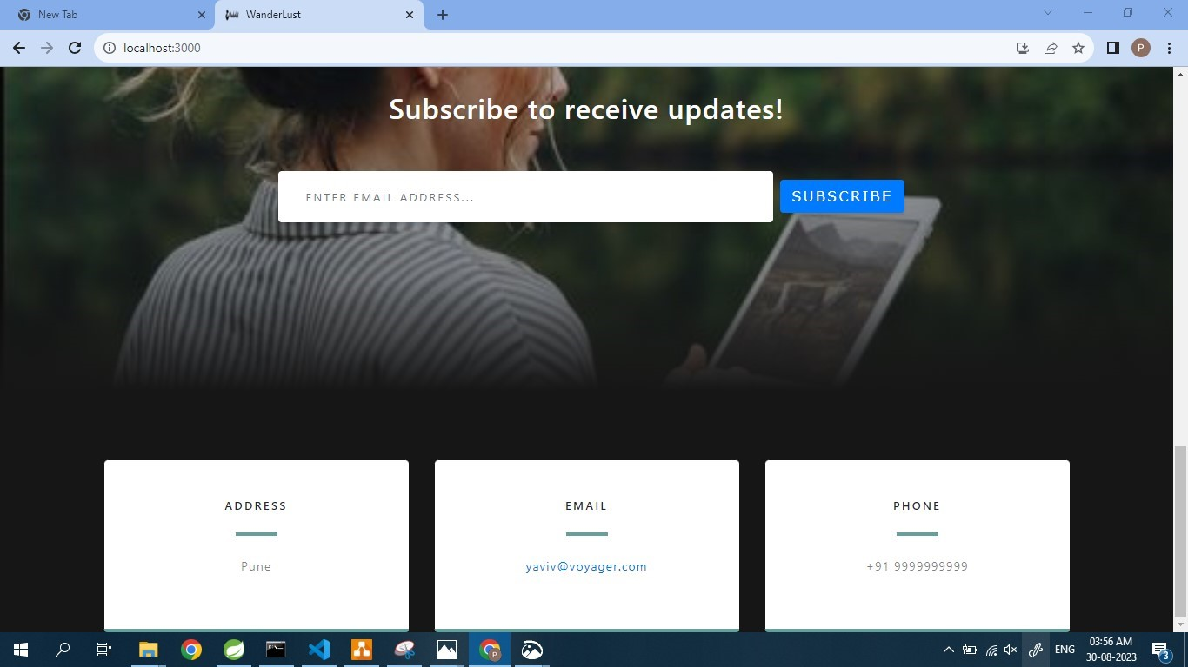
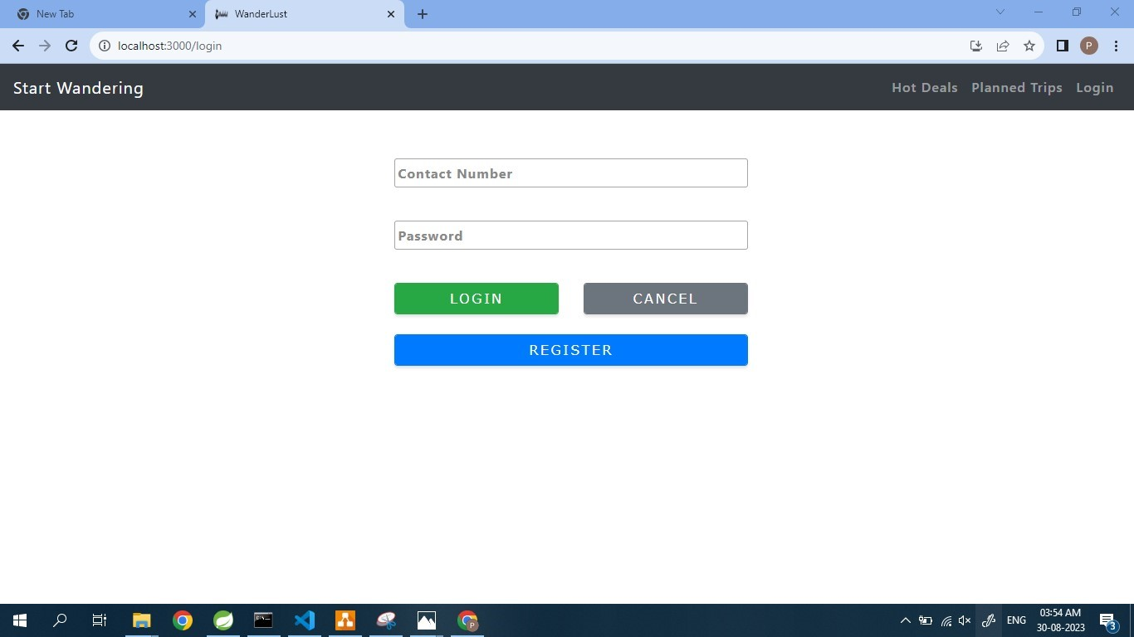
Web Page Snippets :

Slide 12
MEASURES OF UNIQUENESS
Create a tool that helps users plan their travel budgets. It could offer suggestions for different cost categories, allow users to input their spending limits, and dynamically adjust the itinerary based on budget constraints.
Develop a recommendation engine that suggests travel destinations, accommodations, and activities based on user preferences, historical data, and trending travel options.
Apart from the available packages we let our customers choose the package which suits their need.

Slide 13
FUTURE SCOPE AND EVALUATION
Any tourist agency can make use of it for saving customer details in database.
Tourism group can use it for managing their location,hotel,vehicles details.
This application can easily implemented under various situations.
We can add new features as and when we require.

Slide 14
FETURE SCOPE
We will include more functionality as per the user requirements.
We want to improved our home page, as it is the main things which attracts all user
Not a single website is ever consider as complete forever firstly because there is always something new requirements also are growing day by day.

Slide 15
CONCLUSION
“Voyager Hub” simplifies the process in travelling .
Fast processing and immediate result with high security.
Minimizing human effort and cost efficient and cost efficient databases.
Navigation through the site is easy.

Slide 16
REFERENCES
https: //www.wikipedia.com
https: //www.indiaToursOnline.com
https: // www.realityToursandtravel.com

Slide 17
THANKYOU

