Slide 1
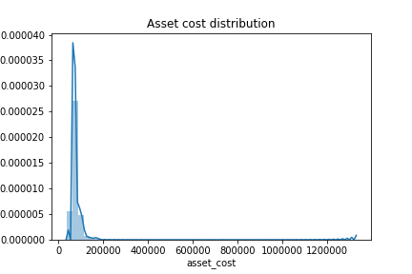
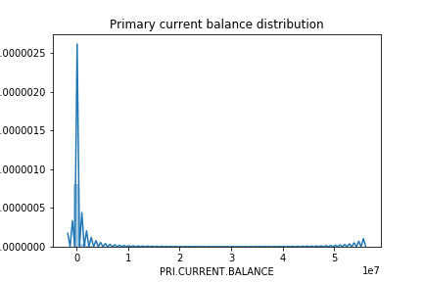
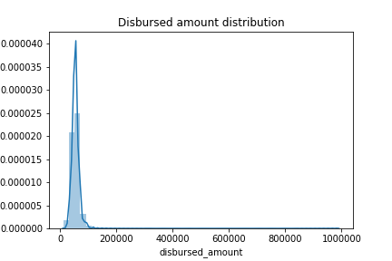
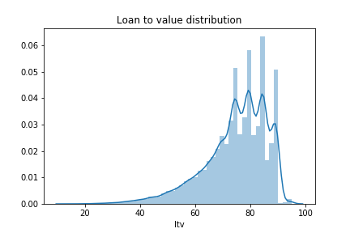
Distribution plot on numerical features: Here numerical features are used for distribution plot. Most of the numerical variable like Asset cost distribution, primary CB, distbursed amount follows right skewed distribution whereas LTV follows left skewed distribution. Becos in case if the borrower defaults on the loan the lender can reposses the collateral and collect the money by selling it off. They can recover the losses for defaulted loan.

Slide 2
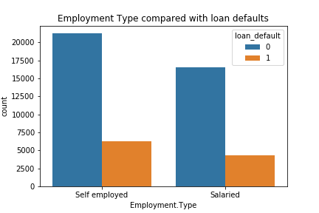
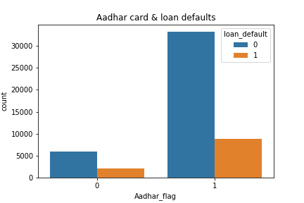
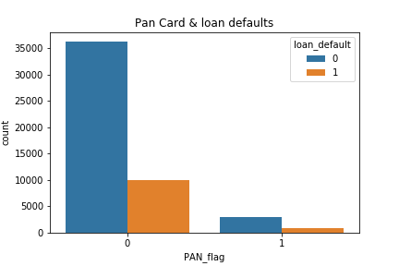
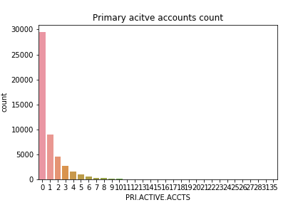
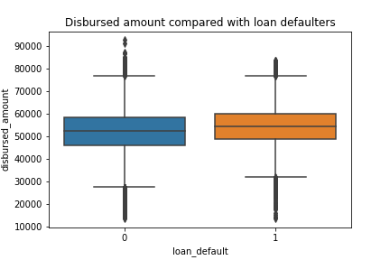
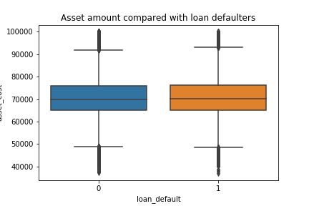
Plots on various features: Count plot for employment type is compared with the loan defaulters here where most of the self employed are a non-loan defaulters. Aadhar and pan details compared with loan defaulters. Person with aadhar are a loan defaulter whereas its just opposite to Pan details. Significant features like disbursed amount and asset amount plotted with loan defaulters, here the distribution is almost same shows no correlation with the target variable.

