Slide 1
Steganography Based Data Hiding
Team Members:
Pravin Kumar Mahato {22MCA0142}
Chirag Bolakani {22MCA0164}

Slide 2
ABSTRACT
Information security plays a major role in any data transfer. One way to restrict direct access and ensure more security can be obtained by information hiding that focuses on hiding the existence of secret messages. Steganography is a data-hiding technique that allows users to conceal messages, images, and other types of data within other forms of data. It is a way of communicating securely by hiding data in plain sight. By concealing data within other types of data, it can be protected from outside detection. This makes it much more difficult to detect and exploit than traditional cryptography. In the following study, we combine steganography, a data hiding technique along with a data encryption algorithm in order to achieve more efficiency in securing access to confidential data.

Slide 3
LITERATURE SURVEY
[2] talks about the recent advances in the steganography domains. It gives and overview of various machine learning, deep learning and statistical approaches being introduced to the field of steganography.
The currently existing techniques for data encryption convert the plain text to cipher text. In this study we focus on hiding the cipher text in the image.
The traditional steganography techniques include hiding the data using Least Significant Bit Substitution method. The substitution method has to be performed cautiously as overloading the cover image may lead to visible changes leaking the presence of the secret information [4] and [5].
A combination of the huffman encoding and LSB substitution methods is used in [6] on videos.
In addition to the LSB approaches, [7] has proposed a combination of Discrete Cosine Transformation (DCT) and Discrete Wavelet Transformation (DWT) for concealing a hidden message within a cover video.

Slide 4
To conceal the secret information, the pixel density of the photos is calculated and a pixel density histogram is created. The Poisson distribution is used in [8] and [9] to calculate the burst error.
The RSA Encryption became vulnerable to many cyber attacks as studied from [11]. It talks about the various vulnerabilities in the algorithm and various attacks that have been found to be affecting its efficiency.
We take inspiration from [12] where the authors took a similar approach in performing the data encryption using Advanced Encryption Standard (AES) Algorithm and Steganography using Least Significant Bit (LSB) Approach for data hiding.
[13] provides details regarding the random number generator of the linux kernel. It talks about the entropy collection and and how random bits are extracted from the three pools.
Linux random number generator is subjected to change from time to time due to new updates to the source code. [14] revisits the study of [13] in order to study the new changes done to it.
[15] combines the use of SHA256 along with AES and Steganography in order to check the integrity and ensure the confidentiality of the data. In our current study we tend to take a similar approach.

Slide 5
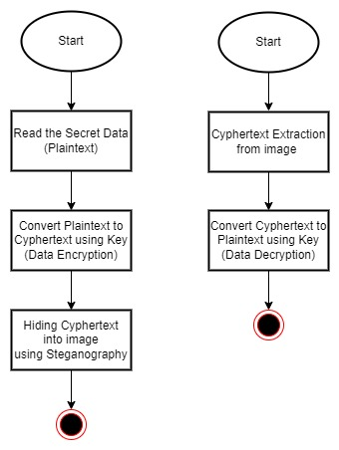
Flowchart
Data Hiding Data Extraction

Slide 6
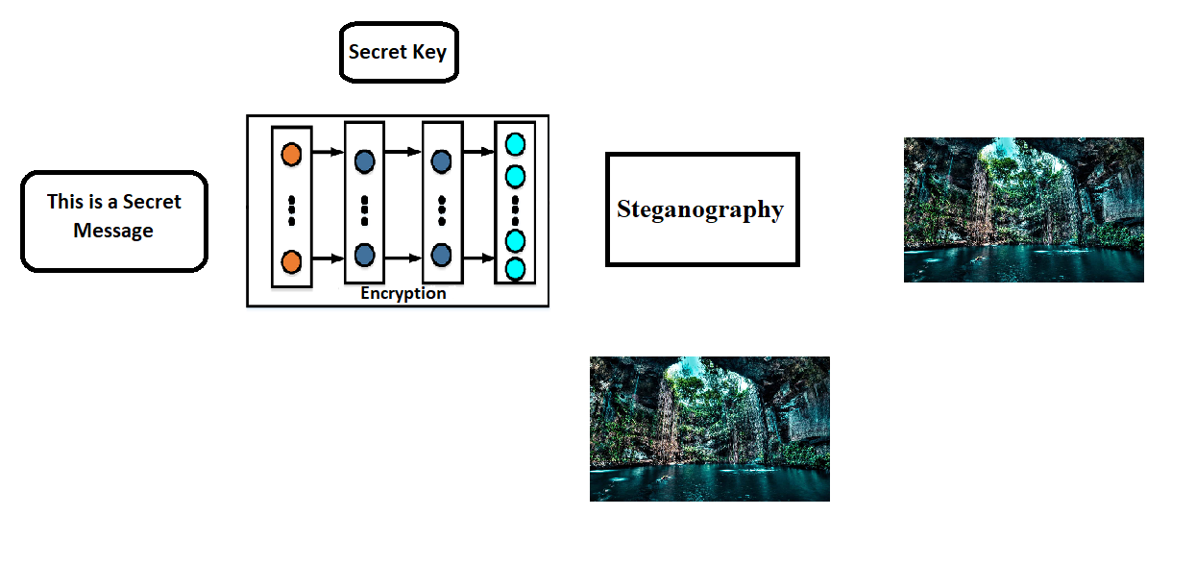
Encryption
Plaintext
Image with Hidden Message
AES & HMAC SHA 256
Image

Slide 7
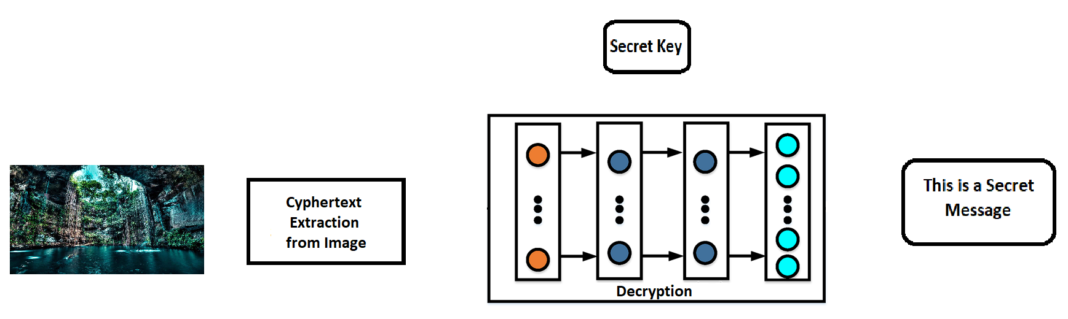
Decryption
Plaintext
Image with Hidden Message
AES & HMAC SHA 256

Slide 8
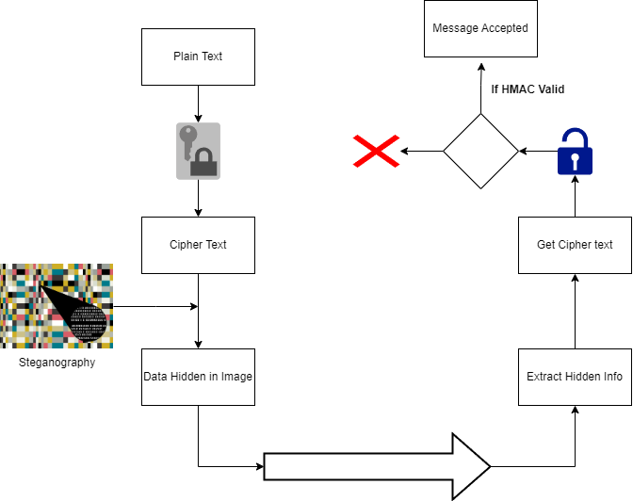

Slide 9
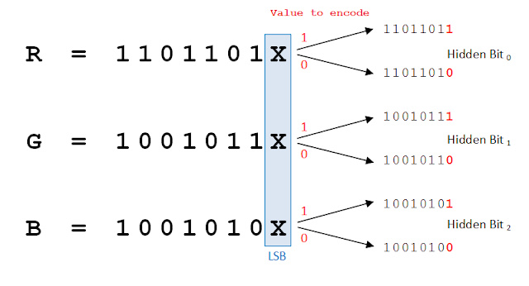
LSB Substitution for Steganography
LSB-Steganography is a steganography technique in which we hide messages inside an image by replacing Least significant bit of image with the bits of message to be hidden.

Slide 10
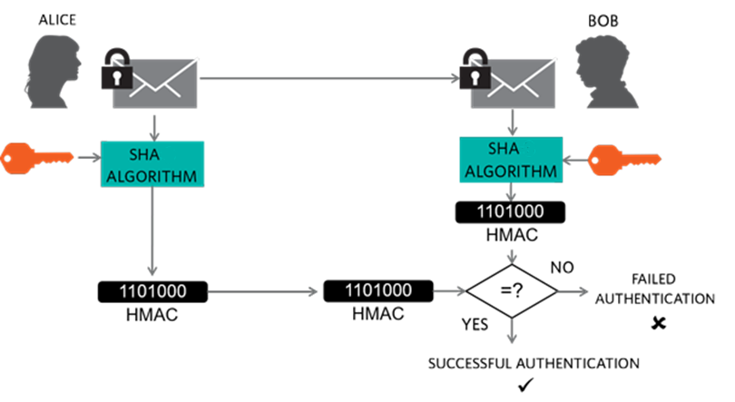
HMAC SHA256

Slide 11
Future Scope - XXHash
xxHash is an Extremely fast Hash algorithm, processing at RAM speed limits. Code is highly portable, and produces hashes identical across all platforms (little / big endian). The library includes the following algorithms :
XXH32 : generates 32-bit hashes, using 32-bit arithmetic
XXH64 : generates 64-bit hashes, using 64-bit arithmetic
XXH3 (since v0.8.0): generates 64 or 128-bit hashes, using vectorized arithmetic. The 128-bit variant is called XXH128.

Slide 12
References
L. Negi and L. Negi, "Image Steganography Using Steg with AES and LSB," 2021 IEEE 7th International Conference on Computing, Engineering and Design (ICCED), Sukabumi, Indonesia, 2021, pp. 1-6, doi: 10.1109/ICCED53389.2021.9664834.
Subramanian, Nandhini & Elharrouss, Omar & Al-ma'adeed, Somaya & Bouridane, Ahmed. (2021). Image Steganography: A Review of the Recent Advances. IEEE Access. PP. 1-1. 10.1109/ACCESS.2021.3053998.
Dagadita, Monica & Slusanschi, Emil & Dobre, Razvan. (2013). Data Hiding Using Steganography. 159-166. 10.1109/ISPDC.2013.29.
N. F. Johnson and S. Jajodia. Exploring steganography: Seeing the unseen. Computer, 31(2):26–34, 1998.
Shilpa Gupta, Geeta Gujral, and Neha Aggarwal. Enhanced least significant bit algorithm for image steganography. IJCEM International Journal of Computational Engineering & Management, 15(4):40–42, 2012.
Shwe Sin Myat Than. Secure data transmission in video format based on lsb and huffman coding. International Journal of Image, Graphics and Signal Processing, 12(1):10, 2020.

Slide 13
R. J. Mstafa, K. M. Elleithy, and E. Abdelfattah. A robust and secure video steganography method in dwt-dct domains based on multiple object tracking and ecc. IEEE Access, 5:5354–5365, 2017.
Wei Lu, Yingjie Xue, Yuileong Yeung, Hongmei Liu, Jiwu Huang, and Yun Shi. Secure halftone image steganography based on pixel density transition. IEEE Transactions on Dependable and Secure Computing, 2019.
Yi Zhang, Chuan Qin, Weiming Zhang, Fenlin Liu, and Xiangyang Luo. On the fault-tolerant performance for a class of robust image steganography. Signal Processing, 146:99–111, 2018.
Z. Gutterman, B. Pinkas and T. Reinman, "Analysis of the Linux random number generator," 2006 IEEE Symposium on Security and Privacy (S&P'06), Berkeley/Oakland, CA, USA, 2006, pp. 15 pp.-385, doi: 10.1109/SP.2006.5.
Boneh, Dan. (2002). Twenty Years of Attacks on the RSA Cryptosystem. NOTICES OF THE AMS. 46.
L. Negi and L. Negi, "Image Steganography Using Steg with AES and LSB," 2021 IEEE 7th International Conference on Computing, Engineering and Design (ICCED), Sukabumi, Indonesia, 2021, pp. 1-6, doi: 10.1109/ICCED53389.2021.9664834.

Slide 14
Z. Gutterman, B. Pinkas and T. Reinman, "Analysis of the Linux random number generator," 2006 IEEE Symposium on Security and Privacy (S&P'06), Berkeley/Oakland, CA, USA, 2006, pp. 15 pp.-385, doi: 10.1109/SP.2006.5.
P. Lacharme, A. Rock, V. Strubel, and M. Videau, “The Linux Pseudorandom Number Generator Revisited.” HAL CCSD, 2012.
C. Chaitanya, C. N. Reddy, K. S. Vignesh, P. R. Krishna, A. Roshini and K. Swetha, "Enhanced Hash Based Image Steganography Technique to Increase Data Integrity and Confidentiality," 2021 7th International Conference on Advanced Computing and Communication Systems (ICACCS), Coimbatore, India, 2021, pp. 1456-1461, doi: 10.1109/ICACCS51430.2021.9442036.

