Slide 1

BALANCED FLOW IN ATMOSPHERE
PRAVIN KUMAR RANA
CENTRE FOR OCEANS, RIVERS, ATMOSPHERE AND LAND SCIENCES
INDIAN INSTITUTE OF TECHNOLOGY
KHARAGPUR -721302

Slide 2

OUTLINE
Balanced Flow
Natural Co-ordinates
Geostropic Flow
Inertial Flow
Cyclostropic Flow
Gradient Flow
Nov.-Dec., 2006
Pravin Kumar Rana

Slide 3
BALANCED FLOW
The pressure and velocity distributions in atmospheric systems are related by simple, approximate force balances
To explore these balanced flow conditions, it is useful to define a new coordinate system, known as natural coordinates
Nov.-Dec., 2006
Pravin Kumar Rana

Slide 4
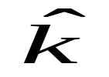

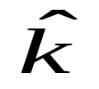







NATURAL CO-ORDINATES
Natural coordinates are defined by a set of mutually orthogonal unit vectors whose orientation depends on the direction of the flow
Nov.-Dec., 2006
Pravin Kumar Rana

Slide 5
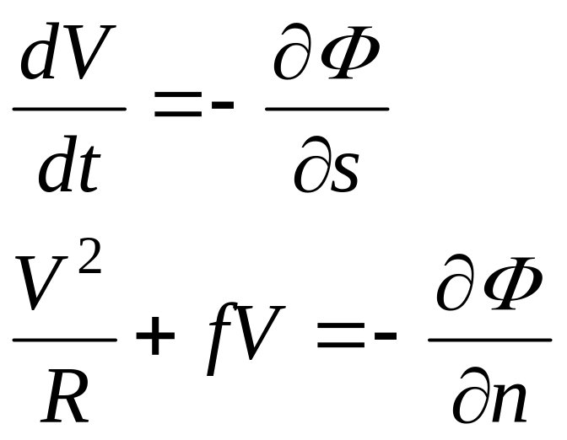
Components of horizontal momentum equation (isobaric) in natural coordinate system
Nov.-Dec., 2006
Pravin Kumar Rana

Slide 6
GEOSTROPHIC FLOW
A state of motion of air in atmosphere in which the horizontal Coriolis force exactly balances the horizontal pressure gradient force at all points of the field
The geotropic wind is directed along the isobars with low pressure to the left in the Northern Hemisphere and to the right in the Southern Hemisphere
Nov.-Dec., 2006
Pravin Kumar Rana

Slide 7
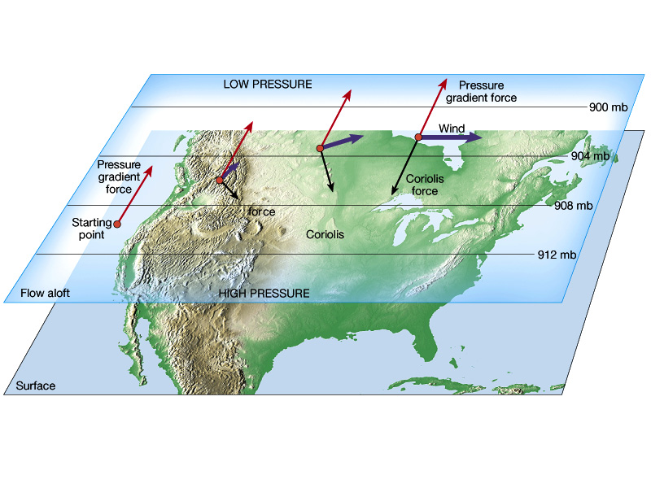
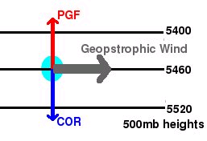
Balance of forces for geostrophic equilibrium
Nov.-Dec., 2006
Pravin Kumar Rana

Slide 8
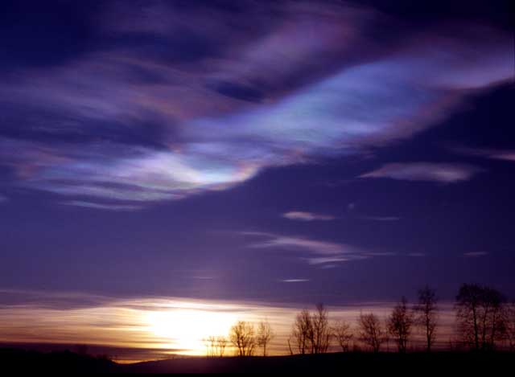
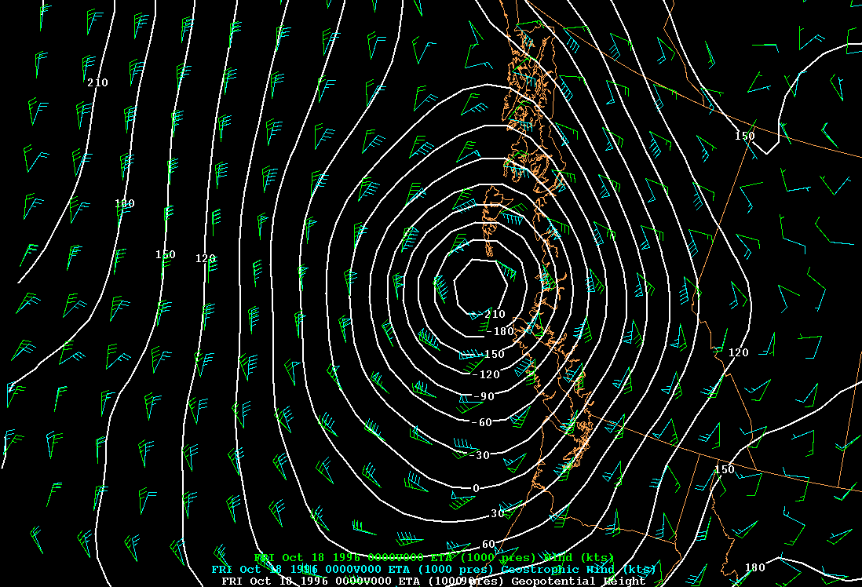

Geostrophic and observed wind 1000 mb (ocean)
Nov.-Dec., 2006
Pravin Kumar Rana

Slide 9
INERTIAL FLOW
In horizontally uniform pressure field, inertial flow is due to exact balance between Coriolis force and centrifugal force
In inertial flow, the air parcels follow circular paths in clockwise in Northern Hemisphere and anticlockwise in Southern Hemisphere (Neglecting the latitudinal dependence of Coriolis force)
Nov.-Dec., 2006
Pravin Kumar Rana

Slide 10
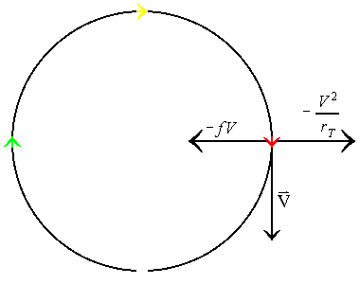
Inertial flow may occur at the poles due to strong Coriolis force
Nov.-Dec., 2006
Pravin Kumar Rana

Slide 11
CYCLOSTROPHIC FLOW
For small horizontal scale of a disturbance, the horizontal pressure gradient force and centrifugal force are in exact balance gives Cyclostrophic flow
Cyclostrophic balance approximation is valid provided that the ratio of the centrifugal force to the Coriolis force is large
Nov.-Dec., 2006
Pravin Kumar Rana

Slide 12
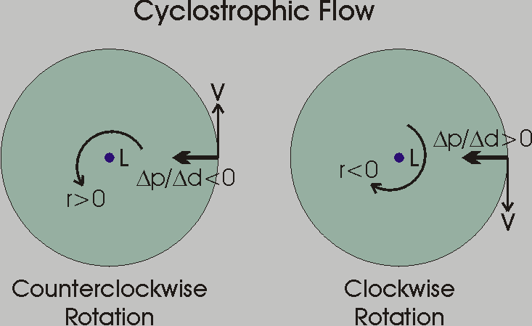
Cyclostrophic flow may be either cyclonic or anti-cyclonic
Nov.-Dec., 2006
Pravin Kumar Rana

Slide 13
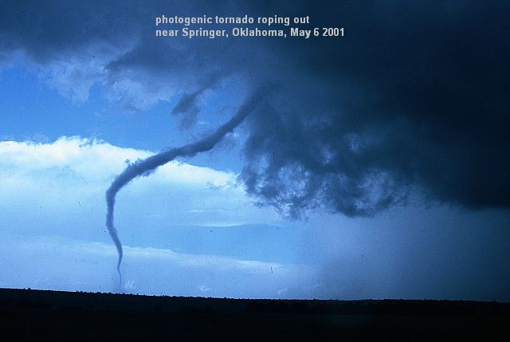
Example Of Cyclostrophic Flow: TORNADO
Nov.-Dec., 2006
Pravin Kumar Rana

Slide 14
GRADIENT FLOW
Gradient flow is horizontal frictionless flow which is parallel to the isobars (isobars are not parallel) so that the tangential acceleration vanishes
In gradient flow, there is a three-way balance between the Coriolis force, the centrifugal force, and the horizontal pressure gradient force
There are four possibilities of geostrophic winds
Nov.-Dec., 2006
Pravin Kumar Rana

Slide 15
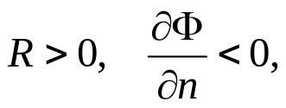



Gradient Wind Possibilities
regular low
V
regular high
PGF
Centrifugal
Centrifugal
L
H
Coriolis
PGF
Coriolis
V
negative root
positive root
anomalous low
anomalous high
PGF
Centrifugal
Centrifugal
L
H
Coriolis
Coriolis
PGF
V
V
negative root
negative root
Nov.-Dec., 2006
Pravin Kumar Rana

Slide 16
Thank You

