Slide 1

DCVF Results and BDCVF
Pravin Kumar Rana
Sound and Image Processing Lab.(SIP)
KTH - Royal Institute of Technology
SE-10044 Stockholm, Sweden

Slide 2

Disparity Field Estimation
Right view
Nagoya Depth Estimation Reference Software
Right view
Estimated Depth
Map
Estimated
Disparity
Field
Disparity
Compensated View Filter
(DCVF)
Common view
Left view
Error view
Right view
Left view

Slide 3
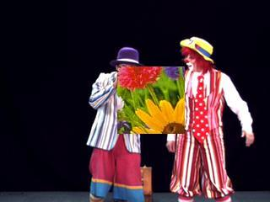
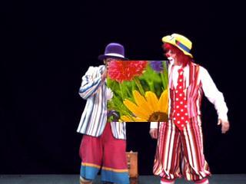
Estimated Disparity Field Information
NDE Reference Software

Slide 4
DCVF on the Modified Pantomime
Energy ratio between common and error view = 0.46 %
Disparity Vector Field Information
DCVF

Slide 5
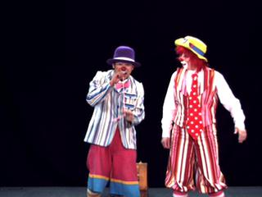
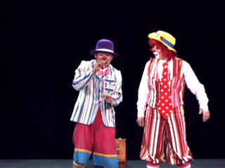
Estimated Disparity Field Information
NDE Reference Software

Slide 6
DCVF on the Pantomime
Energy ratio between common and error view = 0.42 %
Disparity Vector Field Information
DCVF

Slide 7
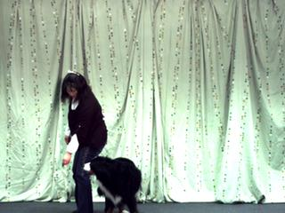
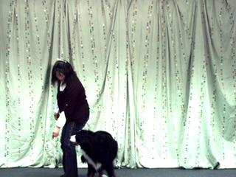
DCVF on the dog
Energy ratio between common and error view = 2.41 %
Disparity Vector Field Information
DCVF

Slide 8
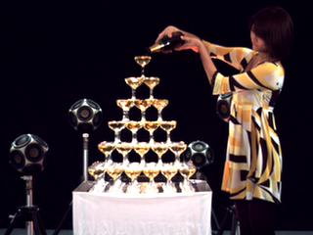
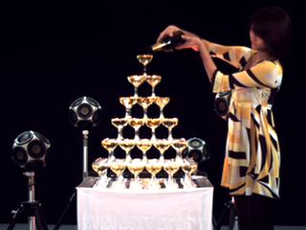
DCVF On the Champagne tower
Energy ratio between common and error view = 2.01 %
Disparity Vector Field Information
DCVF

Slide 9
2 level DCVF

Slide 10
Bidirectional Disparity Compensated View Filter (BDCVF)
c₁
e₇
DCVF
DF₁₅
e₅
e₆
DF₁₃
BDCVF
DF₅₃
DF₅₇
DCVF
e₁
e₂
e₃
e₄
BDCVF
DF₅₆
BDCVF
DF₁₂
DF₂₃
DF₆₇
DF₃₄
BDCVF
DF₄₅
DF₇₈
DCVF
x₁ x₂ x₃ x₄ x₅ x₆ x₇ x₈

Slide 11
Bdcvf results

