Slide 1

MPEG 3DTV FTV EE on the Lovebird1 Data Set
Pravin Kumar Rana
Sound and Image Processing Lab.(SIP)
KTH - Royal Institute of Technology
SE-10044 Stockholm, Sweden

Slide 2
Outline
FTV Exploration Experiments(EE)
EE1: Depth Estimation
EE4: Coding Experiment

Slide 3
FTV Exploration Experiments
EE1
Experiment for the depth map generation improvement with DERS 5.0 and the synthesized views quality improvement with VSRS 3.5.
EE4
Coding experiments for the texture views and the depth map using the JMVC 5.0.5 reference software.
The goal of experiment is to get insights on how the depth maps coding affects the quality of synthesized views.

Slide 4
Exploration Experimental 1 Set Up
View 5
View 6
View 7 View 8
View 9
Depth 6
Depth 8
View 7 - Synthesized
Original View 8
Synthesized Stereo Pair

Slide 5
Automatic Depth Estimation Mode

Slide 6
Semi-automatic Depth Estimation Mode 1

Slide 7
Semi-automatic Depth Estimation Mode 2

Slide 8
Reference Depth Estimation Mode

Slide 9
EE1 Summary
Depth Estimation Mode | Average Y-PSNR (dB)
Automatic Mode | 30.73070
Semi-automatic Mode 1 | 30.74090
Semi-automatic Mode 2 | 30.25470
Reference Depth Mode | 30.76841

Slide 10




Estimated Depth Maps
( Estimated depth maps obtained by DERS 5.0 using depth estimation mode “3”)
(a) Frame #01 (d)Frame #100
(C) Frame #150 (d)Frame #200

Slide 11
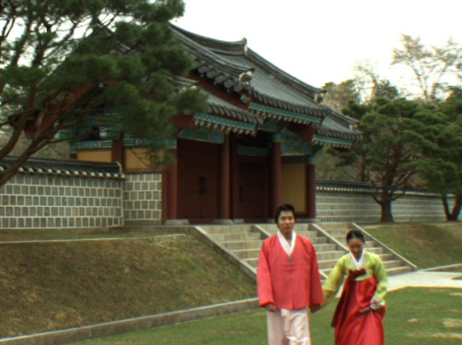
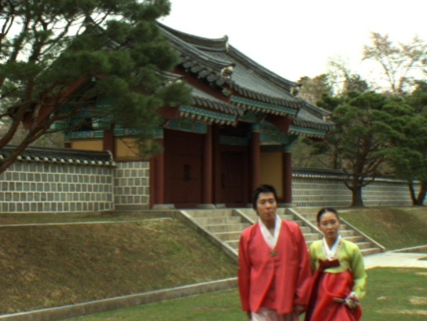
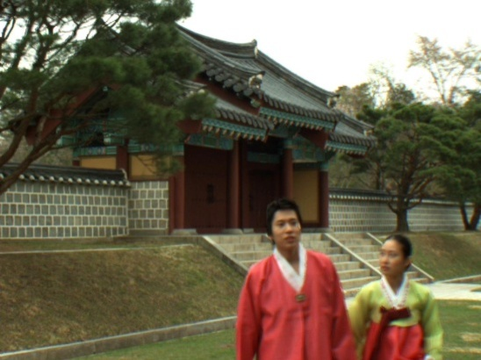
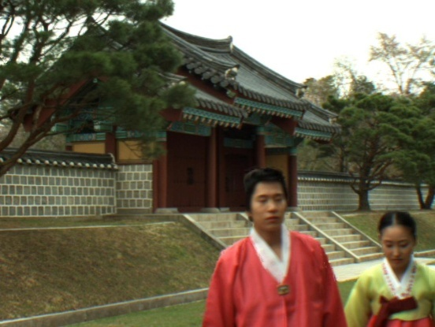
Synthesized Views
(Synthesized “lovebird1” view 7 using VSRS 3.5)
(a) Frame #01 (d)Frame #100
(C) Frame #150 (d)Frame #200

Slide 12
Exploration Experimental 4 Set Up
Original Texture 6
Original Texture 8
Depth View 6
Depth View 8
Encoder JMVC 5.0.5 Decoder
Encoder JMVC 5.0.5 Decoder
Decoded Texture 6
Decoded Texture 8
Decoded Depth 6
Decoded Depth 8
VSRS 3.5
Synthesized View 7

Slide 13
Coding Parameters
JMVC 5.0.5 Coding Parameter
Quantization Parameter (Texture) | {22, 24, 26, 28, 32, 34, 36, 38}
Quantization Parameter (Depth) | {22, 24, 26, 28 , 30 , 32, 34, 36, 38}
Frames To Be Encoded | 200
GOP Size | 8
Intra Period | 8
Inter Period Pics First | 1
Search Mode | Fast Search
Search Range | 96
View Scalability Information SEI | ON
View Order | 0-2

Slide 14
EE4 Results
Total bit rate spent on encoding texture with different depth QP for views (6, 8)

Slide 15
EE4 Results
Quality of the synthesized view 7 vs. the total bit rate. (when QP for depth map is fixed and QP for texture varies)

Slide 16
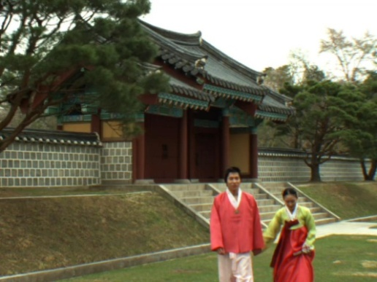
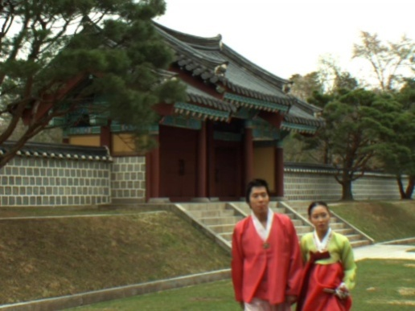


Synthesized Views
(Synthesized “lovebird1” view 7 using “decoded texture” and “decoded depth map”)
(a) Frame #01 (d)Frame #100
(C) Frame #150 (d)Frame #200

Slide 17
ETRI Process for PSNR
ETRI process for PSNR evaluation of the synthesized views:
Encoding color and depth as a combination of QP using MVC.
Decoding the result of process 1.
Synthesize the virtual views using the result of process 2.
Synthesize the virtual views using unencoded original color and depth.
Evaluate PSNR on the results of process 3 and process 4.

Slide 18
Conclusions
EE1
Depth estimation by using a “reference depth map” (depth estimation mode “3”) improves the quality of estimated depth map and hence the quality of the view synthesis.
EE4
Quality of the synthesized view improves by assigning more bit rate to texture views.

