Slide 1

A presentation on…
Prediction of Antarctic Sea Ice Edge Using Active Contour Model
By
PRAVIN KUMAR RANA
(06CL6003)
Under the guidance of
Dr. A. ROUTRAY Dr. MIHIR K. DASH
Centre for Ocean, Rivers, Atmosphere and Land Sciences
Indian Institute of Technology
Kharagpur-721302
India

Slide 2
Outline
Problem
Approach
Prediction Model
Result & Error Analysis
Concluding Remarks

Slide 3
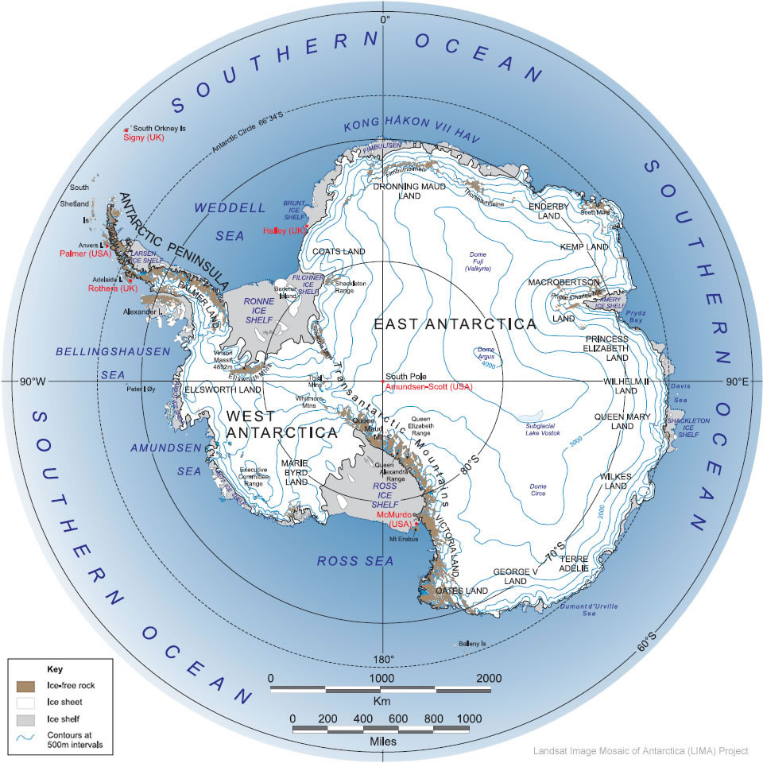
Antarctica: An Introduction
The southern most icy continent of the world surrounding the south pole
Located between the latitudes of approximately 65⁰ S and 90⁰ S
The Pulsating Continent

Slide 4
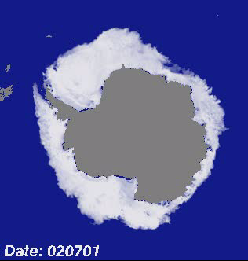
Pulsating Continent : Antarctica
Seasonal Variation of Antarctica Sea Ice Edge: 1st July 2002 to 1st July 2005

Slide 5
Why Antarctica Sea Ice Edge?
Earth Climate System
  Earth Radiation Budget
  Global Ocean Circulation
Marine Biota
Climate Modeling
Navigation
Military Operations

Slide 6
Problem ?
Prediction of Pulsating Nature of Sea Ice Edge over the Antarctica

Slide 7
Present Sea Ice Edge Information Scenario
A number of current microwave sensors make daily global observations of sea-ice cover, in particular, the SeaWinds and SSM/I. Based on these observations, sea-ice extent can be estimated directly using different detection techniques
The United State‘s National Ice Center provides biweekly information about global sea-ice condition but this service depends on availability of good, quality controlled satellite data
Due to the persisting severe weather condition over the Antarctic availability of good data is a very few

Slide 8
Approach
Active contour Model
Polynomial Statistical Method

Slide 9
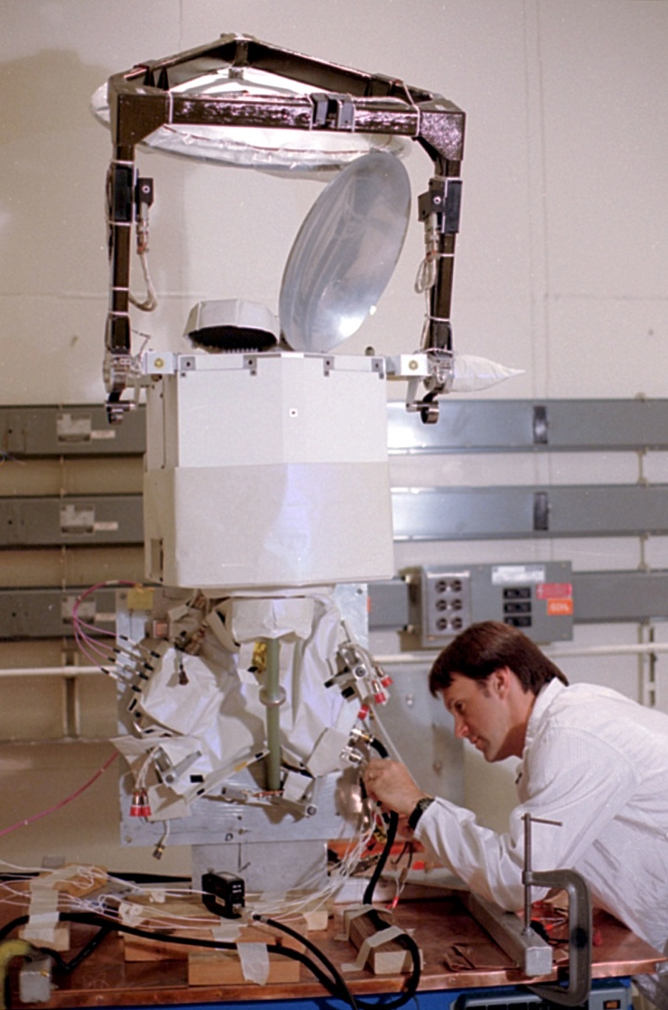
Sea Ice Concentration Data
Special Sensor Microwave/Imager
Source : SSM/I using Bootstrap Algorithm with daily varying tie-points
Grid Resolution: 25km x 25 km
Format :Binary two-byte integer
Spatial Coverage: Whole Globe in 2 days
Temporal Coverage: 1987 to till date, (Daily and monthly)
Bootstrap Algorithm: http://nsidc.org/data/docs/
daac/bootstrap/index.html
Data Source :The National Snow and Ice Data Center
(http://www.nsidc.org)

Slide 10

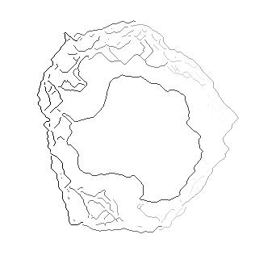
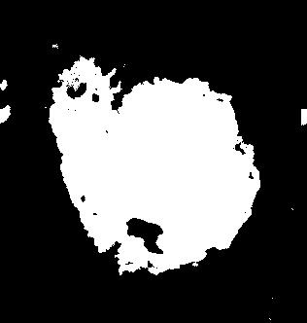

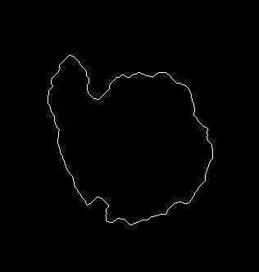
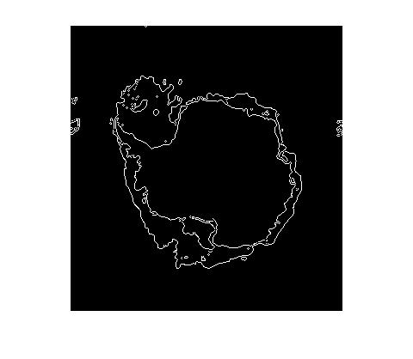
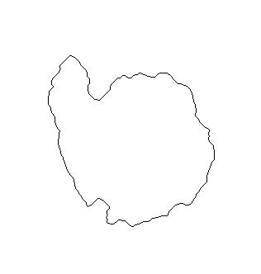
Different Steps To Getting Edge

Slide 11
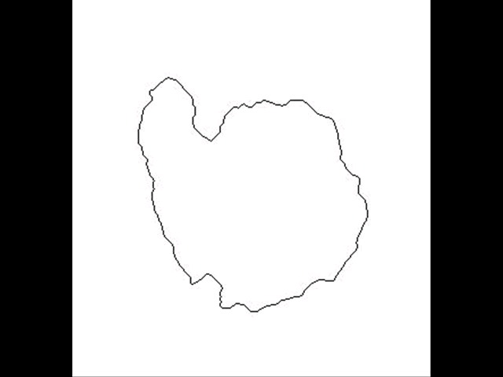
Variation of Antarctic Sea Ice Edge in 2004

Slide 12
Parameterization of Antarctic Sea Ice Edge

Slide 13
Active Contour Model
(Or, Snake)
An energy minimizing spline guided by external
constraint forces and pulled by image forces
toward features
Source: Kass, M., A. Witkin, and D. Terzopoulos, 1987: Snakes: The Active contour models, International Journal of Computer Vision. 1, pp. 321-331

Slide 14
Overview of Active Contour Model
Active Contour are curves defined within an image domain that can move under the influence of the internal forces coming from within the cures itself and external forces computed form the image data
Model is always minimizing its energy functional and exhibits dynamic behavior : Active Contour
The way the contours slither in the model while minimizing their energy is know as Snake Model
The snake’s energy depends on its shape and location

Slide 15
Active Contour Model
A snake is a curve X(s)=[x(s),y(s)],s Є [0,1] that moves through the spatial domain of an image to minimize the energy functional
E_{snake} = ∫₀¹ [E_{internal} (X(s)) + E_{external}(X(s))]ds
where, E_{internal} is the internal energy and E_{external} is the external energy of the snake, respectively

Slide 16
Internal Energy
E_{Internal} = [ { (α(s)|X̕(s)|² + β(s)|X̕̕(s)|²)} /2]
Elasticity Rigidity
where X̕ and X̕̕ are the 1st and 2nd derivatives of the snake with respect to s and α(s) and β(s) specify the elasticity and rigidity of the snake, respectively

Slide 17
External Energy
The external energy computed from the image data is a weighted combination of energies which attract the snake to lines or edges Image data
For a line drawing (black on white) Image I(x, y)
E³_{external} = I(x, y)
E⁴_{external} = G_{σ}(x, y)*I(x, y)
where G_{σ} is the 2D Gaussian function with standard deviation σ and ∇ is the gradient operator

Slide 18
Methods for Snake
Multi-resolution
Advantage :Issue of range capture
Limitation :Can’t specify how the snake moves across
different resolution
Pressure Forces
Advantage :Can be push an snake into boundary
concavities
Limitation :Sensitive to initialization
Distance Potentials
Advantage :Can provide large capture range
Limitation :Can't move a snake into concavities
Gradient Vector Flow

Slide 19
Gradient Vector Flow Snake
Source: Chenyang Xu and J.L. Prince, 1998: Gradient Vector Flow: A New External Force for Snakes, Proc. IEEE Conf. on Comp. Vis. Patt. Recog. (CVPR), Los Alamitos: Comp. Soc. Press., 7, pp. 66-71

Slide 20
Why Gradient Vector Flow Snake?
Insensitivity to initialization
Large capture range
An ability to progress into boundary concavities
Detects shapes with boundary concavities
Does not need prior knowledge about whether to shrink, or expand towards boundary

Slide 21
Gradient Vector Flow
The GVF field is defined to be a vector field
V(x , y) = [u(x , y), v(x , y) ]
V(x , y) is defined such that it minimizes the energy functional
ε=∫∫μ(u_{x}²+u_{y}²+v_{x}²+v_{y}²) +|∇f|²|V - ∇f|²dxdy
where f(x , y) is the Edge Map of the image and μ is noise parameter

Slide 22
Numerical Implementation
Using the calculus of variations & by treating GVF u and v as functions of time. GVF field can be obtained by solving following
u_{i,j}^{n+1} = (1- b_{i,j}∆t)u_{i,j}^{n} + r(u_{i+1,j}^{n} + u_{i,j+1}^{n} + u_{i-1,j}^{n} + u_{i,j-1}^{n} - 4u_{i,j}^{n}) + c_{i,j}¹∆t
v_{i,j}^{n+1} = (1- b_{i,j}∆t)v_{i,j}^{n} + r(v_{i+1,j}^{n} + v_{i,j+1}^{n} + v_{i-1,j}^{n} + v_{i,j-1}^{n} – 4v_{i,j}^{n}) + c_{i,j}²∆t
r = {μ∆t /∆x∆y}≤(1/4)
b(x, y) = fx (x, y)² + fy(x, y)²
c¹=b(x, y)*fx(x, y)
c²=b(x, y)*fy(x, y)
where, i ,j and n corresponds x , y, and t respectively and f_{x} and f_{y} are the partial derivative of the Edge Map

Slide 23
Implementation
The Process of Implementation:
1. Import an image
2. Initialize the snake for the image
3. Compute the Edge Map of the image
4. Input the Edge Map to the GVF Solver
5. Deforms the Snake

Slide 24
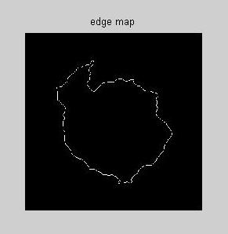
Edge Map
Edge map f(x , y) derived from the image intensity (I(x , y)) having the property that it is larger near the image edges
f(x , y) = -E^{(i)}_{external}(x , y)
i=1,2,3, or 4.

Slide 25
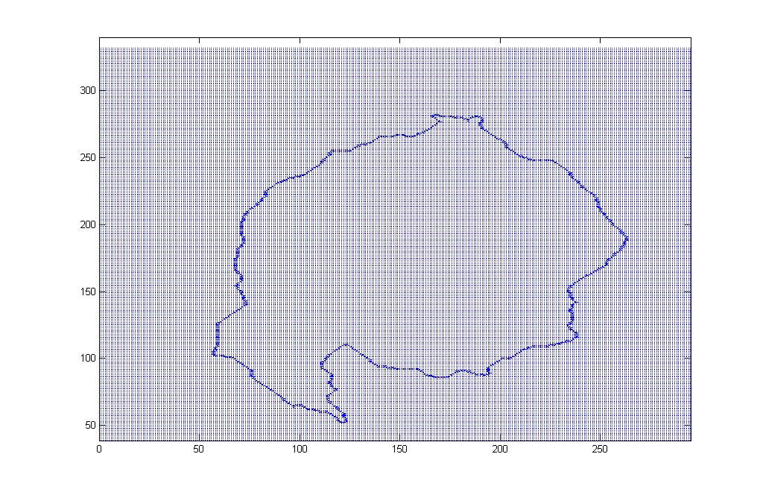
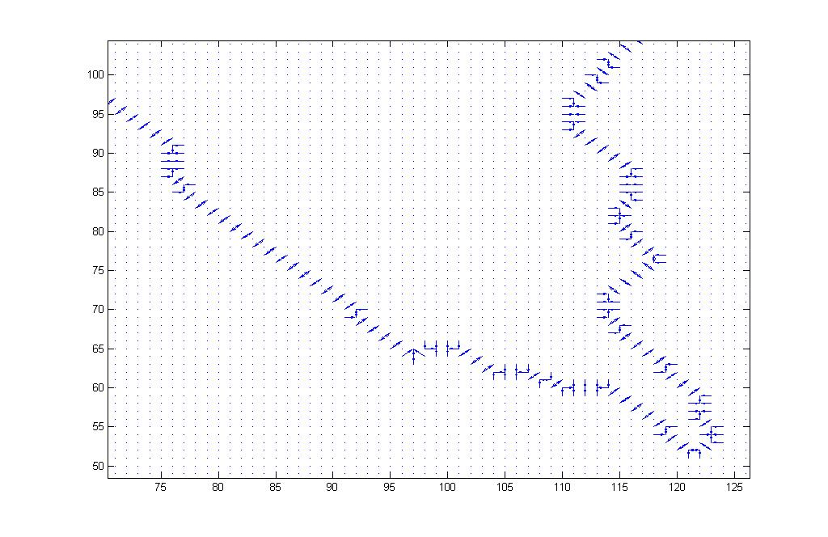
Gradient of Edge Map

Slide 26
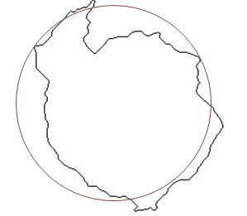
Initial Snake With Input Edge Image
(166,158)

Slide 27
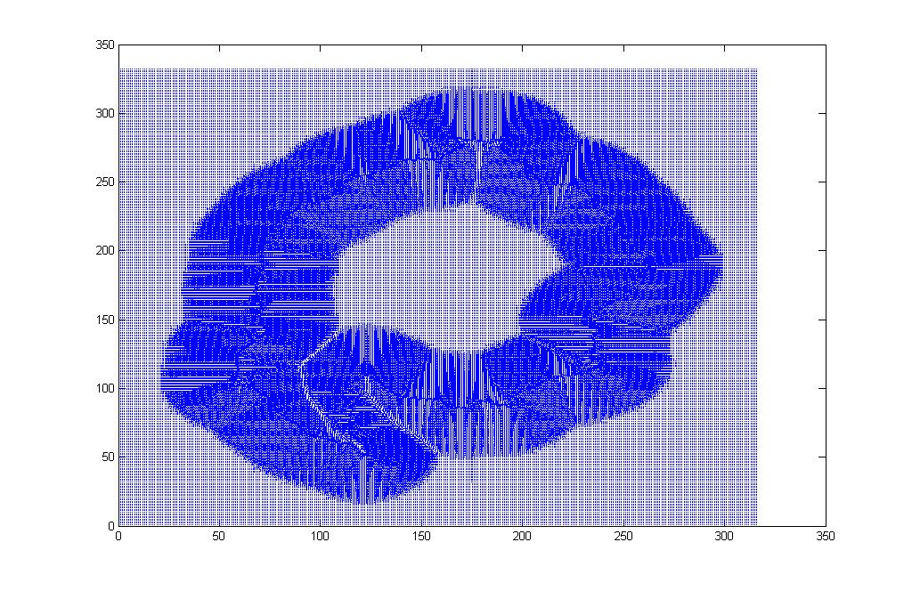
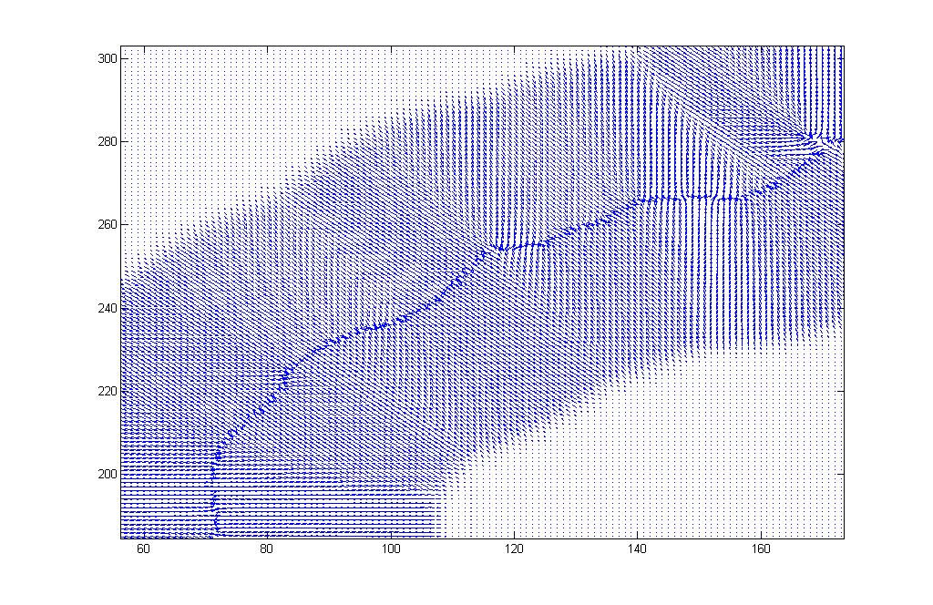
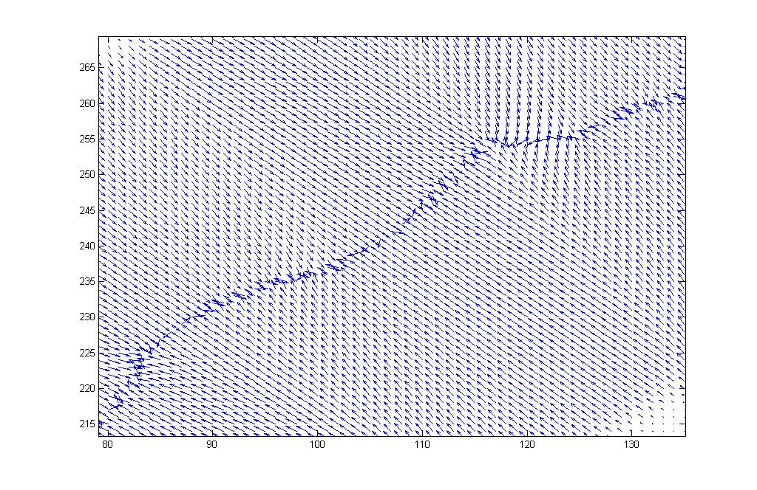
Normalized Gradient Vector Flow Field

Slide 28
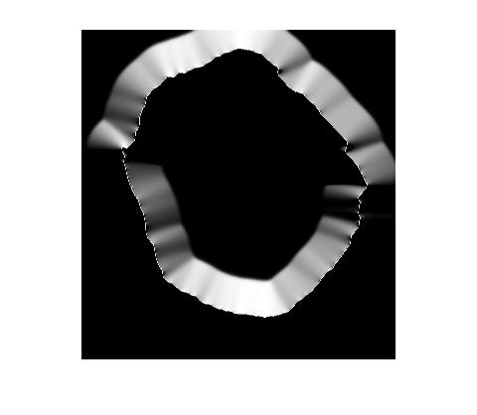
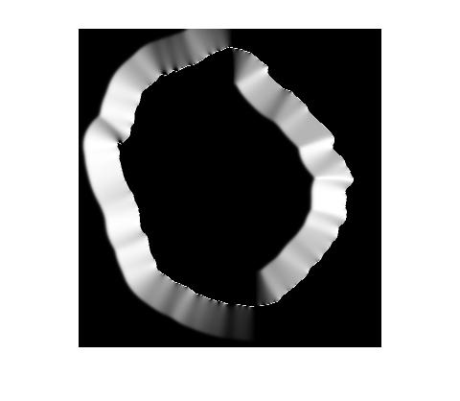
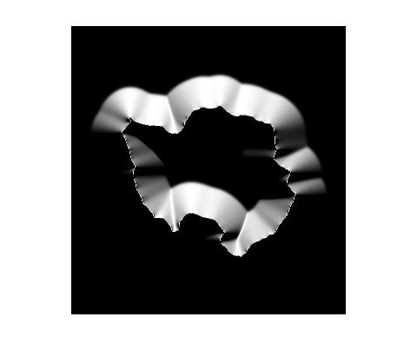
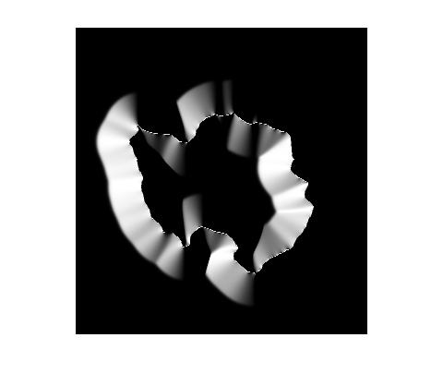
September, 2006
U GVF
V GVF
Normalized 3D View GVF U- And V- Component
February, 2006
U GVF
V GVF

Slide 29
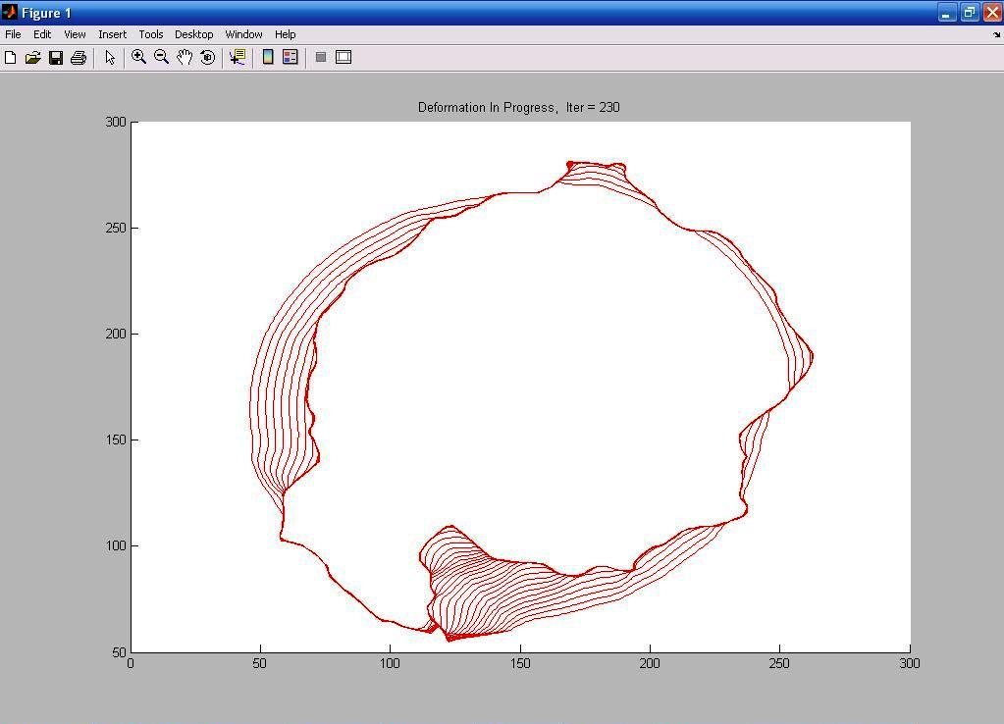
Convergence of A Snake Using GVF External Force Towards Edge

Slide 30
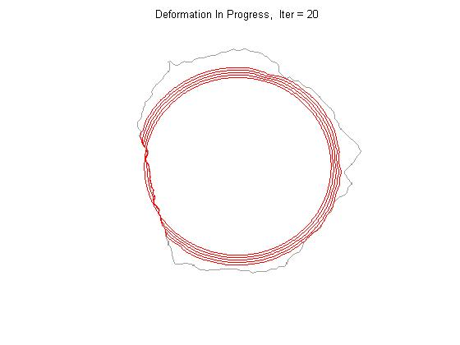
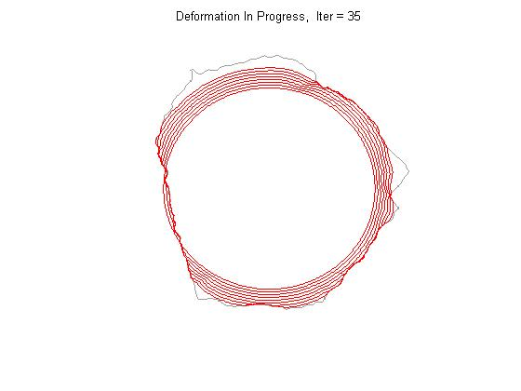
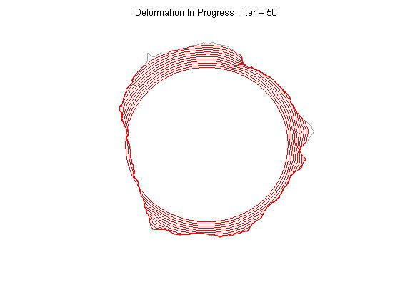
Deformation of GVF Snake

Slide 31
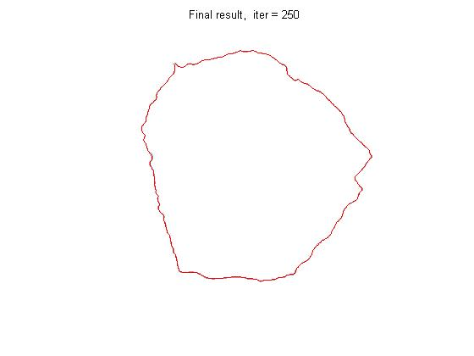
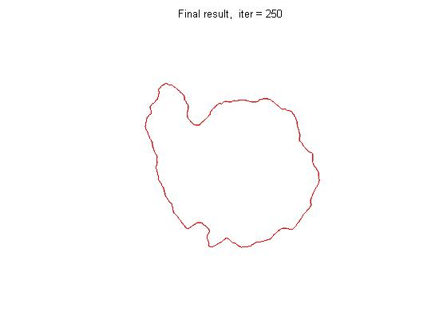
Parameterization Result
September, 2006
February, 2006

Slide 32
GVF Snake Model Parameter
Snake Initialization: (166,158)
Elasticity(α) : 0.05
Rigidity(β): 0
Regularization (μ):0.02
Damping coefficient (γ):1

Slide 33
Prediction Model

Slide 34
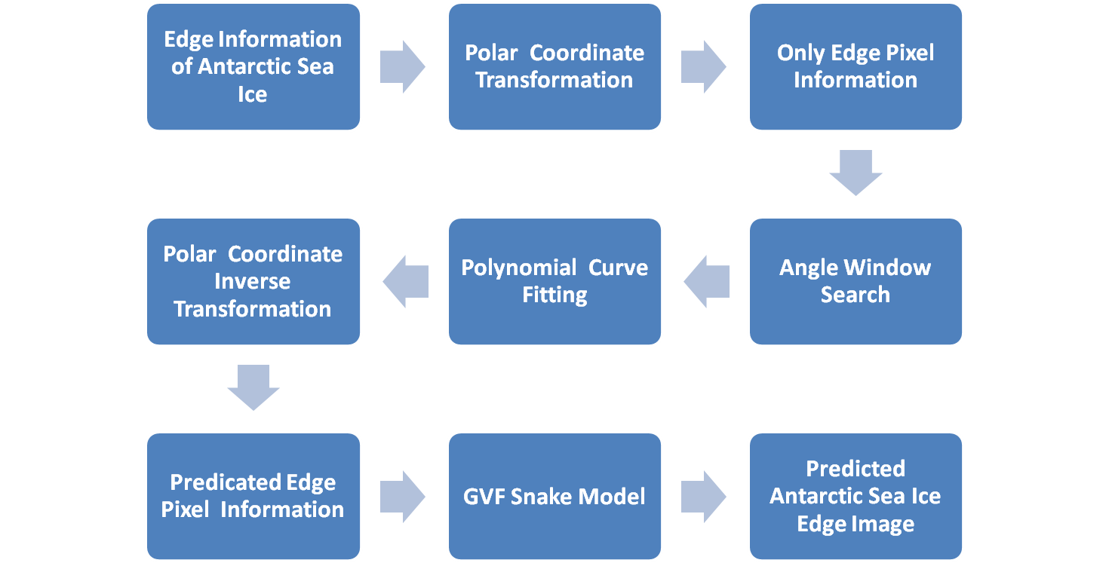
Prediction Approach

Slide 35
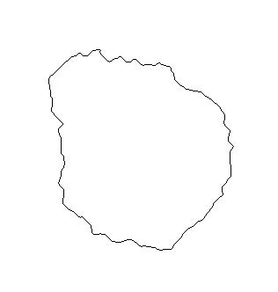
Image Polar Coordinate Parameter
(0,0)
(0,316)
j
(i_{u1}, j_{v1})
O(i₀, j₀)
Ф = tan⁻¹ [(i_{u}-i₀)/(j_{v}-j₀)]
r = √((i_{u}-i₀)²+(j_{v}-j₀)²)
Where,
u=1,2,…332
v=1,2,…316
(i_{u2}, j_{v2})
(332,0)
i

Slide 36
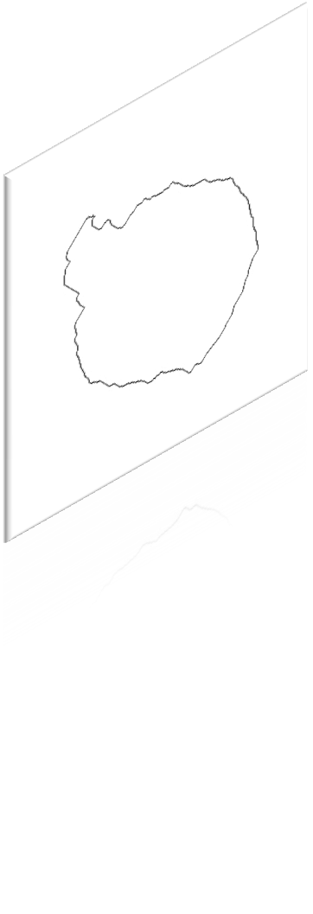
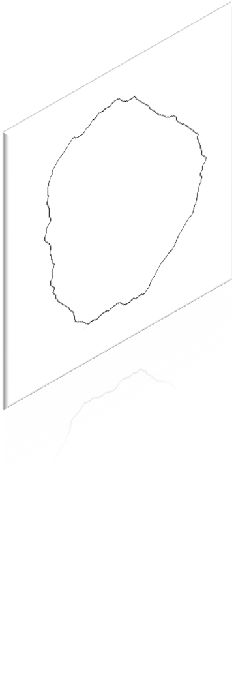
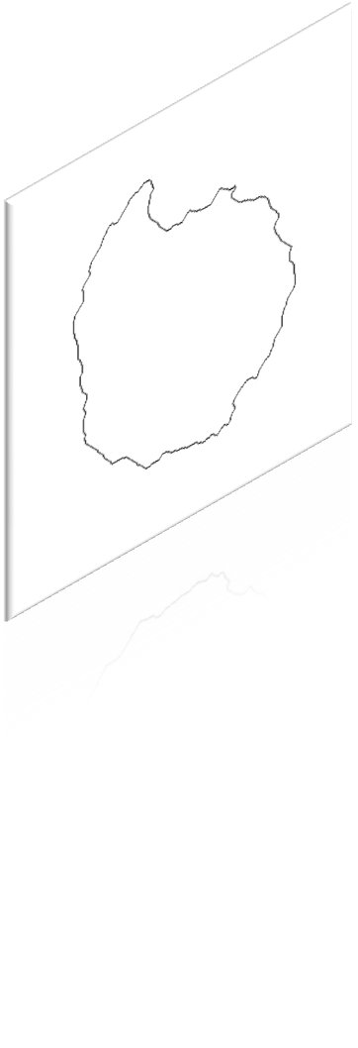
Angle Window Search
Angle Window = ± 0.2⁰

Slide 37
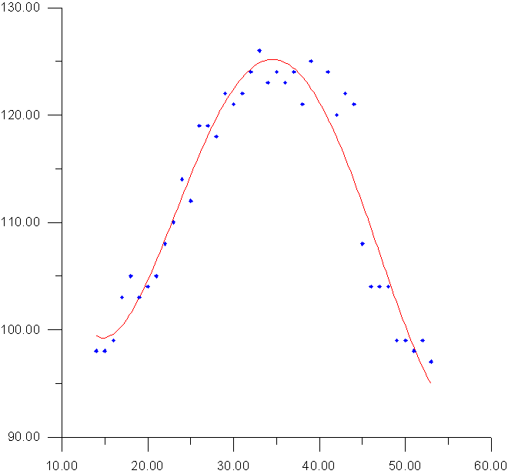
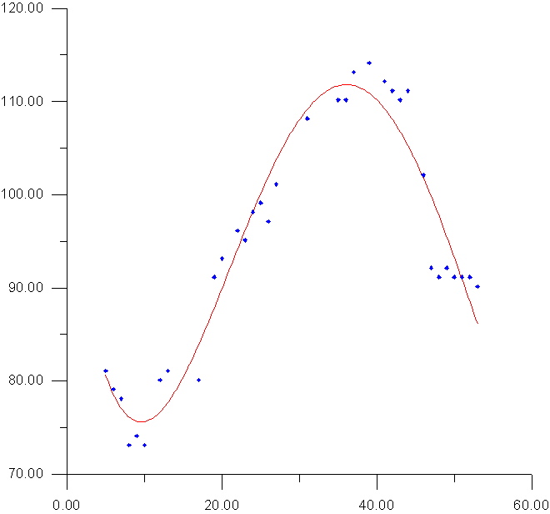
Polynomial Curve Fitting
r₁=206.556 - 18.4108(t)+ 1.05311(t²)-0.0225838(t³) + 0.000160733(t⁴)
r₉₃ =133.542-15.7129(t)+1.18814(t²)-0.0288763(t³) + 0.000227632(t⁴)
1⁰
93⁰

Slide 38
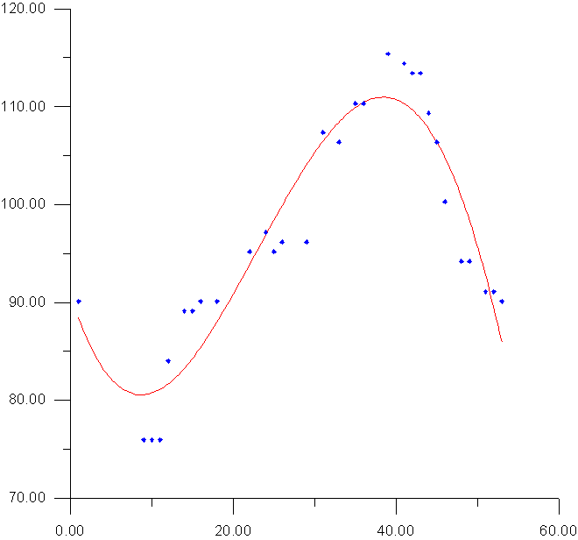
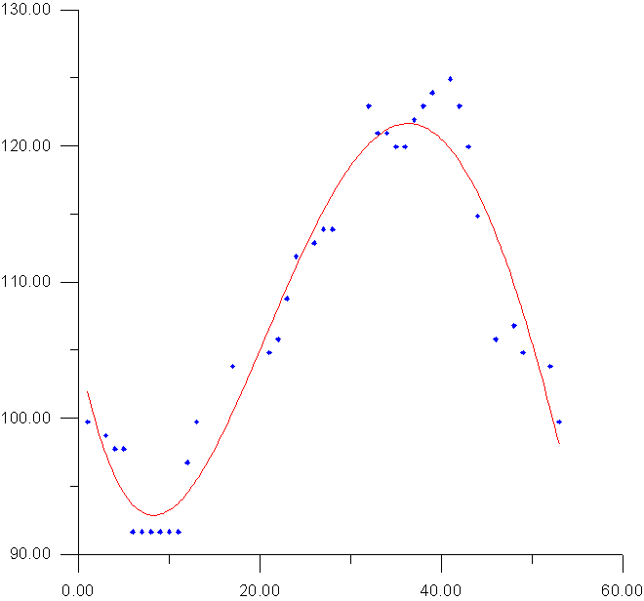
Polynomial Curve Fitting
r₁₈₅=95.3196-2.88371(t) + 0.197632(t²)-0.00352258(t³) + 1.44726 X 10 ⁻⁰⁰⁵ (t⁴)
r₁₅₃=82.988-6.43698(t) + 0.649314(t²)-0.016198(t³) + 0.000119787(t⁴)
185⁰
153⁰

Slide 39
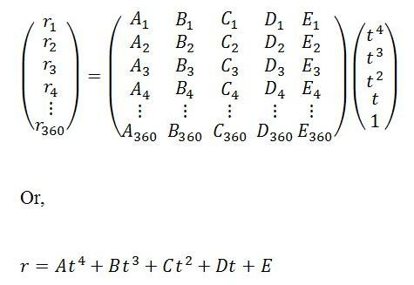
Prediction Model Equation
where,
r_{Ө} = The radius of the each pixel locations, Ө=1,2,3,4…,360
t= Time, t=1, 2, 3, 4…
and
A, B, C, D,E = Polynomial Coefficients

Slide 40
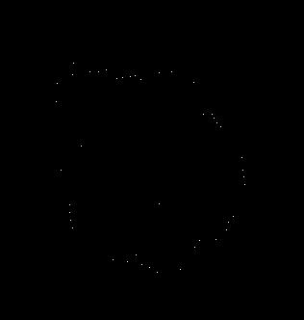
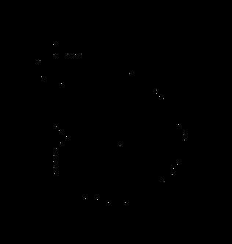
Predicted Edge Pixel
1st week of January, 2005
2nd week of January, 2005

Slide 41
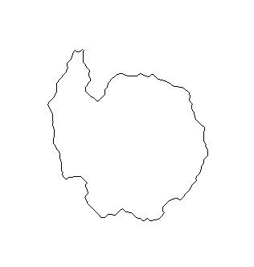
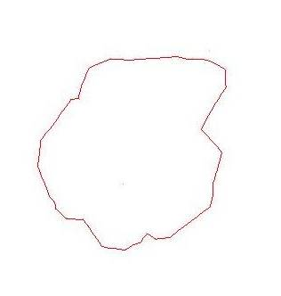
Result
Predicted Image : 1st week of January, 2005
SSM/I Image: 1st week of January , 2005

Slide 42

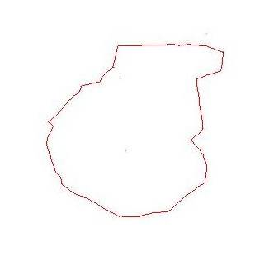
Result
Predicted Image : 2nd week of January, 2005
SSM/I Image : 2nd week of January, 2005

Slide 43

RMS Error Analysis
Where, r _{reference} = Reference Image Pixel Position
r _{predicted} = Predicted Image Pixel Position

Slide 44
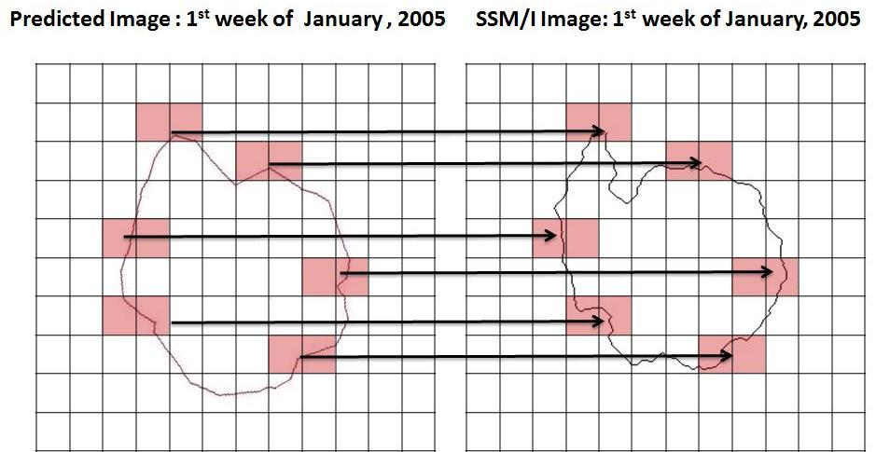
RMS Error Analysis
Average Error : 10 %

Slide 45
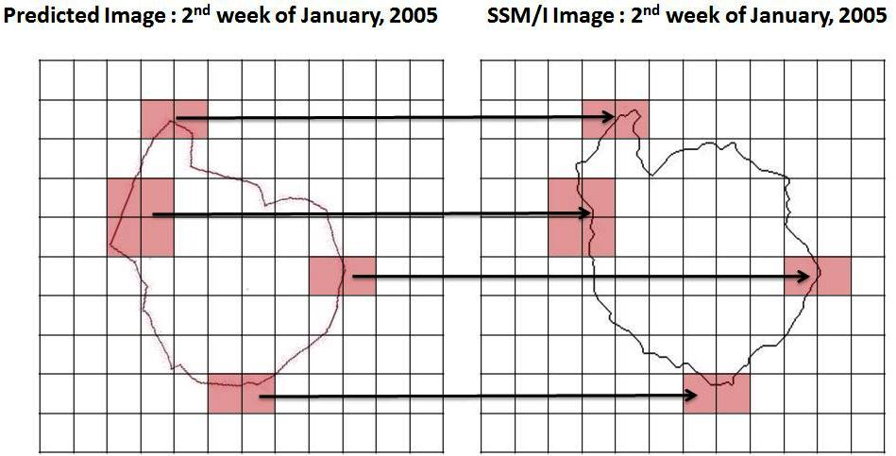
RMS Error Analysis
Average Error : 11 %

Slide 46
Conclusion
The broad features of the predicted edge match well with that observed edge.
Radial RMS Error is of the order of 10%
The visual interpretation shows the GVF snake model has simulated the ice edge with 90 % accuracy
Large deviation at the region around Antarctic peninsula due to use of the Averaging Technique to decide the ice edge when multiple edges are present at a particular angle

Slide 47
Paper Accepted @ Conference
Pravin K. Rana, A. Routray, Mihir K. Dash and P.C. Pandey (2008), abstract entitled “Prediction of Antarctic sea ice edge using Artificial Intelligence”, is approved by the International Scientific Organizing Committee of the SCAR/IASC IPY Open Science Conference 2008 for Oral Presentation at St. Petersburg, Russia from July 8 to July 11, 2008.

Slide 48
Future Work
Improve model reliability of Sea Ice Edge Prediction
  Using more robust techniques
  Using longer time series
Used for the regional sea ice prediction

Slide 49
Applications
Used for deriving the sea ice extent before the satellite era
Used in the climate model to give a better forecast
Used for better study of the climate change signal
Help in coast effective navigation and military plan in Polar Region.
Used for prediction of the ice edge in the Arctic Edge Detection

Slide 50
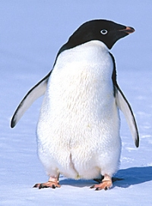
Thank You

