Slide 1
VR Performance Team
June 28, 2018
Pravin Kumar Rana and Robert Malmström
<number>

Slide 2
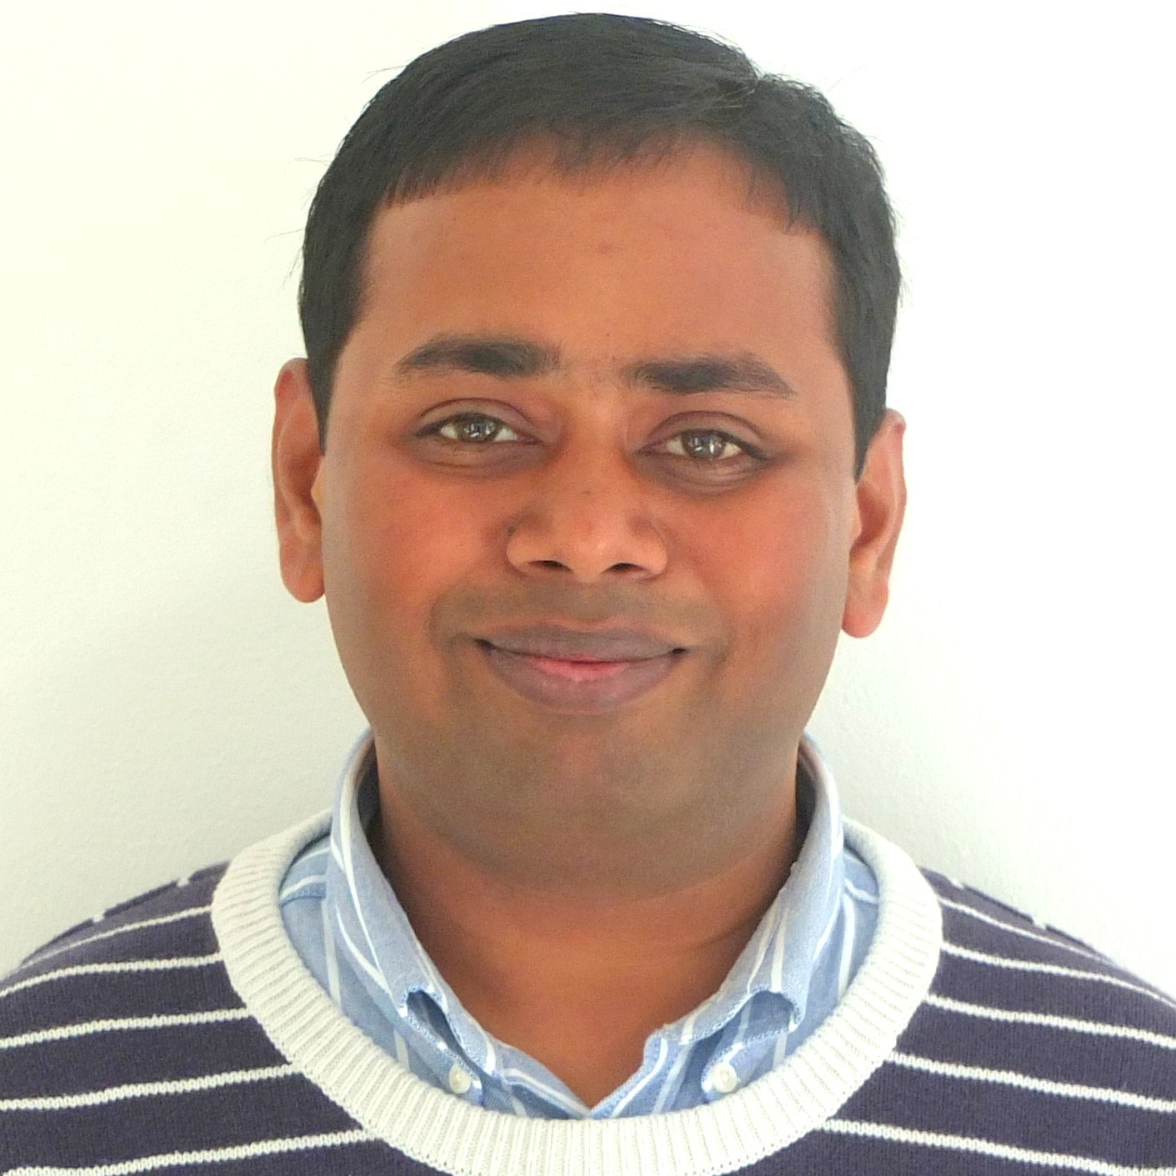
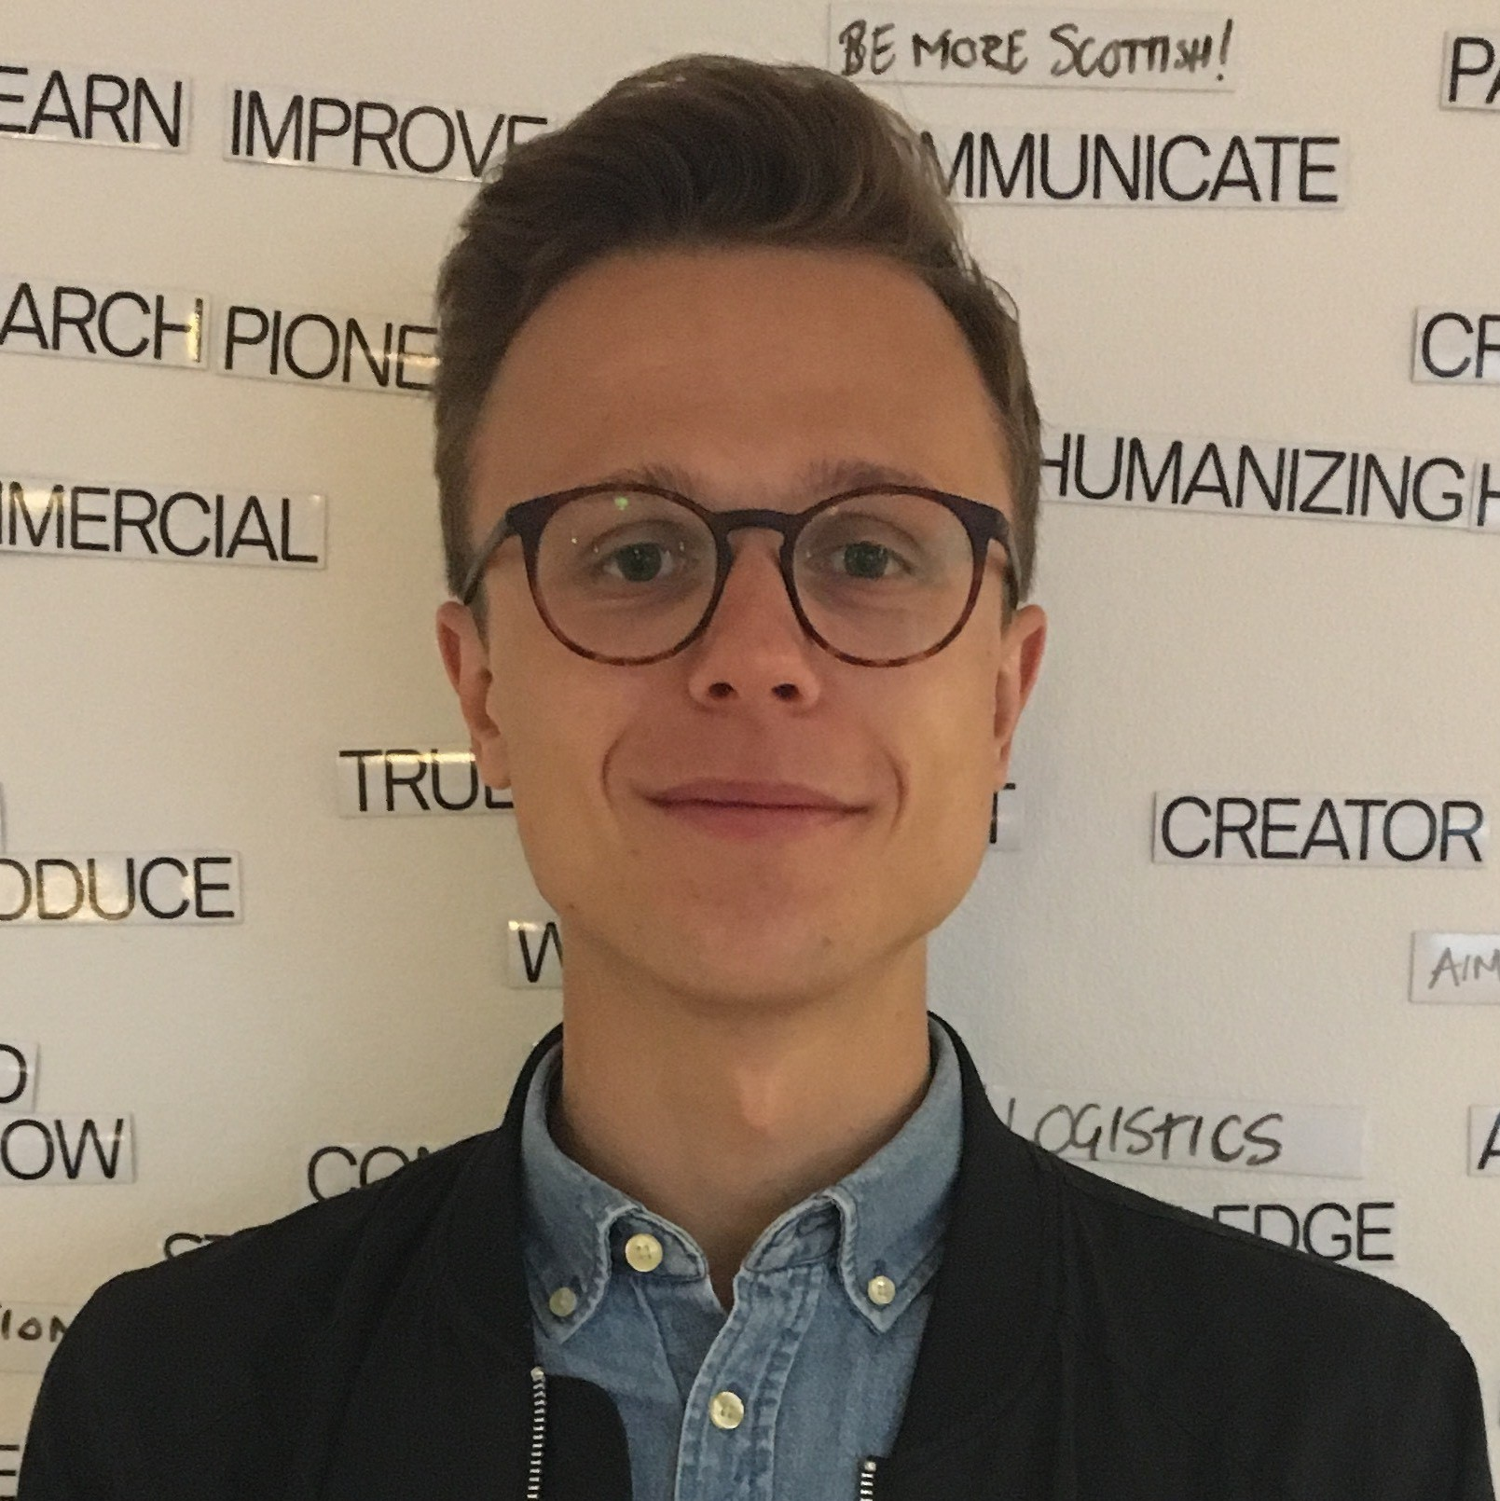
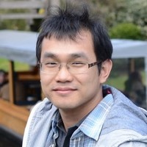
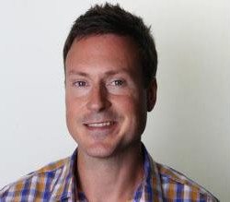
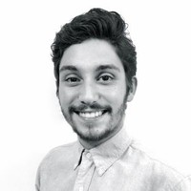
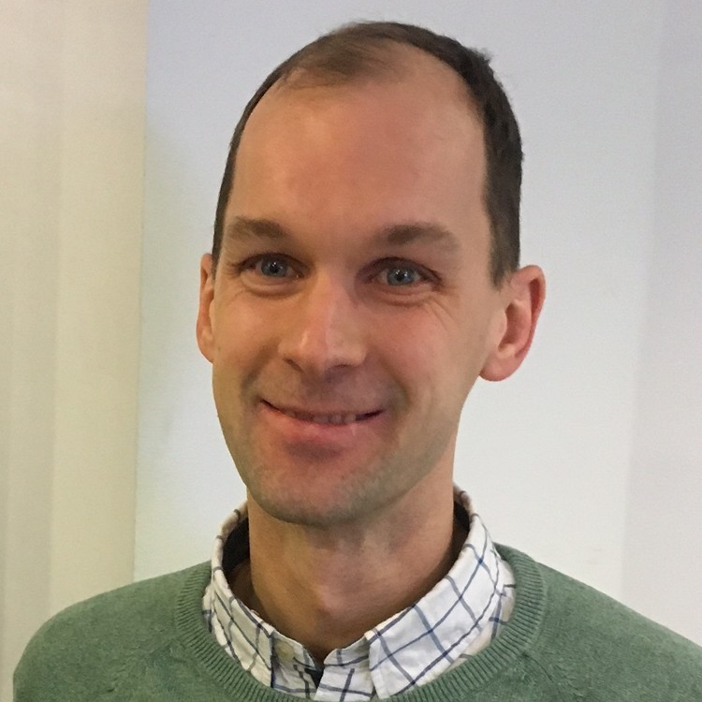
VR performance team
Pravin K Rana
Erik Ljungzell
Yimu Wang
Robert Malmström
(Algo Lead)
Pravin K Rana
(Scrum Master)
Gilfredo-Remon Salazar
Torbjörn Sundberg
Team
<number>

Slide 3
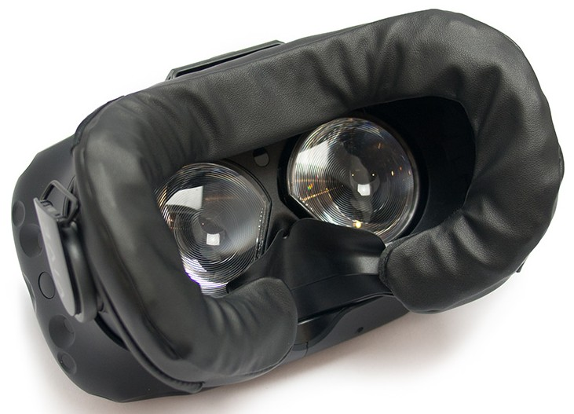
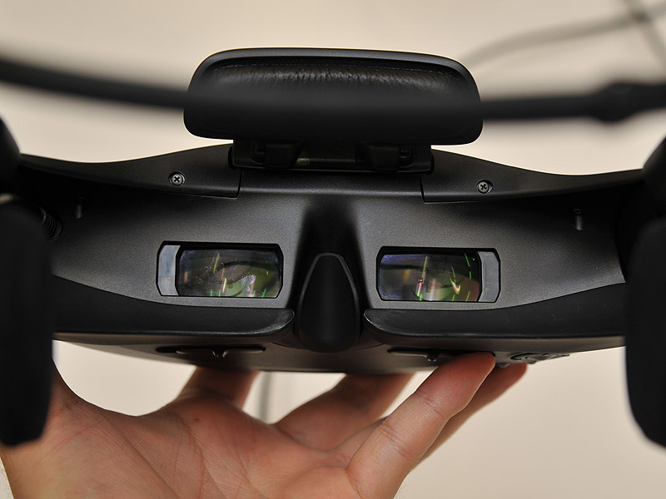
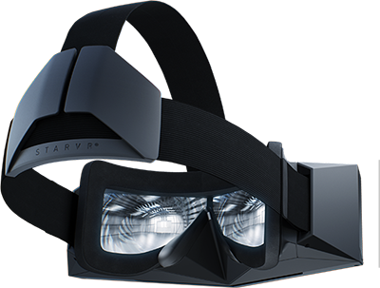
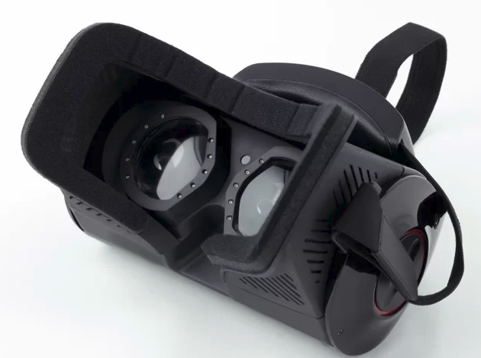
Each VR integration is different
<number>

Slide 4
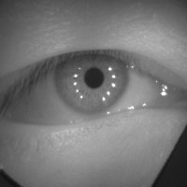
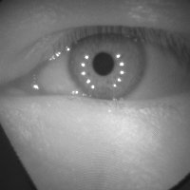
Platform: Everything is wonderful
Cam Left
Cam Right
<number>

Slide 5
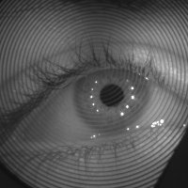
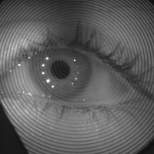
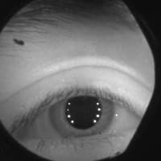
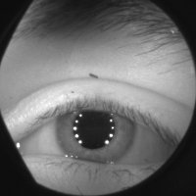
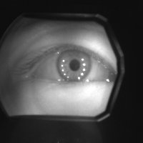
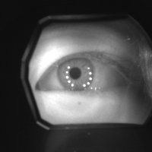
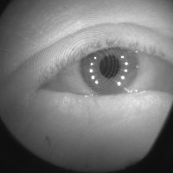
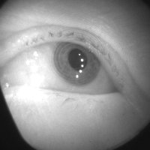
Each VR integration is different
U2
Kite
U2
Love System A
Hiphop
<number>

Slide 6
U2: Fresnel rings
Cam Left
Cam Right
<number>

Slide 7
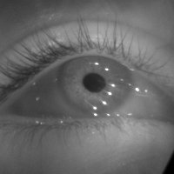
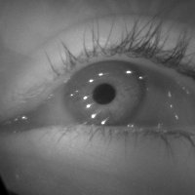
StarVr: FoV and wide gaze angles
Cam Left
Cam Right
<number>

Slide 8
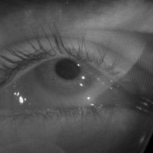
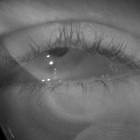
Yoda: IR reflections
V1 Lens (StarVr)
V2 Lens (Yoda)
Cam Left
Cam Right
<number>

Slide 9
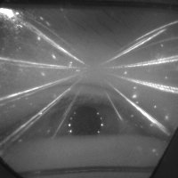
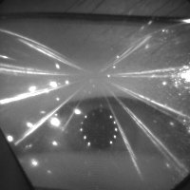
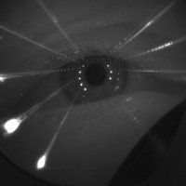
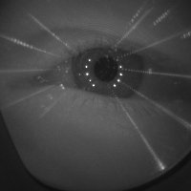
Prescription glasses
Cam Left
Cam Right
<number>

Slide 10
Yoda: IR reflections
V1 Lens
V2 Lens
Cam Left
Cam Right
<number>

Slide 11
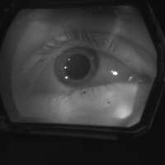
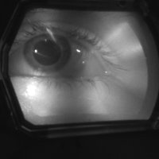
Love A-System: Glints availability
Cam Left
Cam Right
<number>

Slide 12
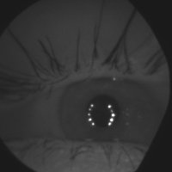
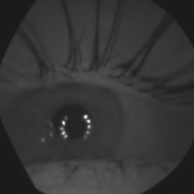
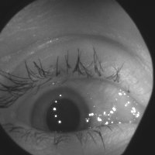
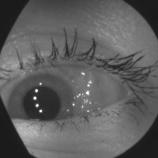
VR HMD positioning
Cam Left
Cam Right
<number>

Slide 13
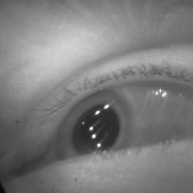
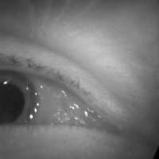
Large IPD/ Wide gaze angles
Cam Left
Cam Right
<number>

Slide 14
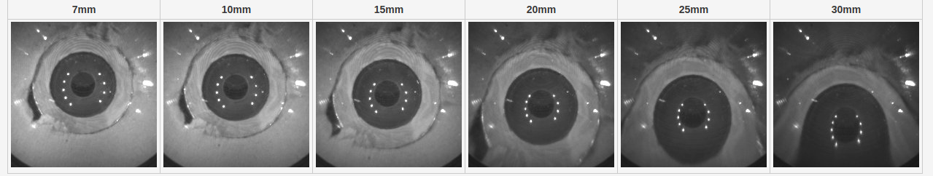
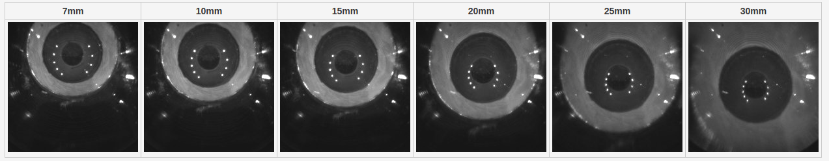
VR Lens + ET Camera Lens Disortion
Artificial eye images through Corolla HMD
<number>

Slide 15
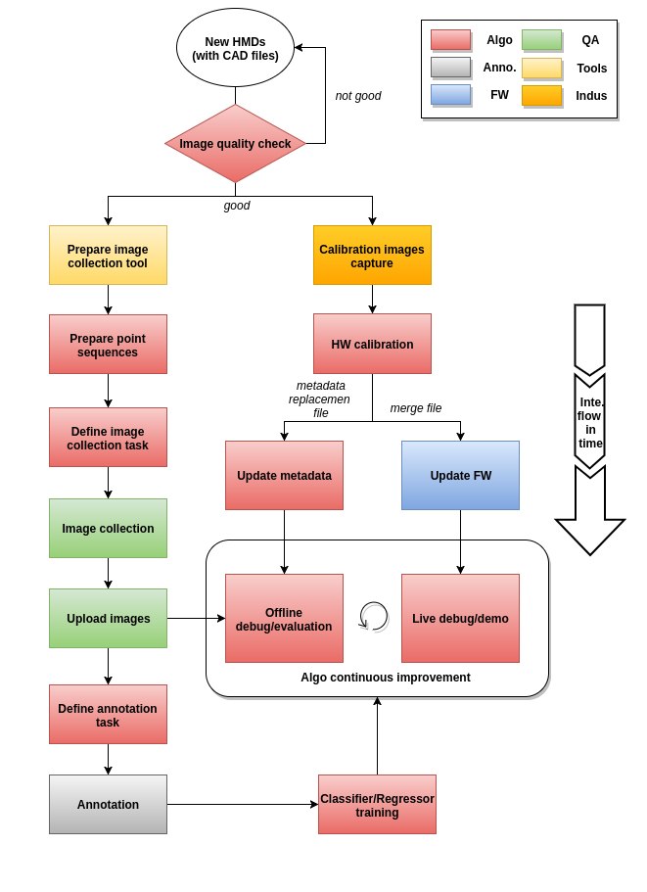
VR integration flow
<number>

Slide 16
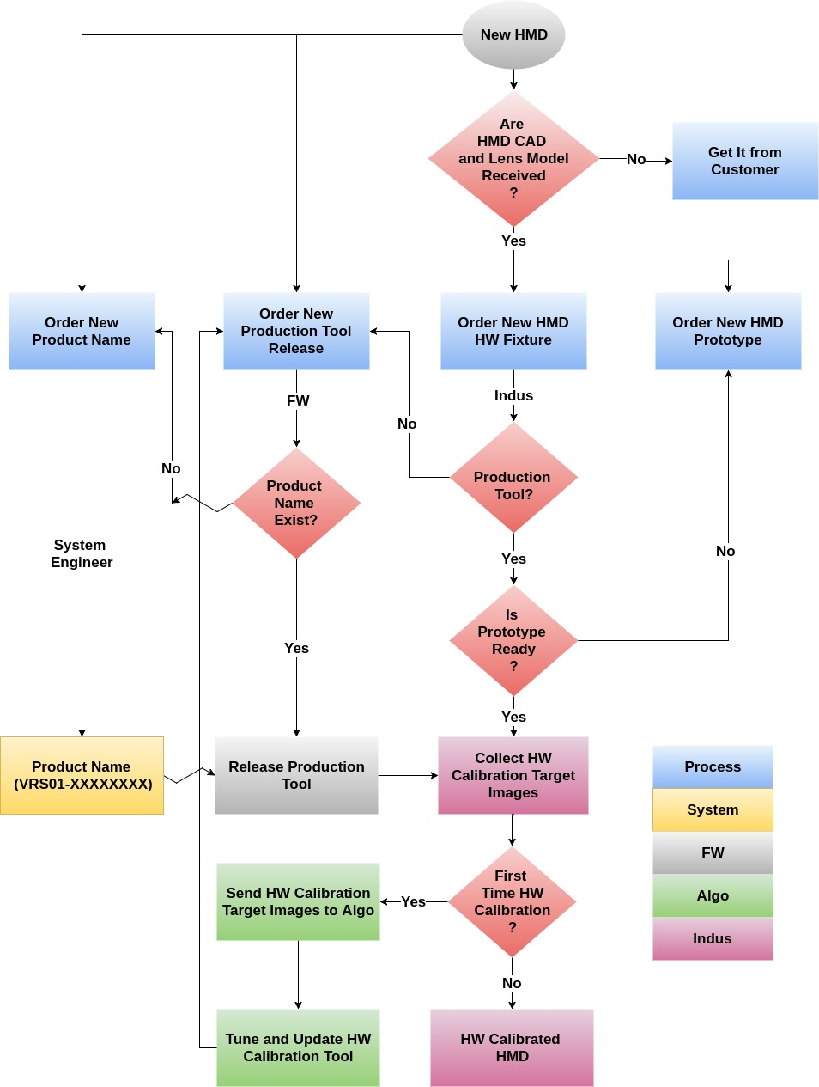
VR HW calibration flow
<number>

Slide 17
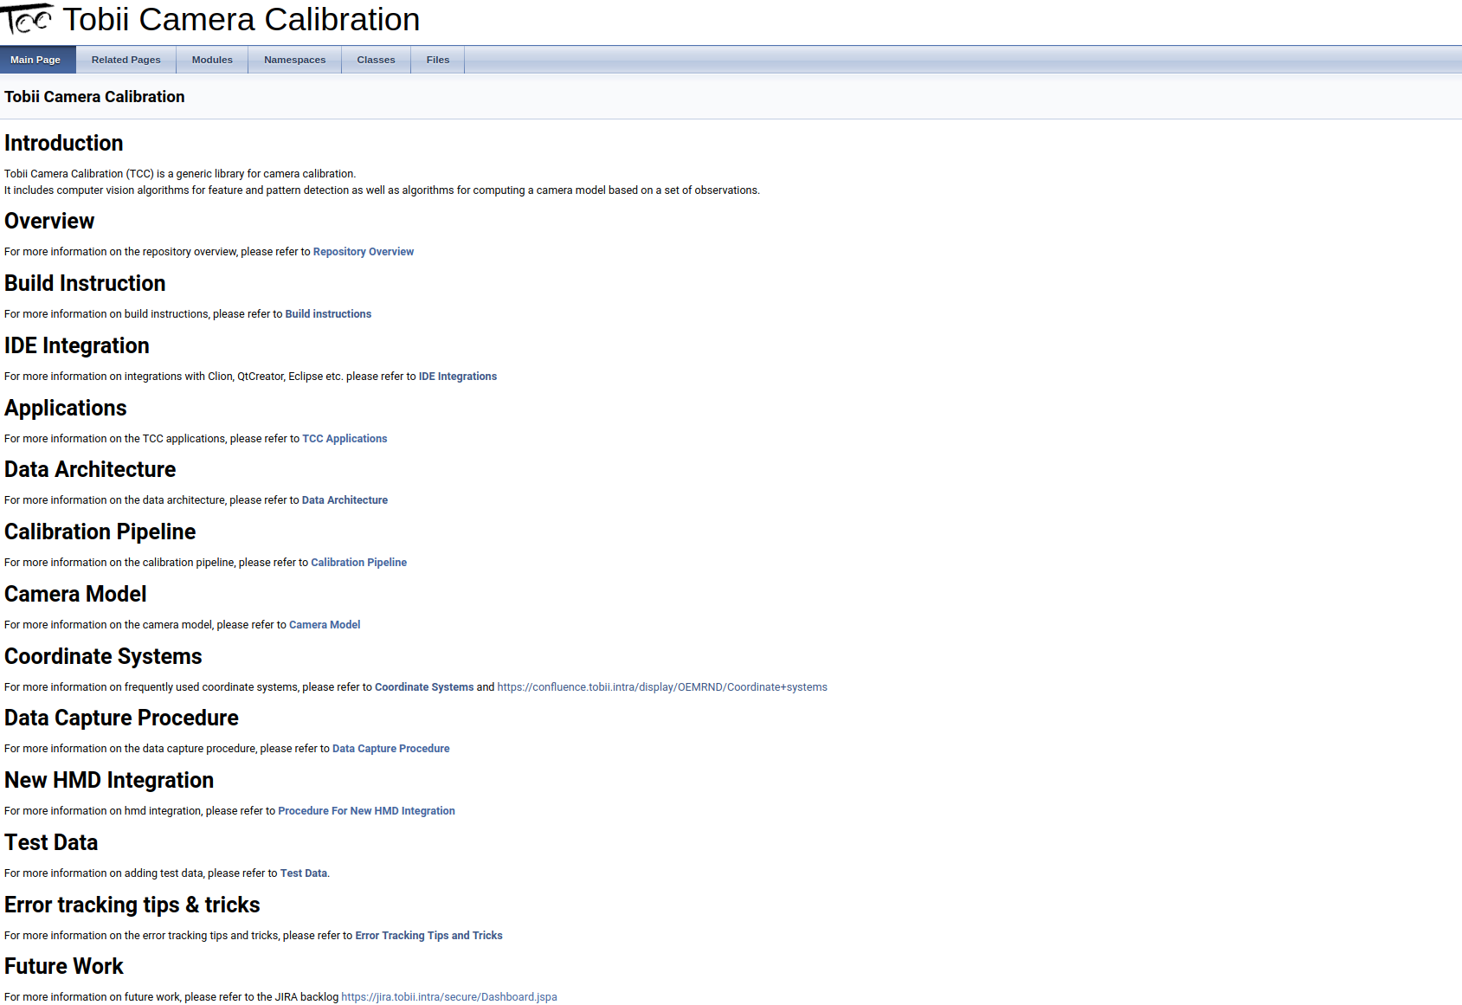
VR HW calibration
Tobii Camera Calibration
<number>

Slide 18
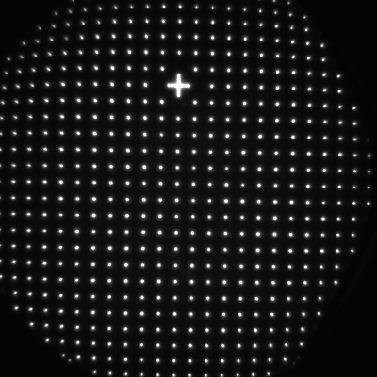
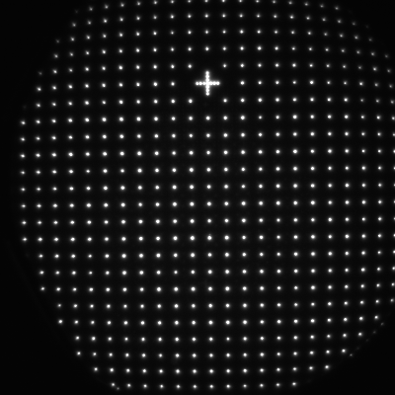
VR HW calibration
Calibration Target Image
Left
Calibration Target Image
Right
<number>

Slide 19
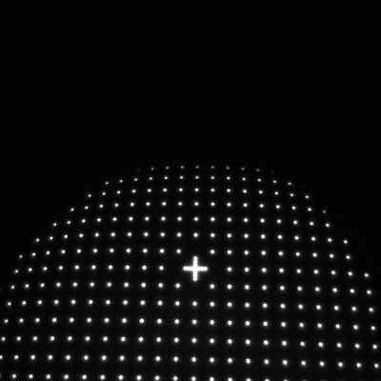
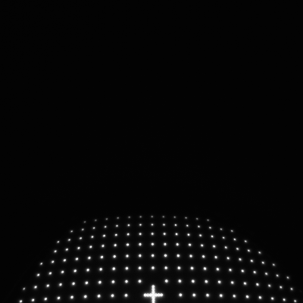
VR HW calibration
Target Image Left
Target Image Right
<number>

Slide 20
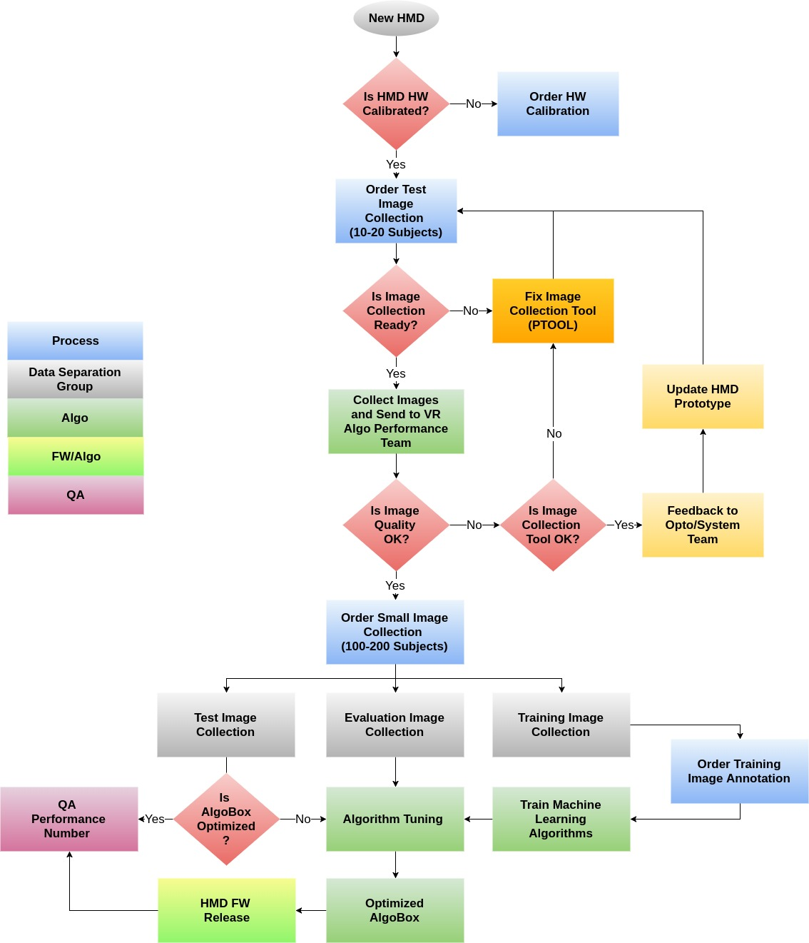
VR data collection flow
<number>

Slide 21
VR data collection flow
<number>

Slide 22
Sprint planning
Algo Performance team recently moved from one week sprint to a two week sprint
Sprint planning is done every other Monday and was done this week
Before each sprint planning PO prioritizes the Stories in the backlog
All new JIRA stories created must have a DoD to be started
JIRA tasks are created by the team during and after sprint planning
<number>

Slide 23
Needed for Algo Performance to get Start working on a new project
Project number for time reporting and JIRA-project
Call for a Kick-off meeting with all teams to create a first initial time plan (from Algo Performance it should be Robert and Pravin)
Make sure the customer delivers (SW, CAD, Lens model, prototype) in time for each step in the time plan
Check with Algo Performance, Image collection and QA that all are synced for the planned image collections
<number>

