Slide 1


Pravin Kumar Rana
Sound and Image Processing Lab.(SIP)
KTH - Royal Institute of Technology
SE-10044 Stockholm, Sweden

Slide 2

Implementation of DCVF
Disparity Information
  Using NDE reference software
  Using a suitable model
2009-02-20
Notes:
Block based

Slide 3
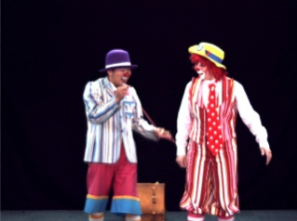
Disparity Information
Using NDE reference software
Nagoya Depth Estimation
Reference Software
View 38
Labels to disparity
Labels to depth
Matching methods
Disparity
Information
View 39
View 40
2009-02-20

Slide 4
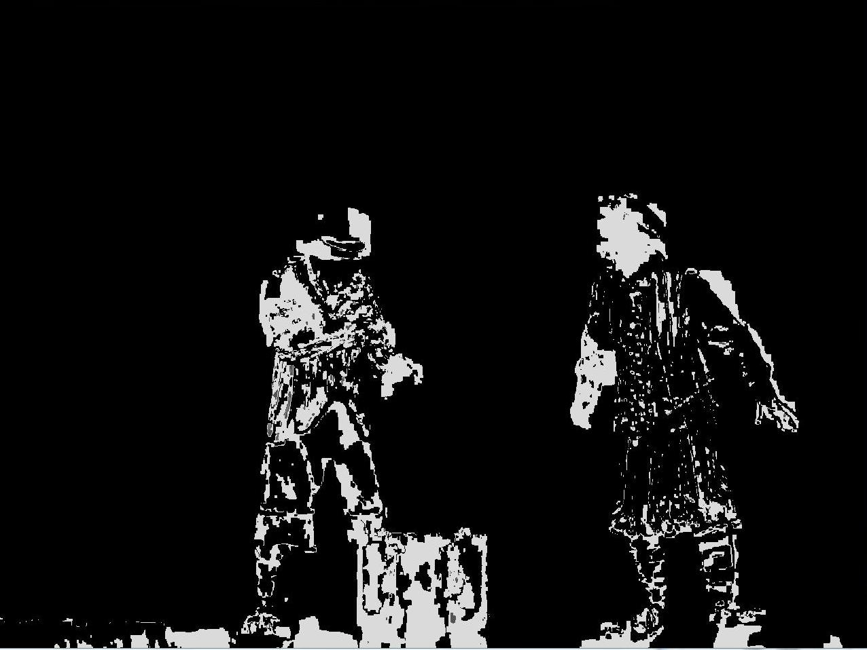

Labels To Disparity
2009-02-20

Slide 5
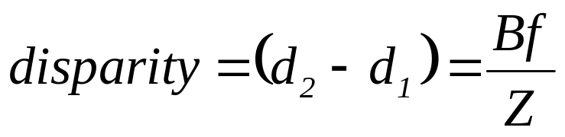

Disparity Information
P(Point in 3-D space)
Depth(Z)
C₁
C₂
Focal
Length
(f)
Image Plane
d₁
d₂
Baseline(B)
2009-02-20

Slide 6
Disparity Information
Using a suitable model
  Epipolar geometry
    Matching points lie along corresponding epipolar lines
    Reduces correspondence problem to 1-D search along conjugate epipolar lines
  Perspective projection
    Sample object space at a grid diverging from a vanishing point
2009-02-20

Slide 7


Epipolar Geometry
P₁
Points in 3D Space
P₂
Image Plane
Epipolar
line
x₂
x₁
x´₂
e₂
e₁
C₁
Baseline
C₂
Pinhole Camera
Epipole
Pinhole Camera
2009-02-20

Slide 8



Epipolar Geometry
P₁
P₂
x₃
x₁
x₂
x´₂
x´₃
e₁
e₃
C₁
e₂
C₂
C₃
2009-02-20

Slide 9
Conclusion
  Epipolar geometry
    Greatly reduces cost and ambiguity of matching
2009-02-20

