Slide 1

Implementation of DCVF
Pravin Kumar Rana
Sound and Image Processing Lab.(SIP)
KTH - Royal Institute of Technology
SE-10044 Stockholm, Sweden

Slide 2

Implementation of DCVF
Disparity Information
Using NDE reference software
Using multi-resolution representation
Using a suitable model

Slide 3
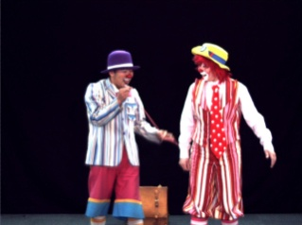
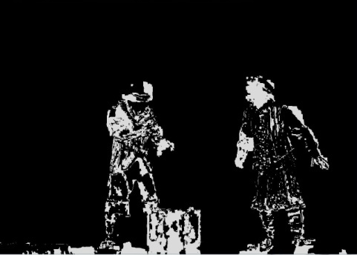
Disparity Information
Using NDE reference software
Disparity Labels
View 38
Disparity
Information
View 39
Nagoya Depth Estimation Reference Software

Slide 4

Disparity Labels

Slide 5
Disparity Information
Using multi-resolution representation
Common Disparity
Error
Disparity Information Filter
(DIF)
…
Error
Error
DIF
DIF
…
Error
Error
Error
Error
DIF
DIF
DIF
DIF
…
DF₁ ₂
DF₃ ₄
DF₅ ₆
DF₇ ₈
DF₉ ₁₀
DF₁₁ ₁₂
DF₁₃ ₁₄
DF₁₅ ₁₆
…
DF=Disparity field

Slide 6
Disparity Information
Using a suitable model with single depth map
Epipolar geometry
Prospective projection
Layered depth model

Slide 7
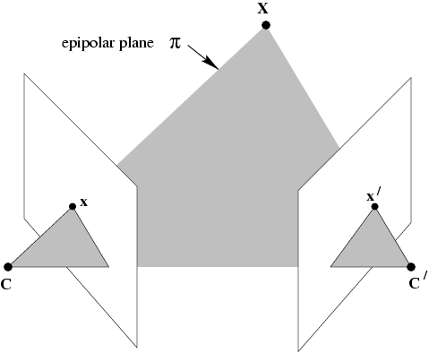
Epipolar Geometry

Slide 8
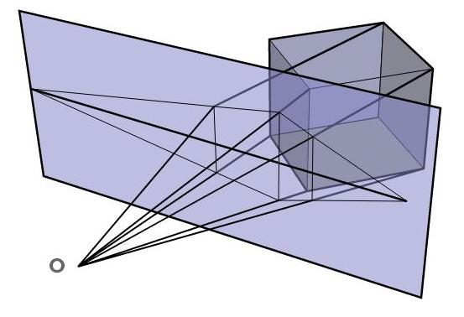
Prospective Geometry

